Slide 1
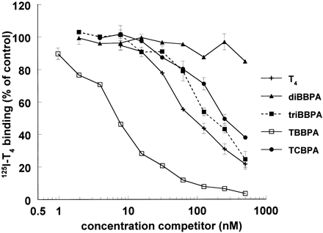
FIG. 1. Displacement of T₄ from TTR by halogenated bisphenol A congeners. Data points are mean values ± SD ...
Notes:
FIG. 1. Displacement of T4 from TTR by halogenated bisphenol A congeners. Data points are mean values ± SD of one representative measurement in duplicate. If no error bar is visible, it is smaller than the marker. Relative 125I-T4-TTR binding is presented as percentage of control value. DiBBPA, dibromobisphenol A; triBBPA, tribromobisphenol A; TBBPA, tetrabromobisphenol A; TCBPA, tetrachlorobisphenol A.
Unless provided in the caption above, the following copyright applies to the content of this slide: © 2000 Society of Toxicology

Slide 2
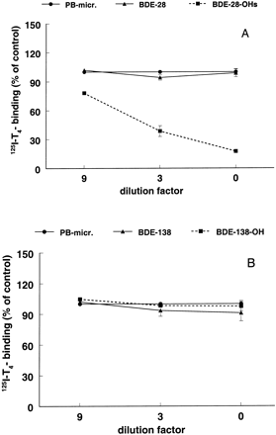
FIG. 2. T₄-TTR competition binding of 2,4,4′-triBDE (BDE-28) (A) and 2,2′,3,4,4′,5′-hexaBDE (BDE-138) (B) ...
Notes:
FIG. 2. T4-TTR competition binding of 2,4,4′-triBDE (BDE-28) (A) and 2,2′,3,4,4′,5′-hexaBDE (BDE-138) (B) prior to microsomal transformation with phenobarbital (PB)-induced rat microsomes (triangles) and of PBDE-metabolites (squares) after microsomal transformation with phenobarbital (PB)-induced rat microsomes. Data present mean ± SD. PB-micr., phenobarbital-induced microsomes (circles).
Unless provided in the caption above, the following copyright applies to the content of this slide: © 2000 Society of Toxicology

Slide 3
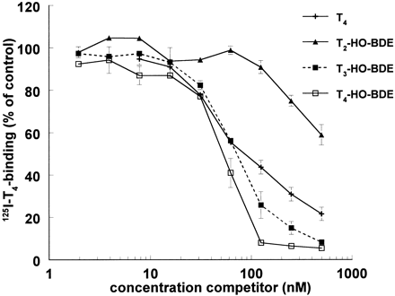
FIG. 3. Displacement of T₄ from TTR by hydroxylated polybrominated diphenyl ethers resembling thyroid ...
Notes:
FIG. 3. Displacement of T4 from TTR by hydroxylated polybrominated diphenyl ethers resembling thyroid hormones. Data points are mean values ± SD of one representative measurement in duplicate. If no error bar is visible, it is smaller than the marker. Relative 125I-T4-TTR binding is presented as percentage of control value. T2-HO-BDE, 4-(2,4,6-tribromophenoxy)phenol; T3-HO-BDE, 2-bromo-4-(2,4,6-tribromophenoxy)phenol; T4-HO-BDE, 2,6-dibromo-4-(2,4,6-tribromophenoxy)phenol.
Unless provided in the caption above, the following copyright applies to the content of this slide: © 2000 Society of Toxicology

