Slide 1
Fig. 1 A normal thrombo-elastogram, with normal range for each variable. r: reaction time; k: clotting time; MA: ...
Notes:
Fig. 1 A normal thrombo-elastogram, with normal range for each variable. r: reaction time; k: clotting time; MA: maximum amplitude; EPL: estimated percent of lysis; LY30: percentage lysis 30 min after clot formation; LY60: percentage lysis 60 min after clot formation; CI: coagulation index; and PMA: platelet mapping assay.
Unless provided in the caption above, the following copyright applies to the content of this slide: © European Association for Cardio-Thoracic Surgery 2010

Slide 2
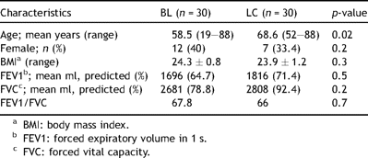
Table 1 Patient characteristics in benign (BL) and malignant (LC) groups.
Notes:
Table 1 Patient characteristics in benign (BL) and malignant (LC) groups.
Unless provided in the caption above, the following copyright applies to the content of this slide: © European Association for Cardio-Thoracic Surgery 2010

Slide 3
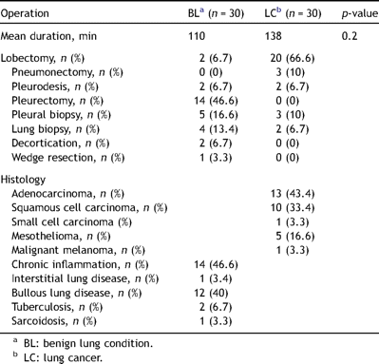
Table 2 Operations performed and histology results.
Notes:
Table 2 Operations performed and histology results.
Unless provided in the caption above, the following copyright applies to the content of this slide: © European Association for Cardio-Thoracic Surgery 2010

Slide 4
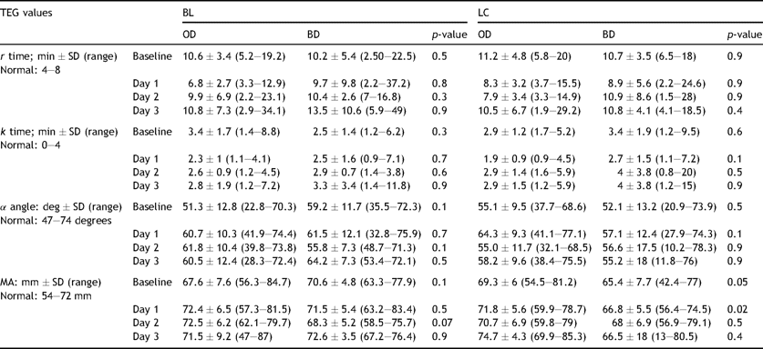
Table 3 Results of pre- and postoperative TEG values in benign (BL) and lung cancer (LC) groups.
Notes:
Table 3 Results of pre- and postoperative TEG values in benign (BL) and lung cancer (LC) groups.
Unless provided in the caption above, the following copyright applies to the content of this slide: © European Association for Cardio-Thoracic Surgery 2010

Slide 5
Fig. 2 Comparing the baseline, preoperative, TEG values in both benign lung (BL) and lung cancer (LC) groups.
Notes:
Fig. 2 Comparing the baseline, preoperative, TEG values in both benign lung (BL) and lung cancer (LC) groups.
Unless provided in the caption above, the following copyright applies to the content of this slide: © European Association for Cardio-Thoracic Surgery 2010

Slide 6
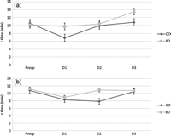
Fig. 3 Illustration of the trend of r time for (a) BL and (b) LC groups.
Notes:
Fig. 3 Illustration of the trend of r time for (a) BL and (b) LC groups.
Unless provided in the caption above, the following copyright applies to the content of this slide: © European Association for Cardio-Thoracic Surgery 2010

