Slide 1
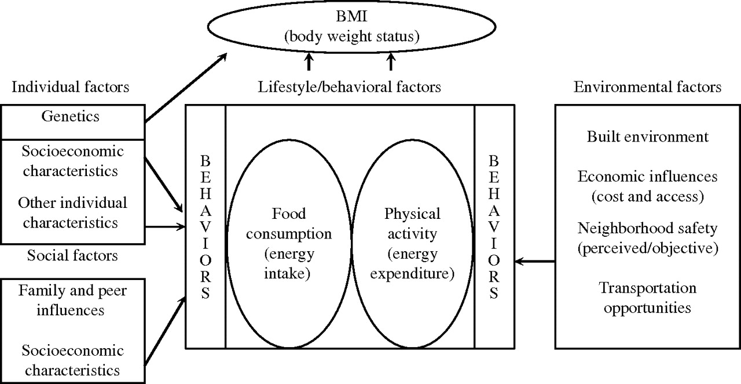
FIGURE 1. Ecologic model relating the built environment to physical activity, diet, and body weight. BMI, body mass ...
Notes:
FIGURE 1. Ecologic model relating the built environment to physical activity, diet, and body weight. BMI, body mass index. Reproduced with the permission of Lisa Powell et al., ImpacTeen Program Office, Institute for Health Research and Policy, University of Illinois at Chicago, Chicago, Illinois ( www.impacteen.org ).
Unless provided in the caption above, the following copyright applies to the content of this slide: Epidemiologic Reviews Copyright © 2007 by the Johns Hopkins Bloomberg School of Public Health All rights reserved; printed in U.S.A.

Slide 2
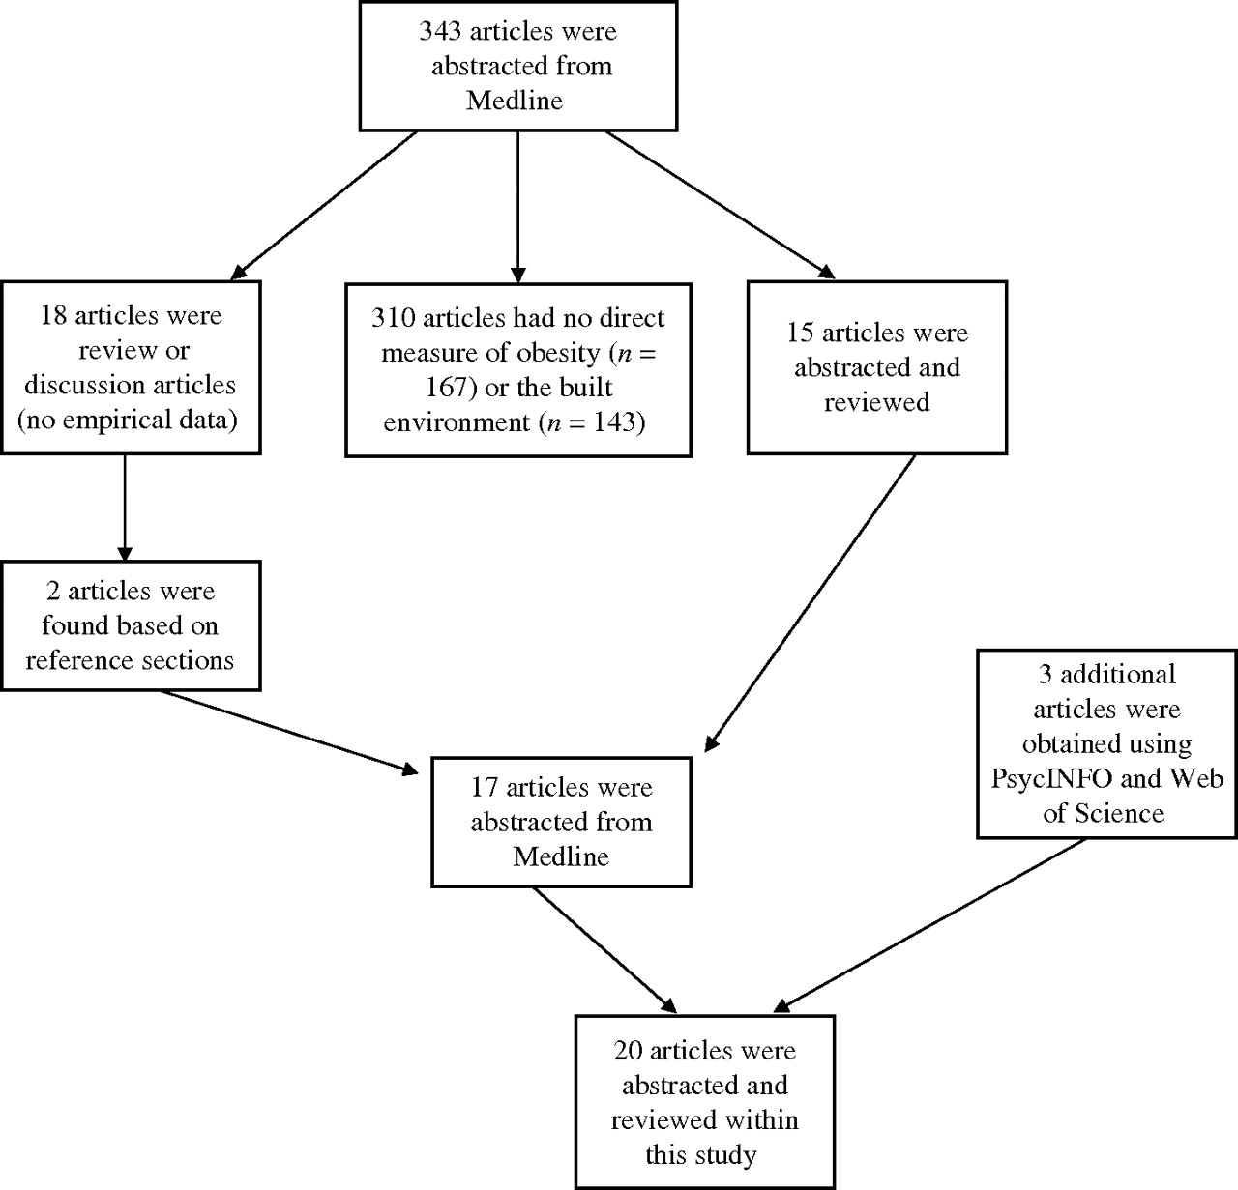
FIGURE 2. Schematic of article abstraction from a Medline search for a review of obesity and the built environment.
Notes:
FIGURE 2. Schematic of article abstraction from a Medline search for a review of obesity and the built environment.
Unless provided in the caption above, the following copyright applies to the content of this slide: Epidemiologic Reviews Copyright © 2007 by the Johns Hopkins Bloomberg School of Public Health All rights reserved; printed in U.S.A.

