Slide 1
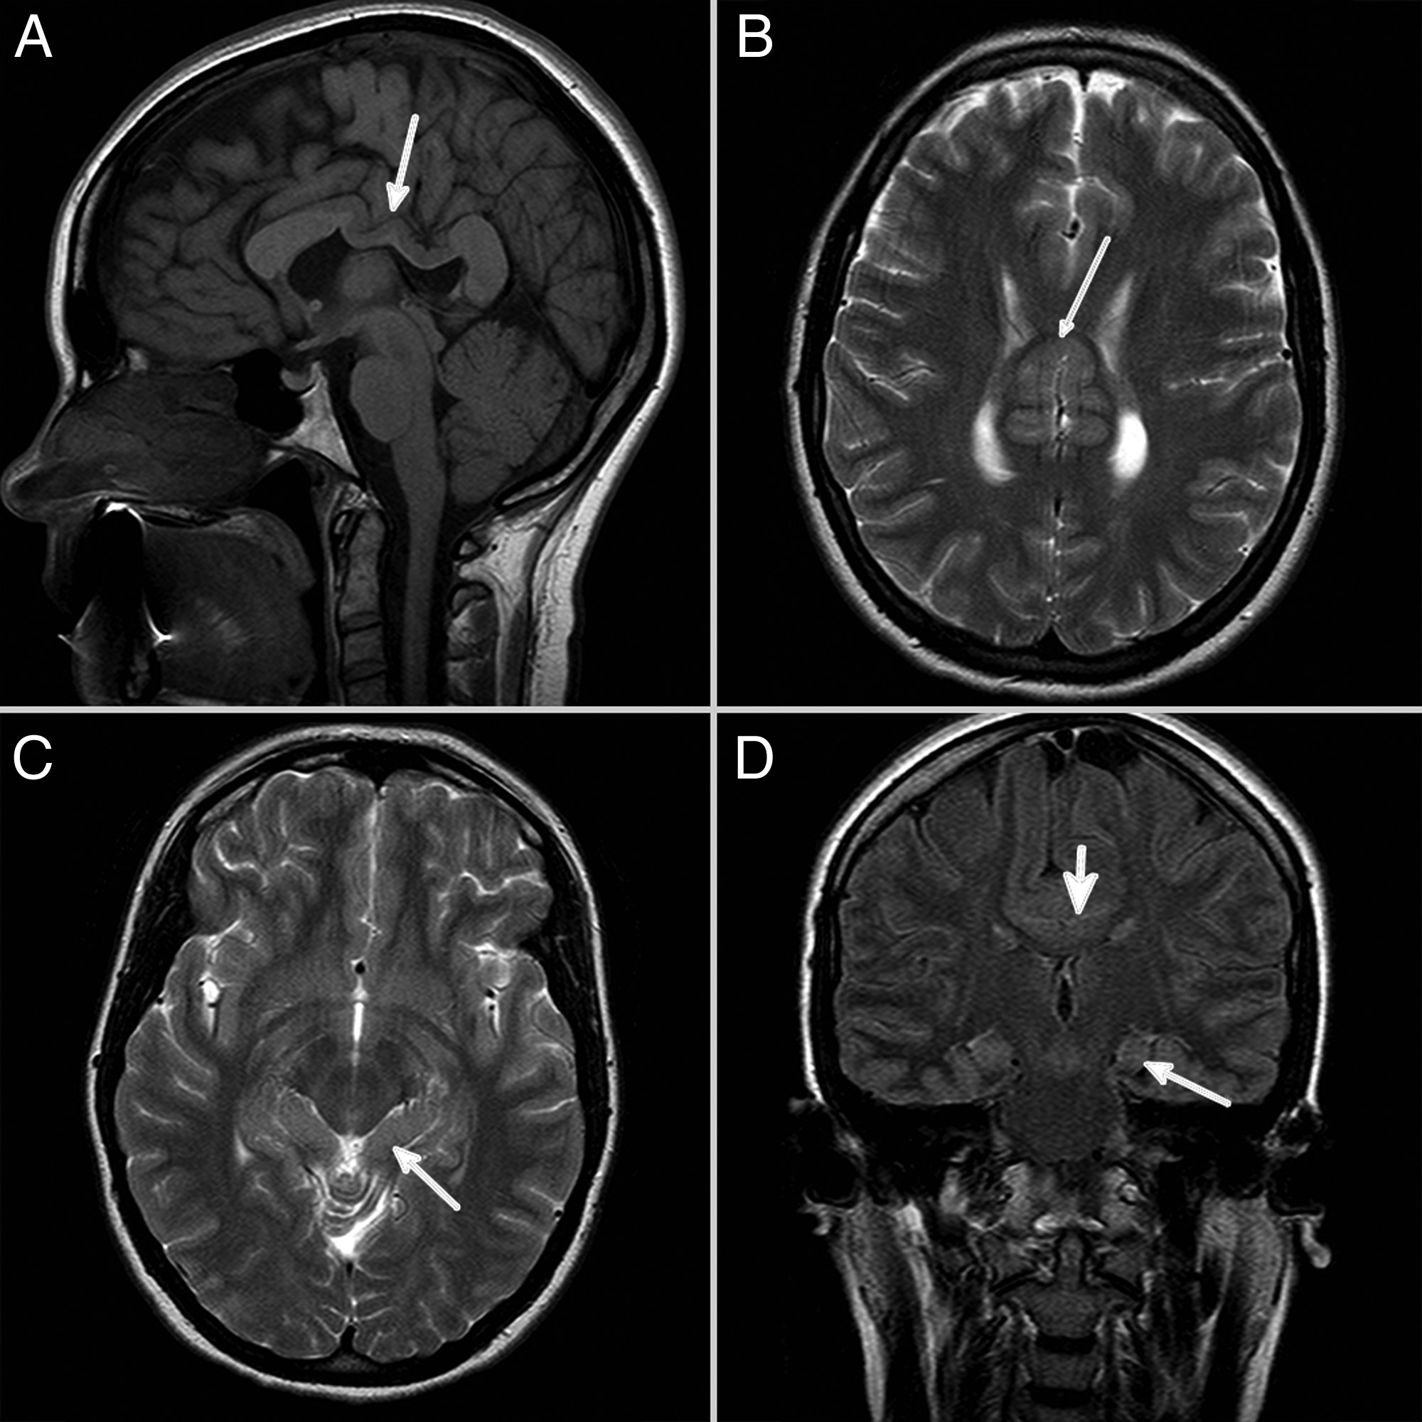
Fig. 1. A sagittal T1-weighted image (A) shows the fusion of cortical structures in the midline (arrow). An axial ...
Notes:
Fig. 1. A sagittal T1-weighted image (A) shows the fusion of cortical structures in the midline (arrow). An axial T2-weighted image (B) also shows the fused frontal cortices (arrow). An axial T2-weighted image (C) at the level of the mesencephalon reveals the abnormal orientation of the hippocampi (arrow). A coronal FLAIR image (D) shows the vertically positioned hippocampi (thin arrow) and also the cortical fusion with no corpus callosum (thick arrow).
Unless provided in the caption above, the following copyright applies to the content of this slide: © The Author 2016. Published by Oxford University Press. All rights reserved. For permissions, please e-mail: journals.permissions@oup.com.

Slide 2
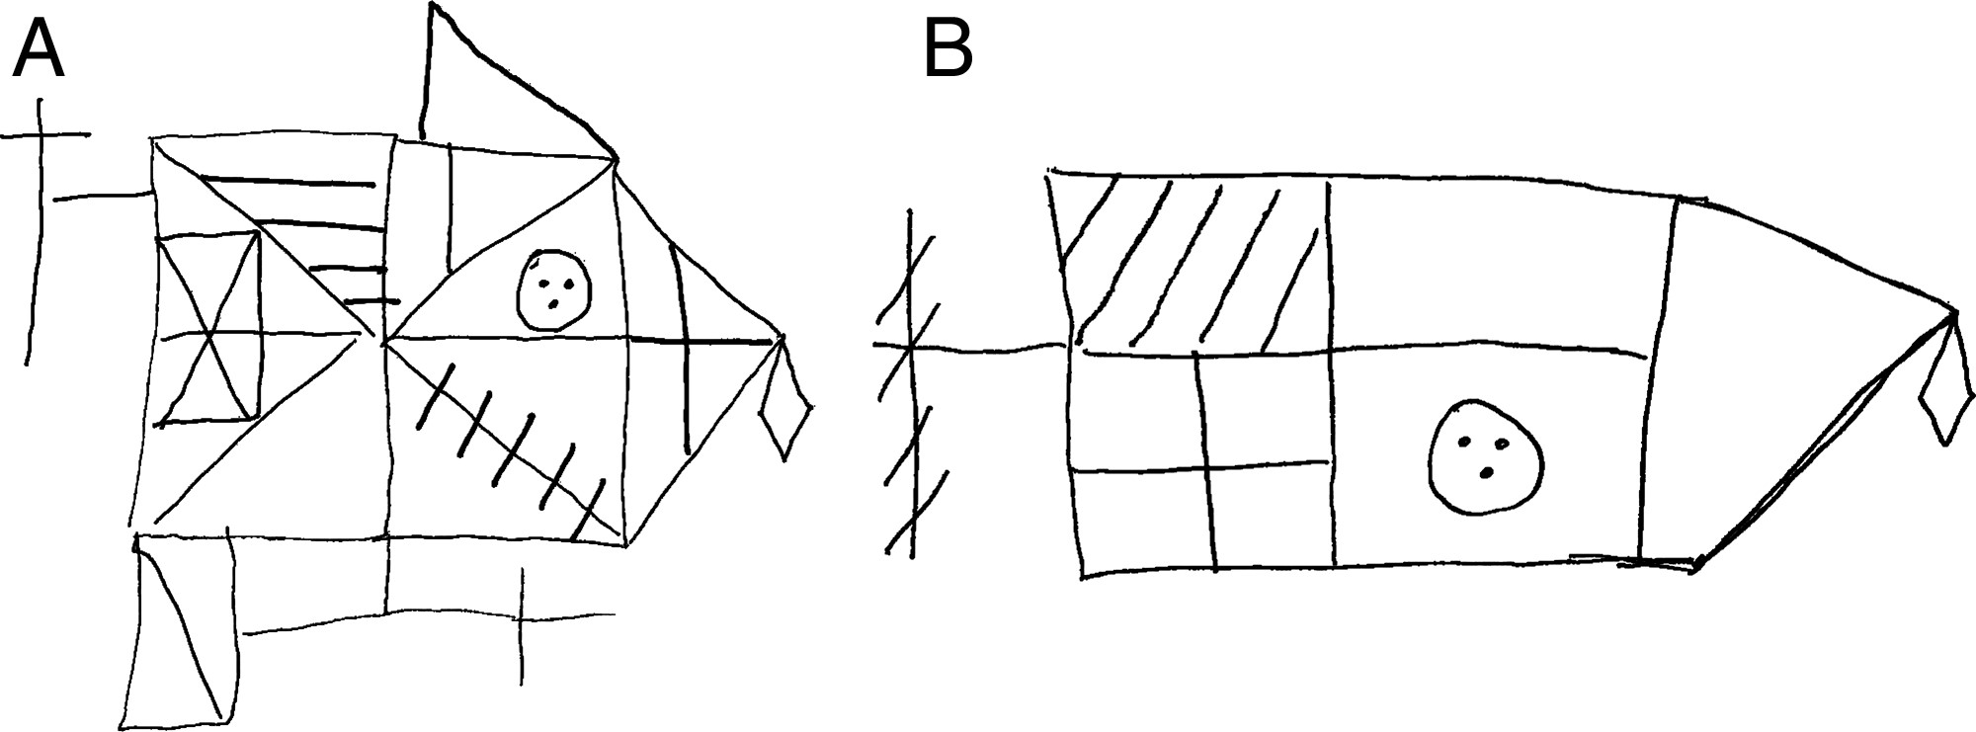
Fig. 2. Copy (A) and immediate recall (B) of the Rey-Osterrieth Complex Figure of an adult case with MIHV.
Notes:
Fig. 2. Copy (A) and immediate recall (B) of the Rey-Osterrieth Complex Figure of an adult case with MIHV.
Unless provided in the caption above, the following copyright applies to the content of this slide: © The Author 2016. Published by Oxford University Press. All rights reserved. For permissions, please e-mail: journals.permissions@oup.com.

