Slide 1
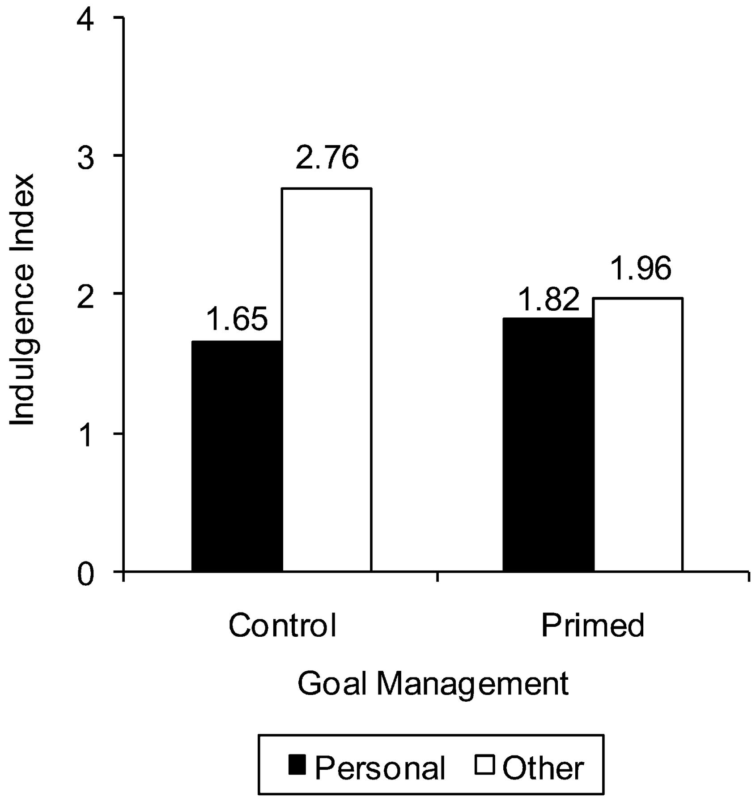
Figure 1 Study 1 Results
Notes:
Figure 1 Study 1 Results
Unless provided in the caption above, the following copyright applies to the content of this slide: © 2010 by Journal of Consumer Research, Inc.

Slide 2
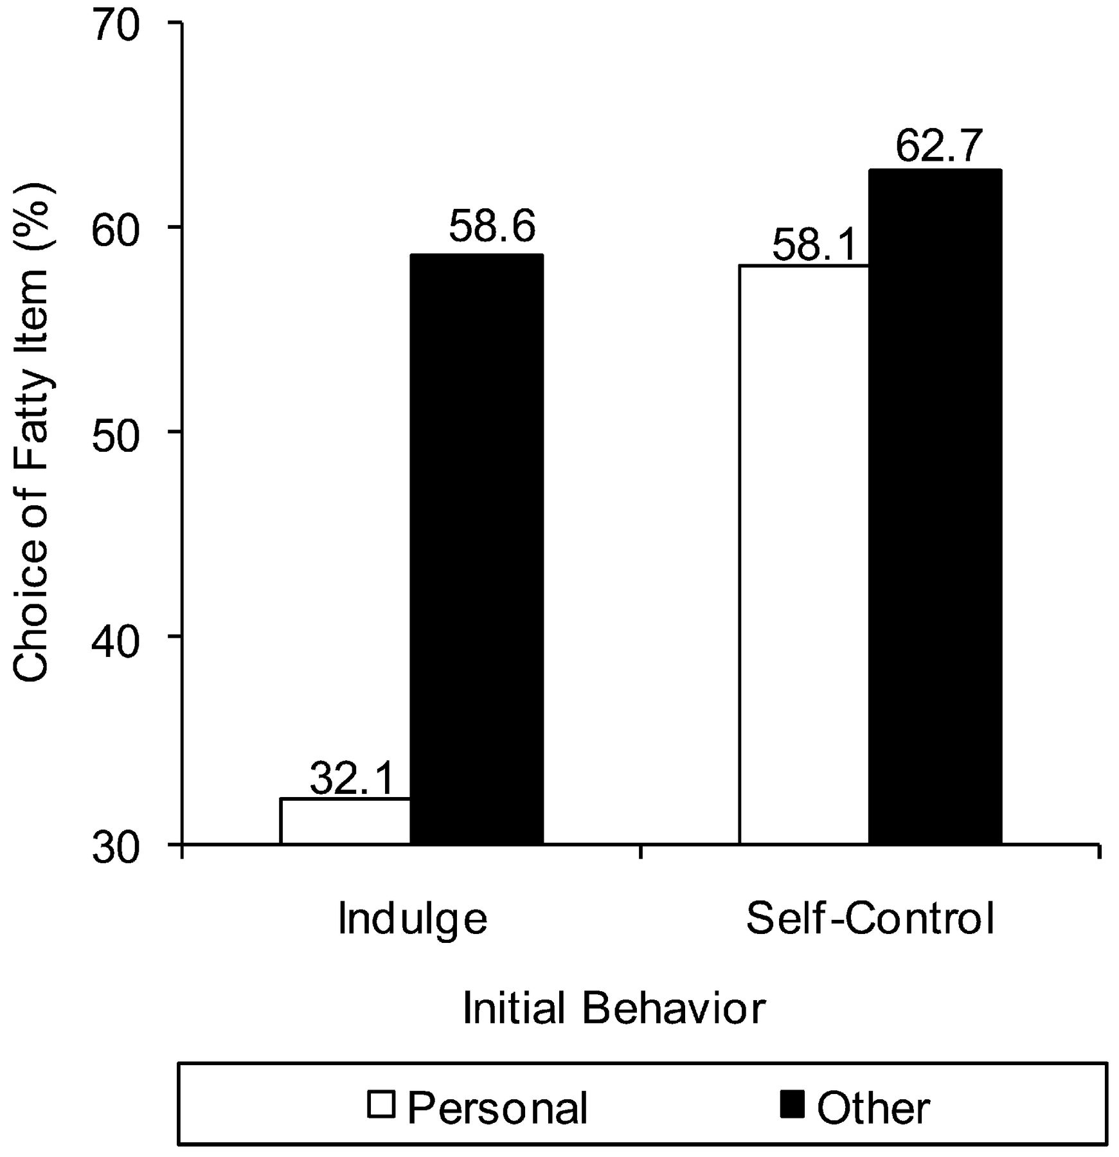
Figure 2 Study 2 Results
Notes:
Figure 2 Study 2 Results
Unless provided in the caption above, the following copyright applies to the content of this slide: © 2010 by Journal of Consumer Research, Inc.

Slide 3
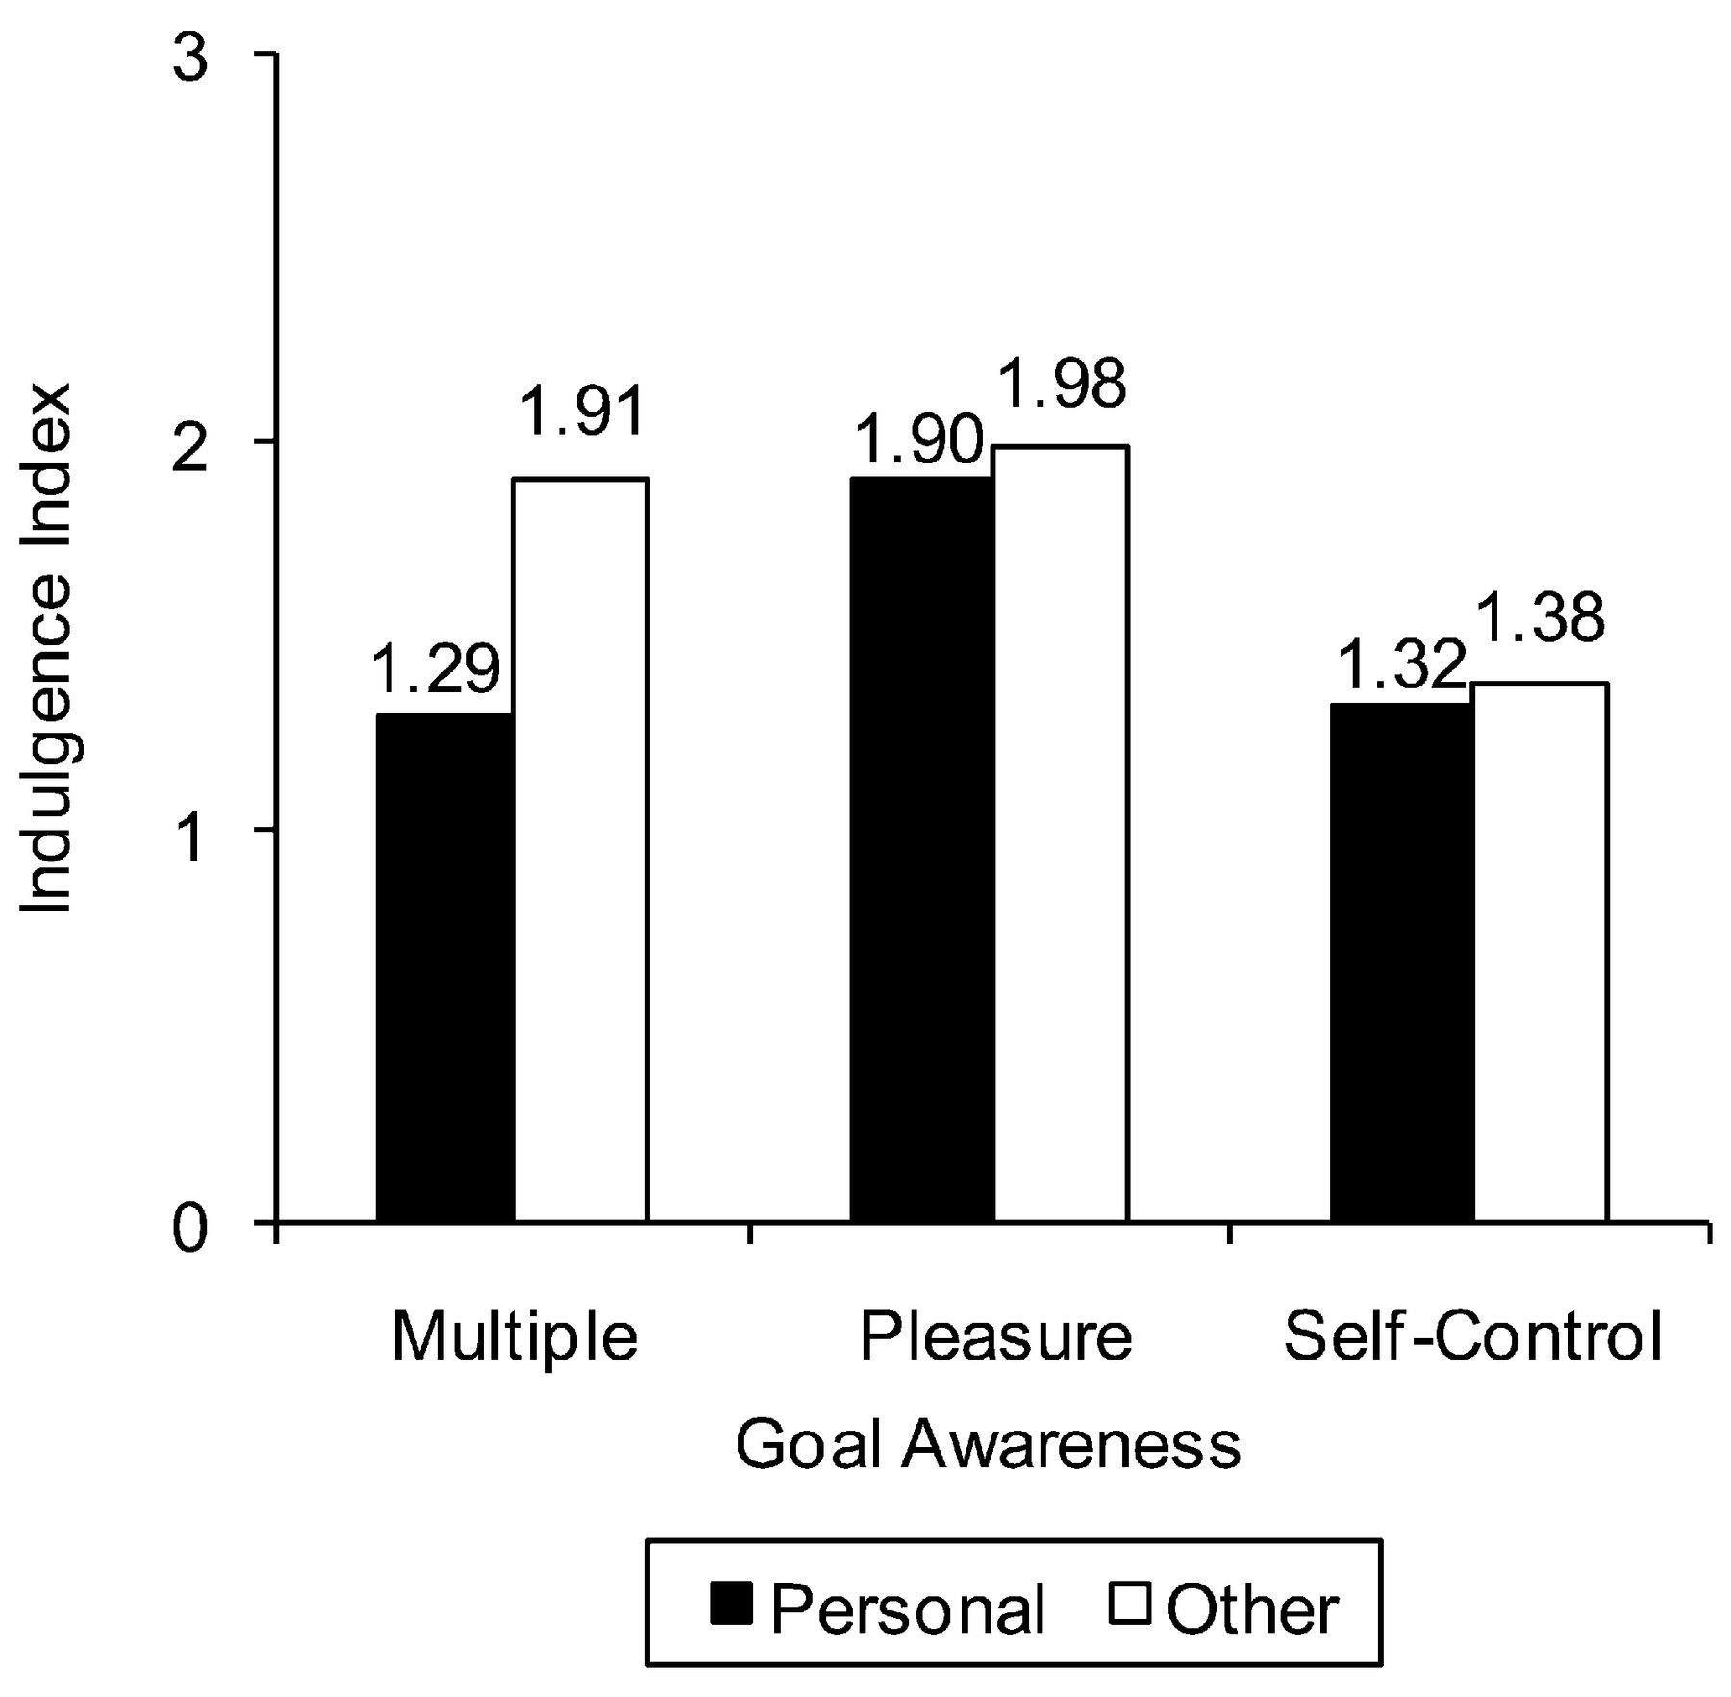
Figure 3 Study 3 Results
Notes:
Figure 3 Study 3 Results
Unless provided in the caption above, the following copyright applies to the content of this slide: © 2010 by Journal of Consumer Research, Inc.

Slide 4
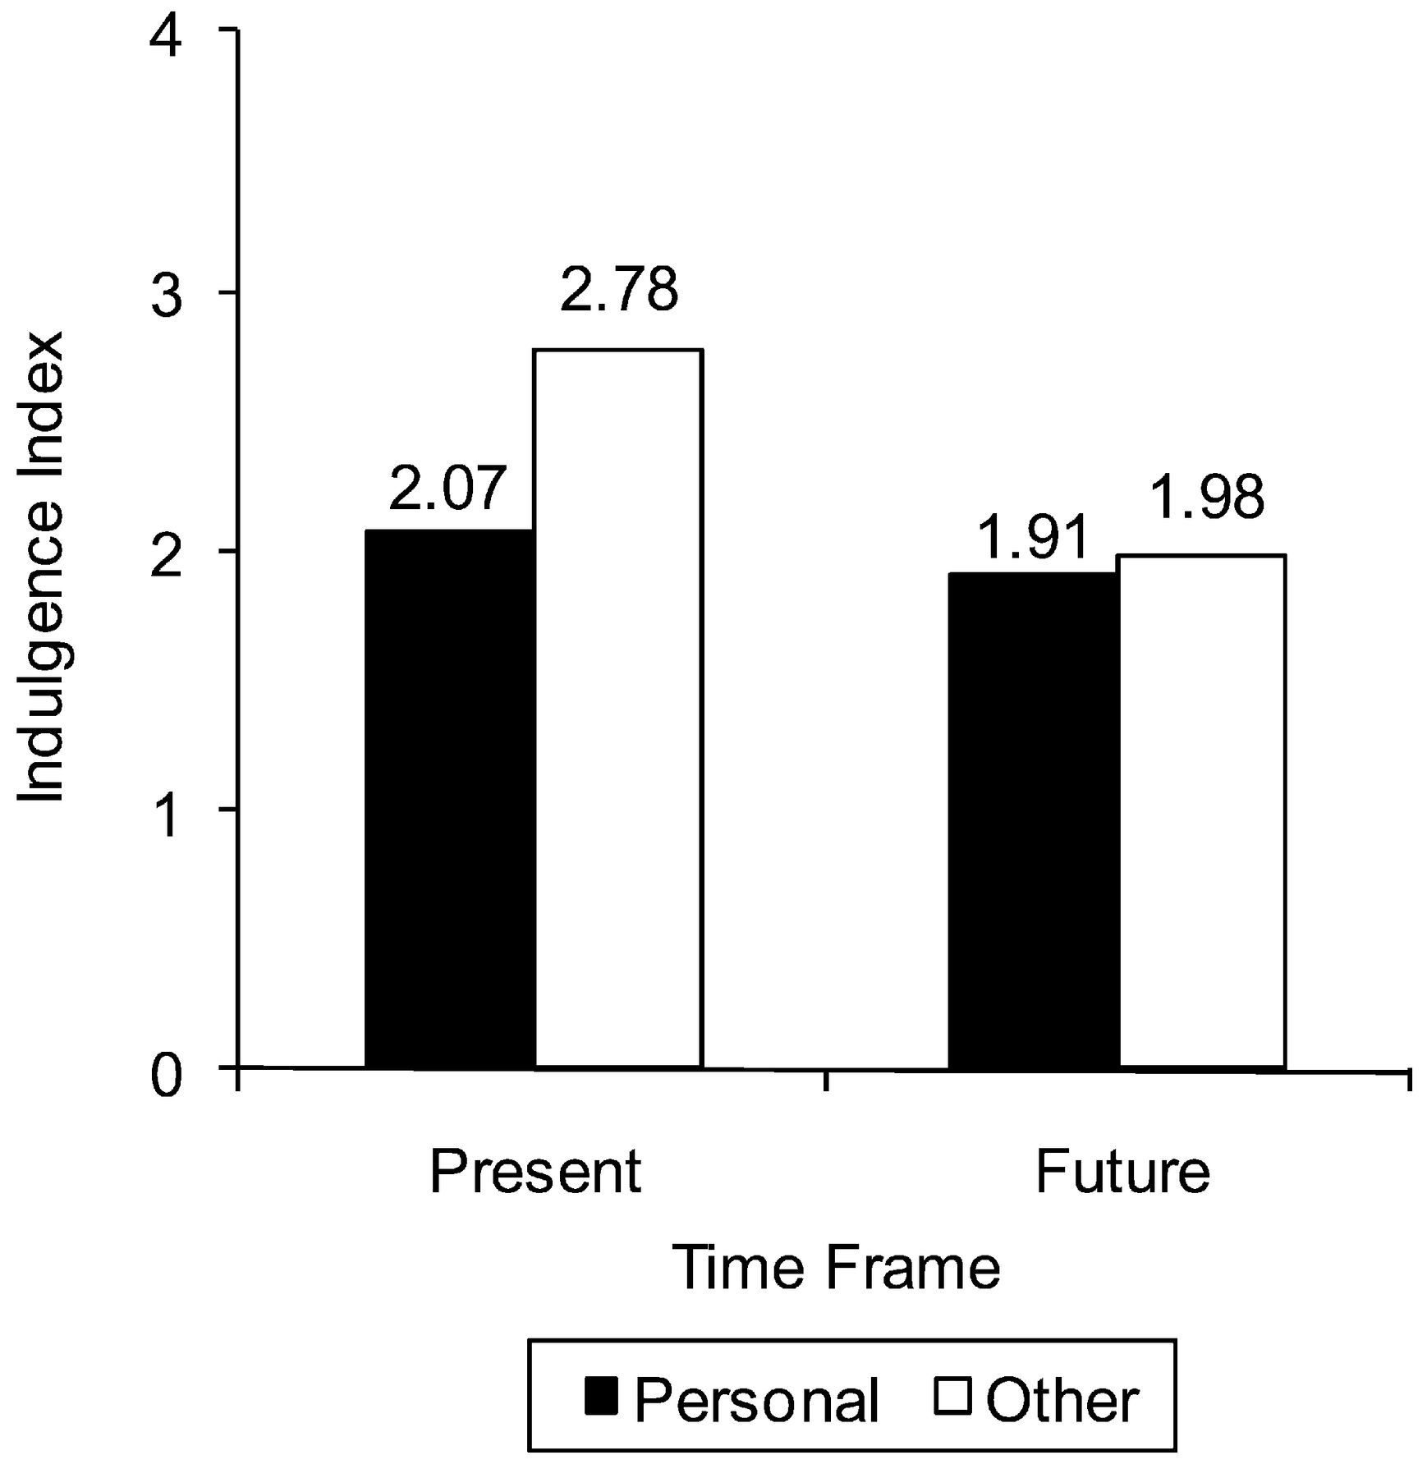
Figure 4 Study 4A Results
Notes:
Figure 4 Study 4A Results
Unless provided in the caption above, the following copyright applies to the content of this slide: © 2010 by Journal of Consumer Research, Inc.

Slide 5
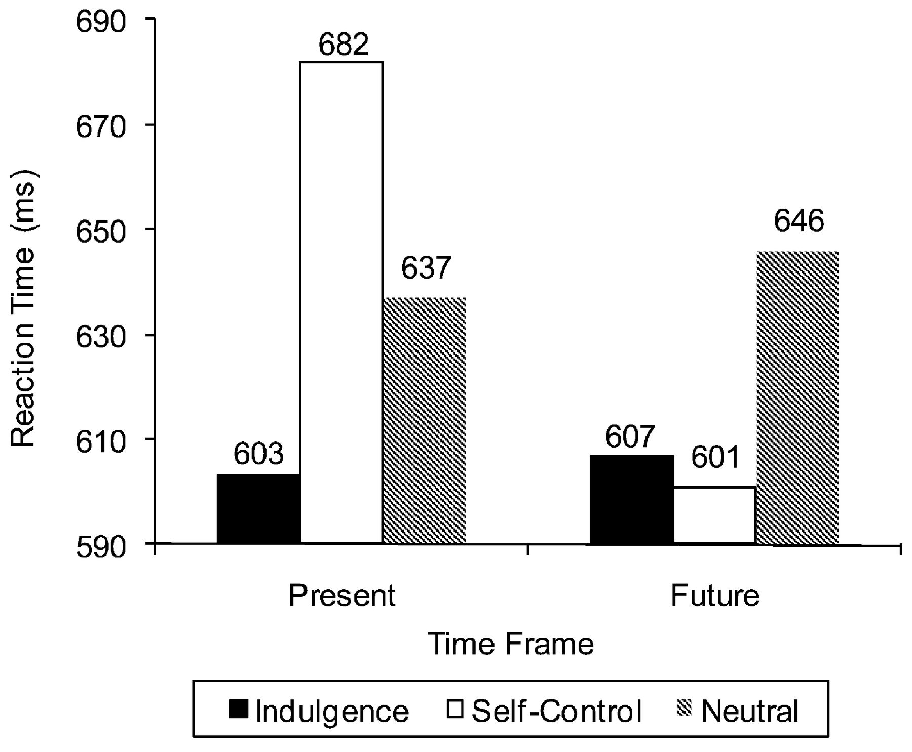
Figure 5 Study 4B Results
Notes:
Figure 5 Study 4B Results
Unless provided in the caption above, the following copyright applies to the content of this slide: © 2010 by Journal of Consumer Research, Inc.

