Slide 1
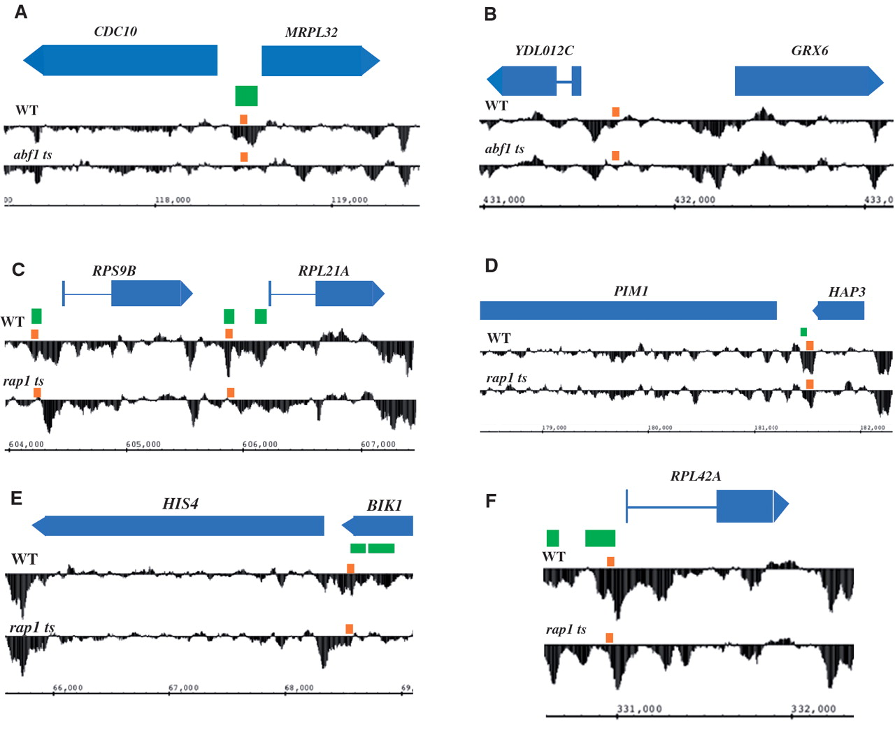
Figure 1. Select genomic regions showing altered nucleosome occupancy profiles in wild-type and abf1 ts ( A and B ) or ...
Notes:
Figure 1. Select genomic regions showing altered nucleosome occupancy profiles in wild-type and abf1 ts ( A and B ) or rap1 ts yeast ( C–F ). Relative nucleosome occupancy (black traces) is represented as the log 2 of (nucleosomal DNA/genomic DNA) signal intensity ratio. For each region, blue bars at top show open reading frames, with introns shown as thin lines, pointing to right or left for those on the Watson or Crick strand, respectively ( PIM1 extends beyond the left edge of the region shown); green boxes indicate regions identified as having significantly altered nucleosome occupancy in ts mutant yeast; small orange boxes above nucleosome occupancy profiles indicate binding sites for Abf1 or Rap1; and chromosomal coordinates are indicated at bottom. Note that the region in the vicinity of the Abf1-binding site upstream of YDL102C ( B ) did not show significantly altered nucleosome occupancy with the parameters used in the Tiling Array Software program; nonetheless, a modest increase in occupancy is seen at this region.
Unless provided in the caption above, the following copyright applies to the content of this slide: © The Author(s) 2010. Published by Oxford University Press.This is an Open Access article distributed under the terms of the Creative Commons Attribution Non-Commercial License (http://creativecommons.org/licenses/by-nc/2.5), which permits unrestricted non-commercial use, distribution, and reproduction in any medium, provided the original work is properly cited.

Slide 2
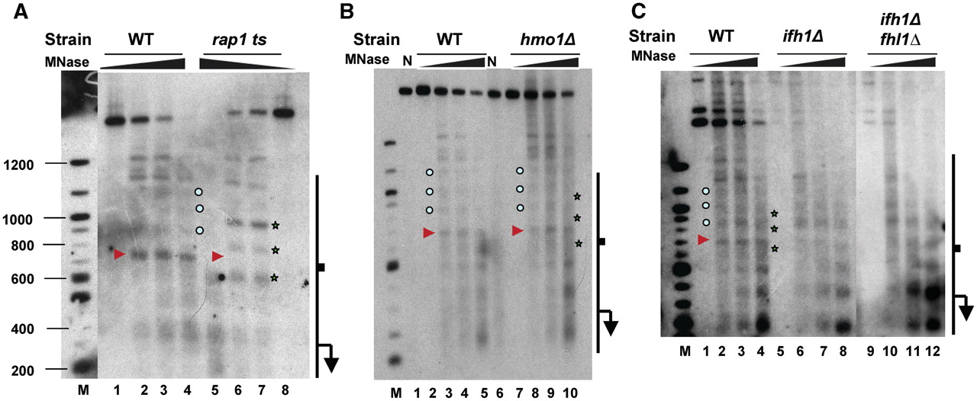
Figure 2. Indirect end-labeling analysis of chromatin structure at the RPL42A promoter ( A ) in wild-type and rap1 ts ...
Notes:
Figure 2. Indirect end-labeling analysis of chromatin structure at the RPL42A promoter ( A ) in wild-type and rap1 ts yeast, ( B ) in wild-type and hmo1Δ yeast, and ( C ) in wild-type, ifh1Δ , and ifh1Δ fhl1Δ yeast. Increasing amounts of MNase were used, from 0 to 20 U/ml (triangles), to digest chromatin prepared from the indicated strains after 1 h at 37°C ( A ) or grown at 30°C ( B and C ), and to digest naked DNA (lanes N). MNase cleavage sites were mapped relative to a BamHI site at +245 bp. Cleavage sites characteristic of chromatin from wild-type cells are indicated by small circles, with a prominent cleavage indicated by the red arrow, while cleavages characteristic of the ts mutant are indicated by stars. Note the presence of the former and absence of the latter cleavages in hmo1Δ , ifh1Δ and ifh1Δ fhl1Δ yeast in ( B and C ).
Unless provided in the caption above, the following copyright applies to the content of this slide: © The Author(s) 2010. Published by Oxford University Press.This is an Open Access article distributed under the terms of the Creative Commons Attribution Non-Commercial License (http://creativecommons.org/licenses/by-nc/2.5), which permits unrestricted non-commercial use, distribution, and reproduction in any medium, provided the original work is properly cited.

Slide 3
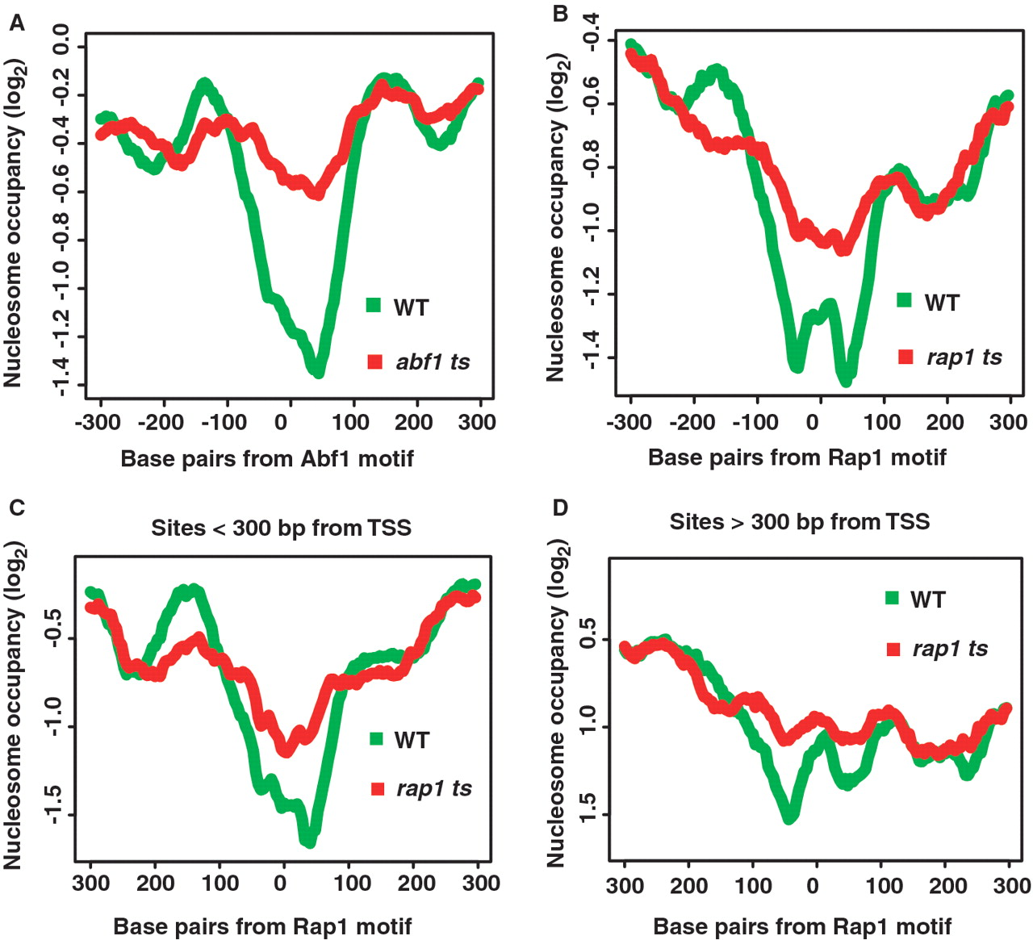
Figure 3. Averaged nucleosome occupancy profiles for ( A ) 67 promoter regions surrounding unique Abf1 sites from ...
Notes:
Figure 3. Averaged nucleosome occupancy profiles for ( A ) 67 promoter regions surrounding unique Abf1 sites from genes identified as probable or putative targets of Abf1 ( 23 ), in abf1 ts and WT yeast; ( B ) 66 promoter regions surrounding unique Rap1 sites from genes identified as probable or putative targets of Rap1 ( 23 ), in rap1 ts and WT yeast; ( C and D ) 30 promoter regions having unique Rap1-binding sites located 300 bp from the TSS, respectively, centered on Rap1-binding sites, in rap1 ts and WT yeast.
Unless provided in the caption above, the following copyright applies to the content of this slide: © The Author(s) 2010. Published by Oxford University Press.This is an Open Access article distributed under the terms of the Creative Commons Attribution Non-Commercial License (http://creativecommons.org/licenses/by-nc/2.5), which permits unrestricted non-commercial use, distribution, and reproduction in any medium, provided the original work is properly cited.

Slide 4
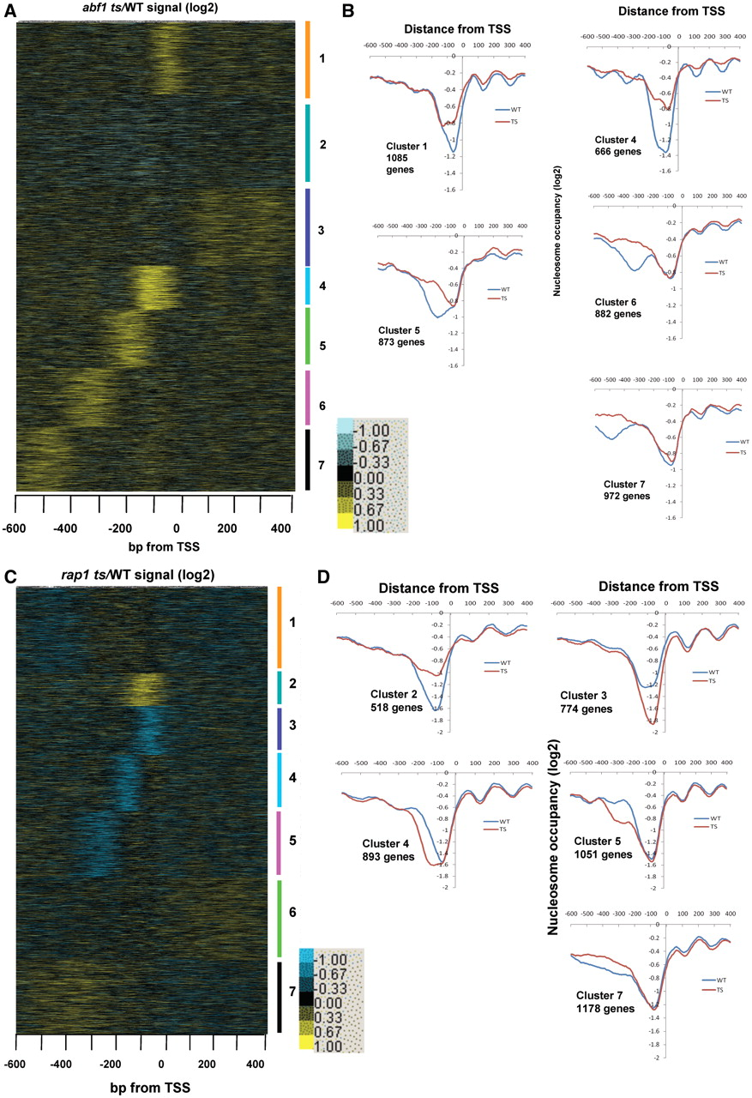
Figure 4. K -means clustering ( K = 7) for log ₂ of nucleosome occupancy for ( A ) abf1 ts yeast and ( C ) ...
Notes:
Figure 4. K -means clustering ( K = 7) for log 2 of nucleosome occupancy for ( A ) abf1 ts yeast and ( C ) rap1 ts over WT for 7052 genes, aligned by TSS; yellow represents increased nucleosome occupancy in the ts mutant, while blue represents depletion. Line graphs for average nucleosome occupancy of indicated clusters are depicted in ( B ) and ( D ); line graphs for Abf1 cluster 3 and Rap1 cluster 6, used as controls for enrichment, are shown in Supplementary Figure S4B and C . Clustering for K = 6 or K = 8 yielded similar results, with some clusters being grouped together or sub-divided further ( Supplementary Figure S10 ).
Unless provided in the caption above, the following copyright applies to the content of this slide: © The Author(s) 2010. Published by Oxford University Press.This is an Open Access article distributed under the terms of the Creative Commons Attribution Non-Commercial License (http://creativecommons.org/licenses/by-nc/2.5), which permits unrestricted non-commercial use, distribution, and reproduction in any medium, provided the original work is properly cited.

Slide 5
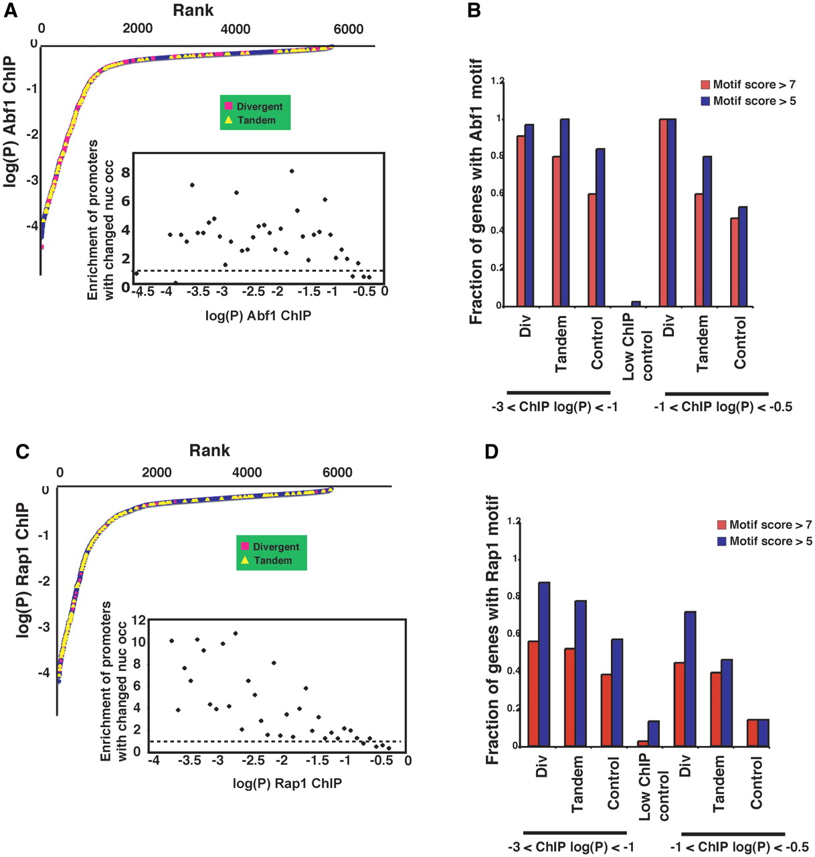
Figure 5. Regions having altered nucleosome occupancy in abf1 ts or rap1 ts yeast are enriched for both strong and ...
Notes:
Figure 5. Regions having altered nucleosome occupancy in abf1 ts or rap1 ts yeast are enriched for both strong and weak Abf1 and Rap1-binding sites. Graphs of genes ranked by log(P) for ChIP against ( A ) Abf1 or ( C ) Rap1 ( 53 ) are shown, with promoters containing regions having significantly changed nucleosome occupancy, and associated with divergent or tandem promoters, indicated by pink squares and yellow triangles, respectively. Regions found to lie in divergent promoters were mapped to only one of the two divergently transcribed genes. Insets show the relative enrichment of promoters having altered nucleosome occupancy in ts mutant yeast against the log(P) for ChIP for Abf1 or Rap1, for increments of log(P) of 1/10. This was calculated by determining the fraction of promoters having altered nucleosome occupancy for each increment of log(P) and dividing by the fraction of all promoters having log(P) in the same increment. The horizontal dashed lines correspond to a value of 1, or no enrichment. In ( B ) and ( D ) are shown the fraction of genes showing altered nucleosome occupancy in abf1 or rap1 ts yeast, respectively, that contain Abf1 or Rap1 motifs defined stringently [motif score >7 in Patser ( 66 ), corresponding approximately to ln(P) 5, corresponding approximately to ln(P) < –8], as indicated, and having ChIP log(P) values as indicated at bottom. Control sets were closely matched for ChIP P- values but did not show altered nucleosome occupancy according to the criteria applied ('Materials and Methods' section), while the ‘low ChIP control’ was a group of genes at about 75th percentile for ChIP P- value.
Unless provided in the caption above, the following copyright applies to the content of this slide: © The Author(s) 2010. Published by Oxford University Press.This is an Open Access article distributed under the terms of the Creative Commons Attribution Non-Commercial License (http://creativecommons.org/licenses/by-nc/2.5), which permits unrestricted non-commercial use, distribution, and reproduction in any medium, provided the original work is properly cited.

Slide 6
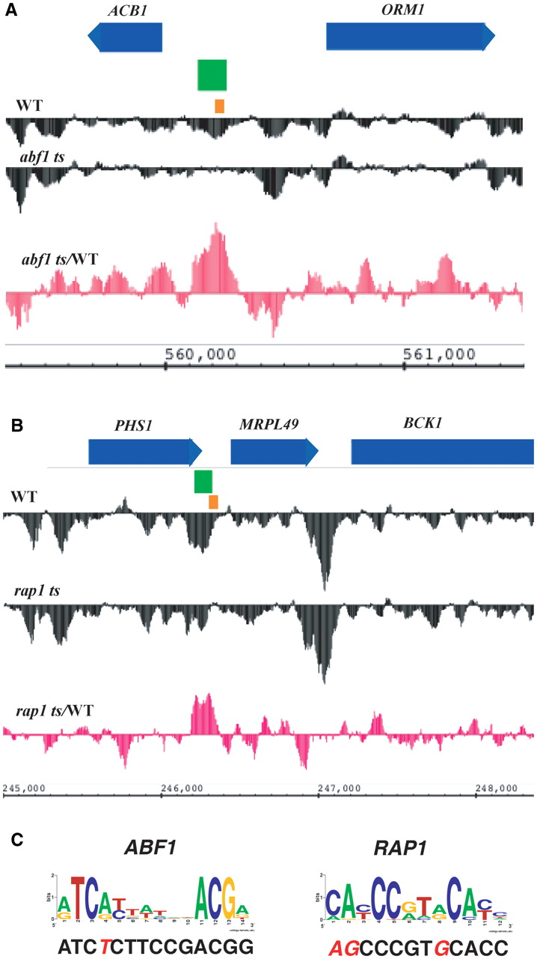
Figure 6. Nucleosome occupancy profiles in the region of the ORM1 gene in WT and abf1 ts yeast ( A ) and in the region ...
Notes:
Figure 6. Nucleosome occupancy profiles in the region of the ORM1 gene in WT and abf1 ts yeast ( A ) and in the region of the MRPL49 gene in WT and rap1 ts yeast ( B ); see Figure 1 legend for additional details. ( C ) Motifs found in the regions of altered nucleosome occupancy in ( A and B ) [orange boxes in ( A and B )] are compared to logos for the Abf1 and Rap1 consensus motifs ( 23 ); differences are highlighted by red italic letters.
Unless provided in the caption above, the following copyright applies to the content of this slide: © The Author(s) 2010. Published by Oxford University Press.This is an Open Access article distributed under the terms of the Creative Commons Attribution Non-Commercial License (http://creativecommons.org/licenses/by-nc/2.5), which permits unrestricted non-commercial use, distribution, and reproduction in any medium, provided the original work is properly cited.

