Slide 1
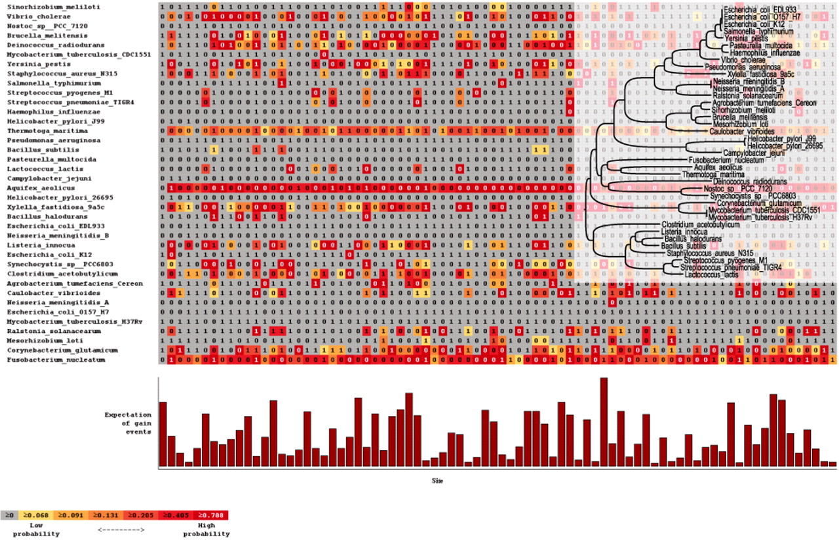
Fig. 1. Stochastic mapping inference of gain events. The size of the bar below each character indicates the sum of ...
Notes:
Fig. 1. Stochastic mapping inference of gain events. The size of the bar below each character indicates the sum of expected gain events over all branches. Each character in the phyletic pattern is color coded according to the probability of a gain event in this character and within the branch leading to this species (presentation is also available for loss events). (Insert) Tree with branch lengths proportional to the total number of gain and loss events.
Unless provided in the caption above, the following copyright applies to the content of this slide: © The Author 2010. Published by Oxford University Press. All rights reserved. For Permissions, please email: journals.permissions@oxfordjournals.org

