Slide 1
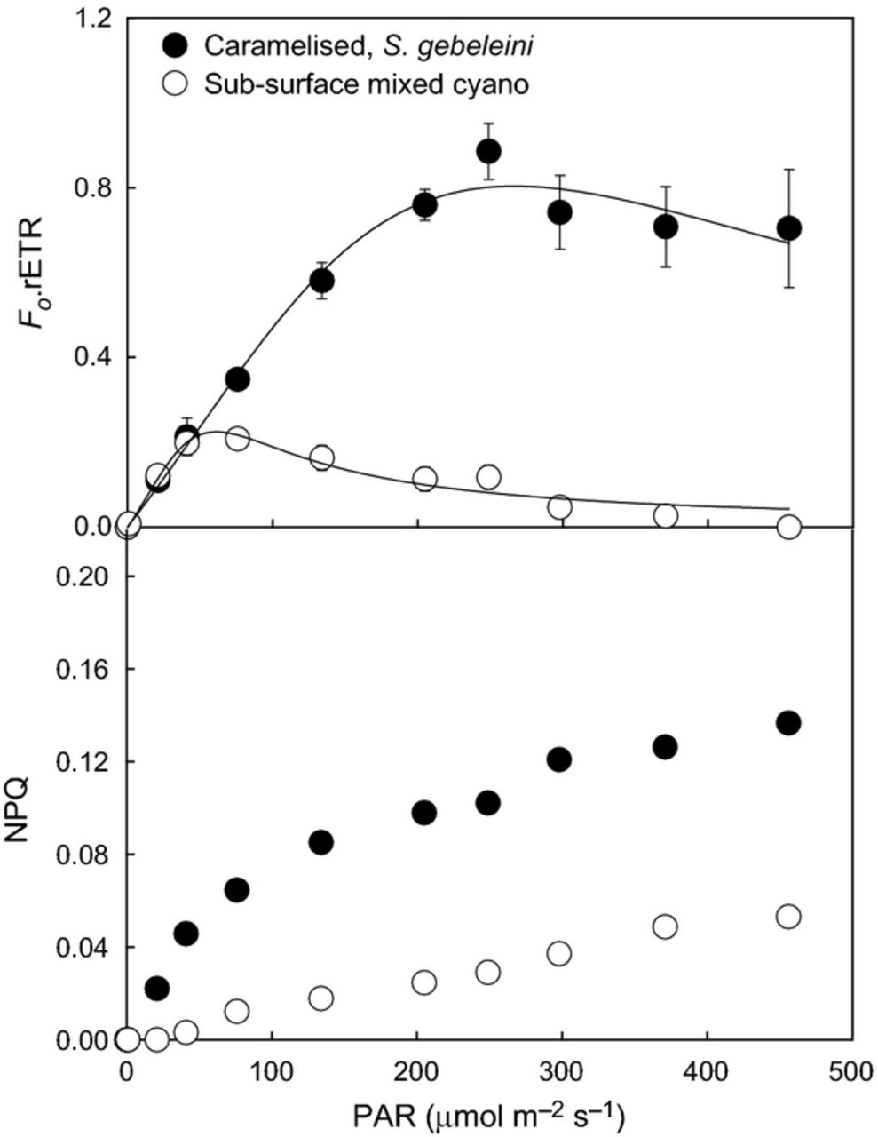
Stromatolite phototrophic microbial communities at Highborne Cay, Bahamas. (a) Sample 1 – Type 1 mat of near ...
Notes:
Stromatolite phototrophic microbial communities at Highborne Cay, Bahamas. (a) Sample 1 – Type 1 mat of near surface Schizothrix gebeleinii community with underlying white (w) and green cyanobacteria community (g) layer; (b) Sample 2 – Type 2 mat comprising bacterial biofilm community with underlying S. gebeleinii; (c) Sample 3 – Type 3 mat, Solentia community; (d) Sample 4 – Pink fuzz, stalked diatom community; (e and h) Sample 5 – Yellow Fuzz, stalked diatom community with underlying S. gebeleinii; (f and i) Tube-dwelling diatom community with underlying Solentia and S. gebeleinii; (g and j) Pudding mat, Phormidium sp. and coccoid cyanobacterium community. Images a–c and h show the surface/near surface ‘caramel layer’ and images a, c, h–j show the subsurface ‘green’ sub-communities of cyanobacteria. a–c and h–j, cross-sections as observed under a dissecting microscope, d–g as they appear in the field. Scale bars are 1 mm.
Unless provided in the caption above, the following copyright applies to the content of this slide: © 2012 Federation of European Microbiological Societies

Slide 2
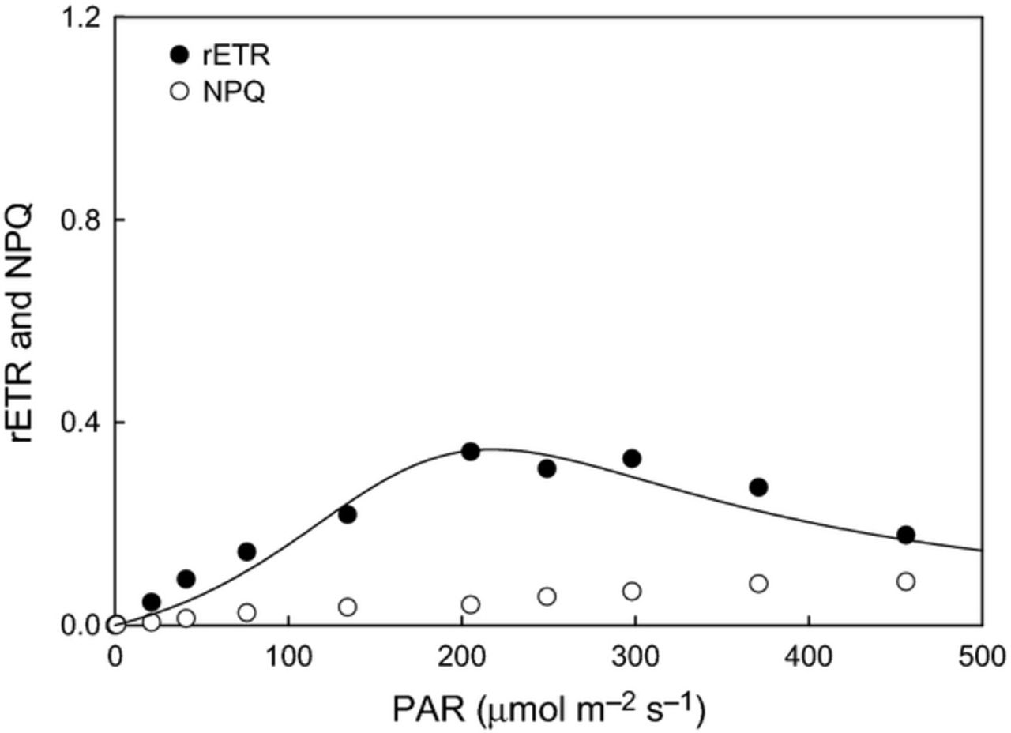
Light response curves (upper panel) and NPQ induction during the same set of light curves (lower panel) for ...
Notes:
Light response curves (upper panel) and NPQ induction during the same set of light curves (lower panel) for Type 1 Stromatolite mats comprising surface Schizothrix gebeleiini and sub-surface mixed cyanobacteria layer. All data mean ± SE from 10 replicate samples.
Unless provided in the caption above, the following copyright applies to the content of this slide: © 2012 Federation of European Microbiological Societies

Slide 3
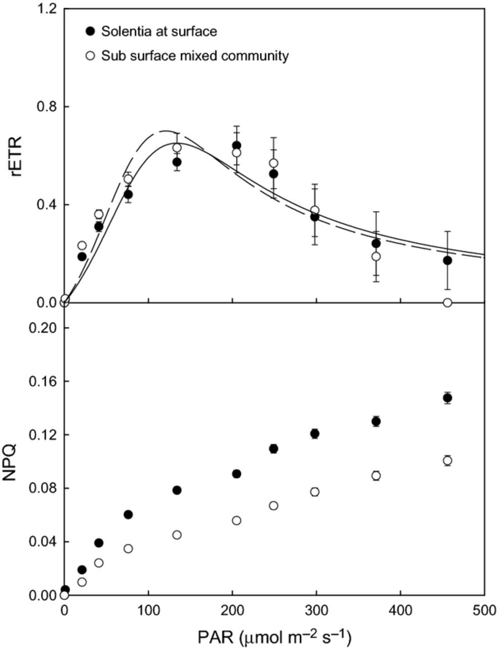
Light response curves and NPQ induction during the same set of light curves for Type 2 Stromatolite mats ...
Notes:
Light response curves and NPQ induction during the same set of light curves for Type 2 Stromatolite mats comprising near surface Schizothrix gebeleinii. All data mean ± SE from 10 replicate samples.
Unless provided in the caption above, the following copyright applies to the content of this slide: © 2012 Federation of European Microbiological Societies

Slide 4
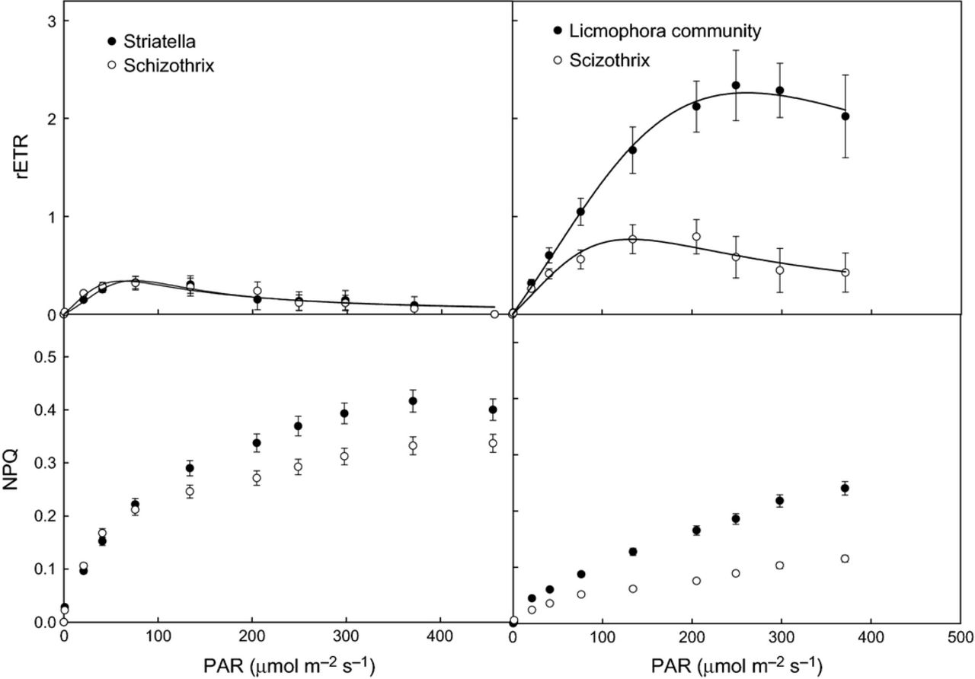
Light response curves (upper panel) and NPQ induction during the same set of light curves (lower panel) for ...
Notes:
Light response curves (upper panel) and NPQ induction during the same set of light curves (lower panel) for Type 3 Stromatolite mats comprising near surface Solentia sp. and sub-surface mixed cyanobacteria layer. All data mean ± SE from 10 replicate samples.
Unless provided in the caption above, the following copyright applies to the content of this slide: © 2012 Federation of European Microbiological Societies

Slide 5
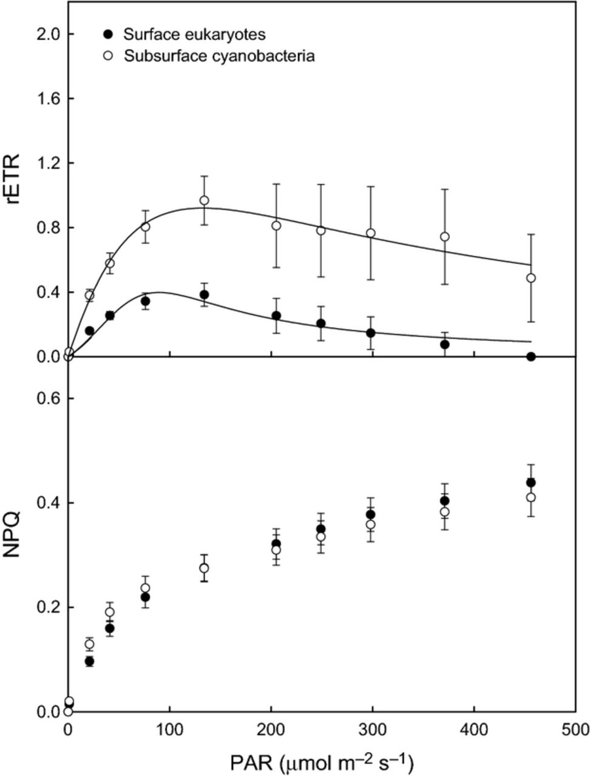
Light response curves (upper panels) and NPQ induction during the same set of light curves (lower panels) for ...
Notes:
Light response curves (upper panels) and NPQ induction during the same set of light curves (lower panels) for stalked diatom sub-communities overlying Schizothrix gebeleinii. Left-hand panels refer to ‘Pink Fuzz’ dominated by Striatella sp. and right-hand panels refer to ‘Yellow Fuzz’ dominated by Licmophora sp. All data mean ± SE from 10 replicate samples.
Unless provided in the caption above, the following copyright applies to the content of this slide: © 2012 Federation of European Microbiological Societies

Slide 6
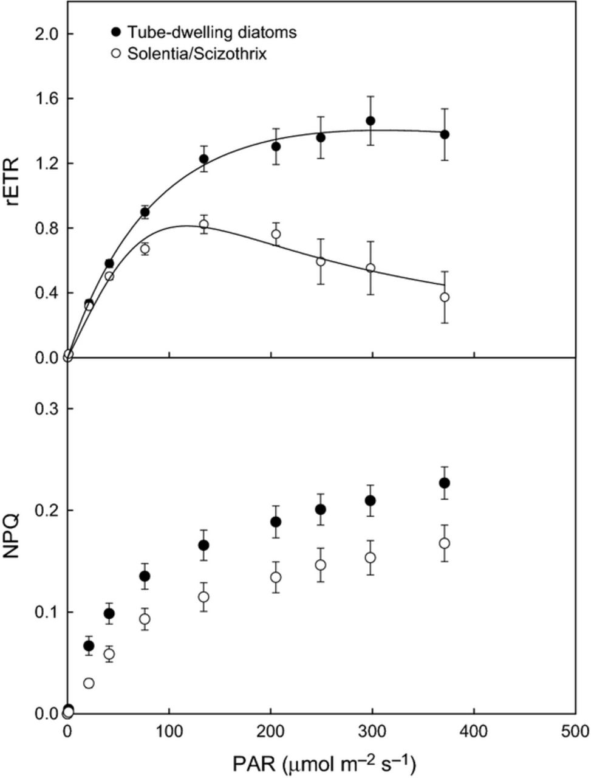
Light response curves (upper panel) and NPQ induction during the same set of light curves (lower panel) for ...
Notes:
Light response curves (upper panel) and NPQ induction during the same set of light curves (lower panel) for stalked diatom sub-communities (thought to be Striatella sp.) overlying cyanobacteria sub-community layer (thought to be Schizothrix gebeleinii) on thrombolite samples. This is the thrombolite ‘Pink Fuzz’ equivalent to the Stromatolite samples in Fig. 5. All data mean ± SE from 10 replicate samples.
Unless provided in the caption above, the following copyright applies to the content of this slide: © 2012 Federation of European Microbiological Societies

Slide 7
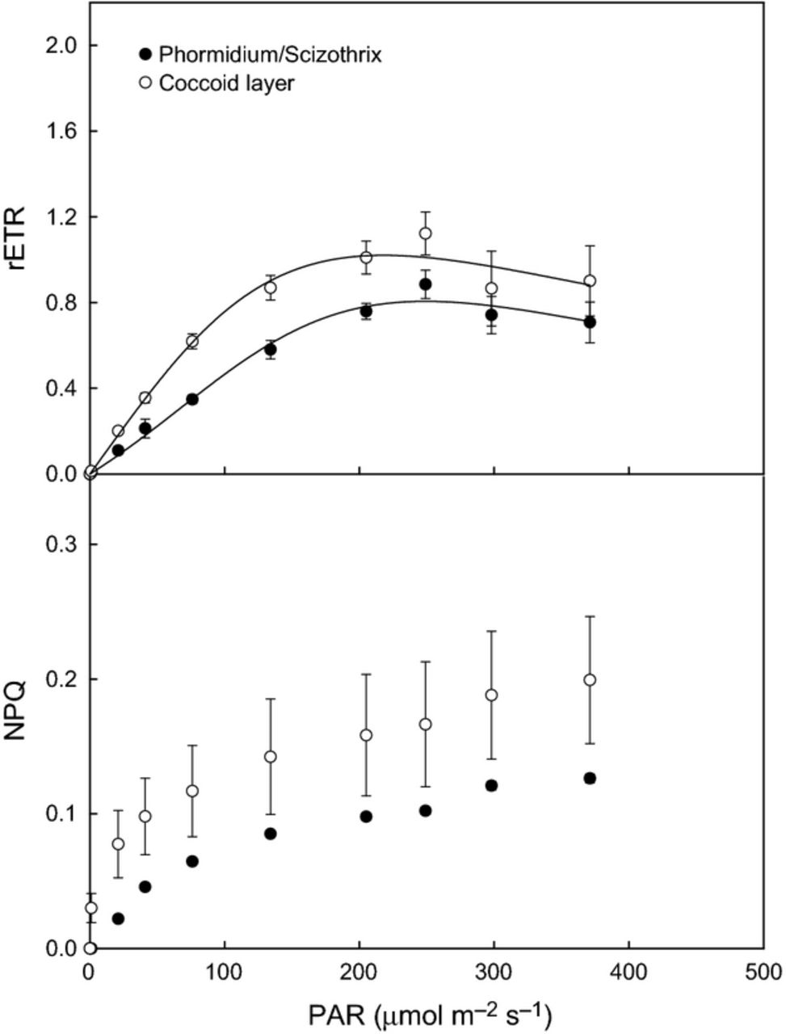
Light response curves (upper panel) and NPQ induction during the same set of light curves (lower panel) for ...
Notes:
Light response curves (upper panel) and NPQ induction during the same set of light curves (lower panel) for tube-dwelling diatom sub-communities overlying Solentia sp./Schizothrix gebeleinii. All data mean ± SE from 10 replicate samples.
Unless provided in the caption above, the following copyright applies to the content of this slide: © 2012 Federation of European Microbiological Societies

Slide 8
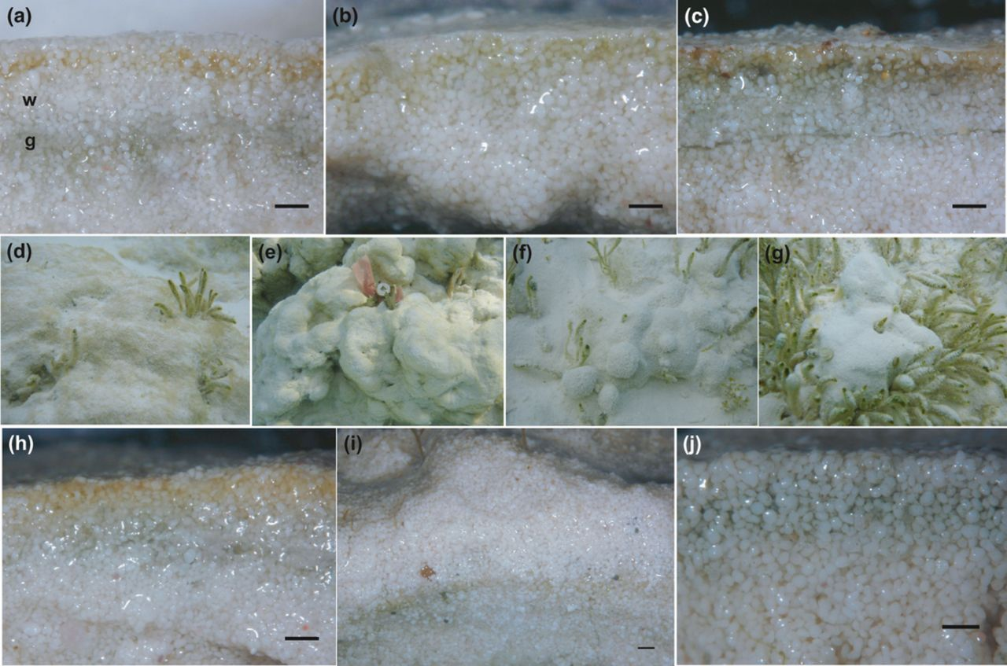
Light response curves (upper panel) and NPQ induction during the same set of light curves (lower panel) for ...
Notes:
Light response curves (upper panel) and NPQ induction during the same set of light curves (lower panel) for ‘coccoid pudding mats’ thought to be comprised of Phormidium sp. and Schizothrix gebeleinii overlying a coccoid cell layer possibly Cyanothece sp. All data mean ± SE from 10 replicate samples.
Unless provided in the caption above, the following copyright applies to the content of this slide: © 2012 Federation of European Microbiological Societies

