Slide 1
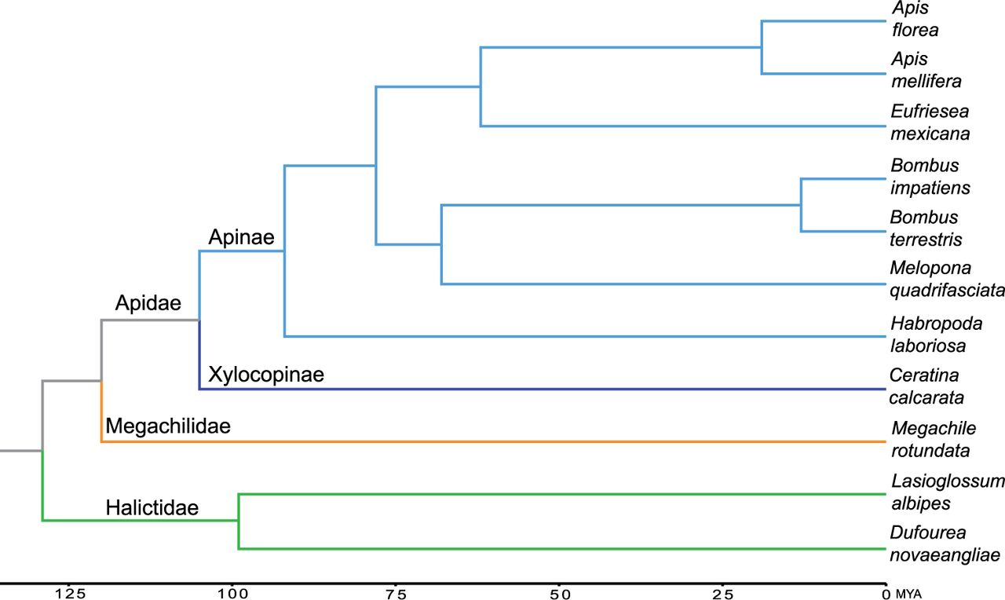
Fig. 1.— Phylogenetic placement of Ceratina calcarata. Divergence dates taken from Kapheim et al. (2015) and Rehan and ...
Notes:
Fig. 1.— Phylogenetic placement of Ceratina calcarata. Divergence dates taken from Kapheim et al. (2015) and Rehan and Schwarz (2015). Ceratina and Apis diverged approximately 105 Ma. Tree topology was confirmed by an analysis of orthologous 4-fold degenerate sites (supplementary material, Supplementary Material online).
Unless provided in the caption above, the following copyright applies to the content of this slide: © The Author 2016. Published by Oxford University Press on behalf of the Society for Molecular Biology and Evolution.This is an Open Access article distributed under the terms of the Creative Commons Attribution Non-Commercial License (http://creativecommons.org/licenses/by-nc/4.0/), which permits non-commercial re-use, distribution, and reproduction in any medium, provided the original work is properly cited. For commercial re-use, please contact journals.permissions@oup.com

Slide 2
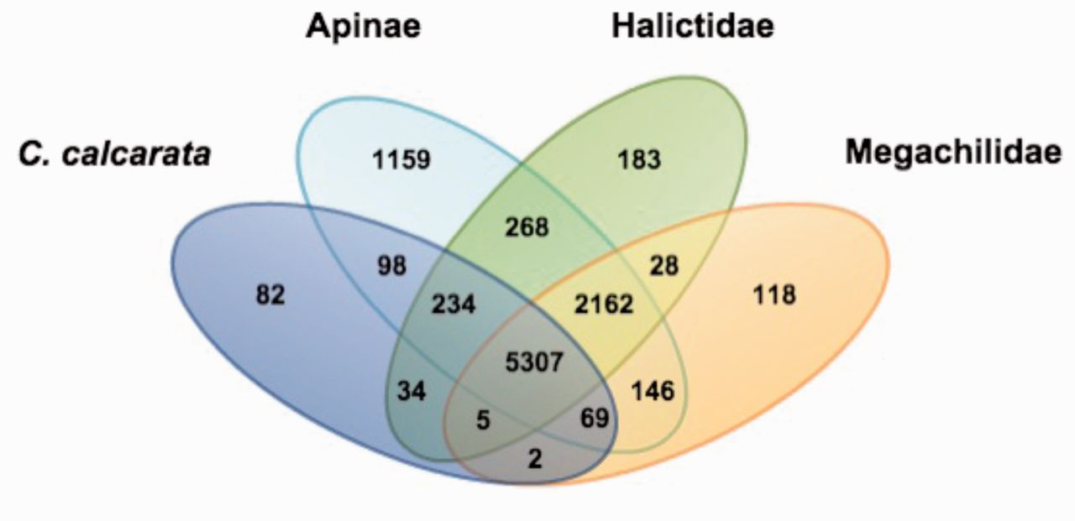
Fig. 2.— Gene family overlap among four bee lineages. The 11 species were sorted into 4 groups based on taxonomic ...
Notes:
Fig. 2.— Gene family overlap among four bee lineages. The 11 species were sorted into 4 groups based on taxonomic classification: (1) Ceratina calcarata (subfamily Xylocopinae) versus (2) subfamily Apinae (Apis florae, Apis mellifera, Bombus impatiens, Bombus terrestris, Eufriesea mexicana, Habropoda laboriosa, and Melipona quadrifasciata) versus (3) family Halictidae (Lasioglossum albipes and Dufourea novaeangliae) versus (4) family Megachilidae (Megachile rotundata). Numbers indicate the gene families in each comparison. A total of 5,307 gene families are shared among all 11 bee species.
Unless provided in the caption above, the following copyright applies to the content of this slide: © The Author 2016. Published by Oxford University Press on behalf of the Society for Molecular Biology and Evolution.This is an Open Access article distributed under the terms of the Creative Commons Attribution Non-Commercial License (http://creativecommons.org/licenses/by-nc/4.0/), which permits non-commercial re-use, distribution, and reproduction in any medium, provided the original work is properly cited. For commercial re-use, please contact journals.permissions@oup.com

Slide 3
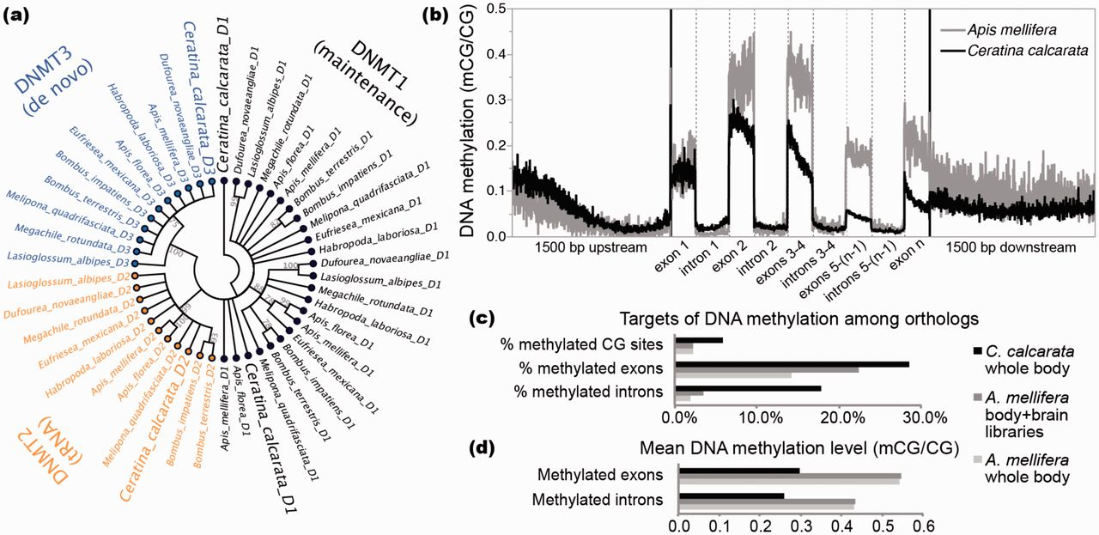
Fig. 3.— DNA methylation in Ceratina calcarata. (a) Unrooted neighbor-joining cladogram showing relationships among ...
Notes:
Fig. 3.— DNA methylation in Ceratina calcarata. (a) Unrooted neighbor-joining cladogram showing relationships among the DNA methyltransferase proteins DNMT1 (D1), DNMT2 (D2), and DNMT3 (D3) from C. calcarata and 10 other bee species, demonstrating the presence of a fully functional DNA methylation toolkit in C. calcarata. Polytomies are plotted for nodes with less than 75% support among 1,000 bootstrap replicates. (b) Spatial profiles of mean DNA methylation levels in genes with significant methylation from C. calcarata and the honey bee Apis mellifera. Exons are divided into 150 proportional bins and introns are divided into 200 proportional bins. DNA methylation is preferentially targeted to exons 1–3, and levels decay toward the 3′ end of genes in each species (Wilcoxon rank-sum tests between exons 1–3 and 4–n, P < 0.0001). (c) Percent of CG dinucleotides, exons, and introns targeted by DNA methylation in 5,698 shared orthologs suggests more widespread targeting of DNA methylation in C. calcarata versus A. mellifera, whereas (d) mean methylation levels suggest that C. calcarata exhibits lower levels of DNA methylation, where targeted, compared with A. mellifera.
Unless provided in the caption above, the following copyright applies to the content of this slide: © The Author 2016. Published by Oxford University Press on behalf of the Society for Molecular Biology and Evolution.This is an Open Access article distributed under the terms of the Creative Commons Attribution Non-Commercial License (http://creativecommons.org/licenses/by-nc/4.0/), which permits non-commercial re-use, distribution, and reproduction in any medium, provided the original work is properly cited. For commercial re-use, please contact journals.permissions@oup.com

