Slide 1
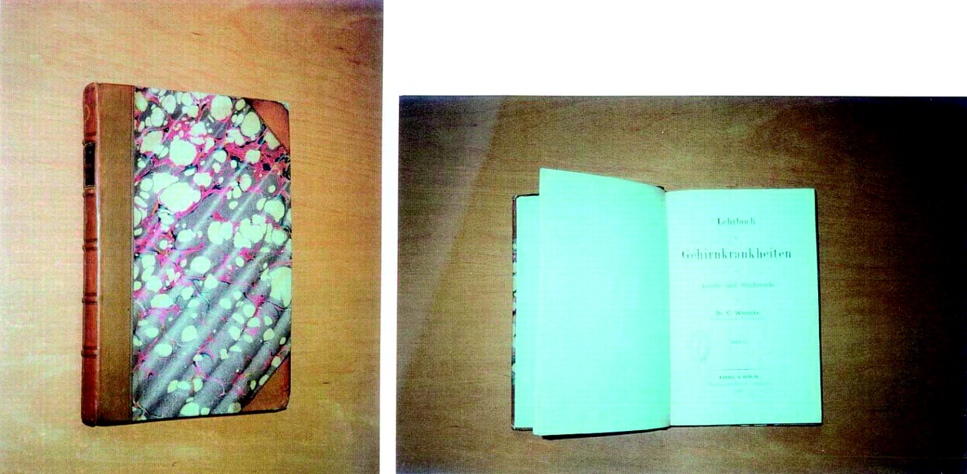
Fig. 1. Wernicke ( 1881 ) Lehrbuch der Gehirnkrankheiten fur Aerzte und Studirende. Vol 2 Kassel Theodor Fischer ...
Notes:
Fig. 1. Wernicke ( 1881 ) Lehrbuch der Gehirnkrankheiten fur Aerzte und Studirende. Vol 2 Kassel Theodor Fischer 229–242.
Unless provided in the caption above, the following copyright applies to the content of this slide: Copyright © The Author 2007. Published by Oxford University Press on behalf of the Medical Council on Alcohol.

