Slide 1
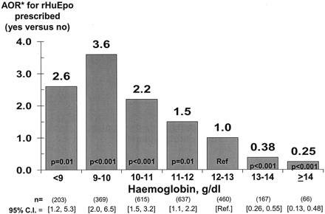
Fig. 3. *Adjusted odds ratios of rHuEpo being prescribed, by patient haemoglobin group. Logistic regression was used ...
Notes:
Fig. 3. *Adjusted odds ratios of rHuEpo being prescribed, by patient haemoglobin group. Logistic regression was used to model the odds of rHuEpo being prescribed (yes vs no) for a point-prevalent sample of year 2000 haemodialysis patients. The model was adjusted for age, gender, 14 classes of co-morbidity, years on dialysis, whether new to haemodialysis, country and facility clustering effects. Patients on dialysis <180 days were excluded; 95% confidence interval (CI) is shown at the bottom of each bar; n = 2520.
Unless provided in the caption above, the following copyright applies to the content of this slide: © European Renal Association–European Dialysis and Transplant Association

Slide 2
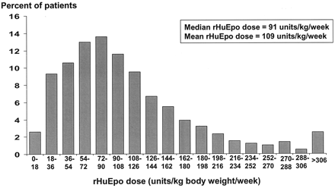
Fig. 2. Distribution of rHuEpo doses prescribed for prevalent haemodialysis patients in Euro-DOPPS. The distribution ...
Notes:
Fig. 2. Distribution of rHuEpo doses prescribed for prevalent haemodialysis patients in Euro-DOPPS. The distribution of rHuEpo doses and the mean and median rHuEpo dose are shown for a point-prevalent sample of haemodialysis patients in the Euro-DOPPS who were receiving rHuEpo therapy in year 2000; n = 2494. Patients on dialysis <90 days were excluded. For comparison, the median rHuEpo dose for a year 1998–1999 point-prevalent sample was 88 U/kg body weight/week.
Unless provided in the caption above, the following copyright applies to the content of this slide: © European Renal Association–European Dialysis and Transplant Association

Slide 3
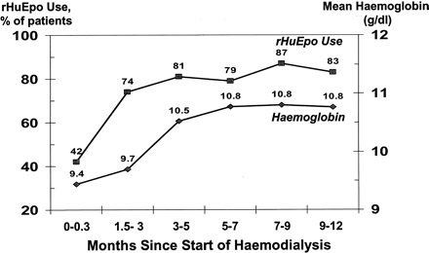
Fig. 4. Time trend in rHuEpo use and mean haemoglobin concentration for new ESRD patients after initiating ...
Notes:
Fig. 4. Time trend in rHuEpo use and mean haemoglobin concentration for new ESRD patients after initiating haemodialysis. The percentage of patients receiving rHuEpo and the mean haemoglobin concentration was determined at six time points during the first year of haemodialysis therapy for a cohort of new ESRD patients entering the DOPPS within 10 days of their first-ever dialysis treatment. The six time points for this analysis were 0–0.3 months, 1.5–3 months, 3–5 months, 5–7 months, 7–9 months and 9–12 months; n = 1133. rHuEpo use (filled squares); mean haemoglobin concentration (filled diamonds).
Unless provided in the caption above, the following copyright applies to the content of this slide: © European Renal Association–European Dialysis and Transplant Association

Slide 4
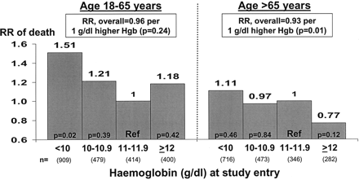
Fig. 6. Relationship between patient haemoglobin concentration and adjusted relative risk of death for patients 18–65 ...
Notes:
Fig. 6. Relationship between patient haemoglobin concentration and adjusted relative risk of death for patients 18–65 years vs >65 years of age. Cox regression analysis was used to determine the relative risk of death as a function of a patient's haemoglobin concentration at the time of study entry for patients 18–65 years vs >65 years of age. Analyses were adjusted for age, gender, 14 co-morbidity classes, ability to walk without assistance, malnourishment, ability to eat independently, years with ESRD, first 180 days of ESRD, country of residence and facility clustering effects. RR, relative risk.
Unless provided in the caption above, the following copyright applies to the content of this slide: © European Renal Association–European Dialysis and Transplant Association

Slide 5
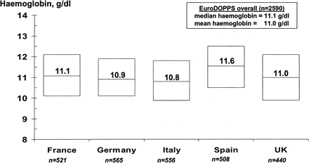
Fig. 1. Median haemoglobin concentration among prevalent haemodialysis patients, by country. Values shown are the ...
Notes:
Fig. 1. Median haemoglobin concentration among prevalent haemodialysis patients, by country. Values shown are the median haemoglobin concentration in each Euro-DOPPS country for a point-prevalent sample of year 2000 haemodialysis patients on dialysis >180 days. Lower and upper horizontal bars correspond to the 25th and 75th percentiles of the haemoglobin concentration distribution in each country. Mean haemoglobin concentrations in Italy and Spain were significantly different (P < 0.01) from the Euro-DOPPS average haemoglobin concentration when adjusted for patient demographics and 14 classes of co-morbidity (data not shown).
Unless provided in the caption above, the following copyright applies to the content of this slide: © European Renal Association–European Dialysis and Transplant Association

Slide 6
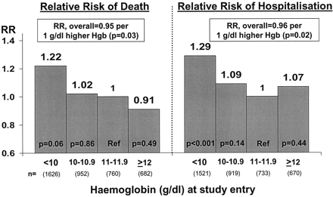
Fig. 5. Relationship between patient haemoglobin concentration and adjusted relative risks of death and ...
Notes:
Fig. 5. Relationship between patient haemoglobin concentration and adjusted relative risks of death and hospitalization. Cox regression analysis was used to determine the relative risk of death or time to first hospitalization as a function of a patient's haemoglobin concentration at the time of study entry. Analyses were adjusted for age, gender, 14 co-morbidity classes, ability to walk without assistance, malnourishment, ability to eat independently, years with ESRD, first 180 days of ESRD, country of residence and facility clustering effects. RR, relative risk. For the mortality analysis, there were a total of 759 deaths with a mean follow-up time of 1.25 years. For the hospitalization analysis, there were a total of 2240 hospitalizations and mean follow-up time to first hospitalization was 0.73 years.
Unless provided in the caption above, the following copyright applies to the content of this slide: © European Renal Association–European Dialysis and Transplant Association

