Slide 1
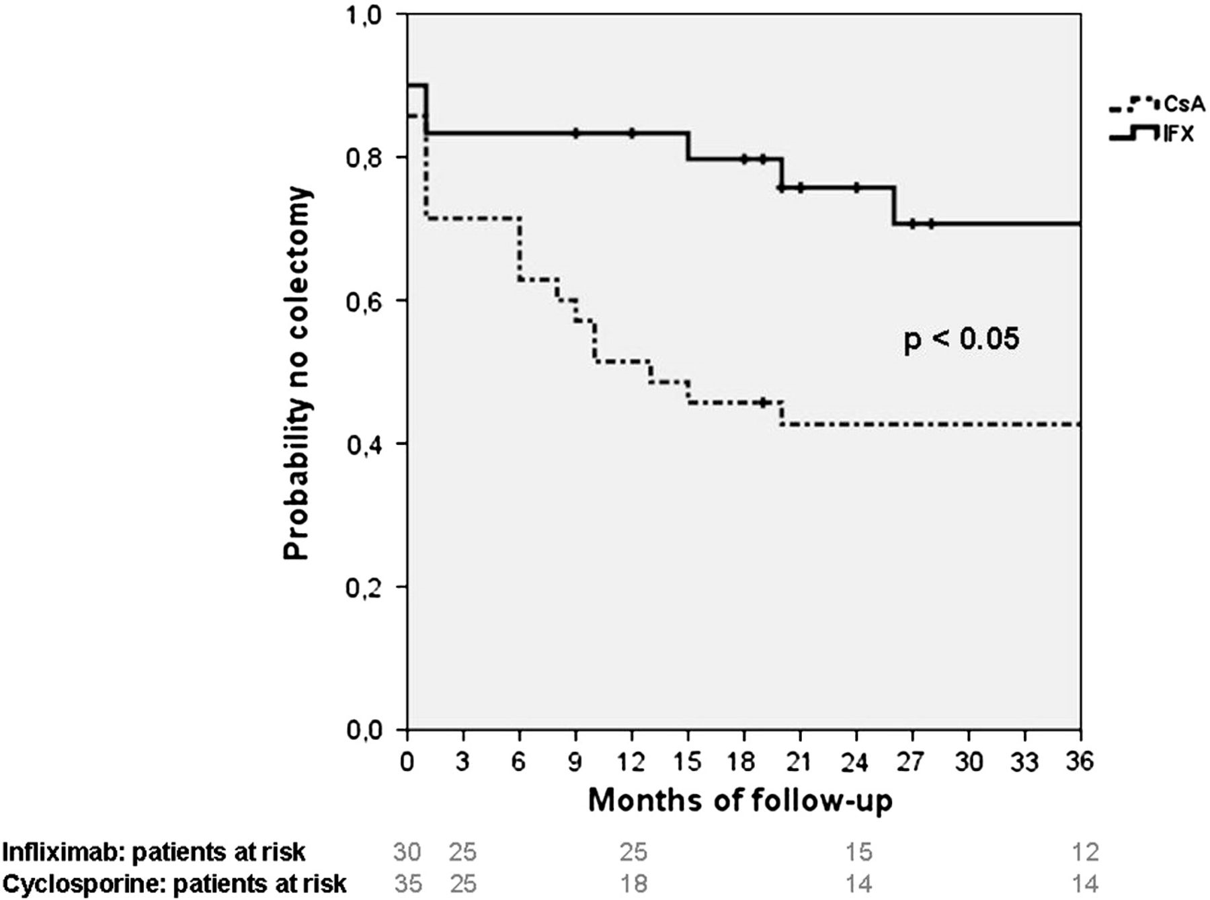
Figure 1 Kaplan–Meier plot showing probability of colectomy-free survival in relation to time after rescue therapy ...
Notes:
Figure 1 Kaplan–Meier plot showing probability of colectomy-free survival in relation to time after rescue therapy with cyclosporine or infliximab.
Unless provided in the caption above, the following copyright applies to the content of this slide: © 2011 European Crohn's and Colitis Organisation

