Slide 1
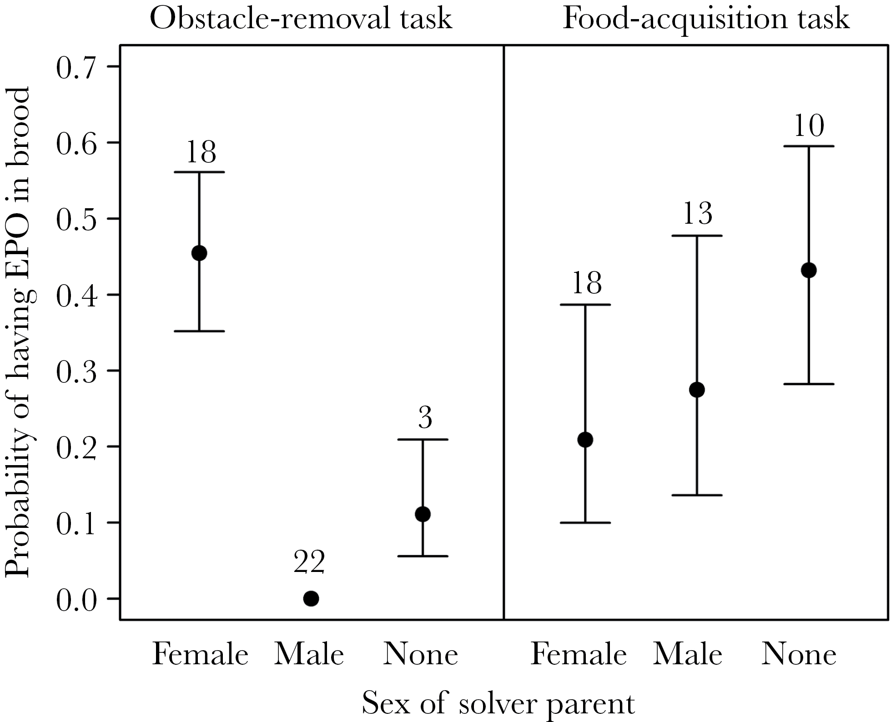
Figure 1 Probability of having extra-pair offspring (EPO) in the brood, in relation to the sex of solver parent in 2 ...
Notes:
Figure 1 Probability of having extra-pair offspring (EPO) in the brood, in relation to the sex of solver parent in 2 problem-solving tasks, as estimated by the models in Table 2. Whiskers correspond to ±1 SE; numbers above the error bars denote sample sizes. Note that there was no variance in EPP among solver males in the obstacle-removal task.
Unless provided in the caption above, the following copyright applies to the content of this slide: © The Author 2017. Published by Oxford University Press on behalf of the International Society for Behavioral Ecology. All rights reserved. For permissions, please e-mail: journals.permissions@oup.com

Slide 2
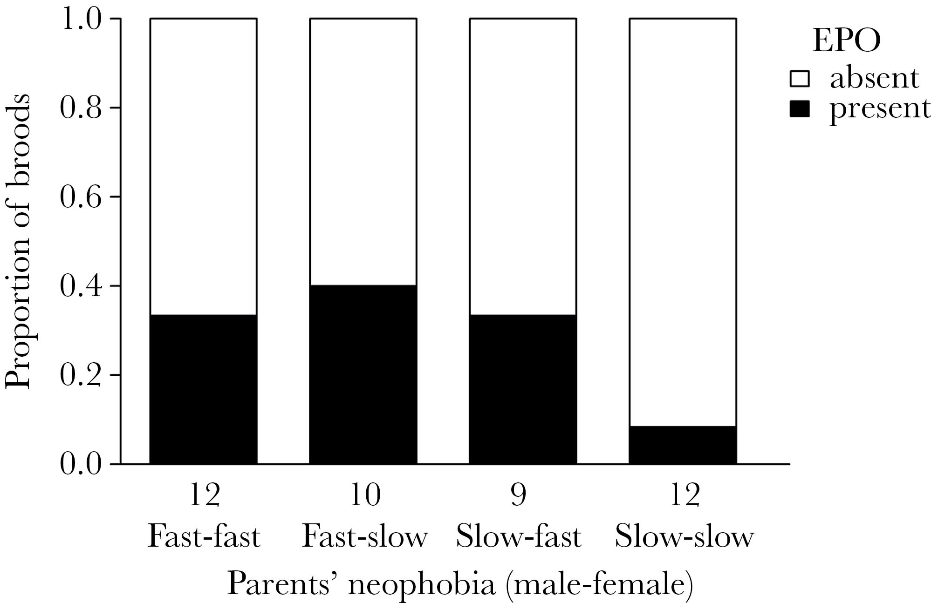
Figure 2 Proportion of broods containing extra-pair offspring (EPO), in relation to the rearing parents’ neophobia. ...
Notes:
Figure 2 Proportion of broods containing extra-pair offspring (EPO), in relation to the rearing parents’ neophobia. For illustrative purposes, neophobia of each sex was dichotomized as “fast” (i.e. shorter than median latency to enter nest box in presence of novel object) or “slow” (≥ median latency). Numbers below the bars denote sample sizes.
Unless provided in the caption above, the following copyright applies to the content of this slide: © The Author 2017. Published by Oxford University Press on behalf of the International Society for Behavioral Ecology. All rights reserved. For permissions, please e-mail: journals.permissions@oup.com

