Slide 1
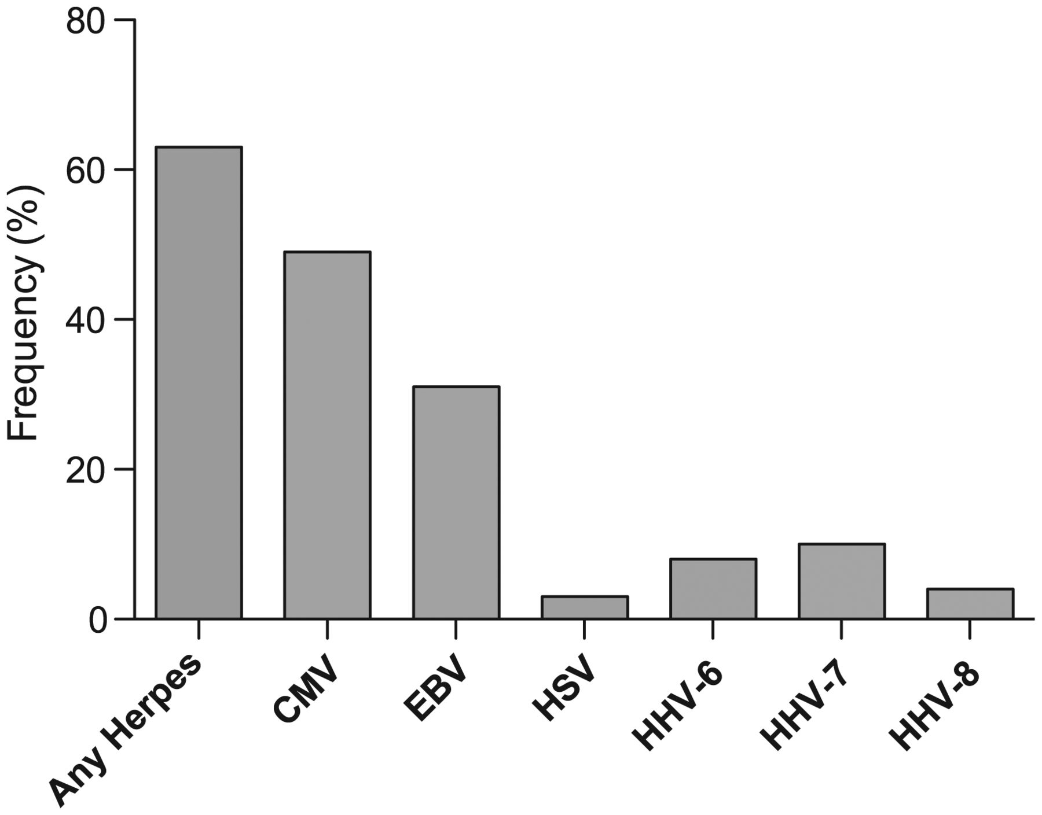
Figure 1. Viral frequencies in semen for each human immunodeficiency virus type 1–infected subject (N = 114). Frequency ...
Notes:
Figure 1. Viral frequencies in semen for each human immunodeficiency virus type 1–infected subject (N = 114). Frequency (%) of patients having at least 1 semen sample positive for any herpesvirus DNA, and for each individual tested virus separately. Note that human herpesvirus (HSV) only refers to HSV type 2, as no HSV type 1 was detected in this cohort. Abbreviations: CMV, cytomegalovirus; EBV, Epstein-Barr virus; HHV, human herpesvirus; HSV, herpes simplex virus.
Unless provided in the caption above, the following copyright applies to the content of this slide: © The Author 2013. Published by Oxford University Press on behalf of the Infectious Diseases Society of America. All rights reserved. For Permissions, please e-mail: journals.permissions@oup.com.

