Slide 1
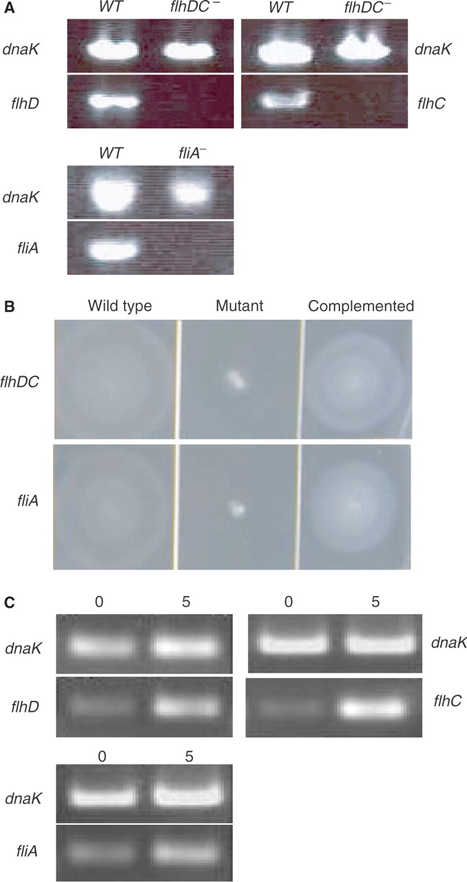
Figure 1. Confirmation of FlhDC and σ^{F} deletion and overexpression in respective strains. (A) RT-PCR ...
Notes:
Figure 1. Confirmation of FlhDC and σF deletion and overexpression in respective strains. (A) RT-PCR analysis of flhD, flhC and fliA expression in deletion strains. RNA isolated from each strain was converted to cDNA and PCR-amplified with primers specific for flhD, flhC and fliA. DnaK served as positive control. Expression of DnaK can be detected by RT-PCR in the wild-type strain as well as in flhDC and fliA mutant strains. Expression of flhD, flhC or fliA can only be detected in wild-type strain, but the expression of these genes is absent in the respective mutants. (B) Motility in E. coli wild-type strain and flhDC and fliA mutant strains. The flhDC and fliA deletion strains lose their motility on soft tryptone swarm agar. The motility can be recovered from these mutant strains by in vivo expression of FlhDC or σF from a plasmid-borne flhDC or fliA gene, respectively. (C) RT-PCR analysis of flhD, flhC and fliA expression in overexpression strains. Compared with the transcript level of control (dnaK), a significant increase of transcripts of flhD, flhC and fliA expression can be seen after a 5-min induction.
Unless provided in the caption above, the following copyright applies to the content of this slide: © 2007 The Author(s)This is an Open Access article distributed under the terms of the Creative Commons Attribution Non-Commercial License (http://creativecommons.org/licenses/by-nc/2.0/uk/) which permits unrestricted non-commercial use, distribution, and reproduction in any medium, provided the original work is properly cited.

Slide 2
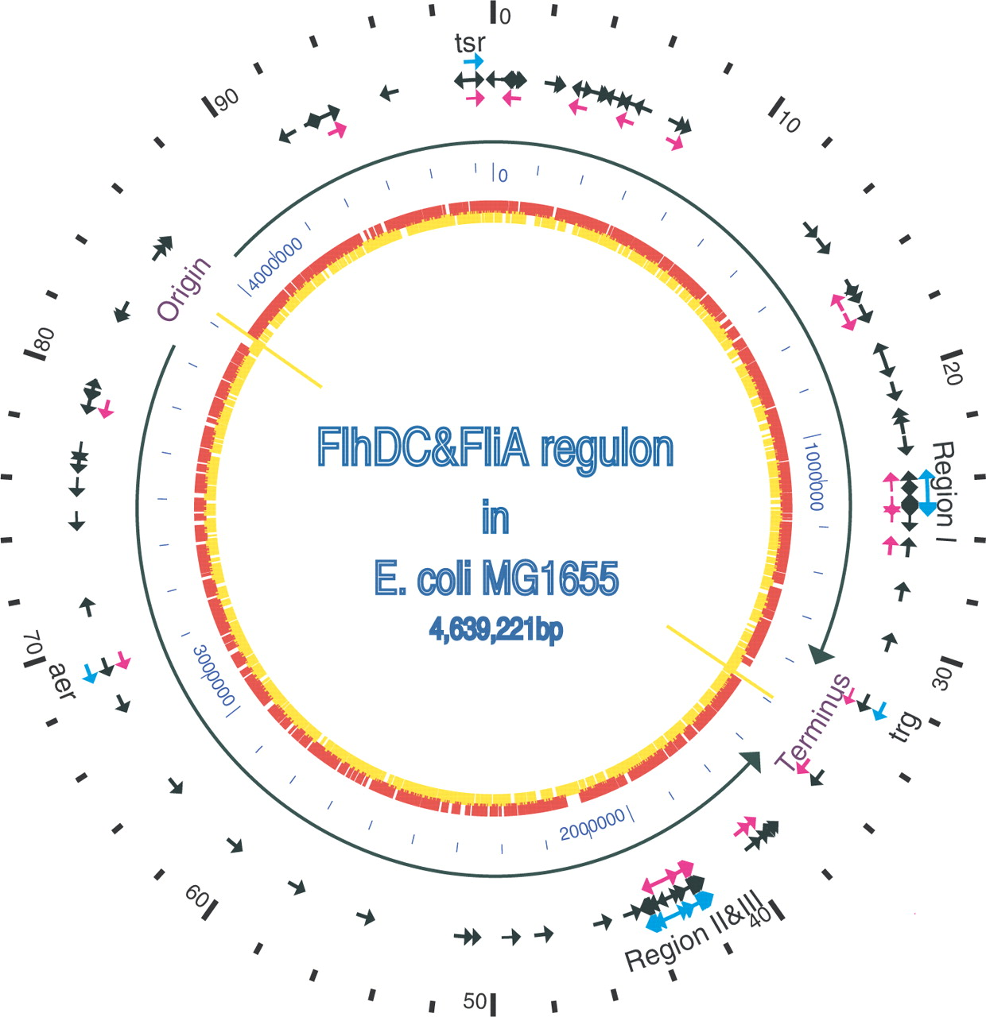
Figure 2. The location and transcription direction of genes in the FlhDC and FliA regulons on the map of the E. coli ...
Notes:
Figure 2. The location and transcription direction of genes in the FlhDC and FliA regulons on the map of the E. coli genome. The outer scale point circle indicates the coordinates in minutes (100 equals intervals of DNA). Blue arrows show the locations and directions of transcription of 53 known flagellar regulon genes. Most of these genes are located in regions I, II and III (i.e. at 24, 42 and 43 min in centisomes, respectively), except three chemotaxis genes trg, aer and tsr, which are at 32, 69, 98 min, respectively. The black arrows show all the genes (117) in FlhDC regulon that were identified by our microarray studies, which include all the previously known flagellar-related genes. The pink arrows show 37 σF-dependent genes identified in our microarray studies. These include all 21 previous known σF-controlled genes in flagellar system. The origin and terminus of replication are shown as yellow lines, with black arrows indicating replichores. The next point circle in light blue gives the scale in base pairs. The inner circle shows ORFs distribution on two complement DNA strands as presented in (24).
Unless provided in the caption above, the following copyright applies to the content of this slide: © 2007 The Author(s)This is an Open Access article distributed under the terms of the Creative Commons Attribution Non-Commercial License (http://creativecommons.org/licenses/by-nc/2.0/uk/) which permits unrestricted non-commercial use, distribution, and reproduction in any medium, provided the original work is properly cited.

Slide 3
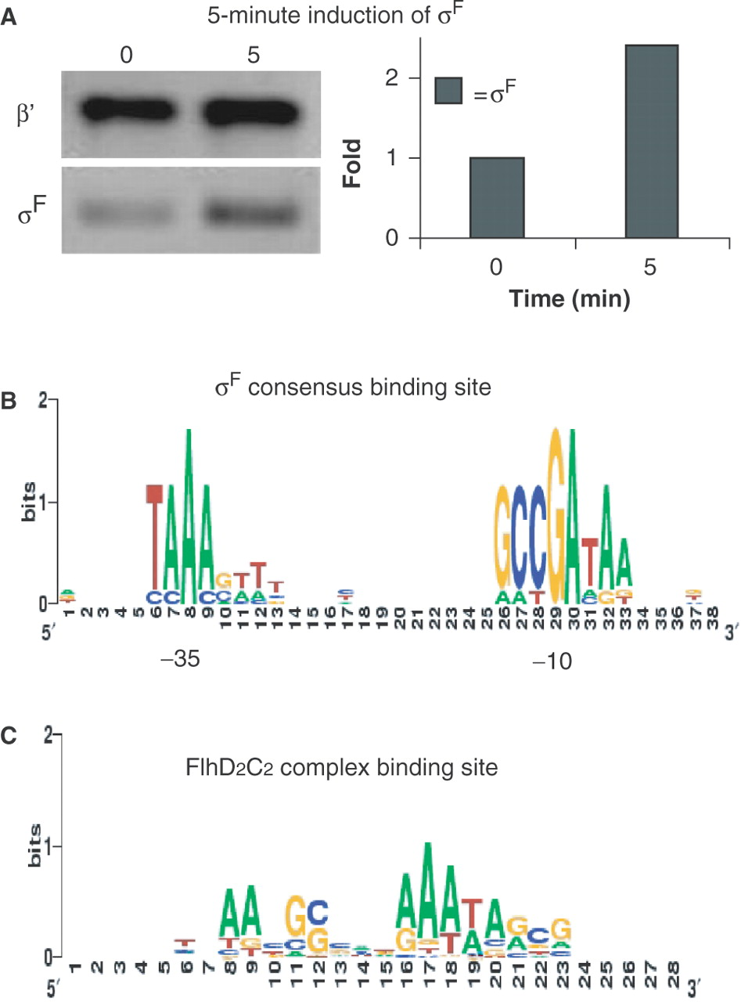
Figure 3. Determination the σ^{F} protein level and the consensus-binding sites of σ^{F} and FlhDC ...
Notes:
Figure 3. Determination the σF protein level and the consensus-binding sites of σF and FlhDC complex. (A) Left: Western blot of β' and σF before and 5 min after induction. β′-subunit of core RNA polymerase served as an internal control. Right: quantification of Western blot. The σF protein level increases approximately 2.3-fold after 5 min of induction. Signal intensities are determined using ImageQuant version 5.2 software. (B) The two-block promoter element recognized by σF is aligned using BioProspector (36) from the upstream sequence of σF-dependent genes identified in our microarray data and displayed using SEQUENCE LOGO (59). (C) The FlhDC-related DNA-binding element is aligned using BioProspector from the upstream sequence of FlhDC-dependent genes identified in our microarray data and displayed using SEQUENCE LOGO. The height of each column reflects the non-random bias of particular residues at that position, the size of each residue letter reflects its frequency at that position.
Unless provided in the caption above, the following copyright applies to the content of this slide: © 2007 The Author(s)This is an Open Access article distributed under the terms of the Creative Commons Attribution Non-Commercial License (http://creativecommons.org/licenses/by-nc/2.0/uk/) which permits unrestricted non-commercial use, distribution, and reproduction in any medium, provided the original work is properly cited.

Slide 4
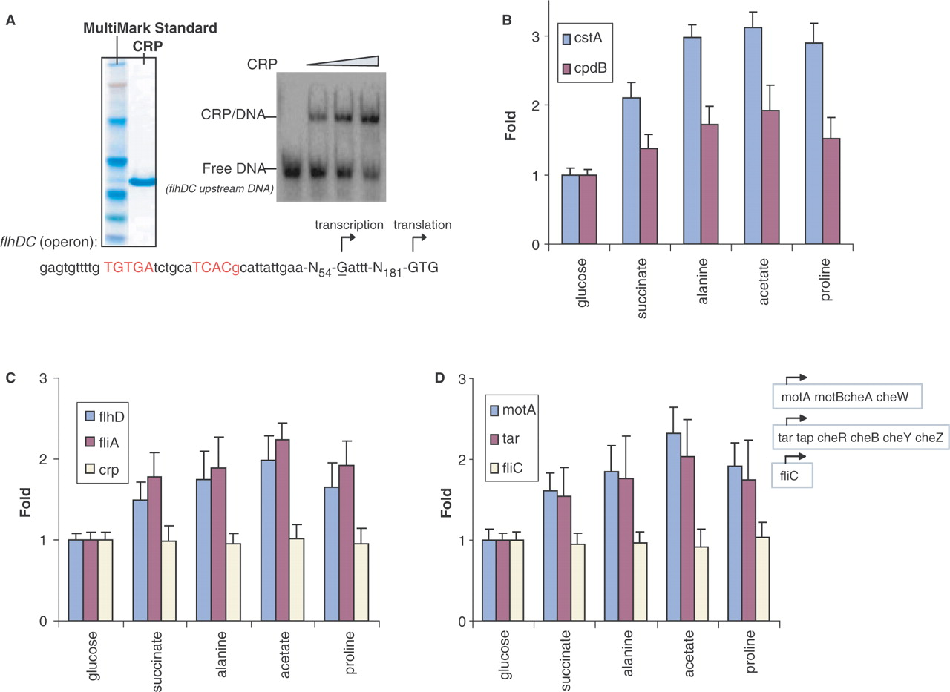
Figure 5. Carbon source effects on cell motility through activation of CRP. (A) SDS–PAGE gel shows purified CRP protein ...
Notes:
Figure 5. Carbon source effects on cell motility through activation of CRP. (A) SDS–PAGE gel shows purified CRP protein as well as MultiMark Standard and native gel shift assays show the binding of CRP to upstream DNA fragment of FlhDC operon. The palindromic consensus DNA-binding site for CRP dimer is shown in red. (B) The transcript abundance of two CRP-dependent genes, cstA and cpdB, in cells grown on different carbon sources. (C) The transcript abundance of flhD, fliA and crp in cells grown on different carbon sources. (D) The transcript abundance of σF-dependent genes, motA, tar and fliC, in cells grown on different carbon sources. Note, these carbon sources are of differing quality as defined by the resulting log-phase growth rates which are 0.97 generation h−1 in glucose, 0.50 generation h−1 in succinate, 0.34 generation h−1 in alanine, 0.21 generation h−1 in acetate and 0.13 generation h−1 in proline.
Unless provided in the caption above, the following copyright applies to the content of this slide: © 2007 The Author(s)This is an Open Access article distributed under the terms of the Creative Commons Attribution Non-Commercial License (http://creativecommons.org/licenses/by-nc/2.0/uk/) which permits unrestricted non-commercial use, distribution, and reproduction in any medium, provided the original work is properly cited.

Slide 5
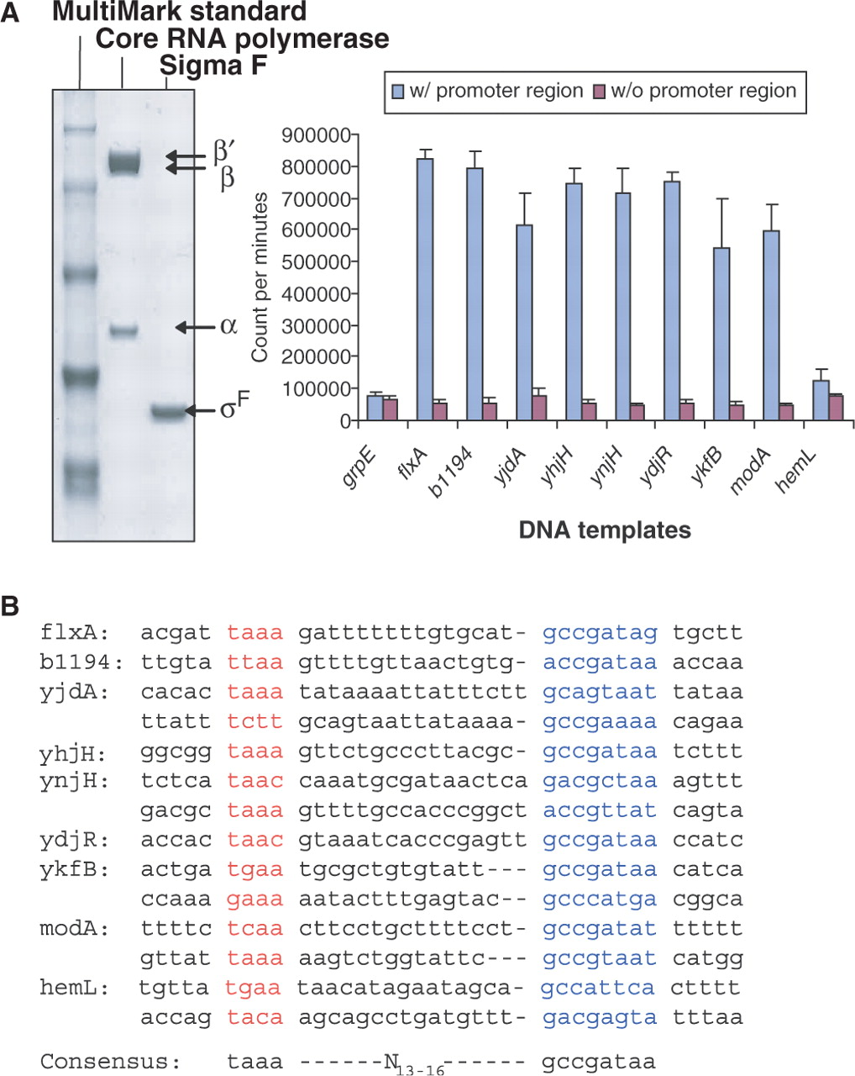
Figure 4. In vitro transcription assays to test the transcription by σ^{F} holoenzyme of the DNA fragments ...
Notes:
Figure 4. In vitro transcription assays to test the transcription by σF holoenzyme of the DNA fragments carrying putative promoter element(s). (A) SDS–PAGE gel shows purified core RNA polymerase and σF as well as MultiMark Standard. In vitro transcription assays are performed using purified σF-associated holoenzyme with DNA fragments from the upstream sequence of candidate σF-dependent genes. The upstream sequence of grpE served as a negative control. Error bars represent standard deviation in three different experiments. (B) Potential σF consensus-binding sites of each gene are predicted and aligned by computer program. Previously known σF two-block promoter element consensus is shown below.
Unless provided in the caption above, the following copyright applies to the content of this slide: © 2007 The Author(s)This is an Open Access article distributed under the terms of the Creative Commons Attribution Non-Commercial License (http://creativecommons.org/licenses/by-nc/2.0/uk/) which permits unrestricted non-commercial use, distribution, and reproduction in any medium, provided the original work is properly cited.

