Slide 1
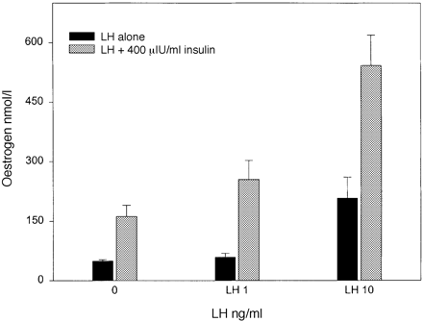
Figure 1. Additive stimulatory effect of LH and insulin on oestrogen production. The black columns show the effect of ...
Notes:
Figure 1. Additive stimulatory effect of LH and insulin on oestrogen production. The black columns show the effect of LH alone. Grey columns illustrate the stimulatory effect of 400 μIU/ml insulin alone and in combination with LH. Each column represents the mean ± SEM of three independent experiments with three replicates per experiment.
Unless provided in the caption above, the following copyright applies to the content of this slide: © European Society of Human Reproduction and Embryology

Slide 2
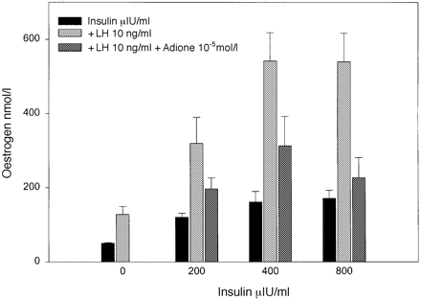
Figure 2. Effect on the oestrogen production of different combinations of insulin, LH and androstenedione (Adione). The ...
Notes:
Figure 2. Effect on the oestrogen production of different combinations of insulin, LH and androstenedione (Adione). The black columns illustrate the stimulatory effect of insulin (0–800 μIU /ml). The light-grey columns show the effect of 10 ng/ml LH alone and in combination with rising concentrations of insulin, and the dark-grey columns represent the inhibitory consequence of androstenedione (10–5 mol/l) on insulin + LH stimulated estrogen production in human granulosa cells. Each column represents the mean ± SEM of three independent experiments with three replicates per experiment.
Unless provided in the caption above, the following copyright applies to the content of this slide: © European Society of Human Reproduction and Embryology

Slide 3
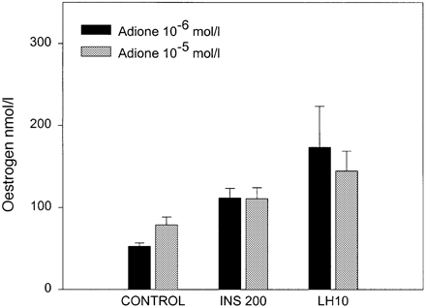
Figure 3. Effect of androstenedione (Adione) (10^{–6} and 10^{–5} mol/l) on basal and stimulated (200 ...
Notes:
Figure 3. Effect of androstenedione (Adione) (10–6 and 10–5 mol/l) on basal and stimulated (200 μIU/ml insulin and 10 ng/ml LH) oestrogen production in human granulosa cells. Each column represents the mean ± SEM of three independent experiments with three replicates per experiment.
Unless provided in the caption above, the following copyright applies to the content of this slide: © European Society of Human Reproduction and Embryology

Slide 4
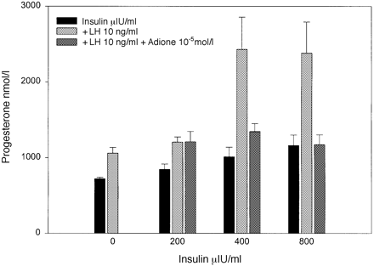
Figure 4. Effect of different combinations of insulin, LH and androstenedione (Adione) on the progesterone production. ...
Notes:
Figure 4. Effect of different combinations of insulin, LH and androstenedione (Adione) on the progesterone production. The black columns illustrate the stimulatory effect of insulin(0–800 μIU/ml). The light-grey columns show the effect of LH(10 ng/ml) alone and in combination with increasing concentrations of insulin, and the dark-grey columns represent the inhibitory influence of androstenedione (10–5 mol/l) on insulin + LH stimulated progesterone production in human granulosa cells. Each column represents the mean ± SE of three independent experiments with three replicates per experiment.
Unless provided in the caption above, the following copyright applies to the content of this slide: © European Society of Human Reproduction and Embryology

