Slide 1
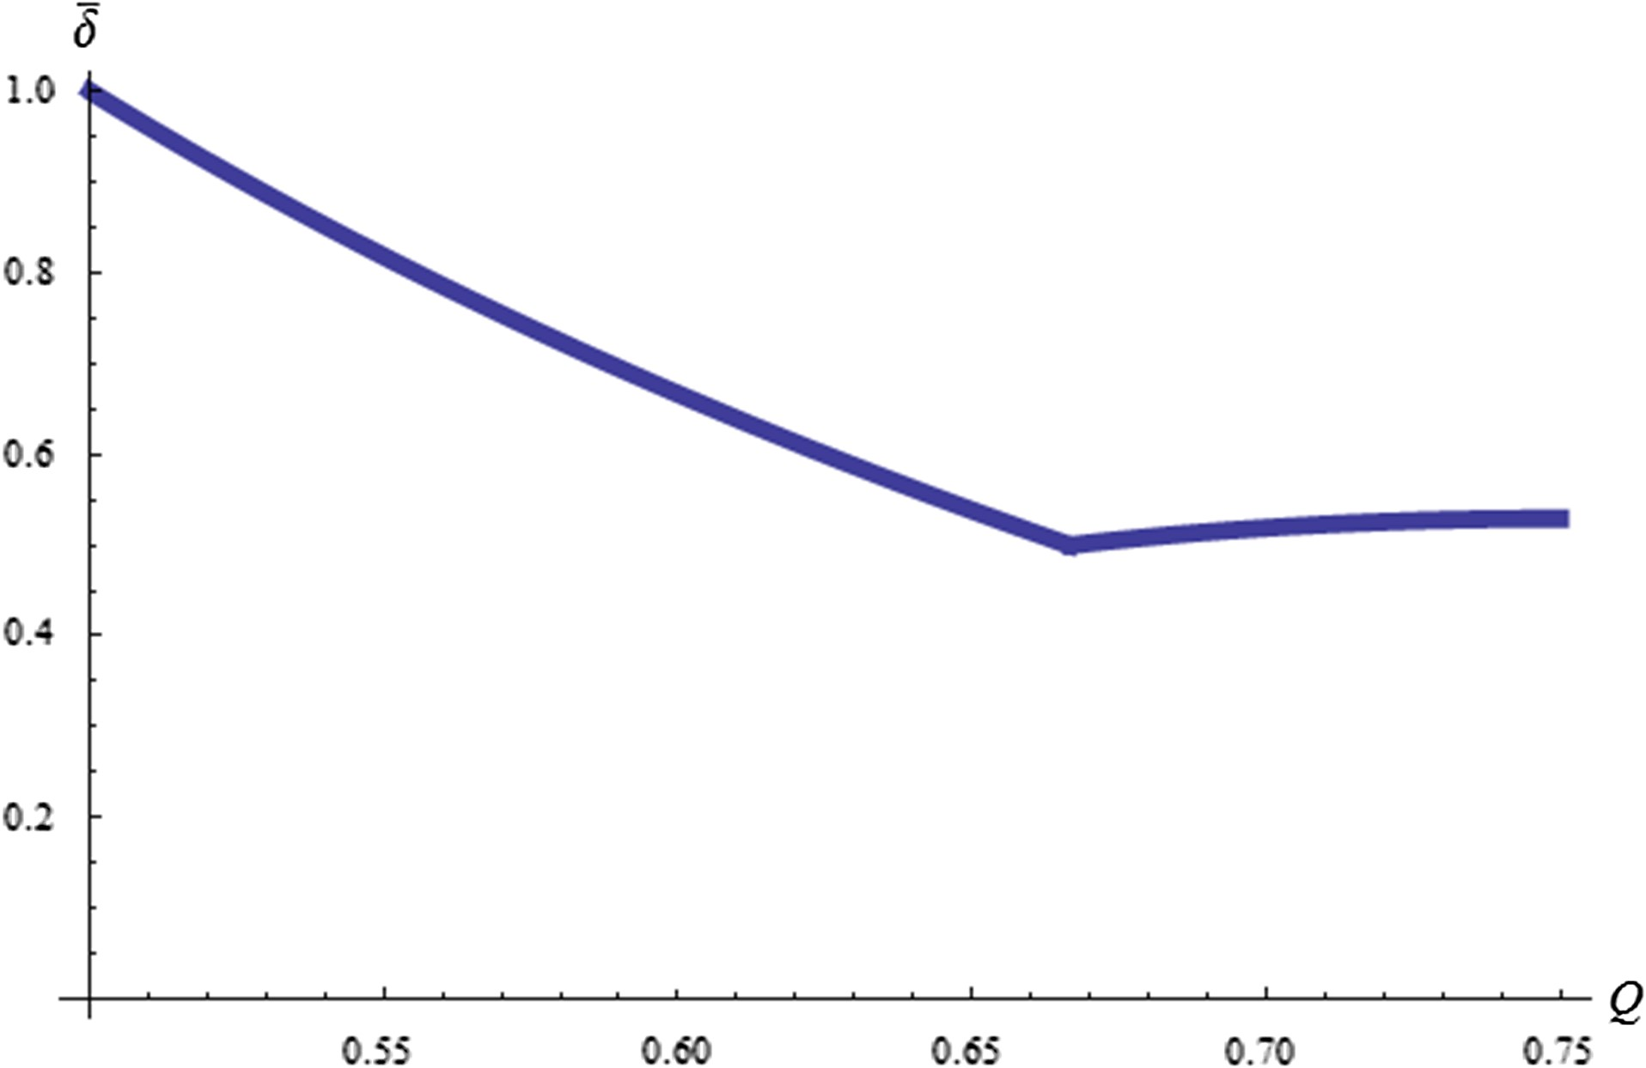
Figure 1. Relationship between total industry capacity Q and δ̅
Notes:
Figure 1. Relationship between total industry capacity Q and δ̅
Unless provided in the caption above, the following copyright applies to the content of this slide: © The Author 2016. Published by Oxford University Press. All rights reserved. For permissions, please e-mail: journals.permissions@oup.com

