Slide 1
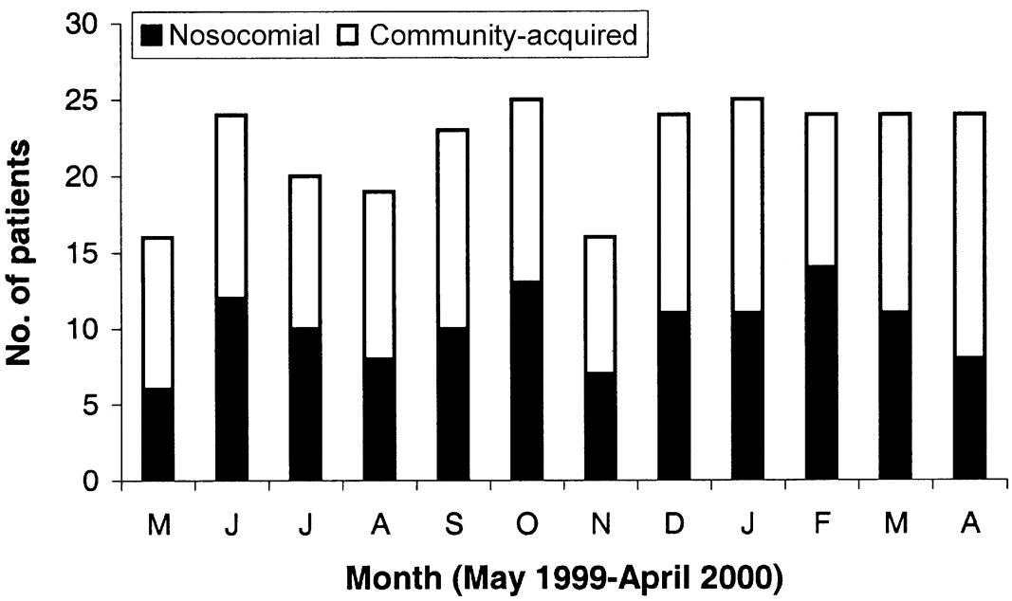
Figure 1 Occurrence of invasive Staphylococcus aureus infections in Calgary, Canada (May 1999 to April 2000). Data are ...
Notes:
Figure 1 Occurrence of invasive Staphylococcus aureus infections in Calgary, Canada (May 1999 to April 2000). Data are no. of patients with nosocomial and community-acquired infections
Unless provided in the caption above, the following copyright applies to the content of this slide: © 2003 by the Infectious Diseases Society of America

Slide 2
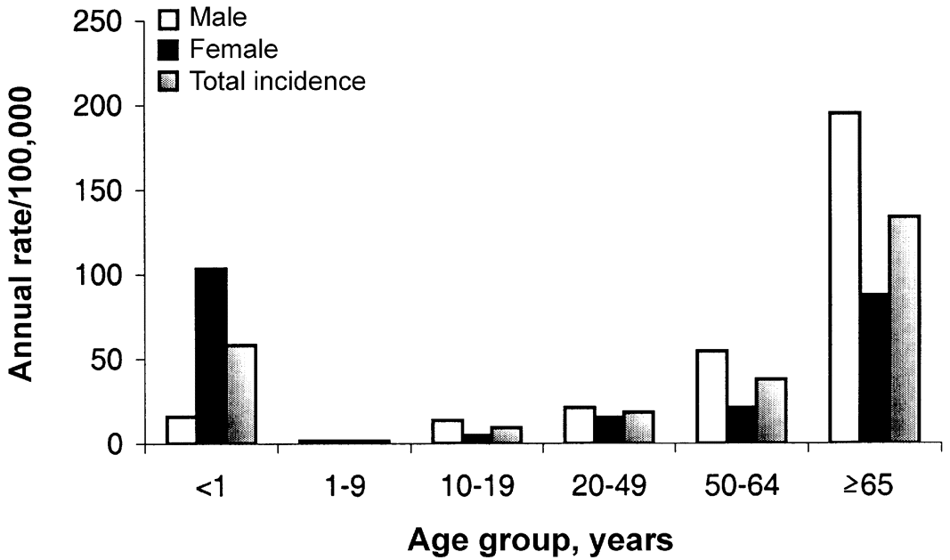
Figure 2 Age-specific incidence of invasive Staphylococcus aureus infections in Calgary, Canada (May 1999 to April ...
Notes:
Figure 2 Age-specific incidence of invasive Staphylococcus aureus infections in Calgary, Canada (May 1999 to April 2000). Data are annual incidence per 100,000 population
Unless provided in the caption above, the following copyright applies to the content of this slide: © 2003 by the Infectious Diseases Society of America

Slide 3
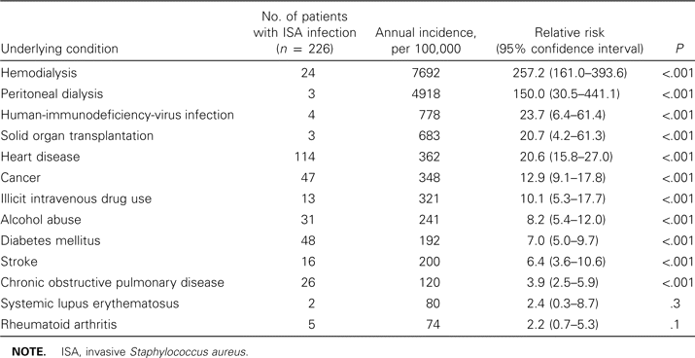
Table 1 Risk of invasive Staphylococcus aureus infection, associated with selected underlying conditions, in adults ...
Notes:
Table 1 Risk of invasive Staphylococcus aureus infection, associated with selected underlying conditions, in adults ⩾20 years old
Unless provided in the caption above, the following copyright applies to the content of this slide: © 2003 by the Infectious Diseases Society of America

Slide 4
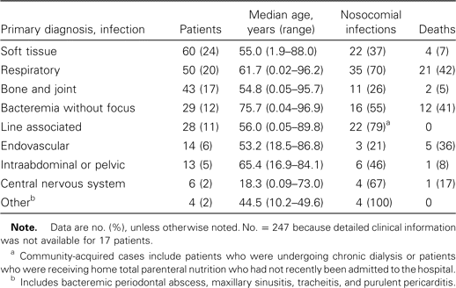
Table 2 Clinical diagnoses associated with invasive Staphylococcus aureus infections in 247 patients, in Calgary, ...
Notes:
Table 2 Clinical diagnoses associated with invasive Staphylococcus aureus infections in 247 patients, in Calgary, Canada (May 1999–April 2000)
Unless provided in the caption above, the following copyright applies to the content of this slide: © 2003 by the Infectious Diseases Society of America

Slide 5
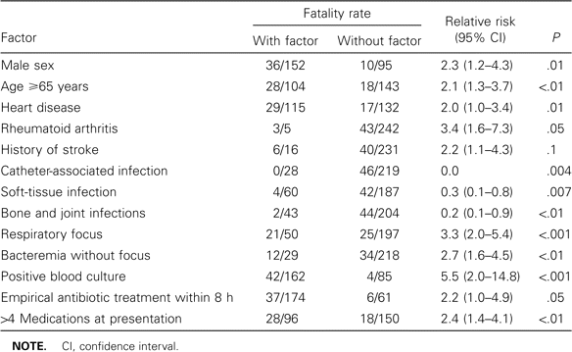
Table 3 Univariate analysis of significant (P⩽.1) predictive factors for death among patients with invasive ...
Notes:
Table 3 Univariate analysis of significant (P⩽.1) predictive factors for death among patients with invasive Staphylococcus aureus infections
Unless provided in the caption above, the following copyright applies to the content of this slide: © 2003 by the Infectious Diseases Society of America

Slide 6
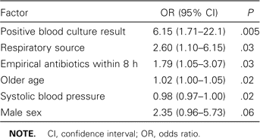
Table 4 Logistic-regression modeling of risk factors for mortality in patients with invasive Staphylococcus aureus ...
Notes:
Table 4 Logistic-regression modeling of risk factors for mortality in patients with invasive Staphylococcus aureus infections
Unless provided in the caption above, the following copyright applies to the content of this slide: © 2003 by the Infectious Diseases Society of America

