Slide 1
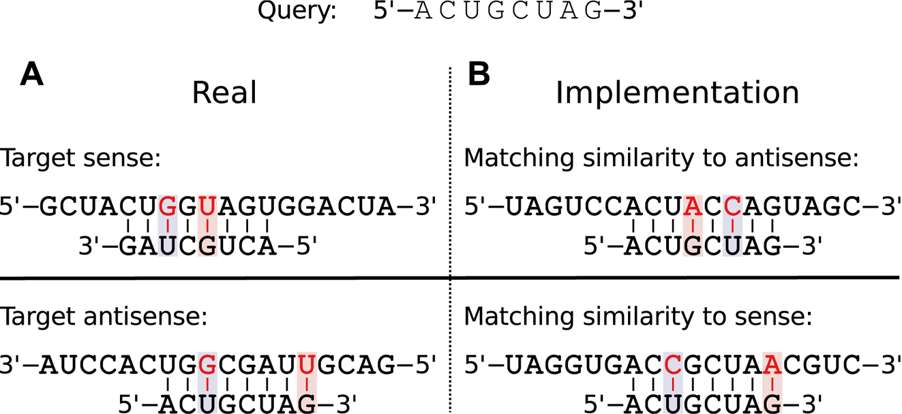
Figure 1. Match implementation. A sample query sequence is given on top. (A) How an interaction to the target sense and ...
Notes:
Figure 1. Match implementation. A sample query sequence is given on top. (A) How an interaction to the target sense and antisense strand might look (complementary and in anti-parallel direction), and (B) how it is implemented within RIsearch2 (identical and in parallel direction). The highlighted bases correspond to G−U wobble pairs.
Unless provided in the caption above, the following copyright applies to the content of this slide: © The Author(s) 2017. Published by Oxford University Press on behalf of Nucleic Acids Research.This is an Open Access article distributed under the terms of the Creative Commons Attribution License (http://creativecommons.org/licenses/by-nc/4.0/), which permits non-commercial re-use, distribution, and reproduction in any medium, provided the original work is properly cited. For commercial re-use, please contact journals.permissions@oup.com

Slide 2
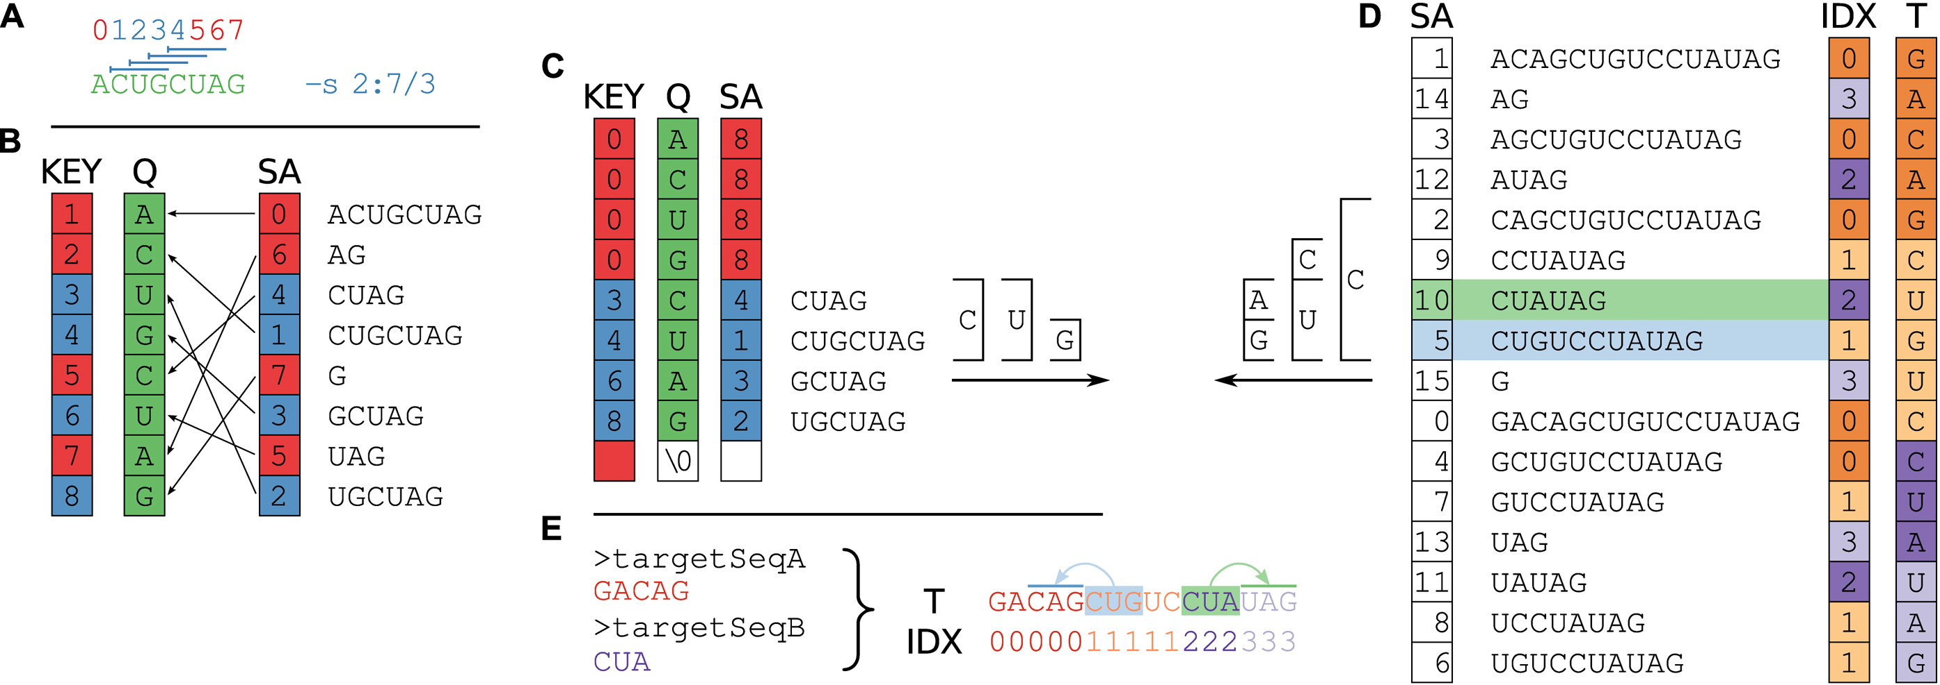
Figure 2. Suffix array preparation and matching. (A) The user provides a query (Q = ACUGCUAG of length m = 8) and ...
Notes:
Figure 2. Suffix array preparation and matching. (A) The user provides a query (Q = ACUGCUAG of length m = 8) and specifies the seed by either length, position, or both. The command-line parameter -s 2:7/3 requires a seed to be at least 3 nt long and located between positions 2–7 of the query. This allows for only four valid seed start locations, indicated with the blue lines above the query sequence. This corresponds to positions 1–4 in the 0-based index being valid start positions that satisfy the seed requirements, colored blue. Seeds starting in any other position would violate the seed requirements and are colored red. (B) A suffix array of the query ($\mathit {SA}$) is constructed, containing the starting positions of suffixes of Q in lexicographical order. $\mathit {KEY}$ holds a running number; boxes are colored blue if the suffixes satisfy the seed requirements, red otherwise. Q is stored as the original sequence, regardless of the $\mathit {SA}$ order. (C) Suffixes that violate the seed requirement (see A) are set to zero in $\mathit {KEY}$ and m in $\mathit {SA}$, pointing to the null terminator. The array is then re-sorted based on $\mathit {KEY}$. This ensures that all discarded suffixes are moved to the beginning of the array, while all valid suffixes are still sorted in lexicographical order. (D) The target $\mathit {SA}$ is built from the concatenated sequences, as shown in Supplementary Figure 1. $\mathit {IDX}$ is sorted according to $\mathit {SA}$ order, while T is stored in order of the original sequence. For both query and target SA, we find the intervals of suffixes starting with each nucleotide. In the example, we show the suffixes starting with C and further traverse both SAs as long as there are corresponding non-empty intervals (between (C) and (D)), until the minimum seed length is reached. We find two positions in the target that match the CUG in the query, highlighted in light green and blue respectively. Note that the query suffix CUAG would also match the target CUA, but not CUG. (E) The match with $\mathit {IDX}$ 2 (light green) refers to a target site in the reverse complement sequence 3, and likewise $\mathit {IDX}$ 1 to a target site in 0 (light blue).
Unless provided in the caption above, the following copyright applies to the content of this slide: © The Author(s) 2017. Published by Oxford University Press on behalf of Nucleic Acids Research.This is an Open Access article distributed under the terms of the Creative Commons Attribution License (http://creativecommons.org/licenses/by-nc/4.0/), which permits non-commercial re-use, distribution, and reproduction in any medium, provided the original work is properly cited. For commercial re-use, please contact journals.permissions@oup.com

Slide 3
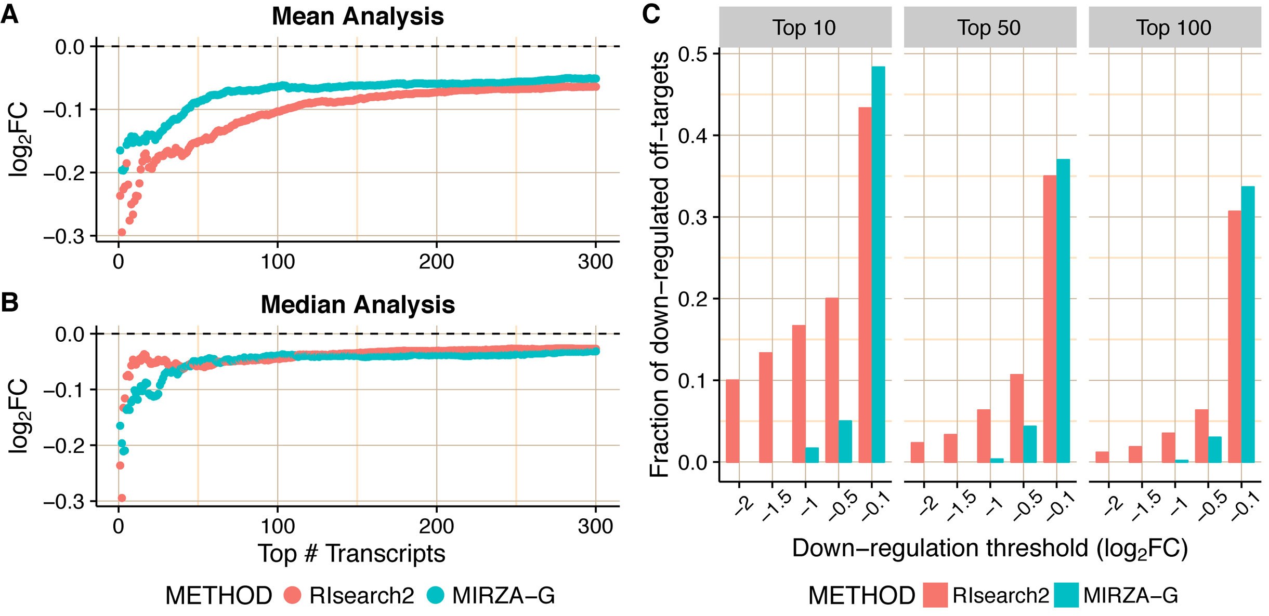
Figure 3. Evaluation of individual off-target predictions performed by RIsearch2 (siRNA off-targets pipeline) and ...
Notes:
Figure 3. Evaluation of individual off-target predictions performed by RIsearch2 (siRNA off-targets pipeline) and MIRZA-G. All analyses are based on the Burchard dataset where six APOB siRNAs were transfected into PLC/PRF/5 cell lines. Top off-targets are selected from method-specific predictions based on the confidence scores generated by either method ($p_{\mathit {off}\!\!,\:j}$ for RIsearch2). In the mean (A) and the median (B) fold changes analyses, mean/median differential expression level (averaged over all siRNAs) of top off-targets are plotted for different numbers of top off-targets considered. (C) Proportion of critical off-targets within the top (10, 50, 100) predictions generated by either method for six siRNAs, i.e. considering 60 transcripts in total for top 10. Off-targets are considered critical if they are downregulated, upon the transfection of siRNA, with a log2FC value lower than the threshold given in the x-axis.
Unless provided in the caption above, the following copyright applies to the content of this slide: © The Author(s) 2017. Published by Oxford University Press on behalf of Nucleic Acids Research.This is an Open Access article distributed under the terms of the Creative Commons Attribution License (http://creativecommons.org/licenses/by-nc/4.0/), which permits non-commercial re-use, distribution, and reproduction in any medium, provided the original work is properly cited. For commercial re-use, please contact journals.permissions@oup.com

Slide 4
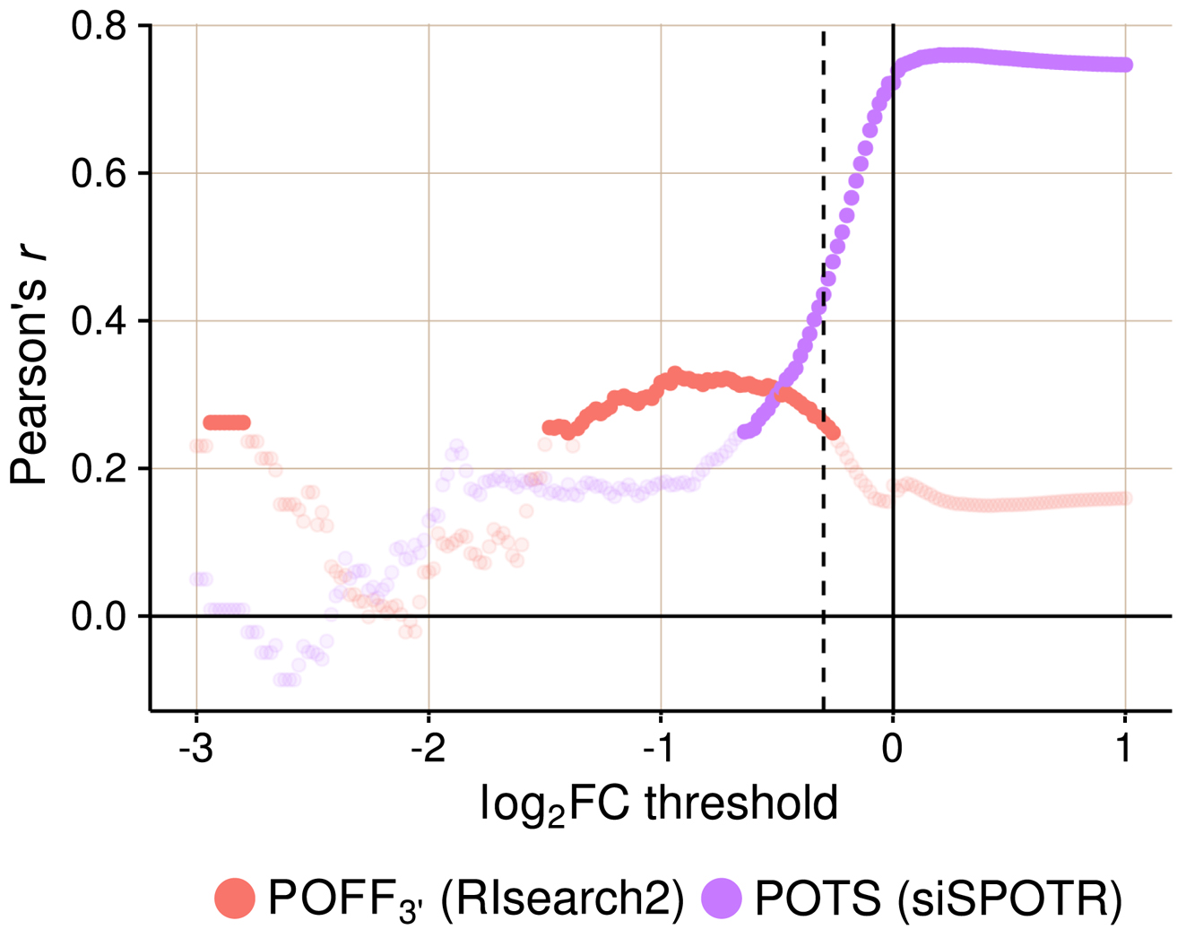
Figure 4. Evaluation of predicted off-targeting potential measures with siRNA-specific differential expression data ...
Notes:
Figure 4. Evaluation of predicted off-targeting potential measures with siRNA-specific differential expression data from 63 siRNA transfection experiments. Pearson's r is given for each correlation analysis between method-specific off-targeting potential measure, RIsearch2-based $\mathit {POFF}_{3^{\prime }}$ or siSPOTR-based $\mathit {POTS}$, and threshold-specific expression-based off-targeting potential measure of 63 siRNAs. The expression-based measure corresponds to the number of transcripts that have a complementary heptamer to the siRNA seed region in their 3΄ UTR and are differentially expressed upon siRNA transfection with a log2FC value lower than the threshold given on the x-axis. Only significant correlations (P-value < 0.05) are highlighted and the log2FC threshold −0.3, which is the evaluation threshold employed in the siSPOTR study, is shown with a dashed line.
Unless provided in the caption above, the following copyright applies to the content of this slide: © The Author(s) 2017. Published by Oxford University Press on behalf of Nucleic Acids Research.This is an Open Access article distributed under the terms of the Creative Commons Attribution License (http://creativecommons.org/licenses/by-nc/4.0/), which permits non-commercial re-use, distribution, and reproduction in any medium, provided the original work is properly cited. For commercial re-use, please contact journals.permissions@oup.com

Slide 5
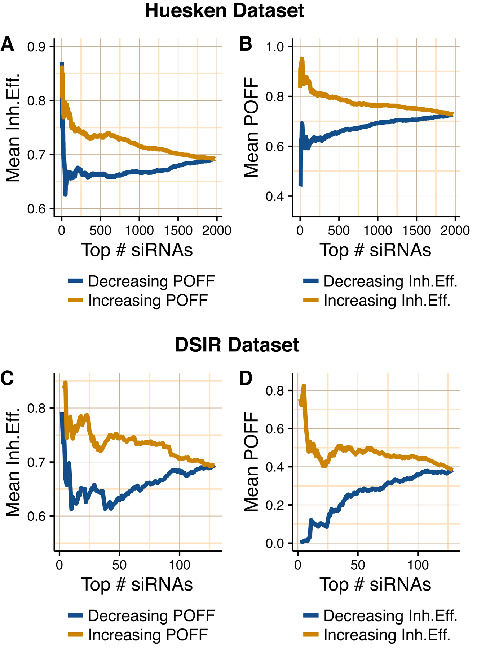
Figure 5. Relationship between inhibition efficiency (Inh.Eff.) and off-targeting potential measure $\mathit {POFF}$ of ...
Notes:
Figure 5. Relationship between inhibition efficiency (Inh.Eff.) and off-targeting potential measure $\mathit {POFF}$ of siRNAs from Huesken (A and B) and DSIR (C and D) datasets. A and C show the mean Inh.Eff. of top n siRNAs when siRNAs are ranked by $\mathit {POFF}$ measure in increasing and decreasing order. B and D show the mean $\mathit {POFF}$ measure of top n siRNAs when siRNAs are ranked by Inh.Eff. in increasing and decreasing order. Note that y-axes are not in the same scale.
Unless provided in the caption above, the following copyright applies to the content of this slide: © The Author(s) 2017. Published by Oxford University Press on behalf of Nucleic Acids Research.This is an Open Access article distributed under the terms of the Creative Commons Attribution License (http://creativecommons.org/licenses/by-nc/4.0/), which permits non-commercial re-use, distribution, and reproduction in any medium, provided the original work is properly cited. For commercial re-use, please contact journals.permissions@oup.com

Slide 6
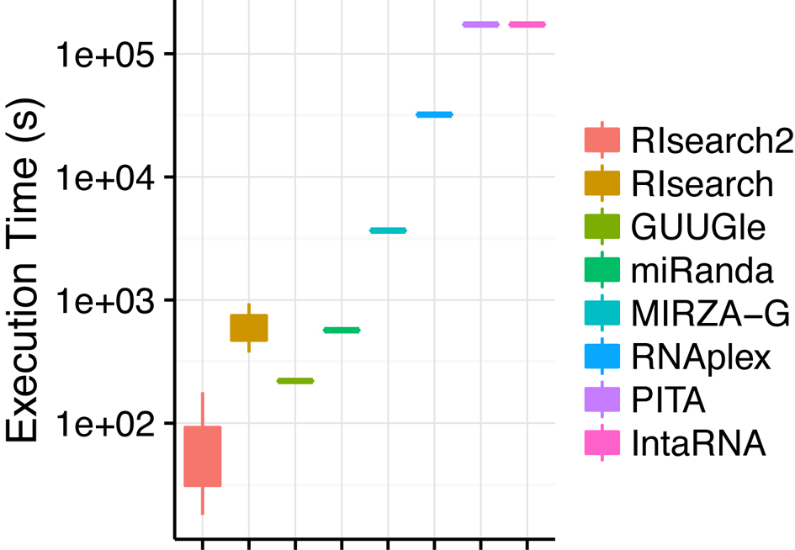
Figure 6. Execution time comparison of RNA–RNA interaction prediction tools on a small test set (63 siRNAs versus ∼6000 ...
Notes:
Figure 6. Execution time comparison of RNA–RNA interaction prediction tools on a small test set (63 siRNAs versus ∼6000 transcripts and their antisense). Executions involve different parameter settings of RIsearch2 and RIsearch methods and actual execution time of PITA and IntaRNA tools are longer than it is shown here (they have been aborted after running for more than 2 days).
Unless provided in the caption above, the following copyright applies to the content of this slide: © The Author(s) 2017. Published by Oxford University Press on behalf of Nucleic Acids Research.This is an Open Access article distributed under the terms of the Creative Commons Attribution License (http://creativecommons.org/licenses/by-nc/4.0/), which permits non-commercial re-use, distribution, and reproduction in any medium, provided the original work is properly cited. For commercial re-use, please contact journals.permissions@oup.com

