Slide 1
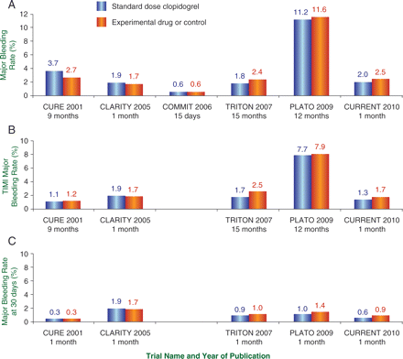
Figure 1 Rates of major bleeding episodes in phase III trials according to: (A) Primary endpoint bleeding definition ...
Notes:
Figure 1 Rates of major bleeding episodes in phase III trials according to: (A) Primary endpoint bleeding definition described in study publication. The PLATO and TRITON-TIMI 38 data shown are annualized Kaplan–Meier estimates, as reported in the primary study publications. (B) Thrombolysis in myocardial infarction major bleeding definition. (C) Thrombolysis in myocardial infarction major bleeding definition (or closest equivalent) on day 30. Thrombolysis in myocardial infarction major bleeding criteria were used for CLARITY-TIMI 28. Non-coronary artery bypass graft thrombolysis in myocardial infarction major bleeding criteria were used for CURE, TRITON-TIMI 38 and CURRENT-OASIS 7. Non-procedure-related PLATO major bleeding rates were used. CURE21 and TRITON-TIMI 38 data were from unpublished data. PLATO data were estimated from Kaplan–Meier curve by visual inspection.
Unless provided in the caption above, the following copyright applies to the content of this slide: Published on behalf of the European Society of Cardiology. All rights reserved. © The Author 2011. For permissions please email: journals.permissions@oup.com

Slide 2
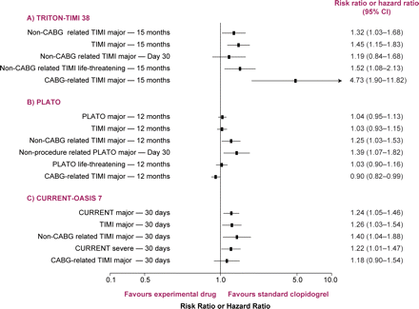
Figure 2 Impact of bleeding definition on estimates of the relative risk of bleeding in P2Y₁₂ inhibitor ...
Notes:
Figure 2 Impact of bleeding definition on estimates of the relative risk of bleeding in P2Y12 inhibitor trials in patients with acute coronary syndromes.
Unless provided in the caption above, the following copyright applies to the content of this slide: Published on behalf of the European Society of Cardiology. All rights reserved. © The Author 2011. For permissions please email: journals.permissions@oup.com

Slide 3
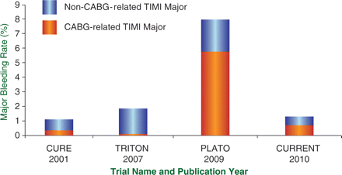
Figure 3 Proportion of Thrombolysis in myocardial infarction major bleeding events reported as coronary artery bypass ...
Notes:
Figure 3 Proportion of Thrombolysis in myocardial infarction major bleeding events reported as coronary artery bypass graft related and non-coronary artery bypass graft related in standard-dose clopidogrel treatment arms. Non-coronary artery bypass graft-related major bleeds and coronary artery bypass graft-related major bleeds are not mutually exclusive; therefore, the actual major bleeding rate may not equal the sum of the non-coronary artery bypass graft- and coronary artery bypass graft-related major bleeds. Coronary artery bypass graft.
Unless provided in the caption above, the following copyright applies to the content of this slide: Published on behalf of the European Society of Cardiology. All rights reserved. © The Author 2011. For permissions please email: journals.permissions@oup.com

