Slide 1
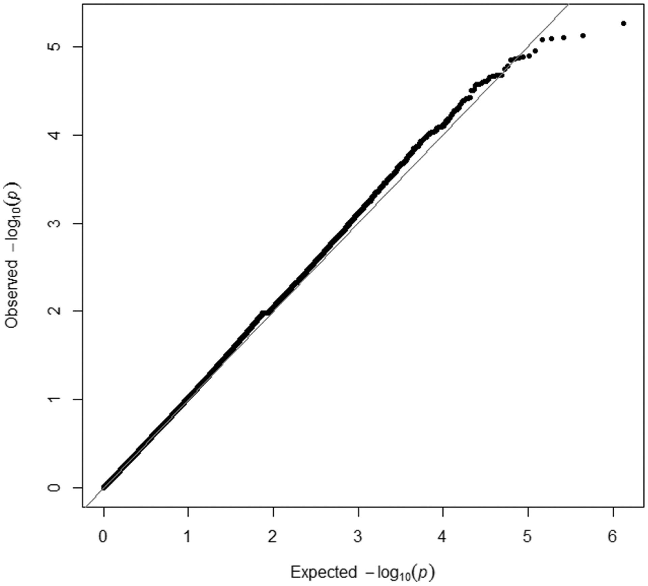
Figure 1. QQ plot of the whole sample ( n = 4432).
Notes:
Figure 1. QQ plot of the whole sample ( n = 4432).
Unless provided in the caption above, the following copyright applies to the content of this slide: © The Author 2016. Published by Oxford University Press. All rights reserved. For permissions, please e-mail: journals.permissions@oup.com

Slide 2
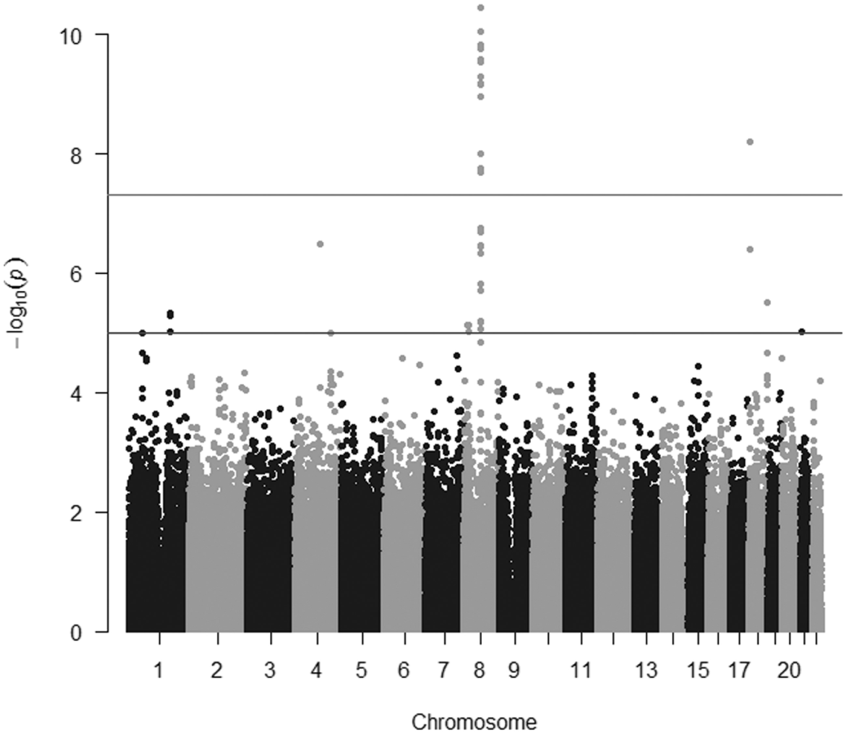
Figure 2. Manhattan plot (−log10[ P ] genome-wide association plot) of the GWAS on erythrocyte cadmium in 1728 never ...
Notes:
Figure 2. Manhattan plot (−log10[ P ] genome-wide association plot) of the GWAS on erythrocyte cadmium in 1728 never smoker individuals in the MDC-CV cohort.
Unless provided in the caption above, the following copyright applies to the content of this slide: © The Author 2016. Published by Oxford University Press. All rights reserved. For permissions, please e-mail: journals.permissions@oup.com

