Slide 1
Fig. 1. Interpretation of the matrix C^{k,l}(i,j).
Notes:
Fig. 1. Interpretation of the matrix Ck,l(i,j).
Unless provided in the caption above, the following copyright applies to the content of this slide: © 2008 The Author(s)This is an Open Access article distributed under the terms of the Creative Commons Attribution Non-Commercial License (http://creativecommons.org/licenses/by-nc/2.0/uk/) which permits unrestricted non-commercial use, distribution, and reproduction in any medium, provided the original work is properly cited.

Slide 2
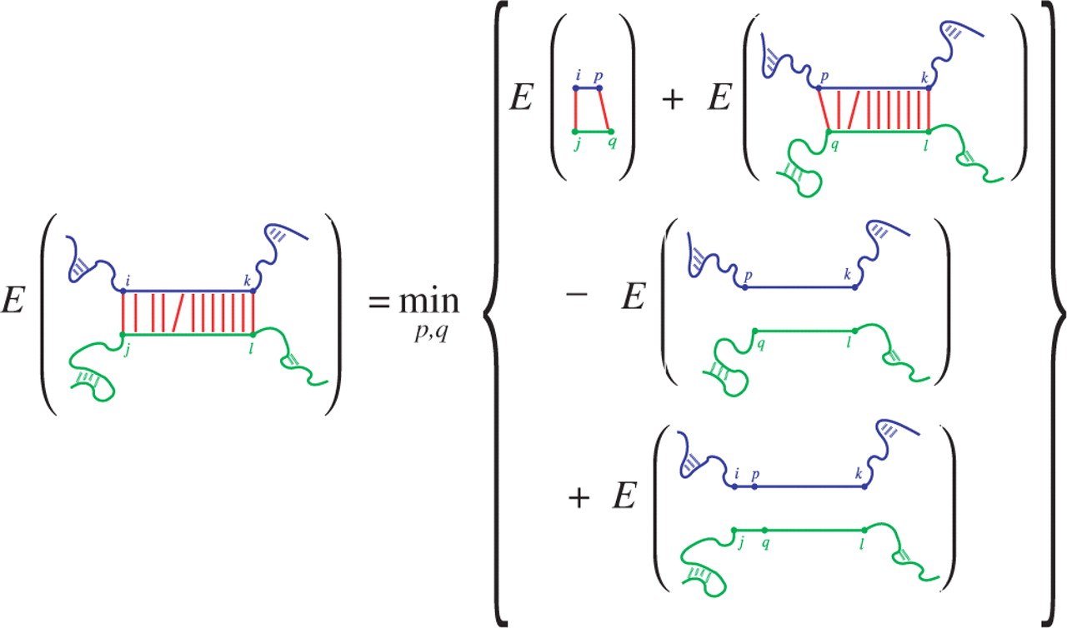
Fig. 2. Visualization of the recursion for C^{k,l}(i,j). The hybridized part is shown in red, while the ...
Notes:
Fig. 2. Visualization of the recursion for Ck,l(i,j). The hybridized part is shown in red, while the energy required to make the mRNA and the sRNA target site accessible (ED) is given in blue and green, respectively. Since ED-values are not additive, e.g. ED(i,k)≠ED(i,p)+ED(p,k), we need to substract ED(p,k) and ED(q,l), and add ED(i,k) and ED(j,l) to get the final result of Ck,l(i,j).
Unless provided in the caption above, the following copyright applies to the content of this slide: © 2008 The Author(s)This is an Open Access article distributed under the terms of the Creative Commons Attribution Non-Commercial License (http://creativecommons.org/licenses/by-nc/2.0/uk/) which permits unrestricted non-commercial use, distribution, and reproduction in any medium, provided the original work is properly cited.

Slide 3
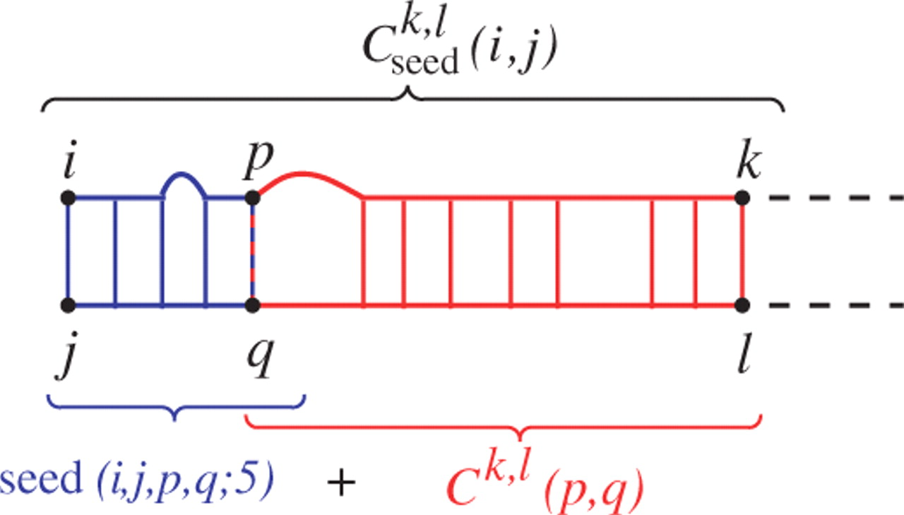
Fig. 3. C ^{k,l} _{seed}(i,j) matrix and its relation to the other ...
Notes:
Fig. 3. C k,l seed(i,j) matrix and its relation to the other matrices. Note that both Ck,l(p,q) and seed(i,j,p,q;5) consistently assume that (p,q) is a pair. Here, a seed of 5 bp and one unpaired base is shown.
Unless provided in the caption above, the following copyright applies to the content of this slide: © 2008 The Author(s)This is an Open Access article distributed under the terms of the Creative Commons Attribution Non-Commercial License (http://creativecommons.org/licenses/by-nc/2.0/uk/) which permits unrestricted non-commercial use, distribution, and reproduction in any medium, provided the original work is properly cited.

Slide 4
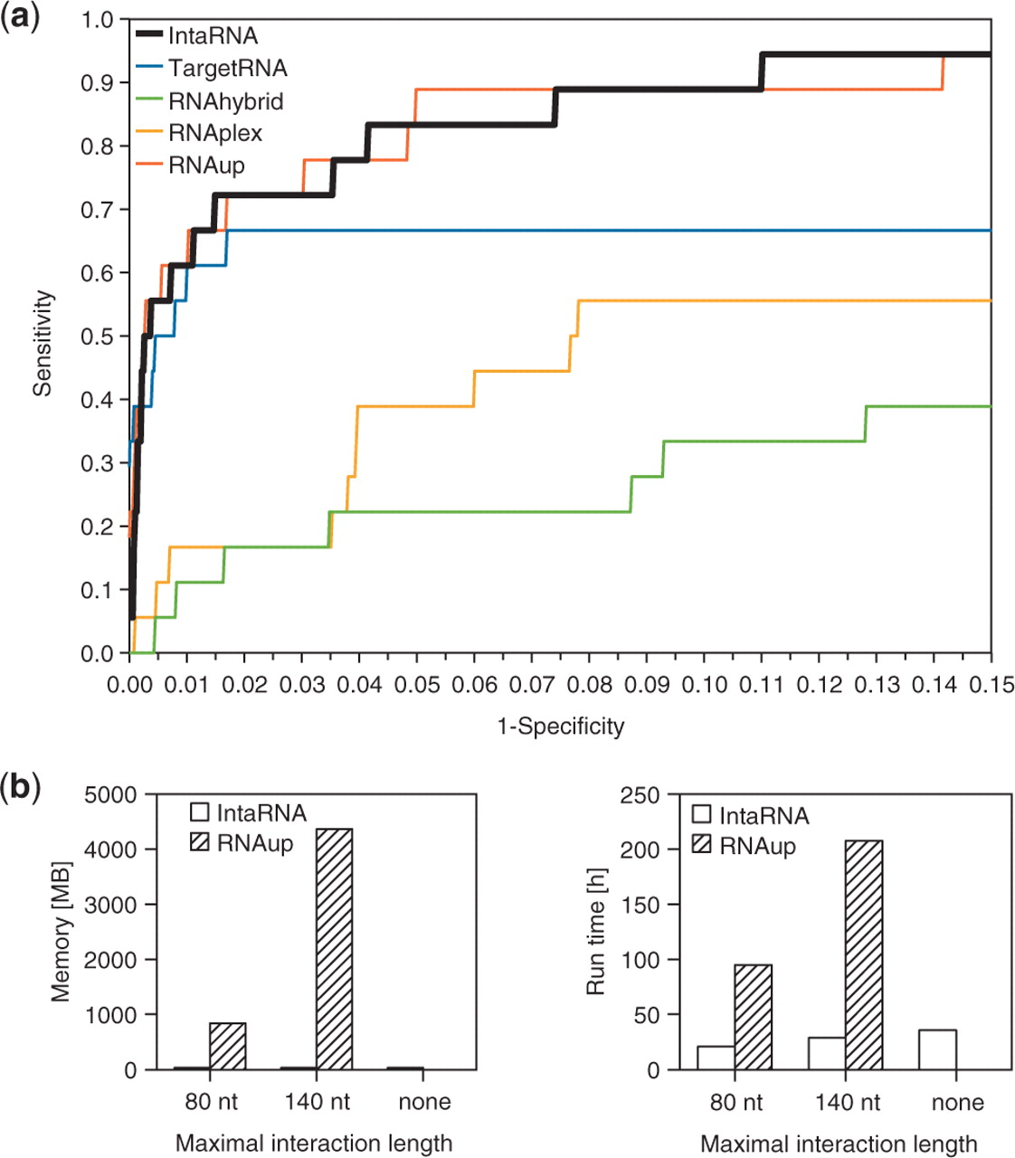
Fig. 4. Performance of INTARNA. (a) Comparison of INTARNA and other leading methods in the prediction of targets on ...
Notes:
Fig. 4. Performance of INTARNA. (a) Comparison of INTARNA and other leading methods in the prediction of targets on our test set of 18 sRNAs with experimentally verified targets. The sensitivity (true positive rate) is shown as a function of the false positive rate (1−specificity). For each prediction method, the target candidates for each sRNA were sorted by energy score. Each ROC curve was generated from the rate of true and false predictions, while varying the number of considered interactions per sRNA. (b) Comparison of resource requirements of INTARNA (including computation of ED-values) and RNAUP for a GcvB target search in Salmonella. Without restricting the interaction length, RNAUP uses up the available complete memory and, as a consequence, crashes.
Unless provided in the caption above, the following copyright applies to the content of this slide: © 2008 The Author(s)This is an Open Access article distributed under the terms of the Creative Commons Attribution Non-Commercial License (http://creativecommons.org/licenses/by-nc/2.0/uk/) which permits unrestricted non-commercial use, distribution, and reproduction in any medium, provided the original work is properly cited.

