Slide 1
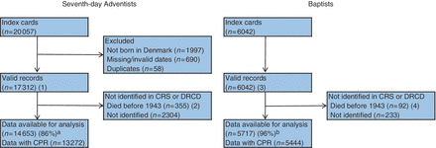
Figure 1 Flow diagram of identification of Seventh-day Adventist and Baptist member cards. ªPercentage is ...
Notes:
Figure 1 Flow diagram of identification of Seventh-day Adventist and Baptist member cards. aPercentage is number divided by (1) minus (2) (n = 16 957) and bpercentage is number divided by (3) minus (4) (n = 5950). CRS, civil registration system; DRCD, register of causes of death; CPR, CPR number
Unless provided in the caption above, the following copyright applies to the content of this slide: Published by Oxford University Press on behalf of the International Epidemiological Association © The Author 2011; all rights reserved.

Slide 2
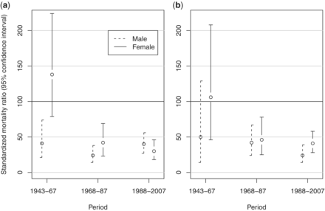
Figure 2 SMRs of Seventh-day Adventists and Baptists during three periods for (a) lung cancer and (b) chronic ...
Notes:
Figure 2 SMRs of Seventh-day Adventists and Baptists during three periods for (a) lung cancer and (b) chronic obstructive lung disease, Denmark, 1943–2007
Unless provided in the caption above, the following copyright applies to the content of this slide: Published by Oxford University Press on behalf of the International Epidemiological Association © The Author 2011; all rights reserved.

