Slide 1
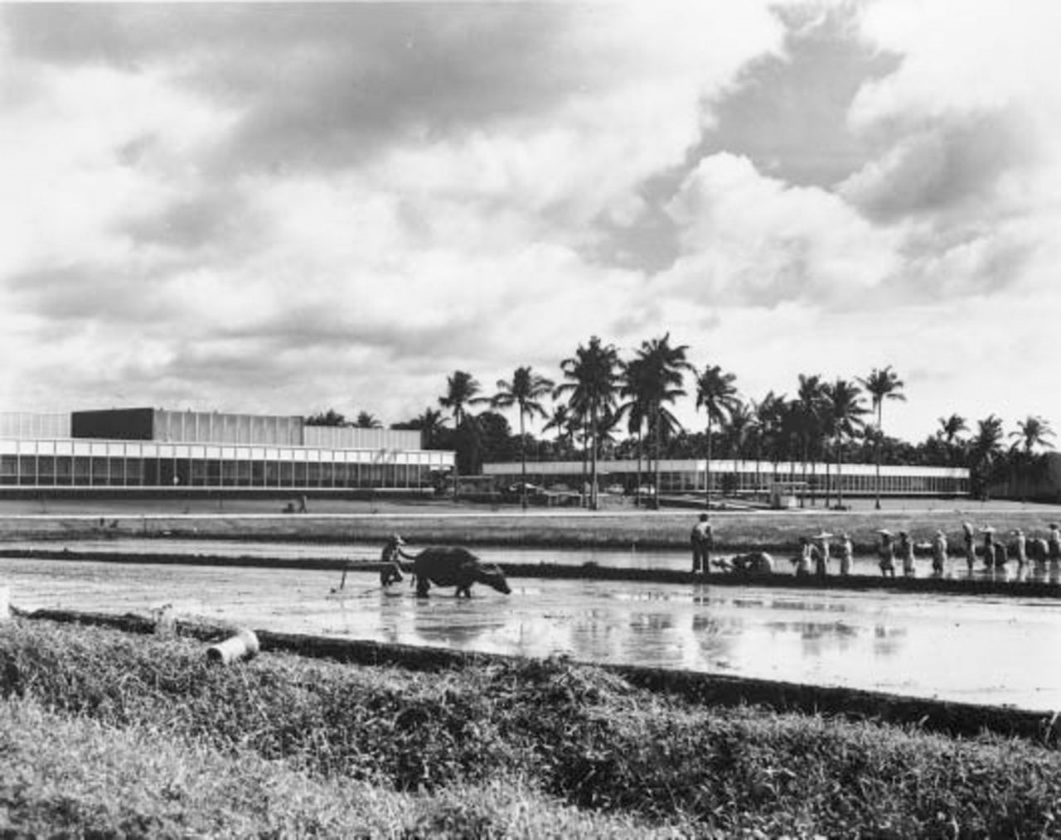
Figure 1 IRRI displayed the contrast it wanted to create throughout Asia. Its modern glass and aluminum laboratories ...
Notes:
Figure 1 IRRI displayed the contrast it wanted to create throughout Asia. Its modern glass and aluminum laboratories faced an experimental farm where rice was grown in “traditional” ways. Scientist trainees were expected to “wade right in.” (Source: Rockefeller Archive Center).
Unless provided in the caption above, the following copyright applies to the content of this slide: © The Society for Historians of American Foreign Relations (SHAFR)

Slide 2
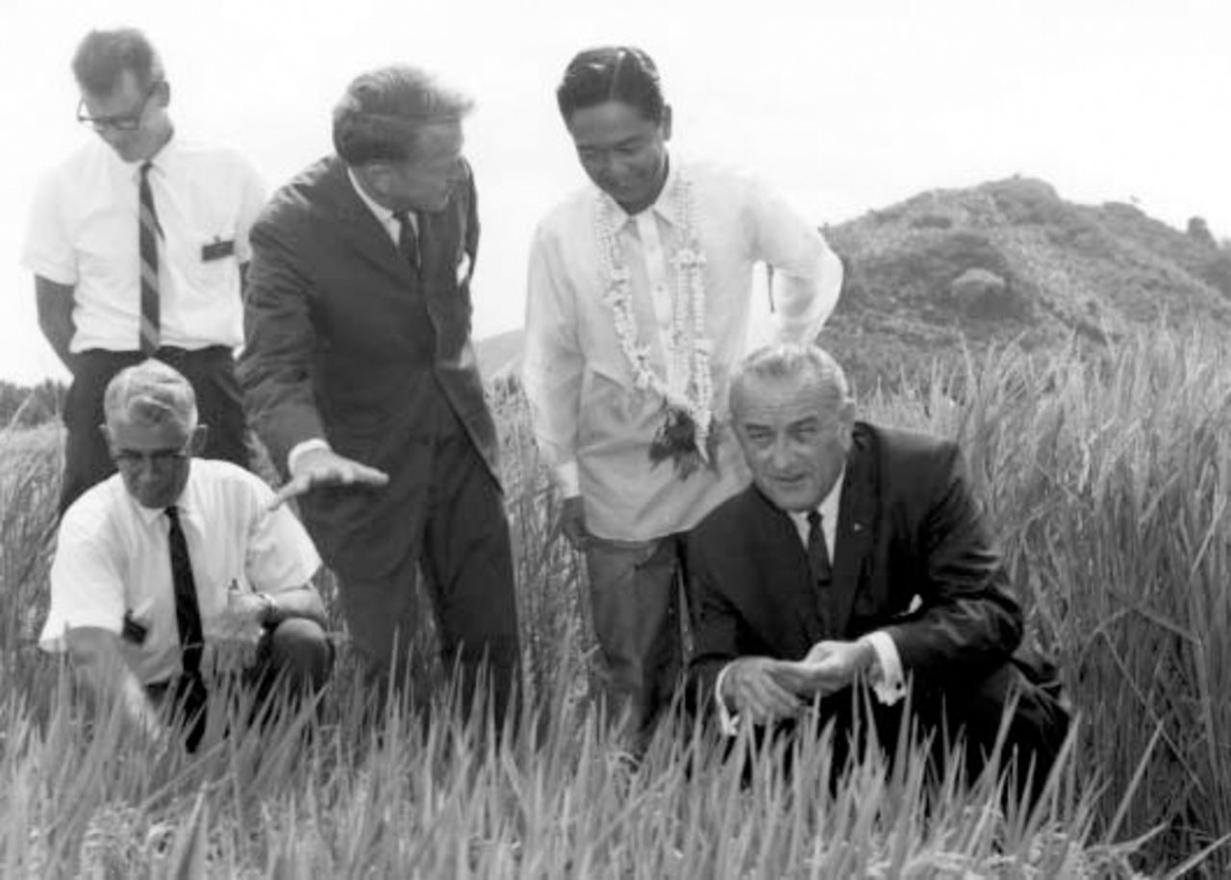
Figure 2 IRRI scientists Henry Beachell, Peter Jennings, and Robert Chandler (clockwise from bottom) introduce Marcos ...
Notes:
Figure 2 IRRI scientists Henry Beachell, Peter Jennings, and Robert Chandler (clockwise from bottom) introduce Marcos and Johnson to dwarf rice in 1996. Rice of “traditional” height can be seen on LBJ's left. LBJ wanted to use the new rice to “escalate the war on hunger.” Source: IRRI
Unless provided in the caption above, the following copyright applies to the content of this slide: © The Society for Historians of American Foreign Relations (SHAFR)

