Slide 1
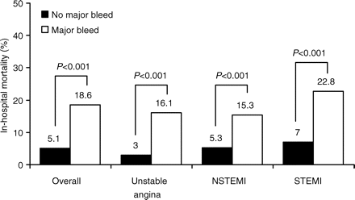
Figure 1 In-hospital death rates in patients according to major bleeding in GRACE (Reprinted from Moscucci M et ...
Notes:
Figure 1 In-hospital death rates in patients according to major bleeding in GRACE (Reprinted from Moscucci M et al.3 with permission from the European Society of Cardiology).
Unless provided in the caption above, the following copyright applies to the content of this slide: Published on behalf of the European Society of Cardiology. All rights reserved. © The Author 2009. For permissions please email: journals.permissions@oxfordjournals.org

Slide 2
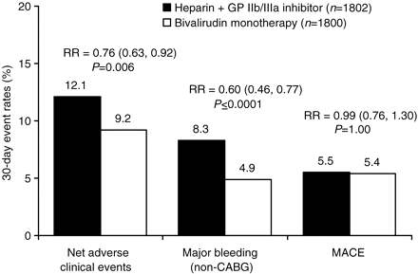
Figure 2 Primary 30-day outcomes of the HORIZONS-AMI trial. MACE, major adverse cardiac events (all-cause death, ...
Notes:
Figure 2 Primary 30-day outcomes of the HORIZONS-AMI trial. MACE, major adverse cardiac events (all-cause death, re-infarction, ischaemic target vessel revascularization, or stroke).
Unless provided in the caption above, the following copyright applies to the content of this slide: Published on behalf of the European Society of Cardiology. All rights reserved. © The Author 2009. For permissions please email: journals.permissions@oxfordjournals.org

Slide 3
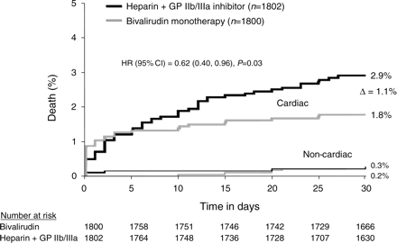
Figure 3 Thirty-day cardiac and non-cardiac mortality in the HORIZONS-AMI trial (Reprinted from Stone GW et ...
Notes:
Figure 3 Thirty-day cardiac and non-cardiac mortality in the HORIZONS-AMI trial (Reprinted from Stone GW et al.14 with permission from Massachusetts Medical Society. All rights reserved.).
Unless provided in the caption above, the following copyright applies to the content of this slide: Published on behalf of the European Society of Cardiology. All rights reserved. © The Author 2009. For permissions please email: journals.permissions@oxfordjournals.org

