Slide 1
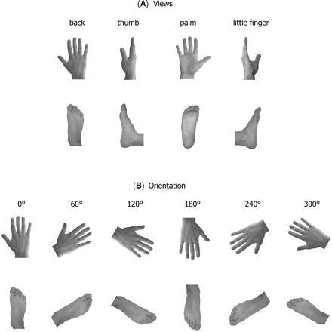
Fig. 1 Schematic representation of the experimental stimuli in (A) four different views (back, thumb, palm and ...
Notes:
Fig. 1 Schematic representation of the experimental stimuli in (A) four different views (back, thumb, palm and little finger), and (B) six orientations (0°, 60°, 120°, 180°, 240° and 300°). Left stimuli were mirror images of right stimuli.
Unless provided in the caption above, the following copyright applies to the content of this slide: © The Author (2005). Published by Oxford University Press on behalf of the Guarantors of Brain. All rights reserved. For Permissions, please email: journals.permissions@oxfordjournals.org

Slide 2
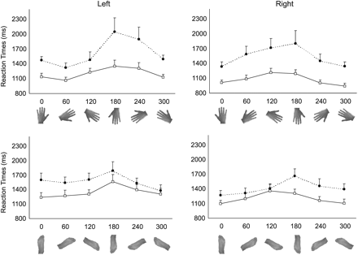
Fig. 2 Reaction time profiles at different stimulus orientations in writer's cramp (black circles) and control ...
Notes:
Fig. 2 Reaction time profiles at different stimulus orientations in writer's cramp (black circles) and control subjects (white squares) for left and right hands (upper inserts) and feet (lower inserts). Error bars indicate standard errors.
Unless provided in the caption above, the following copyright applies to the content of this slide: © The Author (2005). Published by Oxford University Press on behalf of the Guarantors of Brain. All rights reserved. For Permissions, please email: journals.permissions@oxfordjournals.org

Slide 3
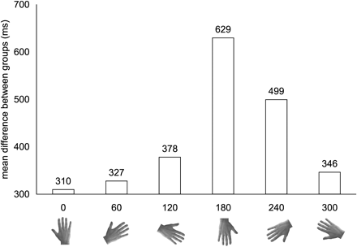
Fig. 3 Mean RT differences between dystonic patients and controls for each stimulus orientation in the hands mental ...
Notes:
Fig. 3 Mean RT differences between dystonic patients and controls for each stimulus orientation in the hands mental rotation task. This difference has been computed by averaging RTs to left and right hands.
Unless provided in the caption above, the following copyright applies to the content of this slide: © The Author (2005). Published by Oxford University Press on behalf of the Guarantors of Brain. All rights reserved. For Permissions, please email: journals.permissions@oxfordjournals.org

