Slide 1
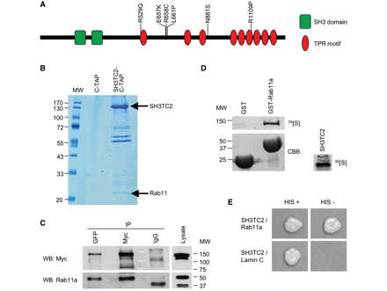
Figure 1 SH3TC2 interacts with the small GTPase Rab11. (A) Schematic drawing showing predicted domain structure of ...
Notes:
Figure 1 SH3TC2 interacts with the small GTPase Rab11. (A) Schematic drawing showing predicted domain structure of SH3TC2 and positions of CMT4C-associated missense mutations. Domains were predicted using Simple Modular Architecture Research Tool (SMART, http://smart.embl-heidelberg.de). (B) Identification of proteins complexing with SH3TC2 by tandem affinity purification. SH3TC2-C-TAP and C-TAP were purified from stably transfected Flp-In T-REx 293 cells and the interacting proteins were separated and visualized on a GelCode Blue-stained SDS gel. Resulting bands were analysed by mass spectrometry. (C) Coimmunoprecipitation of SH3TC2-Myc and GFP-Rab11a. HEK293 cells were transiently transfected with SH3TC2-Myc and GFP-Rab11a. Cells were lysed and an aliquot of the lysate was retained to analyse input protein levels (right). The remaining cell lysate was immunoprecipitated using mouse monoclonal Myc- and GFP-specific antibodies. Immunoprecipitation with mouse IgG was used as control. Protein complexes were resolved by SDS–PAGE and immunoblotted. SH3TC2-Myc was detected using a mouse monoclonal anti-Myc antibody, followed by a goat anti-mouse IgG antibody conjugated to horse radish peroxidase (upper left). GFP-Rab11a was detected using a rabbit polyclonal anti-Rab11a antibody, followed by a goat anti-rabbit IgG antibody conjugated to horse radish peroxidase (lower left). (D) GST pulldown of in vitro translated 35[S]-SH3TC2 with Rab11a. Purified recombinant GST and GST-fused Rab11a were incubated with in vitro translated 35[S]-SH3TC2. Bound labelled SH3TC2 was detected by autoradiography (upper left). GST proteins used in the pulldown were visualized by Coomassie staining (lower left). Autoradiographic detection of 35[S]-SH3TC2 in the input proved successful in vitro translation (right). (E) Yeast-two-hybrid assay with SH3TC2 and Rab11a. pACT2-Rab11a was cotransformed into the yeast NMY32 reporter strain of Saccharomyces cerevisiae with pLexA-SH3TC2 or pLexA-Lamin C (as a negative control). Transformant viability is shown in the left panel (HIS+), while protein–protein interactions are indicated by growth of the transformants on media lacking histidine in the right panel (HIS−). CBB = Coomassie brilliant blue; IP = immunoprecipitation; MW = molecular weight; SH3 = Src homology 3; TPR = tetratricopeptide repeat; WB = western blot.
Unless provided in the caption above, the following copyright applies to the content of this slide: © The Author (2010). Published by Oxford University Press on behalf of the Guarantors of Brain. All rights reserved. For Permissions, please email: journals.permissions@oxfordjournals.org

Slide 2
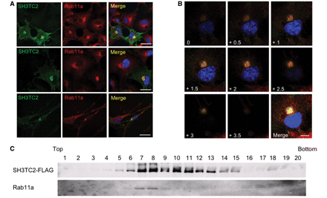
Figure 2 SH3TC2 and Rab11 localize to the same intracellular compartment. (A) Immunofluorescence studies of SH3TC2 and ...
Notes:
Figure 2 SH3TC2 and Rab11 localize to the same intracellular compartment. (A) Immunofluorescence studies of SH3TC2 and endogenous Rab11a in different cell lines using confocal microscopy. Cells were transiently transfected with SH3TC2-FLAG. The left column shows SH3TC2-FLAG in HEK29 (upper panel), COS7 (middle panel) and RT4-D6PT2 cells (lower panel), detected by a mouse monoclonal anti-FLAG antibody and an Alexa Fluor 488-conjugated goat anti-mouse IgG antibody. Endogenous Rab11a was visualized by a rabbit polyclonal anti-Rab11a antibody and a Cy3-conjugated goat anti-rabbit IgG antibody (middle column). Merged images are shown in the right column with nuclei stained with DAPI. Scale bars denote 20 µm. (B) Colocalization of SH3TC2 and Rab11a in consecutive optical sections of cells. COS7 cell were transiently transfected with SH3TC2-FLAG and stained with a mouse monoclonal anti-FLAG and an Alexa Fluor 488-conjugated goat anti-mouse IgG antibody (green) and a rabbit polyclonal anti-Rab11 antibody and a Cy3-conjugated goat anti-rabbit IgG antibody (red). A stack of confocal images (0.5 µm apart) from a double-labelled cell is shown with the nucleus stained with DAPI. A merged image of all confocal planes is show in lower right corner. Scale bar denotes 10 µm. (C) Detection of SH3TC2 and Rab11a in the same subcellular fractions. HEK293 cells were transiently transfected with SH3TC2-FLAG. Cells were lysed and post-nuclear supernatant was fractionated using a 5–25% Optiprep gradient. Equal amounts of fractions were resolved by SDS–PAGE and analysed by western blotting with a mouse monoclonal anti-FLAG and a mouse monoclonal anti-Rab11a antibody, followed by a goat anti-mouse IgG antibody conjugated to horse radish peroxidase. Twenty fractions were collected from lowest (top, lane 1) to highest (bottom, lane 20) density.
Unless provided in the caption above, the following copyright applies to the content of this slide: © The Author (2010). Published by Oxford University Press on behalf of the Guarantors of Brain. All rights reserved. For Permissions, please email: journals.permissions@oxfordjournals.org

Slide 3
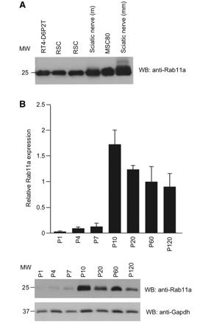
Figure 3 Expression of Rab11 in the peripheral nervous system. (A) Western blot analysis of different Schwann cell ...
Notes:
Figure 3 Expression of Rab11 in the peripheral nervous system. (A) Western blot analysis of different Schwann cell lines (RT4-D6PT2 and MSC80), primary rat Schwann cell (RSC) cultures and sciatic nerve lysates from adult mouse and rat. Rab11a was detected by using a mouse monoclonal anti-Rab11a antibody followed by a goat anti-mouse IgG (Fc) antibody conjugated to horse radish peroxidase. (B) Western blot analysis of Rab11a expression in the developing mouse sciatic nerve. Rab11a was detected by using the same antibodies as in A. To ensure similar loading, the membrane was probed with a mouse monoclonal anti-Gapdh antibody, followed by an alkaline phosphatase-conjugated goat anti-mouse IgG antibody. The blot shown is representative of three independent experiments. Quantification of these experiments is depicted in the graph showing Rab11a expression normalized against Gapdh levels. Error bars indicate ± SEM. MW = molecular weight; P = post-natal day; WB = western blot.
Unless provided in the caption above, the following copyright applies to the content of this slide: © The Author (2010). Published by Oxford University Press on behalf of the Guarantors of Brain. All rights reserved. For Permissions, please email: journals.permissions@oxfordjournals.org

Slide 4
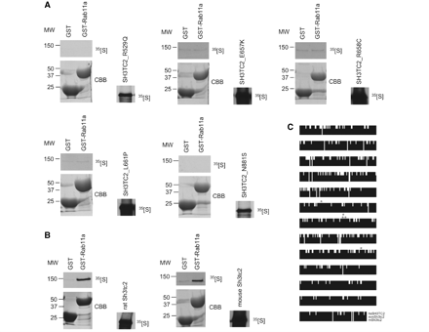
Figure 4 SH3TC2 binding to Rab11 is disrupted by CMT4C missense mutations. (A) GST pulldown experiments of different ...
Notes:
Figure 4 SH3TC2 binding to Rab11 is disrupted by CMT4C missense mutations. (A) GST pulldown experiments of different CMT4C-associated in vitro translated 35[S]-SH3TC2 mutants with Rab11a. Purified recombinant GST and GST-Rab11a were incubated with five different in vitro translated 35[S]-SH3TC2 missense mutants. Bound labelled SH3TC2 mutants were detected by autoradiography (upper left) and GST proteins present in the binding reaction were detected by Coomassie staining (lower left). Autoradiographic detection of 35[S]-SH3TC2 mutants in the input proved successful in vitro translation (right). (B) GST pulldown of rodent Sh3tc2 with human GST-Rab11a. Purified recombinant GST and GST-Rab11a were incubated with in vitro translated mouse and rat 35[S]-Sh3tc2. Bound labelled mouse and rat 35[S]-Sh3tc2 were detected by autoradiography (upper left) and GST proteins present in the binding reaction were detected by Coomassie staining (lower left). Autoradiographic detection of rodent 35[S]-Sh3tc2 in the input proved successful in vitro translation (right). (C) Multiple sequence alignment of human, mouse and rat SH3TC2/Sh3tc2 displaying conserved amino acids between species. CMT4C-related missense mutations affect amino acid residues in SH3TC2/Sh3tc2 that are conserved through evolution (indicated with asterisks). CBB = Coomassie brilliant blue; MW = molecular weight; Hs = human; mm = mouse; rn = rat.
Unless provided in the caption above, the following copyright applies to the content of this slide: © The Author (2010). Published by Oxford University Press on behalf of the Guarantors of Brain. All rights reserved. For Permissions, please email: journals.permissions@oxfordjournals.org

Slide 5
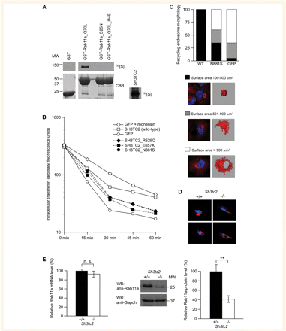
Figure 5 SH3TC2 is a potential new Rab11 effector. (A) GST pulldown of in vitro translated ³⁵[S]-SH3TC2 ...
Notes:
Figure 5 SH3TC2 is a potential new Rab11 effector. (A) GST pulldown of in vitro translated 35[S]-SH3TC2 using Rab11a mutants interfering with nucleotide loading of the GTPase. GST and GST-Rab11a mutants [constitutively active, GTP bound (Q70L) and dominant negative, guanosine diphosphate bound (S25N)] were expressed as recombinant proteins and incubated with full length in vitro translated 35[S]-SH3TC2. Binding of labelled SH3TC2 was detected by autoradiography (upper left). GST proteins present in the binding reaction were detected by Coomassie staining (lower left). Autoradiographic detection of labelled SH3TC2 in the input proved successful in vitro translation (right). (B) Kinetic analysis of transferrin recycling measured by fluorescent activated cell sorting. HEK293 cells were transfected with SH3TC2-GFP wild-type or SH3TC2-GFP harbouring CMT4C missense mutations. Cells transfected with GFP alone or GFP transfected cells additionally treated with 10 μM monensin [a potent inhibitor of transferrin receptor recycling (Stein et al., 1984)] were used as controls. The cells were incubated for 30 min with fluorescently labelled transferrin and then chased with an excess of unlabelled transferrin for the indicated lengths of time. The y-axis represents the intensities of the fluorescent signals in a log scale. Graphs represent the mean of three experiments. Values of data points ± SEM and significance levels are shown in Supplementary Table 1. (C) Effect of SH3TC2 on recycling endosome morphology. COS7 cells were transiently transfected with wild-type SH3TC2-FLAG, SH3TC2_N881S-FLAG or GFP. Endogenous Rab11a was labelled with a rabbit polyclonal anti-Rab11a antibody and a Cy3-conjugated goat anti-rabbit IgG antibody. Transfected cells were identified by GFP fluorescence or staining with a mouse monoclonal anti-FLAG and an Alexa Fluor 488-conjugated goat anti-mouse IgG antibody (not shown). One hundred cells were analysed per condition. Using stacks of confocal images (0.122 µm intervals) the Rab11a-positive surface was calculated and corrected for cell size to estimate the surface of the recycling endosome. Immunofluorescence pictures and 3D reconstructions show representative examples of each category of surface area. (D) Rab11a distribution in Schwann cells of Sh3tc2 wild-type and knockout littermates. Teased nerve fibres were prepared from sciatic nerves of adult mice (at post-natal day 56). Rab11a was detected with a rabbit polyclonal anti-Rab11a antibody followed by a goat anti-rabbit IgG antibody conjugated to Alexa Fluor 594. Nuclei were stained with DAPI. (E) Rab11a mRNA and Rab11a protein levels in sciatic nerves of Sh3tc2 wild-type and knockout littermates. Rab11a mRNA levels were obtained from cRNA microarray data from post-natal day 5 sciatic nerves of Sh3tc2 wild-type and knockout littermates (R. Chrast and E. Arnaud, unpublished data). The quantification graph shows Rab11a mRNA levels normalized against Gapdh expression. For western blot analysis of sciatic nerves of wild-type and Sh3tc2 knockout mice at post-natal day 5, Rab11a was detected with a mouse monoclonal anti-Rab11a antibody followed by a goat anti-mouse IgG (Fc) antibody conjugated to horse radish peroxidase. To ensure similar loading, the membrane was probed with a mouse monoclonal anti-Gapdh antibody, followed by an alkaline phosphatase-conjugated goat anti-mouse IgG antibody. The blot shown is representative of three independent experiments. Quantification of these experiments is depicted in the graph showing Rab11a expression normalized against Gapdh levels. Error bars indicate ± SEM. n.s. = not significant; **P < 0.01. CBB = Coomassie brilliant blue; MW = molecular weight; P = post-natal day; WB = western blot; WT = wild-type.
Unless provided in the caption above, the following copyright applies to the content of this slide: © The Author (2010). Published by Oxford University Press on behalf of the Guarantors of Brain. All rights reserved. For Permissions, please email: journals.permissions@oxfordjournals.org

Slide 6
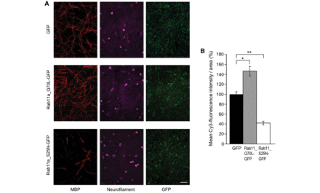
Figure 6 Rab11 regulates Schwann cell myelination in Schwann cell/neuron co-cultures. (A) Immunofluorescence studies ...
Notes:
Figure 6 Rab11 regulates Schwann cell myelination in Schwann cell/neuron co-cultures. (A) Immunofluorescence studies of primary rat Schwann cells/mouse dorsal root ganglion neuron co-cultures after 12 days of myelination. Primary rat Schwann cells were either transduced with GFP (upper row) as a control, constitutively active Rab11a_Q70L-GFP (middle row) or dominant negative Rab11a_S25N-GFP (lower row). Myelinated segments were stained with a rat monoclonal anti-myelin basic protein antibody, followed by a Cy3-conjugated goat anti-rat IgG antibody (left column). Neurons were detected with a mouse monoclonal anti-neurofilament antibody and a goat anti-mouse IgG antibody conjugated to Cy5 (middle column). Transduction efficiency was monitored by GFP fluorescence (right column). Scale bar denotes 100 µm. (B) Quantification of myelin basic protein positive segments in Schwann cell/neuron co-cultures. Mean Cy3-fluorescence intensity per area was measured by ImageJ software and used as an estimate of the number of myelin basic protein positive segments. Mean Cy3-fluorescence intensity in control (GFP) infected Schwann cell/neuron co-cultures was set as 100% and compared with cultures expressing Rab11a_Q70L-GFP or Rab11a_S25N-GFP. Experiments were done in triplicate and at least three coverslips per condition were analysed in each experiment. Error bars indicate ± SEM; *P < 0.05; **P < 0.01.
Unless provided in the caption above, the following copyright applies to the content of this slide: © The Author (2010). Published by Oxford University Press on behalf of the Guarantors of Brain. All rights reserved. For Permissions, please email: journals.permissions@oxfordjournals.org

