Slide 1
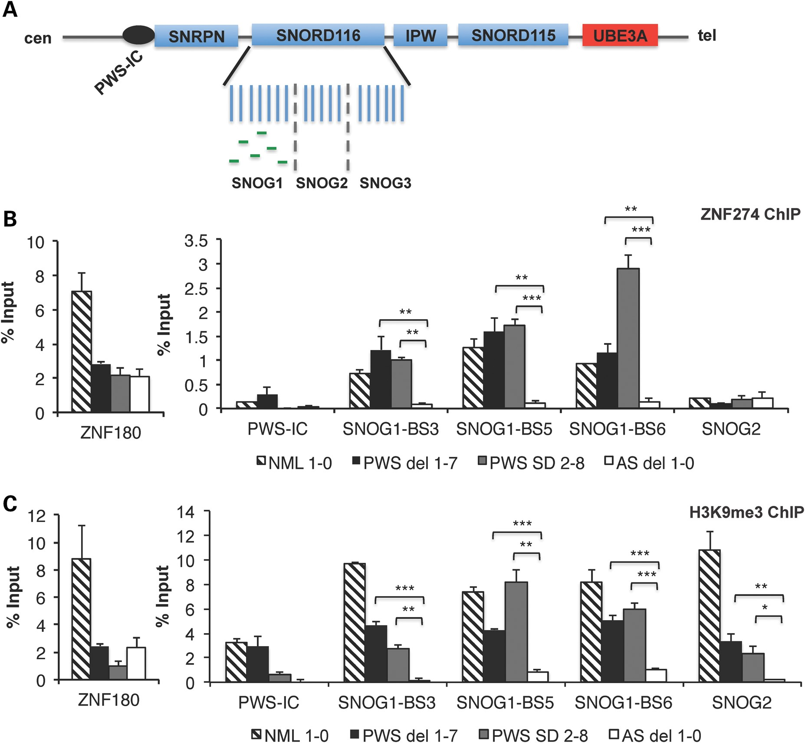
Figure 1. ZNF274 is a novel epigenetic regulator of the silent maternal allele in PWS. (A) A map of a subregion of ...
Notes:
Figure 1. ZNF274 is a novel epigenetic regulator of the silent maternal allele in PWS. (A) A map of a subregion of 15q11-q13, indicating ZNF274 binding sites in SNOG1/116HGG1 within the SNORD116 cluster. Imprinted, paternally expressed genes are denoted by blue boxes. UBE3A is biallelically expressed in iPSCs. The PWS-IC is denoted by the black circle. Green lines within SNOG1/116HGG1 represent the six ZNF274 binding sites. (B) ZNF274 ChIP assays in iPSCs. Allele specificity was determined by comparing the enrichment observed on the silent maternal allele in PWS iPSCs derived from two classes of PWS patients to the active paternal allele in AS iPSCs. Enrichment at ZNF180 was used as a positive control in these assays. Quantification of ChIPs was performed and calculated as percent input for each sample. Non-specific IgG values were subtracted from percent input values. (C) ChIP assays for the repressive histone modification H3K9me3. H3K9me3 was enriched on maternal allele in iPSCs derived from all three classes of PWS patients, when compared with AS iPSCs. *P ≤ 0.1, **P ≤ 0.05, ***P ≤ 0.01.
Unless provided in the caption above, the following copyright applies to the content of this slide: © The Author 2014. Published by Oxford University Press. All rights reserved. For Permissions, please email: journals.permissions@oup.com

Slide 2
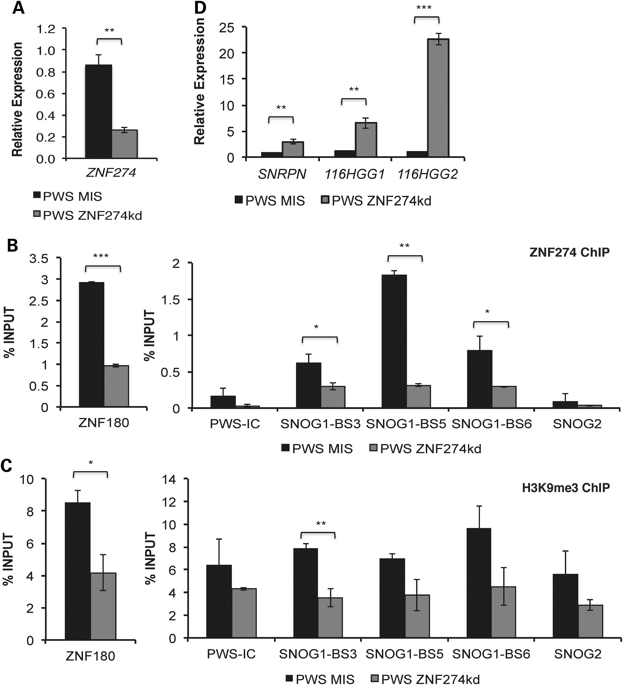
Figure 2. Functional role of ZNF274 complex in the silencing of the maternal allele in PWS. (A) Gene expression of ...
Notes:
Figure 2. Functional role of ZNF274 complex in the silencing of the maternal allele in PWS. (A) Gene expression of ZNF274 in PWS iPSCs following transfection with control siRNAs or specific siRNAs targeting ZNF274. GADPH was used as an endogenous control. Data were normalized to PWS MIS. ChIP assays for ZNF274 (B) and H3K9me3 (C), respectively, in PWS ZNF274kd iPSCs. Enrichment at ZNF180 was used as a control in these assays. (D) Gene expression analysis of SNRPN and 116HG in PWS ZNF274kd iPSCs. GADPH was used as an endogenous control and data were normalized to PWS MIS. * P ≤ 0.1, ** P ≤ 0.05, *** P ≤ 0.01.
Unless provided in the caption above, the following copyright applies to the content of this slide: © The Author 2014. Published by Oxford University Press. All rights reserved. For Permissions, please email: journals.permissions@oup.com

Slide 3
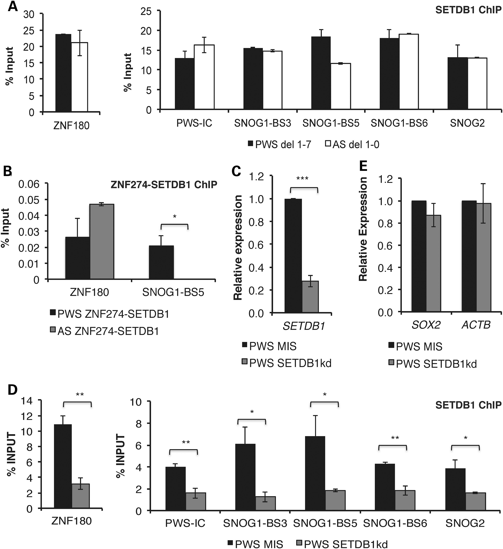
Figure 3. SETDB1 associates with ZNF274 on the silent maternal allele within SNORD116. (A) Enrichment of SETDB1 within ...
Notes:
Figure 3. SETDB1 associates with ZNF274 on the silent maternal allele within SNORD116. (A) Enrichment of SETDB1 within 15q11-q13 by ChIP analyses, in PWS del 1–7 and AS del 1-0 iPSCs. (B) Sequential ChIP assays in PWS del 1–7 and AS del 1-0 iPSCs within SNORD116. Enrichment at ZNF180 was used as a control in these assays. ZNF274 ChIP samples were sequentially immunoprecipitated using ZNF274 antibody followed by SETDB1 antibody. (C) Gene expression of SETDB1 in PWS 1–7 iPSCs following lentiviral transduction with control or specific shRNA constructs targeting SETDB1. GAPDH was used as an endogenous control and data were normalized to PWS MIS iPSCs. (D) ChIP analyses for enrichment of SETDB1 in PWS SETDB1kd iPSCs, relative to MIS control. Enrichment at ZNF180 was used as a control in these assays. (E) Expression of genes outside of 15q11-q13 in PWS SETDB1kd iPSCs used as negative controls. *P ≤ 0.1, **P ≤ 0.05, ***P ≤ 0.01.
Unless provided in the caption above, the following copyright applies to the content of this slide: © The Author 2014. Published by Oxford University Press. All rights reserved. For Permissions, please email: journals.permissions@oup.com

Slide 4
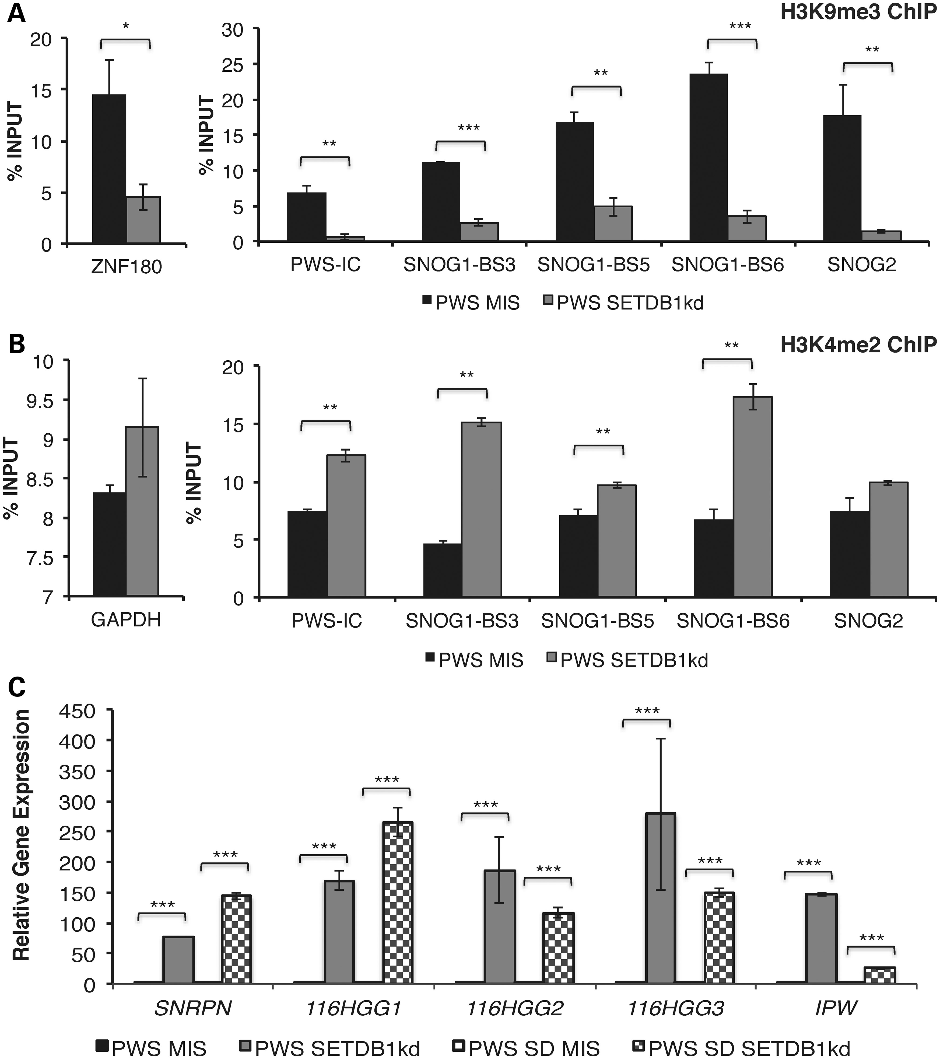
Figure 4. Reactivation of the silent maternal allele in PWS. ChIP analyses for H3K9me3 (A) and H3K4 dimethylation ...
Notes:
Figure 4. Reactivation of the silent maternal allele in PWS. ChIP analyses for H3K9me3 (A) and H3K4 dimethylation (H3K4me2) (B) in PWS SETDB1kd iPSCs, relative to PWS MIS iPSCs. Enrichment at ZNF180 and GAPDH was used as a control in these assays, respectively. (C) Analysis of SNRPN and 116HG expression levels in PWS SETDB1kd and PWS SD SETDB1kd iPSCs. GADPH was used as an endogenous control and data were normalized to their respective MIS controls. *P ≤ 0.1, **P ≤ 0.05, ***P ≤ 0.01.
Unless provided in the caption above, the following copyright applies to the content of this slide: © The Author 2014. Published by Oxford University Press. All rights reserved. For Permissions, please email: journals.permissions@oup.com

Slide 5
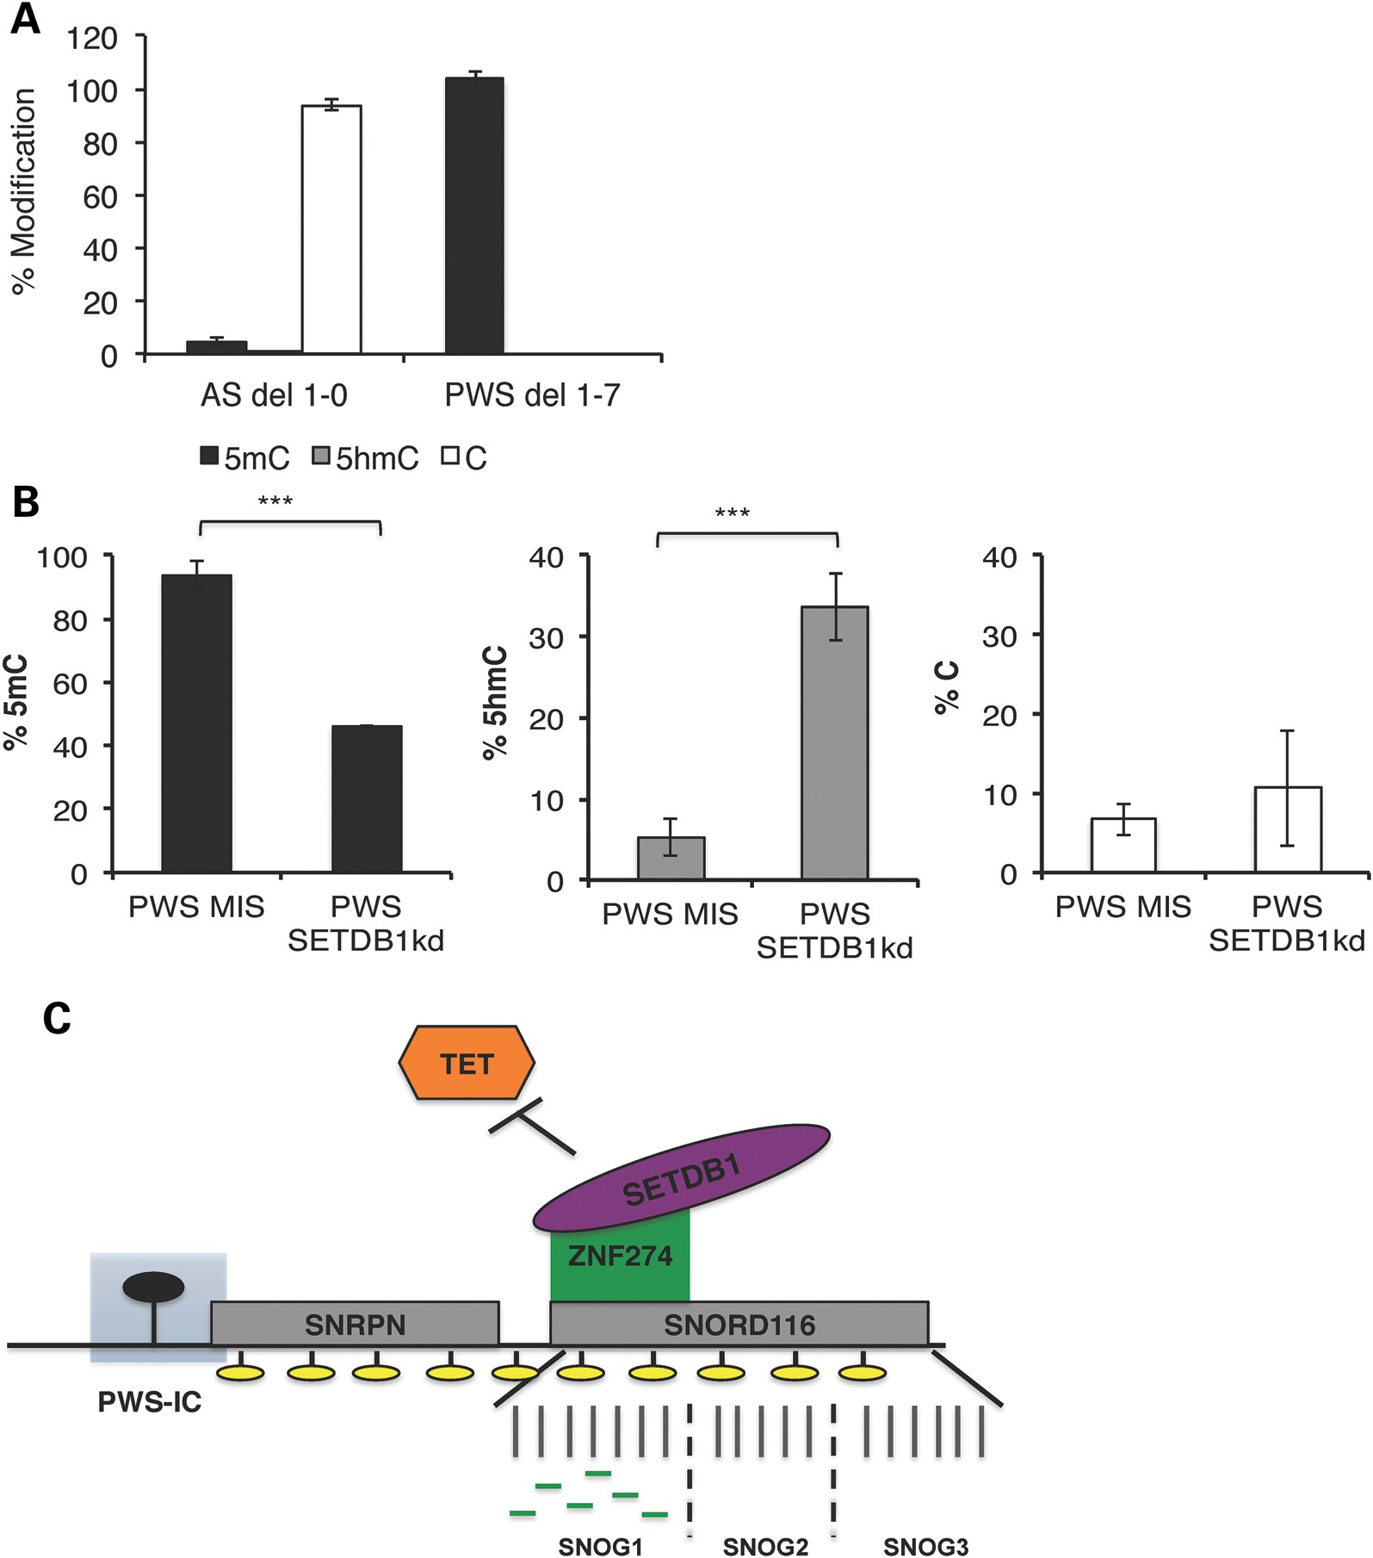
Figure 5. DNA methylation levels change when the silent maternal allele in PWS is reactivated. Content of 5hmC at the ...
Notes:
Figure 5. DNA methylation levels change when the silent maternal allele in PWS is reactivated. Content of 5hmC at the PWS-IC, quantified by subtraction of 5hmC from the total methylated cytosine levels, determined by HpaII sensitivity as a percentage of total cytosine in PWS del 1–7 and AS del 1-0 iPSCs (A) or PWS SETDB1kd iPSCs, relative to PWS MIS iPSCs (B). ***P ≤ 0.01. (C) Model describing the role of the ZNF274/SETDB1 complex in the establishment/maintenance of silencing of the maternal allele of 15q11-q13. Boxes represent: SNRPN (small nuclear ribonucleoprotein polypeptide N) and SNORD116 (small nucleolar RNA, C/D box 116). Filled oval represents presence of 5mC methylation at the PWS-IC. ZNF274 and SETDB1 potentially in association with other proteins recognize the tandemly repeated SNOG1 maternal alleles at early times after fertilization. Green lines within SNOG1/116HGG1 represent the six ZNF274 binding sites. Binding of the repressive complex to paternal SNOG1 alleles may be prevented by active transcription through the PWSCR at early stages of development. Binding of the complex to the maternal SNOG1 alleles results in deposition of the repressive H3K9me3 (indicated by yellow ovals) and stabilizes epigenetic silencing of the PWSCR in early development. The ZNF274/SETDB1 complex may also protect the 5mC mark at the maternal PWS-IC from oxidative modification by TET proteins that are highly expressed at the blastocyst and epiblast stages (27).
Unless provided in the caption above, the following copyright applies to the content of this slide: © The Author 2014. Published by Oxford University Press. All rights reserved. For Permissions, please email: journals.permissions@oup.com

