Slide 1
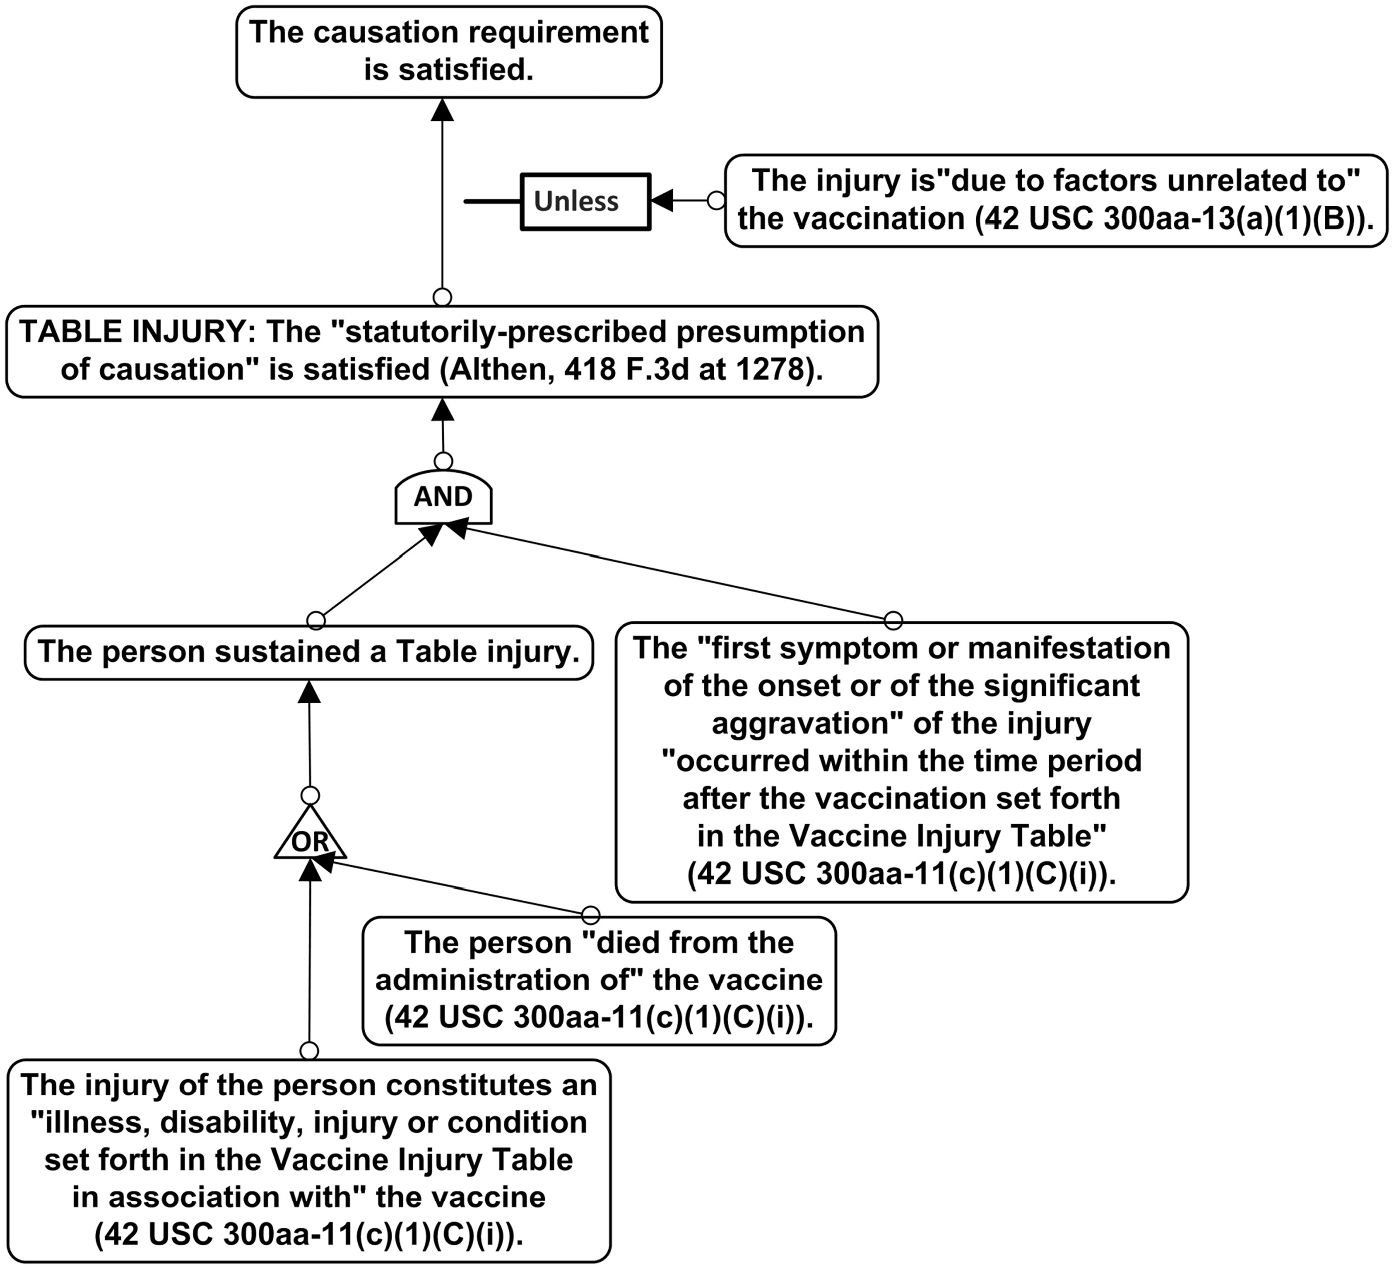
Fig. 1. Partial rule tree for vaccine decisions, showing the statutory presumption of causation and the rebutting ...
Notes:
Fig. 1. Partial rule tree for vaccine decisions, showing the statutory presumption of causation and the rebutting defeater (defence).
Unless provided in the caption above, the following copyright applies to the content of this slide: © The Author [2014]. Published by Oxford University Press. All rights reserved

Slide 2
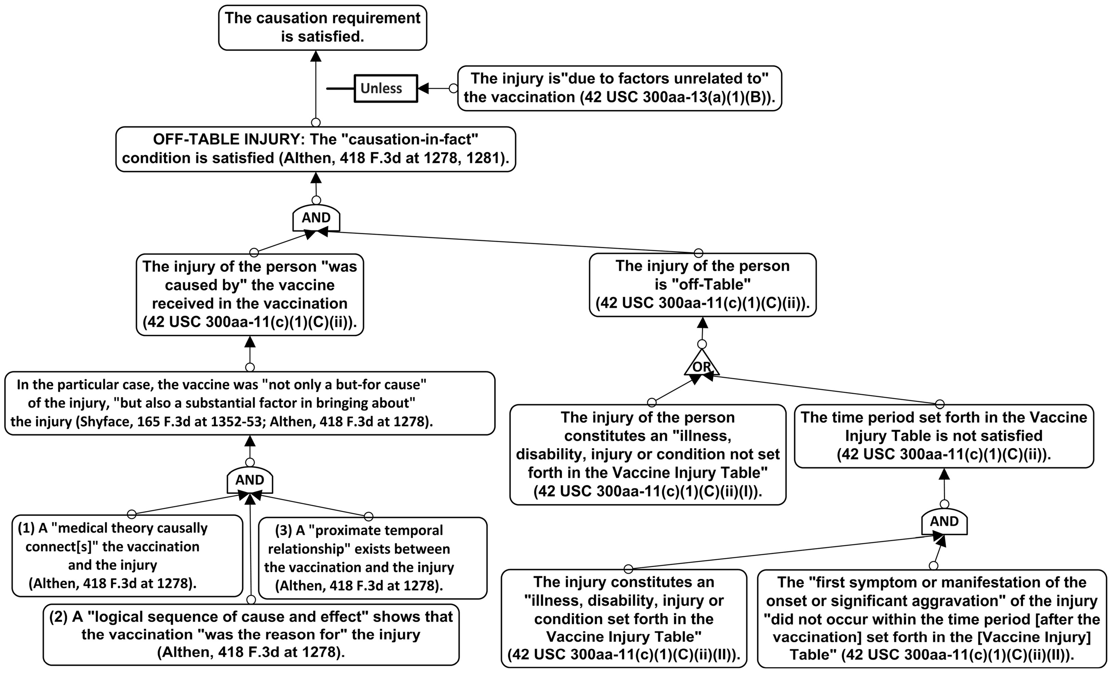
Fig. 2. Partial rule tree for vaccine decisions, showing the three causation conditions of Althen and the rebutting ...
Notes:
Fig. 2. Partial rule tree for vaccine decisions, showing the three causation conditions of Althen and the rebutting defeater (defence).
Unless provided in the caption above, the following copyright applies to the content of this slide: © The Author [2014]. Published by Oxford University Press. All rights reserved

