Slide 1
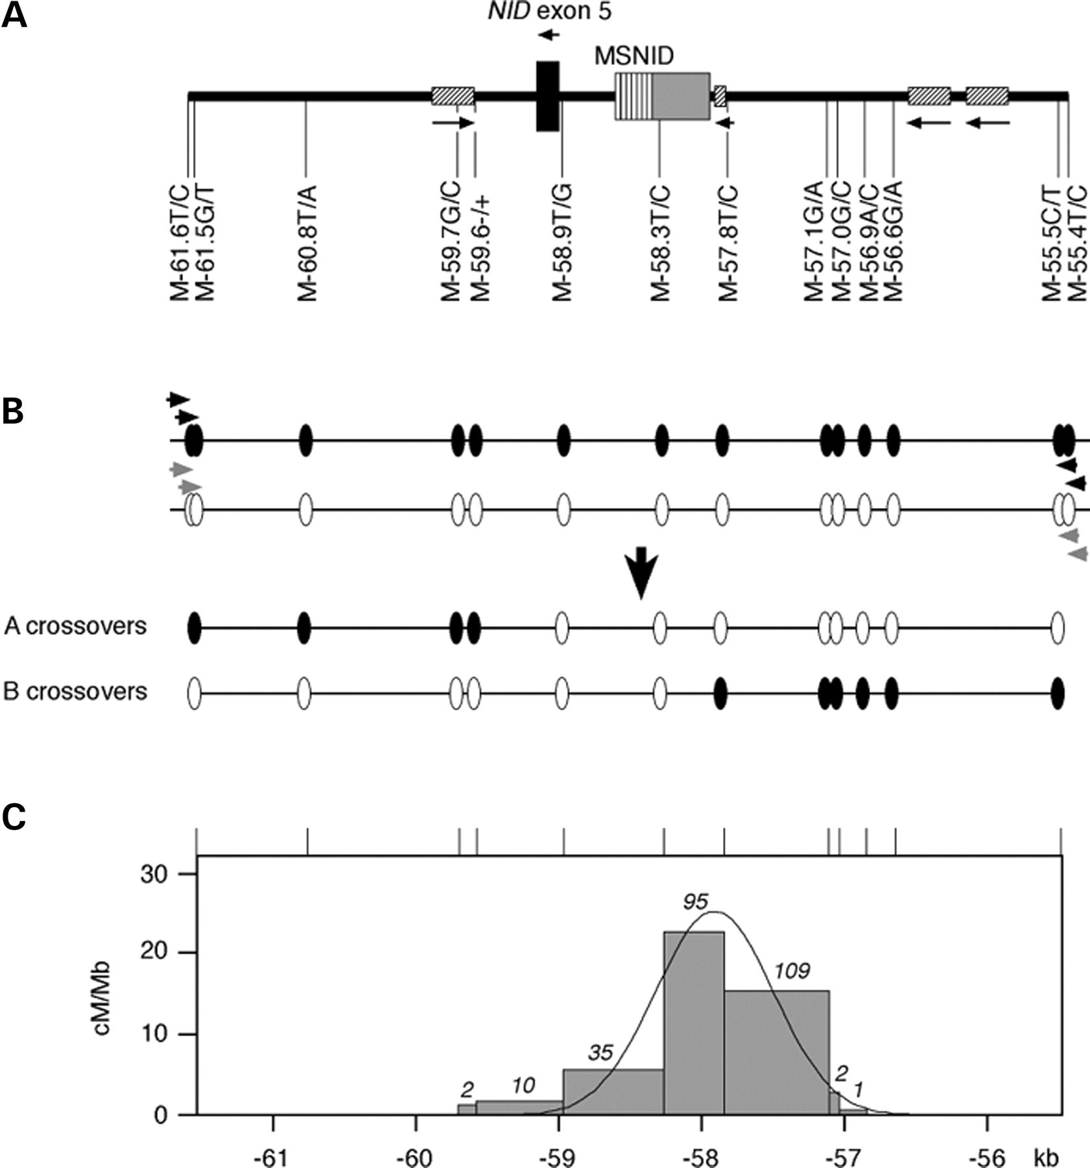
Figure 1. Location and morphology of the NID1 recombination hotspot. (A) Location in NID intron 4, with Alu ...
Notes:
Figure 1. Location and morphology of the NID1 recombination hotspot. (A) Location in NID intron 4, with Alu repeats shown as hatched boxes and the AT-rich region next to minisatellite MSNID indicated in grey. The locations of SNPs are shown below. (B) Strategy for recovering crossover molecules from sperm DNA. Two rounds of nested allele-specific PCR using primers in repulsion-phase specific to the black or white haplotype (arrows) are used to selectively amplify either A-type crossovers (black to white) or B-type crossovers (white to black) from sperm DNA. Crossover breakpoints in these recombinant DNA molecules are mapped by typing internal informative SNPs. (C) Sperm crossover distribution across the NID1 hotspot. A and B crossovers recovered from sperm DNA from two men (man 1, 51 A crossovers, 67 B crossovers, each recovered from 180 000 amplifiable molecules of each progenitor haplotype; man 2, 58 A crossovers, 78 B crossovers, each recovered from 310 000 molecules) were combined to determine the number of crossovers (in italics) in each interval between heterozygous SNPs, from which the crossover activity in cM/Mb was estimated. Man 1 and man 2 showed similar crossover frequencies (3.3×10−4 and 2.2×10−4 per sperm, respectively) and indistinguishable crossover distributions (data not shown). The solid line shows the least-squares best-fit distribution assuming that crossovers are normally distributed across the hotspot (5). The fit is poor (P<0.001), with evidence that the true distribution is skewed to the left (distribution symmetry test, z=1.86, two-tailed P=0.06).
Unless provided in the caption above, the following copyright applies to the content of this slide: © The Author 2005. Published by Oxford University Press. All rights reserved. For Permissions, please email: journals.permissions@oupjournals.org

Slide 2
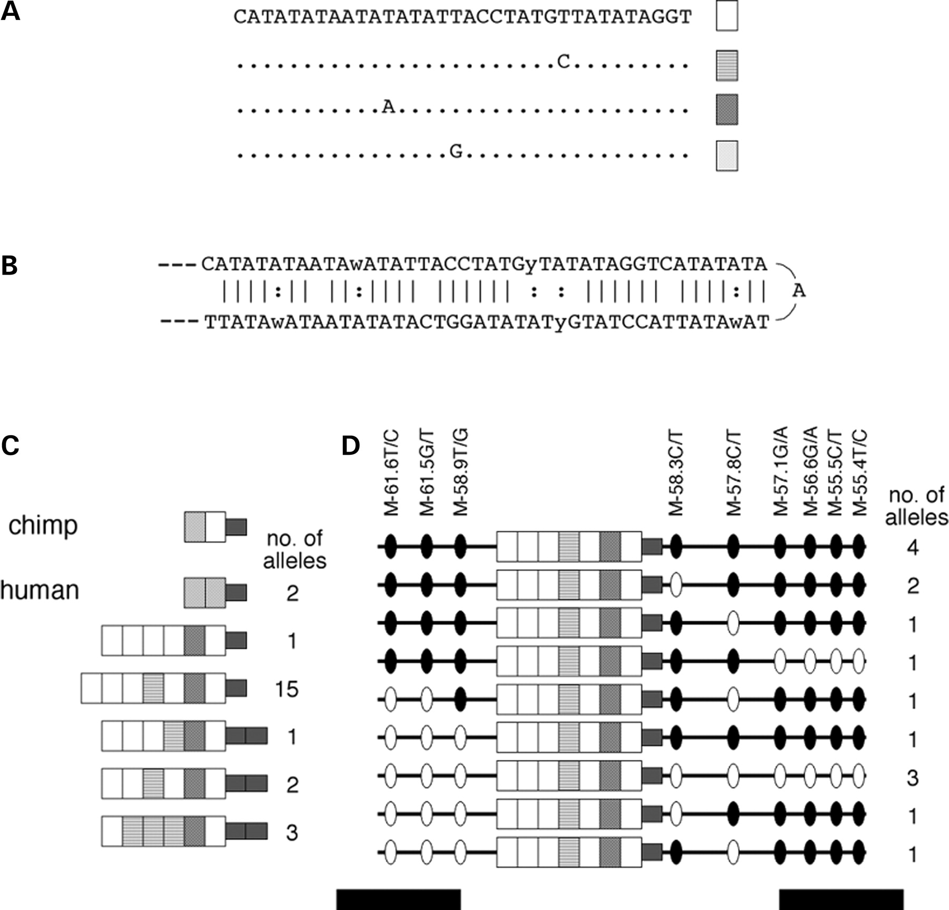
Figure 2. Properties of minisatellite MSNID. (A) Repeat sequence of MSNID with variant repeats indicated ...
Notes:
Figure 2. Properties of minisatellite MSNID. (A) Repeat sequence of MSNID with variant repeats indicated below. (B) Predicted fold-back structure, illustrated using 2.5 repeats. (C) Allelic diversity in human MSNID from a survey of 24 fully resequenced alleles, with repeats coded as in (A). The adjacent 35 bp sequence ATAAATATAT TACATATATG TAATATATAT TAAAT (dark grey rectangle) is perfectly duplicated on some alleles. The chimpanzee MSNID structure was deduced from the draft chimp genome sequence. (D) Flanking haplotype diversity among fifteen identical human MSNID alleles, with SNP alleles coded black (first allele, e.g. M-61.6T) and white (second allele, e.g. M-61.6C). SNP locations are not to scale and LD blocks flanking the hotspot are shown below as black bars.
Unless provided in the caption above, the following copyright applies to the content of this slide: © The Author 2005. Published by Oxford University Press. All rights reserved. For Permissions, please email: journals.permissions@oupjournals.org

Slide 3
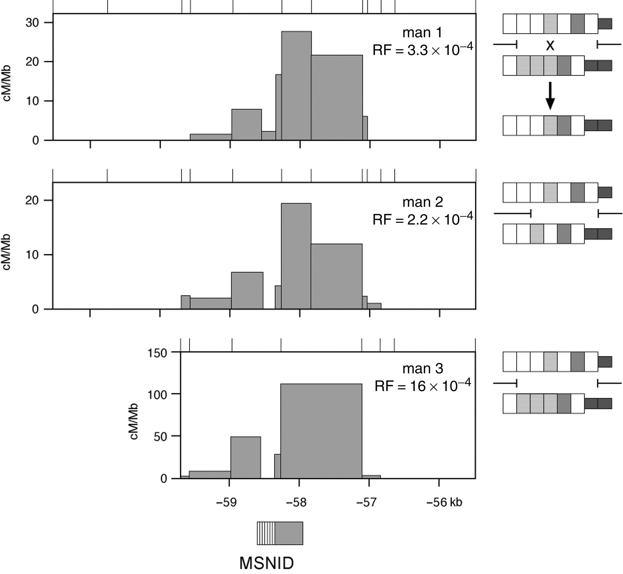
Figure 3. Location of sperm crossovers in hotspot NID1 relative to minisatellite MSNID. Three men were typed ...
Notes:
Figure 3. Location of sperm crossovers in hotspot NID1 relative to minisatellite MSNID. Three men were typed for crossovers. Data for men 1 and 2 are from Figure 1C. Man 3 yielded 140 crossovers from 88 000 progenitor molecules of each haplotype; the shorter test interval is due to homozygosity at the M-61.5T/G selector site, forcing the use of SNP M-59.7C/G for crossover recovery (Fig. 4B). All exchanges mapping to the interval containing MSNID were sequenced. Minisatellite structures so determined were compared with the progenitor alleles in each man (shown at right) to locate each exchange point. Only the region between the barred lines for each man is informative for locating minisatellite exchanges. Only one exchange, in man 1, mapped within MSNID; its structure and the deduced location of the exchange is shown at right. The location of MSNID (hatched) and its associated AT-rich DNA (grey box) is indicated below.
Unless provided in the caption above, the following copyright applies to the content of this slide: © The Author 2005. Published by Oxford University Press. All rights reserved. For Permissions, please email: journals.permissions@oupjournals.org

Slide 4
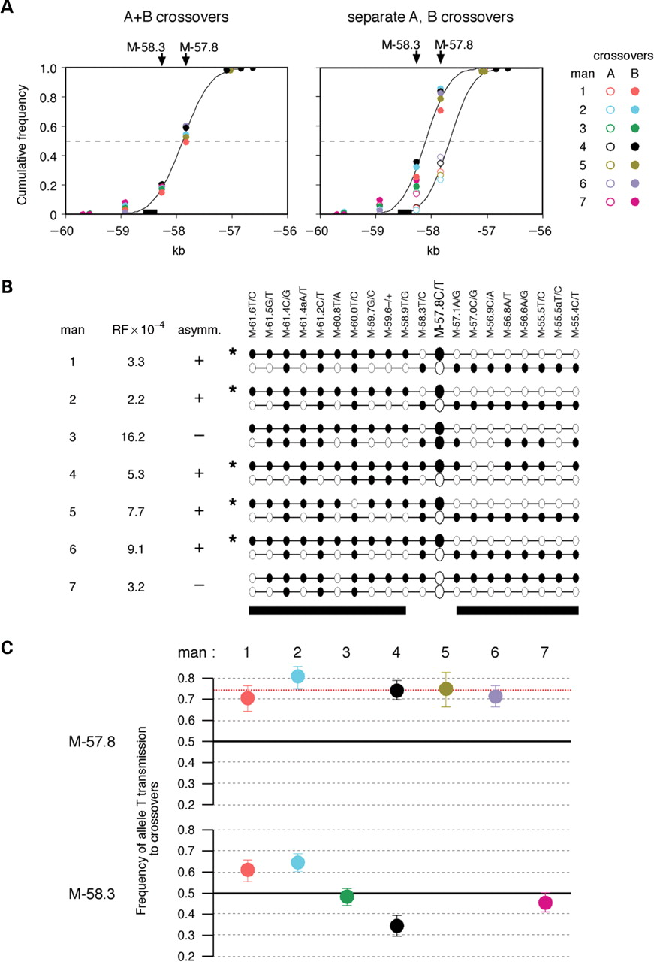
Figure 4. Reciprocal crossover asymmetry and meiotic drive in hotspot NID1. (A) Cumulative frequencies of ...
Notes:
Figure 4. Reciprocal crossover asymmetry and meiotic drive in hotspot NID1. (A) Cumulative frequencies of crossovers across the hotspot in seven men. A- and B-type crossovers were recovered and mapped from sperm from each man and are shown combined (left) and separately (right). Markers within the hotspot are arrowed and minisatellite MSNID shown as a box below. (B) Haplotypes, crossover frequency and the existence or otherwise of asymmetry in each man analysed. Markers in haplotypes are not shown to scale and alleles are coded black or white as in Figure 2C. If asymmetry arises from differences between haplotypes in recombination initiation rate, then the haplotype asterisked in each donor showing asymmetry must be the more active in initiation. Haplotype blocks flanking the hotspot (8) are indicated below by black bars. (C) Transmission frequencies of hotspot alleles to crossover products. The mean frequencies, plus 95% CI, of transmission of alleles M-57.8T and M-58.3T to equal number of A- and B-type crossovers are shown for each informative man. The red line shows the mean level of transmission of M-57.8T in M-57.8T/C heterozygotes. All data were determined from the following number of A- and B-type crossovers analysed/number of amplifiable progenitor molecules of each haplotype screened: man 1, A 51/180 000, B 67/180 000; man 2, A 57/310 000, B 137/540 000; man 3, A 140/78 000, B 140/97 000; man 4, A 152/270 000, B 80/160 000; man 5, A 32/46 000, B 65/75 000; man 6, A 108/250 000, B 120/250 000; man 7, A 101/290 000, B 95/330 000.
Unless provided in the caption above, the following copyright applies to the content of this slide: © The Author 2005. Published by Oxford University Press. All rights reserved. For Permissions, please email: journals.permissions@oupjournals.org

Slide 5
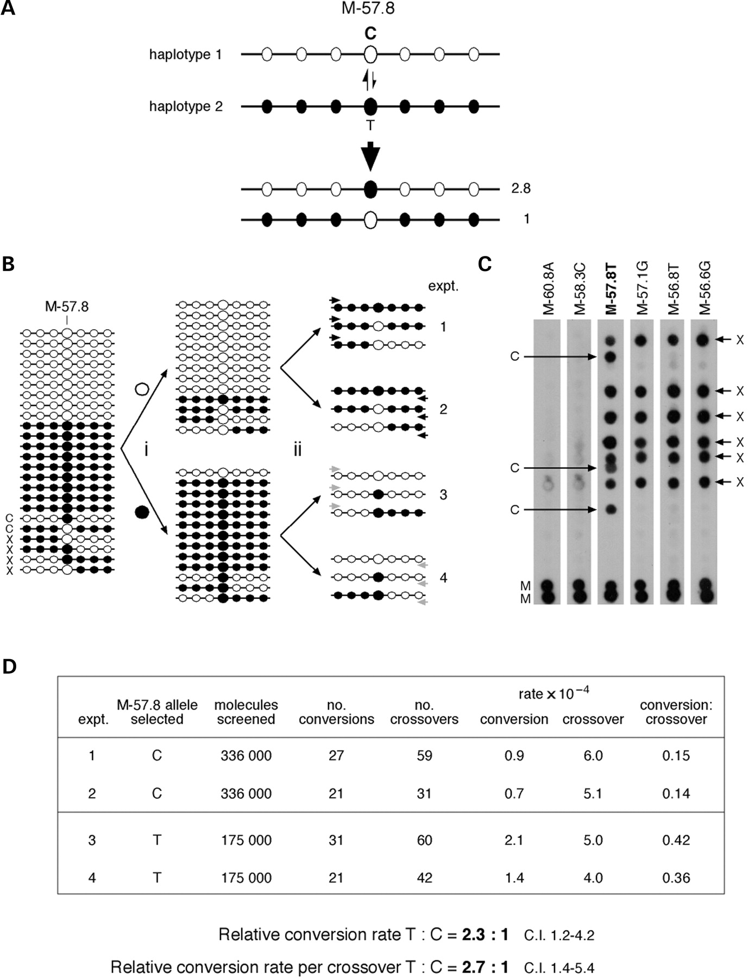
Figure 5. Disparity in gene conversion frequencies between M-57.8C and M-57.8T. (A) Relative frequencies of ...
Notes:
Figure 5. Disparity in gene conversion frequencies between M-57.8C and M-57.8T. (A) Relative frequencies of sperm conversions without exchange involving marker M-57.8, predicted from the mean strength of reciprocal crossover asymmetry seen in Figure 4. (B) Procedure for assaying crossovers and conversions involving exchanges at M-57.8C/T in man 4. Sperm DNA containing a low frequency of conversion (C) and crossover (X) molecules was restricted and fractionated by hybridization with a biotinylated ASO specific for M-57.8C or for M-57.8T to remove the bulk of haplotype 2 or haplotype 1 molecules, respectively (i). Enriched single-stranded DNA was then amplified using allele-specific primers directed to markers either 5′ (experiments 1 and 3) or 3′ (experiments 2 and 4) to the hotspot and specific for the depleted haplotype. PCR products will be derived from any remaining molecules of the depleted progenitor haplotype, together with any conversions and crossovers that include an exchange between M-57.8 and the allele-specific primer site. Note that experiments 1 and 2 should give the same conversion frequency but different crossover frequencies because not all crossovers will be detected (for example, experiment 1 will only yield crossovers that map 5′ to M-57.8). The same is true for experiments 3 and 4. (C) Examples of PCRs from experiment 3 analysed by dot-blot hybridization with ASOs specific for the enriched haplotype 2. Each PCR contained 940 amplifiable molecules of haplotype 2 and approximately 12 remaining molecules of haplotype 1; the former will not be amplified and a recombinant molecule, if present, will constitute ∼10% of the PCR products. Three conversions exchanged at M-57.8 only, and six crossovers each exchanged in the interval M-58.3/M-57.8, were detected. M, control 10:1 mixtures of haplotype 1:haplotype 2. (D) Summary of recombinants seen in experiments 1–4. The number of molecules screened was estimated by Poisson analysis of multiple limiting dilutions of each enriched DNA fraction. Crossover frequencies were corrected for the proportion of exchanges that would be missed in each experiment, using data on A- and B-type crossover distributions from Figure 5A. The relative frequencies and confidence intervals for M-58.3T→C and C→T conversions shown below were determined by maximum likelihood analysis of the entire data set.
Unless provided in the caption above, the following copyright applies to the content of this slide: © The Author 2005. Published by Oxford University Press. All rights reserved. For Permissions, please email: journals.permissions@oupjournals.org

