Slide 1
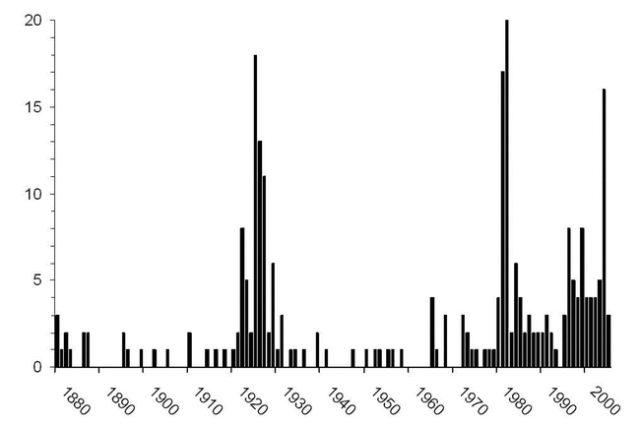
Figure 1. Numbers of references in Science and The Scientific Monthly to the creationist–evolutionist controversy, ...
Notes:
Figure 1. Numbers of references in Science and The Scientific Monthly to the creationist–evolutionist controversy, shown by year. Peaks in 1925 and 1981 through 1987 reflect the Scopes trial and trials in California, Arkansas, and Louisiana. Since 1996, the intelligent design movement has attracted attention
Unless provided in the caption above, the following copyright applies to the content of this slide: © 2006 American Institute of Biological Sciences

