Slide 1
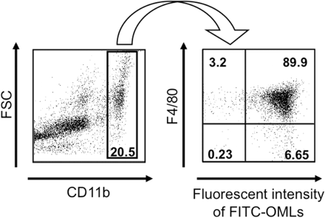
Fig. 1. Identification of cells that ingested OMLs in the peritoneal cavity. OMLs containing FITC-BSA (FITC-OMLs) ...
Notes:
Fig. 1. Identification of cells that ingested OMLs in the peritoneal cavity. OMLs containing FITC-BSA (FITC-OMLs) were injected into the peritoneal cavity of mice and PECs were recovered 1 h after injection. The cells were then stained with PerCP-Cy5.5-labelled anti-CD11b and PE-labelled anti-F4/80 antibodies. Cells that were strongly positive for CD11b were gated (left panel) and ingestion of OMLs and expression of F4/80 was analysed in the gated cells (right panel). About 90% of the CD11b-positive cells expressed F4/80 and ingested OMLs preferentially.
Unless provided in the caption above, the following copyright applies to the content of this slide: © 2008 The Japanese Biochemical Society

Slide 2
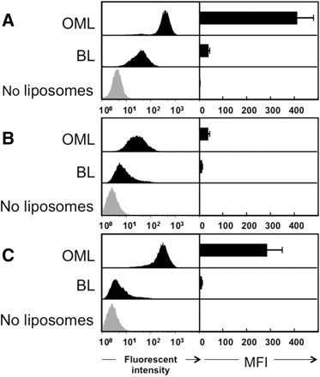
Fig. 2. Effect of PF on uptake of OMLs into PEMs in vitro.In vivo uptake of OMLs into PEMs (A) and in vitro uptake of ...
Notes:
Fig. 2. Effect of PF on uptake of OMLs into PEMs in vitro.In vivo uptake of OMLs into PEMs (A) and in vitro uptake of OMLs into PEMs with (C) or without (B) PF were analysed. For analysis in vivo uptake of OMLs, OMLs or BLs with encased FITC-BSA were injected into the peritoneal cavity of C57BL/6 mice, and PECs were harvested 1 h after injection. For analysis of in vitro uptake of OMLs, PECs were harvested from the peritoneal cavity and then incubated with OMLs or BLs with encased FITC-BSA with or without PF (4 mg/ml) at 37°C for 1 h. The resulting PECs were then stained with PerCP-Cy5.5-labelled CD11b and analysed by FACS. CD11b-positive cells were identified as PEMs and the fluorescent intensity of FITC in these cells is shown. Shaded peaks indicate PEMs incubated without FITC-BSA-containing OMLs. Data are expressed as both histograms and mean fluorescent intensities (MFI) from three independent experiments. Each bar represents the mean ± SD.
Unless provided in the caption above, the following copyright applies to the content of this slide: © 2008 The Japanese Biochemical Society

Slide 3
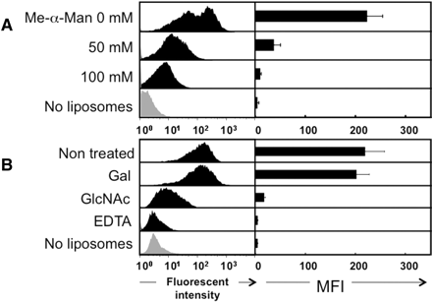
Fig. 3. Effect of carbohydrates on in vitro uptake of OMLs into PEMs in the presence of PF. (A) Isolated PECs were ...
Notes:
Fig. 3. Effect of carbohydrates on in vitro uptake of OMLs into PEMs in the presence of PF. (A) Isolated PECs were incubated with OMLs with encased FITC-BSA in the presence of PF and with different concentrations of methyl-α-mannoside. (B) PF-mediated uptake of FITC-BSA-containing OMLs into PEMs was determined in the presence of 50 mM N-acetylglucosamine (GlcNAc), 50 mM galactose (Gal) or 10 mM EDTA. Data are expressed as both histograms and MFI from three independent experiments. Each bar represents the mean ± SD.
Unless provided in the caption above, the following copyright applies to the content of this slide: © 2008 The Japanese Biochemical Society

Slide 4
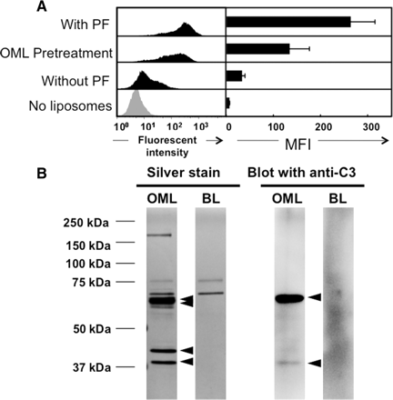
Fig. 4. Uptake of PF-treated OMLs into PEMs in vitro. (A) FITC-BSA-containing OMLs (60 μg of cholesterol) were ...
Notes:
Fig. 4. Uptake of PF-treated OMLs into PEMs in vitro. (A) FITC-BSA-containing OMLs (60 μg of cholesterol) were incubated with PF (1.2 mg of protein) in serum-free RPMI 1640 medium for 30 min, and then recovered by centrifugation and washed with serum-free RPMI 1640 medium. The resulting PF-treated OMLs were incubated with isolated PECs in serum-free RPMI 1640 medium without PF for 1 h. PECs were harvested, washed and stained with PerCP-Cy5.5-labelled CD11b, as described in the legend to Fig. 1. Data are expressed as both histograms and MFI from three independent experiments. Each bar represents the mean ± SD. (B) OMLs or BLs (60 μg of cholesterol) were incubated with PF (1.2 mg of protein) in serum-free RPMI 1640 medium for 30 min, and then recovered by centrifugation and washed with serum-free RPMI 1640 medium. The resulting PF-treated OMLs or PF-treated BLs (each 10 µg of cholesterol) were subjected to SDS–PAGE on 10% gels under reducing conditions. The proteins were stained using a Silver Stain MS Kit. Alternatively, the separated proteins were probed with an anti-C3 polyclonal antibody. Arrowheads indicate protein bands corresponding to C3 fragments (69, 67, 43 and 38 kDa).
Unless provided in the caption above, the following copyright applies to the content of this slide: © 2008 The Japanese Biochemical Society

Slide 5
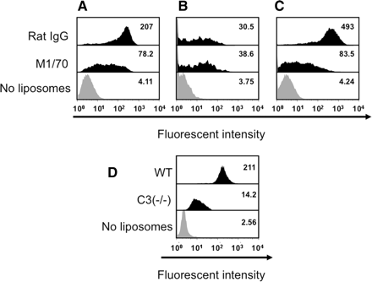
Fig. 5. Contribution of CR3 and C3 to uptake of OMLs by PEMs in vitro and in vivo. (A and B) Isolated PECs were ...
Notes:
Fig. 5. Contribution of CR3 and C3 to uptake of OMLs by PEMs in vitro and in vivo. (A and B) Isolated PECs were treated with 10 μg/ml of an anti-CR3 monoclonal antibody M1/70 (rat IgG2b) or a rat IgG2b isotype control for 20 min at 4°C. After washing the cells with cold PBS, the PECs were incubated with OMLs containing FITC-BSA in the presence (A) or absence (B) of PF at 37°C for 1 h, as described in the legend to Fig. 2. (C) An anti-CR3 monoclonal antibody (5 µg) or an isotype control (5 µg) was injected into the peritoneal cavity 10 min before injection of FITC-BSA-containing OMLs into the peritoneal cavity. Thirty minutes after injection of OMLs, PECs were harvested and OML uptake into PEMs was analysed as described in the legend to Fig. 1. (D) OMLs with encased FITC-BSA (60 μg cholesterol) were injected into the peritoneal cavity of C3-deficient (C3−/−) mice or WT mice bred in a C57BL/6 genetic background. One hour after intraperitoneal injection, PECs were harvested and OML uptake into PEMs was analysed. The MFI is indicated in each figure.
Unless provided in the caption above, the following copyright applies to the content of this slide: © 2008 The Japanese Biochemical Society

Slide 6
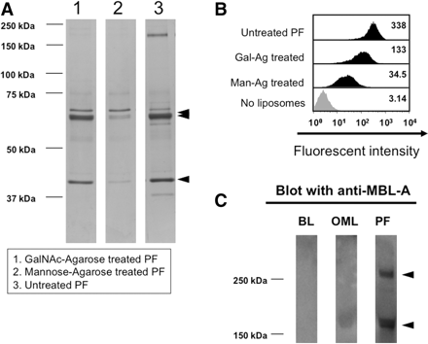
Fig. 6. Contribution of soluble C-type lectins in PF to opsonization and uptake of OMLs in vitro. PFs were treated ...
Notes:
Fig. 6. Contribution of soluble C-type lectins in PF to opsonization and uptake of OMLs in vitro. PFs were treated with mannose–agarose (Man–Ag) or N-acetylgalactosamine–agarose (GalNAc–Ag) at 4°C overnight, as described in the MATERIALS AND METHODS section. (A) OMLs were then incubated with the same concentration of Man–Ag-treated PF, GalNAc–Ag-treated PF or untreated PF at 37°C for 30 min. After washing with PBS, the OML samples were subjected to SDS–PAGE. Arrowheads indicate protein bands corresponding to C3 fragments with molecular weights of 69, 67 and 43 kDa, respectively. (B) Isolated PEMs were incubated with FITC-BSA-containing OMLs (60 μg of cholesterol) for 1 h at 37°C in the presence of Man–Ag-treated PF, GalNAc–Ag-treated PF or untreated PF (4 mg/ml). (C) OMLs or BLs (60 μg of cholesterol) were incubated with PF (1.2 mg of protein) for 30 min at 37°C, as described in the legend to Fig. 4. The resulting PF-treated OMLs or PF-treated BLs (each 10 µg of cholesterol) and PF (30 µg of protein) were subjected to SDS–PAGE on 10% gels under non-reducing conditions and probed with an anti-MBL-A polyclonal antibody. Arrowheads indicate the MBL dimer (180 kDa) and trimer (270 kDa), respectively.
Unless provided in the caption above, the following copyright applies to the content of this slide: © 2008 The Japanese Biochemical Society

