Slide 1
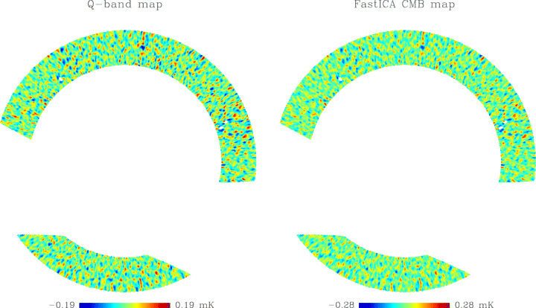
Figure 1 left: the BEAST Q-band map smoothed to 40 arcmin; right: the reconstructed astrophysical component (with g ...
Notes:
Figure 1 left: the BEAST Q-band map smoothed to 40 arcmin; right: the reconstructed astrophysical component (with g function). The Galactic plane is removed for |b| ≤ 175.
Unless provided in the caption above, the following copyright applies to the content of this slide: © 2006 The Authors. Journal compilation © 2006 RAS

Slide 2
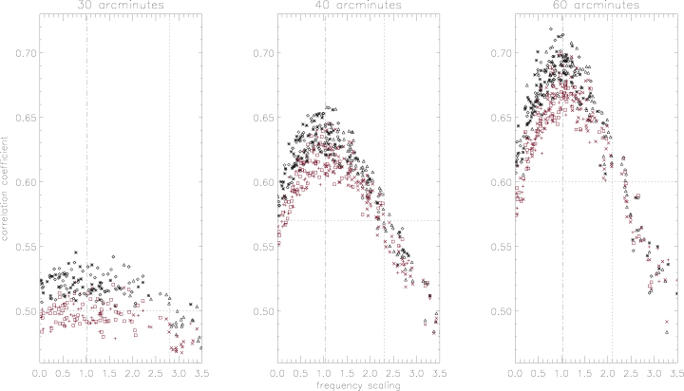
Figure 2 Correlation between ICA CMB and simulated CMB in Ka (plus sign =p, square =g, ‘x’=t) and Q band (asterisk =p, ...
Notes:
Figure 2 Correlation between ICA CMB and simulated CMB in Ka (plus sign =p, square =g, ‘x’=t) and Q band (asterisk =p, diamond =g, triangle =t) towards recovered frequency scaling at 30, 40 and 60 arcmin. Dot–dashed lines show the expected scaling (1.022). Dotted lines indicate the minimum correlation and the maximum scaling for a good CMB reconstruction. We can also observe that correlation with CMB-Q map is greater than with CMB–Ka map.
Unless provided in the caption above, the following copyright applies to the content of this slide: © 2006 The Authors. Journal compilation © 2006 RAS

Slide 3
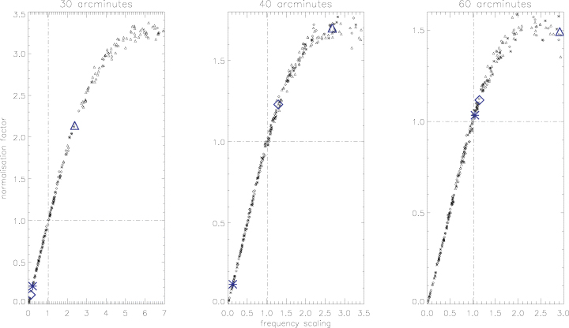
Figure 3 Normalization factor as a function of the frequency scaling for 30, 40 and 60 arcmin. Dot–dashed lines ...
Notes:
Figure 3 Normalization factor as a function of the frequency scaling for 30, 40 and 60 arcmin. Dot–dashed lines indicate normalization factor equal to 1 and the expected frequency scaling. The bigger symbols show the interpolation with the frequency scalings of the CMB recovered from BEAST data, cutting the Galactic plane for |b| ≤ 17.5° and using p (asterisks), g (diamonds) and t (triangles) function.
Unless provided in the caption above, the following copyright applies to the content of this slide: © 2006 The Authors. Journal compilation © 2006 RAS

Slide 4
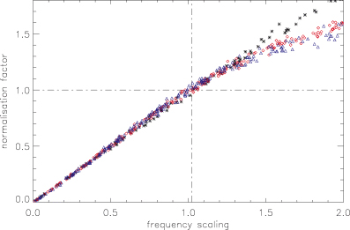
Figure 4 Normalization factor as a function of frequency scaling for 30 (asterisks), 40 (diamonds) and 60 arcmin ...
Notes:
Figure 4 Normalization factor as a function of frequency scaling for 30 (asterisks), 40 (diamonds) and 60 arcmin (triangles).
Unless provided in the caption above, the following copyright applies to the content of this slide: © 2006 The Authors. Journal compilation © 2006 RAS

Slide 5
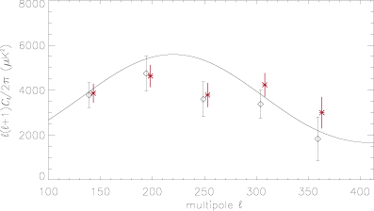
Figure 5 CMB power spectra from BEAST data: stars show the spectrum extracted from fastica 40-arcmin CMB map, diamonds ...
Notes:
Figure 5 CMB power spectra from BEAST data: stars show the spectrum extracted from fastica 40-arcmin CMB map, diamonds show the 23-arcmin Q-band map spectrum (O'Dwyer et al. 2005). ICA spectrum is shifted by Δℓ= 4 for clarity. Solid line is the best-fitting WMAP power spectrum.
Unless provided in the caption above, the following copyright applies to the content of this slide: © 2006 The Authors. Journal compilation © 2006 RAS

