Slide 1
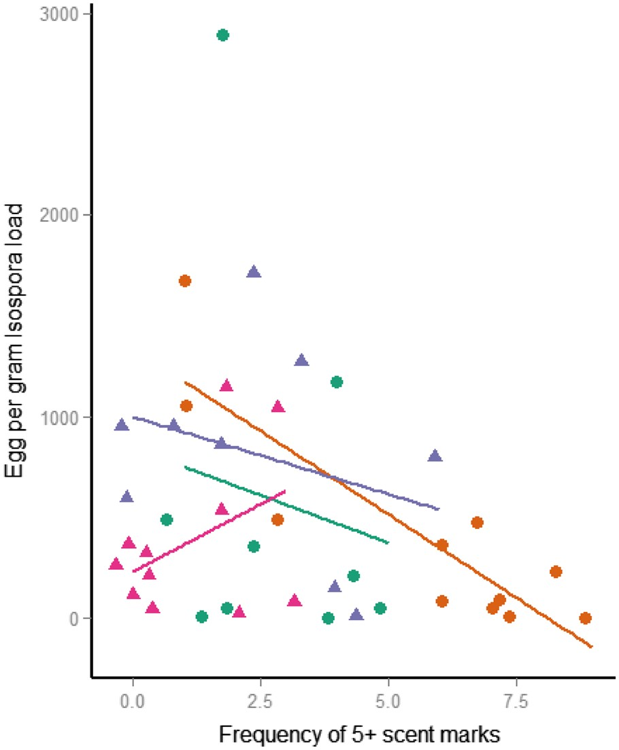
Figure 1 The relationship between Isospora load and intensive marking behavior. Points show raw data (circles = male, ...
Notes:
Figure 1 The relationship between Isospora load and intensive marking behavior. Points show raw data (circles = male, triangles = female). Lines (green for social group 1B females, orange 1B males, purple for 1H females and pink for 1H males) were calculated by linear regression of Isospora load upon the frequency of depositing >5 marks per bout. Results were based upon 102 observations of group marking events within 2 social groups containing 40 individual banded mongooses aged >6 months. In general, individuals with lower Isospora loads engaged in intense marking (>5 marks per bout) significantly more frequently than individuals of higher Isospora load. The exception to this is females within group 1H (purple line, triangular points).
Unless provided in the caption above, the following copyright applies to the content of this slide: © The Author (2017). Published by Oxford University Press. This is an Open Access article distributed under the terms of the Creative Commons Attribution Non-Commercial License (http://creativecommons.org/licenses/by-nc/4.0/), which permits non-commercial re-use, distribution, and reproduction in any medium, provided the original work is properly cited. For commercial re-use, please contact journals.permissions@oup.com

Slide 2
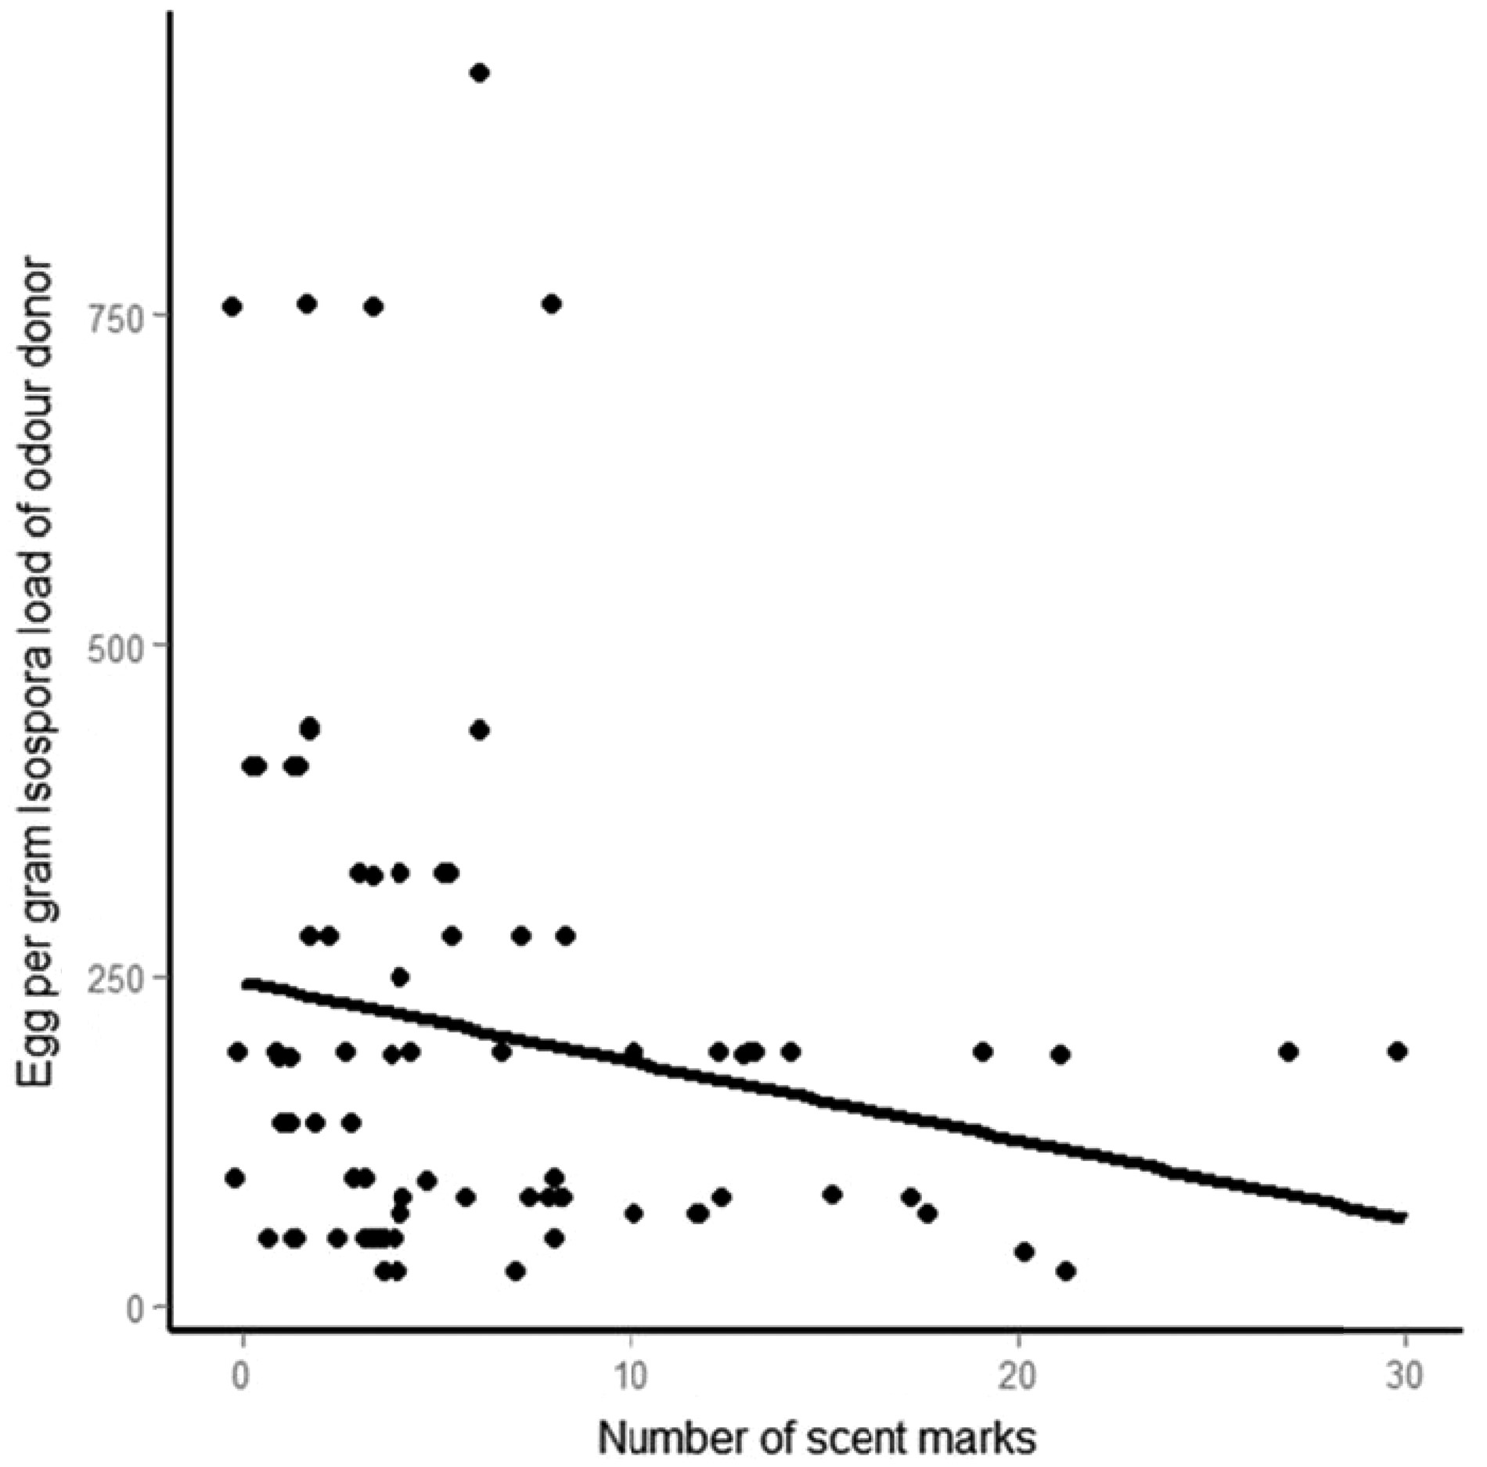
Figure 2 The relationship between Isospora load and marking behavior to presented odors. Recipients deposited fewer ...
Notes:
Figure 2 The relationship between Isospora load and marking behavior to presented odors. Recipients deposited fewer marks toward opposite sex odors as the Isospora load of the odor donor increased. Points show average EPG Isospora counts for each odor donor, and lines were fit by linear regression of EPG load against scent marking.
Unless provided in the caption above, the following copyright applies to the content of this slide: © The Author (2017). Published by Oxford University Press. This is an Open Access article distributed under the terms of the Creative Commons Attribution Non-Commercial License (http://creativecommons.org/licenses/by-nc/4.0/), which permits non-commercial re-use, distribution, and reproduction in any medium, provided the original work is properly cited. For commercial re-use, please contact journals.permissions@oup.com

Slide 3
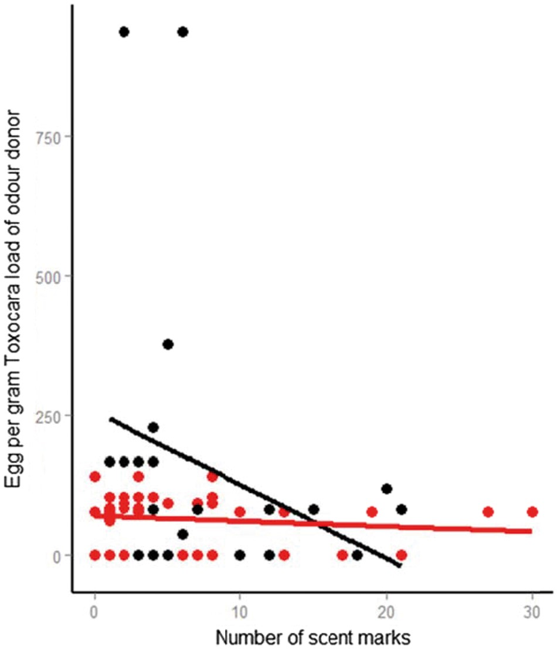
Figure 3 The relationship between odor donor sex, Toxocara load and reactions to opposite sex presented scents. ...
Notes:
Figure 3 The relationship between odor donor sex, Toxocara load and reactions to opposite sex presented scents. Recipients deposited more marks toward male odors as their Toxocara load decreased (black points). This trend was not as strong when considering female odors (red points). Points represent average EPG Toxocara counts for each odor donor, lines fit by linear regression of egg load against scent marking.
Unless provided in the caption above, the following copyright applies to the content of this slide: © The Author (2017). Published by Oxford University Press. This is an Open Access article distributed under the terms of the Creative Commons Attribution Non-Commercial License (http://creativecommons.org/licenses/by-nc/4.0/), which permits non-commercial re-use, distribution, and reproduction in any medium, provided the original work is properly cited. For commercial re-use, please contact journals.permissions@oup.com

