Slide 1
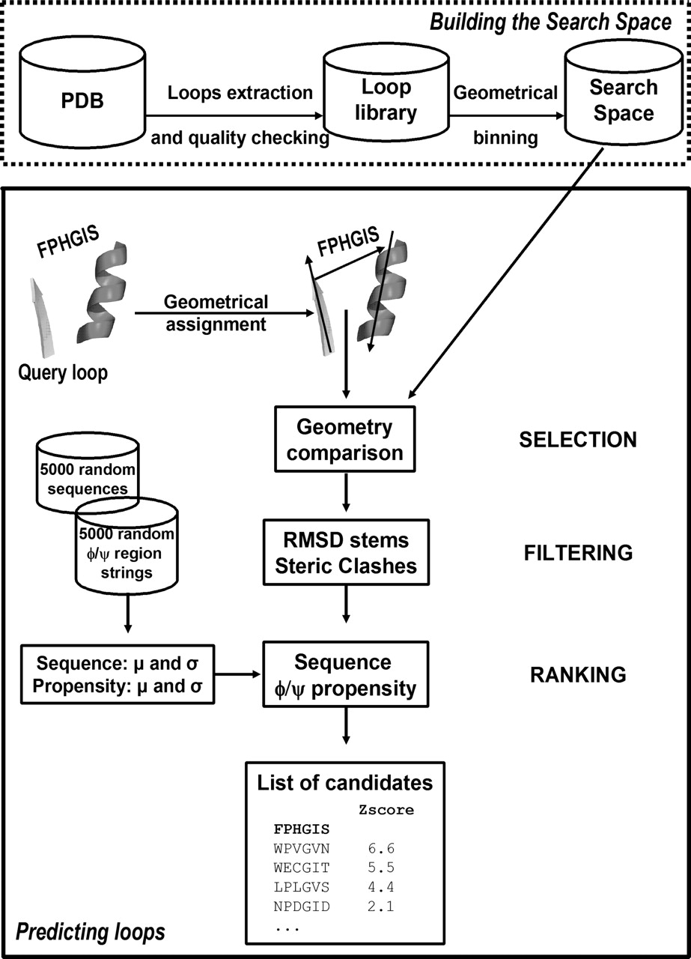
Figure 1 Flowchart of the methodology for building the Search Space and performing the prediction.
Notes:
Figure 1 Flowchart of the methodology for building the Search Space and performing the prediction.
Unless provided in the caption above, the following copyright applies to the content of this slide: © The Author 2006. Published by Oxford University Press. All rights reserved The online version of this article has been published under an open access model. Users are entitled to use, reproduce, disseminate, or display the open access version of this article for non-commercial purposes provided that: the original authorship is properly and fully attributed; the Journal and Oxford University Press are attributed as the original place of publication with the correct citation details given; if an article is subsequently reproduced or disseminated not in its entirety but only in part or as a derivative work this must be clearly indicated. For commercial re-use, please contact journals.permissions@oxfordjournals.org

Slide 2
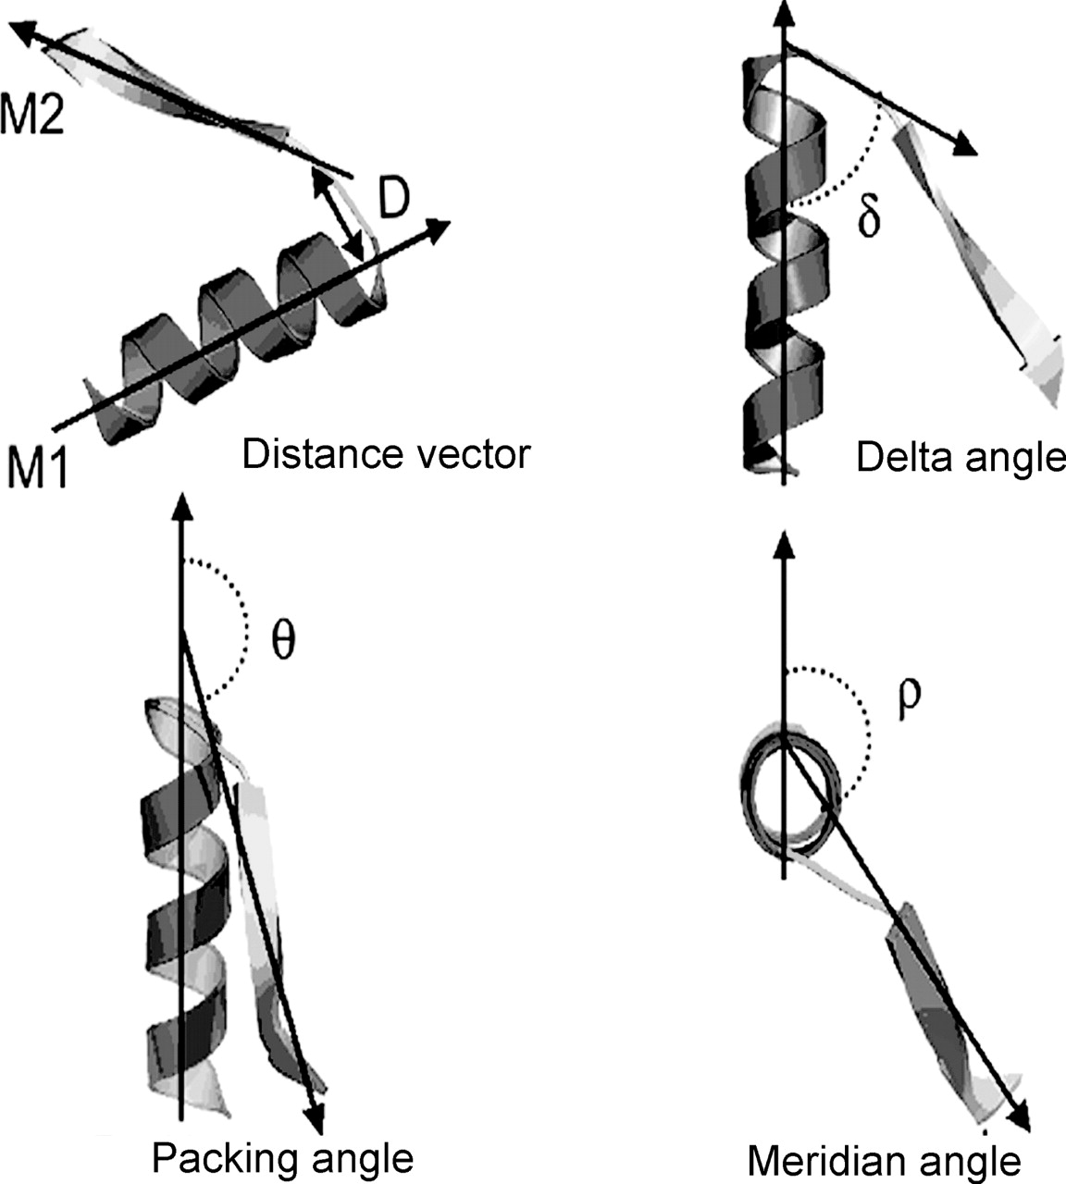
Figure 2 Definition of loop geometry. The axis for an α or β secondary structure is defined as the shortest of the ...
Notes:
Figure 2 Definition of loop geometry. The axis for an α or β secondary structure is defined as the shortest of the principal moments of inertia of that structure. M1 and M2 are the axis vectors of the secondary structure. The geometry of each motif is defined by four internal co-ordinates: (i) D , a distance between ending points, (ii) Hoist angle, δ, the angle between axis M1 and vector of D; (iii) Packing angle, θ, the angle between M1 and M2; and (iv) Meridian angle, ρ, the angle between M2 and the plane that contains the vector M1.
Unless provided in the caption above, the following copyright applies to the content of this slide: © The Author 2006. Published by Oxford University Press. All rights reserved The online version of this article has been published under an open access model. Users are entitled to use, reproduce, disseminate, or display the open access version of this article for non-commercial purposes provided that: the original authorship is properly and fully attributed; the Journal and Oxford University Press are attributed as the original place of publication with the correct citation details given; if an article is subsequently reproduced or disseminated not in its entirety but only in part or as a derivative work this must be clearly indicated. For commercial re-use, please contact journals.permissions@oxfordjournals.org

Slide 3
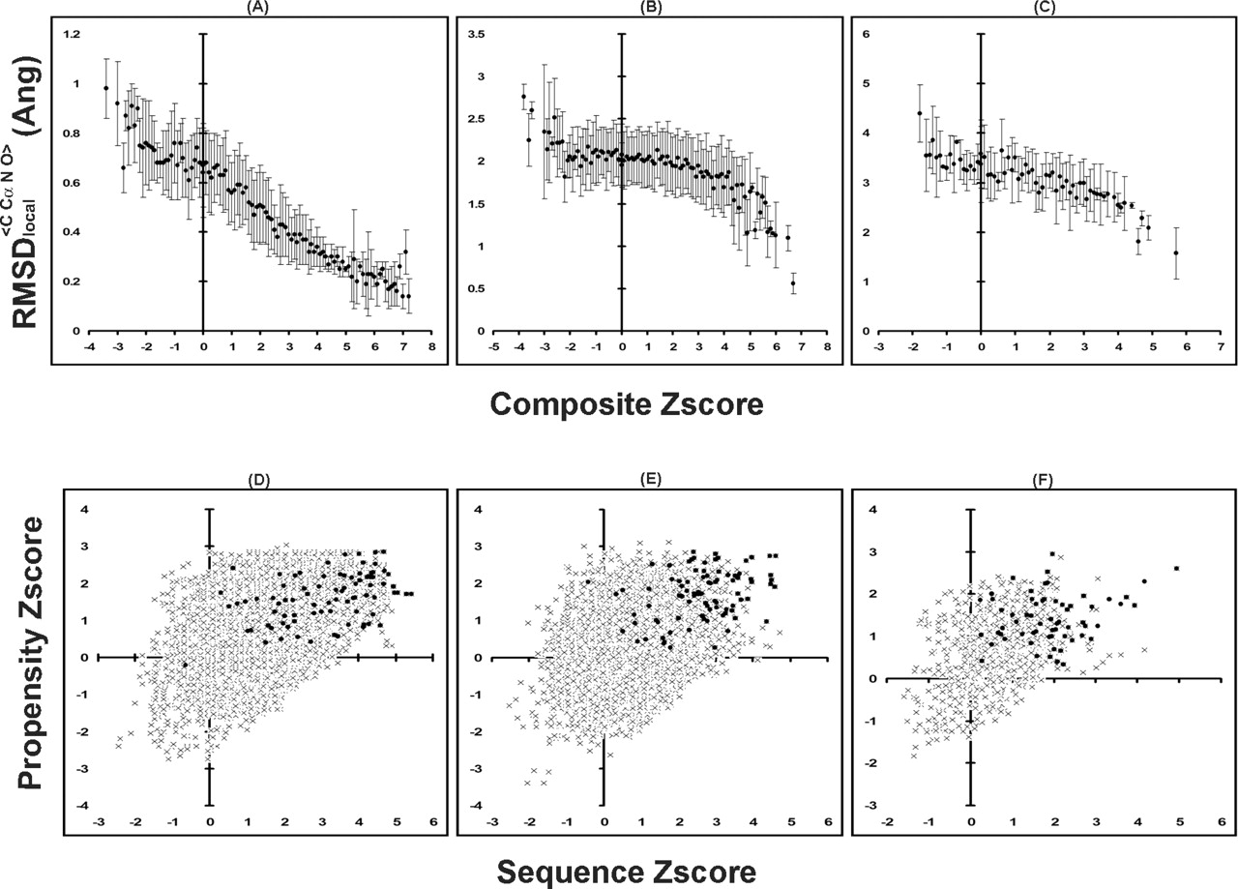
Figure 3 ( A ) Correlation a of composite Z -score and accuracy of prediction (average r.m.s.d. _{local} ) ...
Notes:
Figure 3 ( A ) Correlation a of composite Z -score and accuracy of prediction (average r.m.s.d. local ) for calibration test-sets of ( A ) 4, ( B ) 8 and ( C ) 12 residues long loops, respectively. SDs are shown around the averages. ( B ) Distribution of Z -scores (propensity Z -score versus sequence Z -score) for all candidates ( x ) and for the candidates with the best r.m.s.d. local among top 10 hits (closed circle) for ( D ) 4, ( E ) 8 and ( F ) for 12 residues long loops, respectively.
Unless provided in the caption above, the following copyright applies to the content of this slide: © The Author 2006. Published by Oxford University Press. All rights reserved The online version of this article has been published under an open access model. Users are entitled to use, reproduce, disseminate, or display the open access version of this article for non-commercial purposes provided that: the original authorship is properly and fully attributed; the Journal and Oxford University Press are attributed as the original place of publication with the correct citation details given; if an article is subsequently reproduced or disseminated not in its entirety but only in part or as a derivative work this must be clearly indicated. For commercial re-use, please contact journals.permissions@oxfordjournals.org

Slide 4
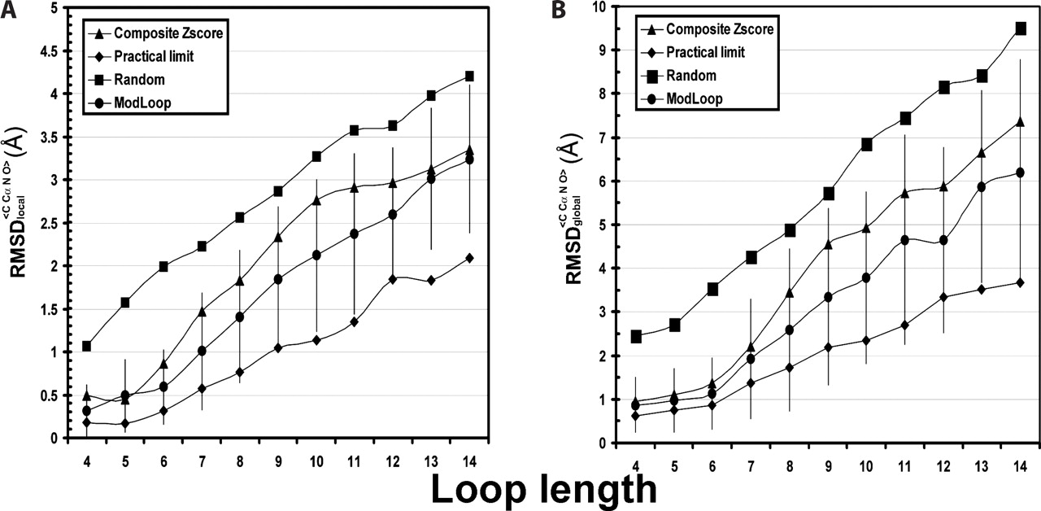
Figure 4 Average ( A ) r.m.s.d. _{local} and ( B ) r.m.s.d. _{global} as a function of loop length. ...
Notes:
Figure 4 Average ( A ) r.m.s.d. local and ( B ) r.m.s.d. global as a function of loop length. (closed diamond) indicates the practical limit of the prediction; (closed circle) shows the average r.m.s.d. of ModLoop predictions; (closed triangle) shows the average r.m.s.d. of candidates with the highest composite Z -score; and (closed square) shows the average r.m.s.d. for random prediction.
Unless provided in the caption above, the following copyright applies to the content of this slide: © The Author 2006. Published by Oxford University Press. All rights reserved The online version of this article has been published under an open access model. Users are entitled to use, reproduce, disseminate, or display the open access version of this article for non-commercial purposes provided that: the original authorship is properly and fully attributed; the Journal and Oxford University Press are attributed as the original place of publication with the correct citation details given; if an article is subsequently reproduced or disseminated not in its entirety but only in part or as a derivative work this must be clearly indicated. For commercial re-use, please contact journals.permissions@oxfordjournals.org

Slide 5
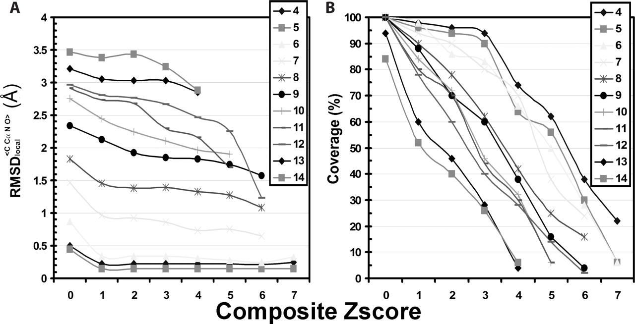
Figure 5 Average r.m.s.d. _{local} ( A ) and coverage ( B ) as a function of Z -score threshold for all loop ...
Notes:
Figure 5 Average r.m.s.d. local ( A ) and coverage ( B ) as a function of Z -score threshold for all loop lengths.
Unless provided in the caption above, the following copyright applies to the content of this slide: © The Author 2006. Published by Oxford University Press. All rights reserved The online version of this article has been published under an open access model. Users are entitled to use, reproduce, disseminate, or display the open access version of this article for non-commercial purposes provided that: the original authorship is properly and fully attributed; the Journal and Oxford University Press are attributed as the original place of publication with the correct citation details given; if an article is subsequently reproduced or disseminated not in its entirety but only in part or as a derivative work this must be clearly indicated. For commercial re-use, please contact journals.permissions@oxfordjournals.org

Slide 6
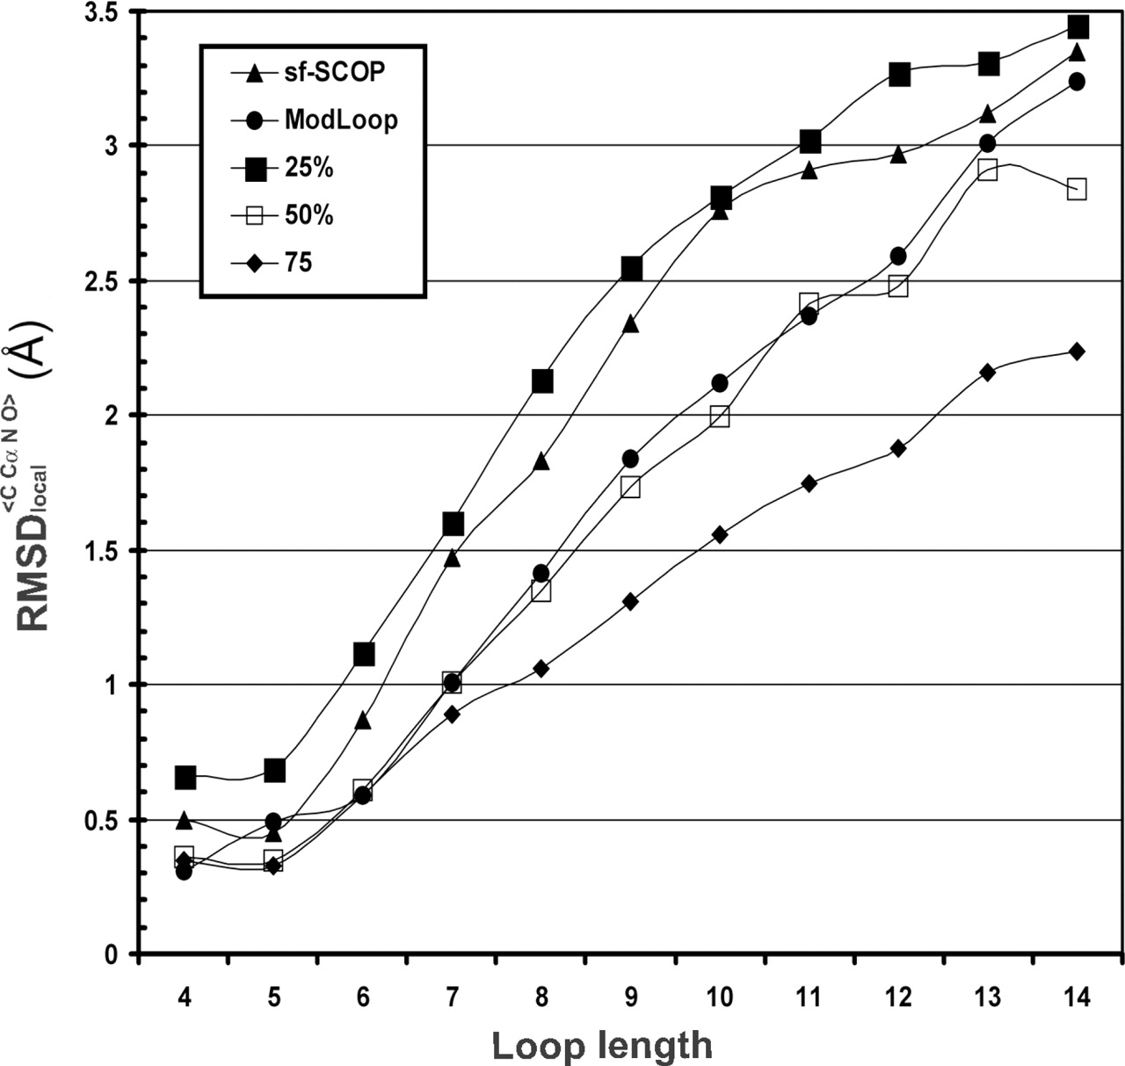
Figure 6 Average r.m.s.d. _{local} as a function of loop lengths under different condition of pre-filtering ...
Notes:
Figure 6 Average r.m.s.d. local as a function of loop lengths under different condition of pre-filtering Search Space: selecting from candidates that belong to a different SCOP superfamily than the query loop (closed triangle); using ModLoop (closed circle); selecting among candidates that have <75% (closed diamond), 50% (open square) and 25% (closed square) sequence identity with query loop.
Unless provided in the caption above, the following copyright applies to the content of this slide: © The Author 2006. Published by Oxford University Press. All rights reserved The online version of this article has been published under an open access model. Users are entitled to use, reproduce, disseminate, or display the open access version of this article for non-commercial purposes provided that: the original authorship is properly and fully attributed; the Journal and Oxford University Press are attributed as the original place of publication with the correct citation details given; if an article is subsequently reproduced or disseminated not in its entirety but only in part or as a derivative work this must be clearly indicated. For commercial re-use, please contact journals.permissions@oxfordjournals.org

Slide 7
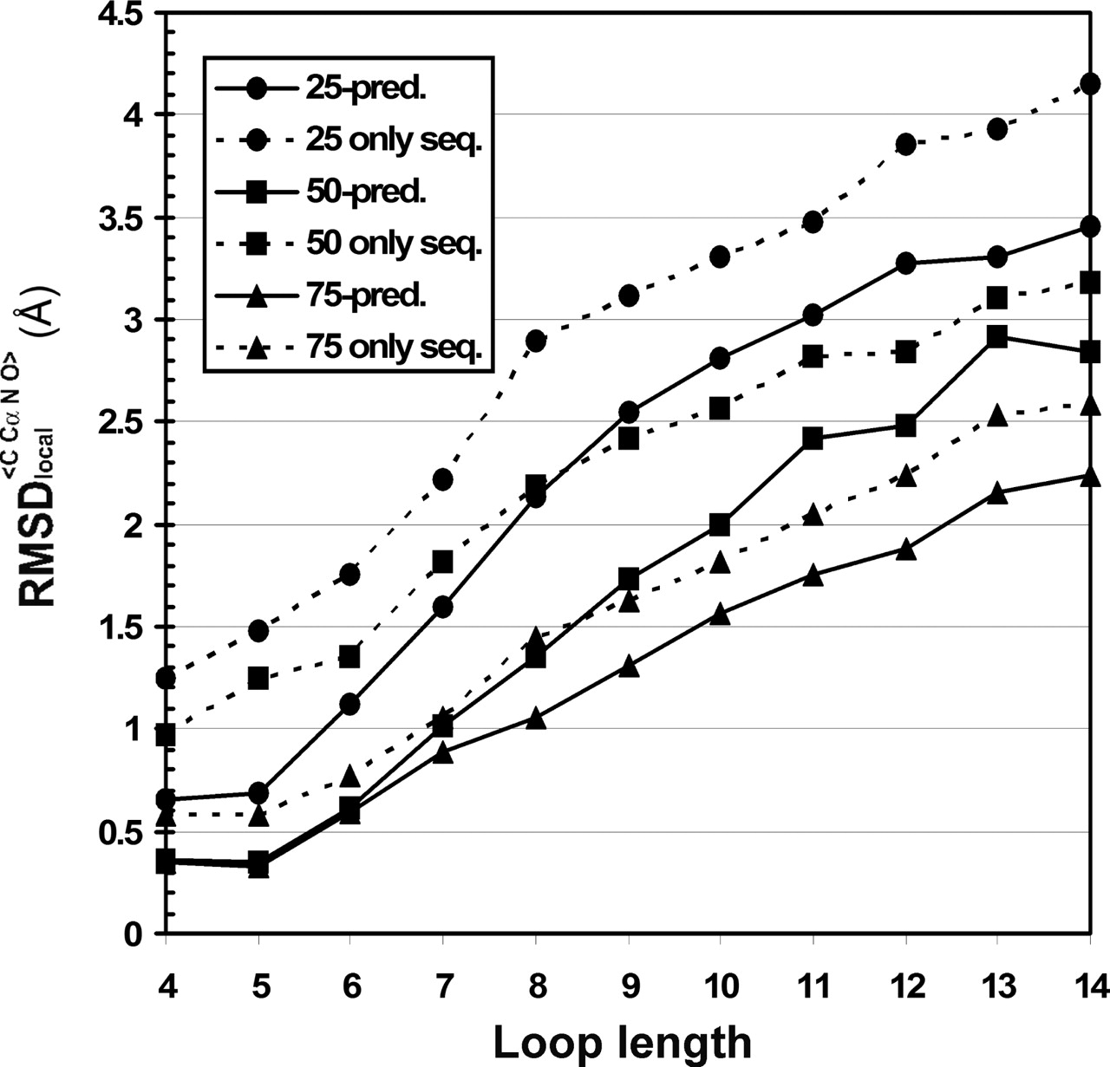
Figure 7 Average r.m.s.d. _{local} versus loop length under different condition of selection using ...
Notes:
Figure 7 Average r.m.s.d. local versus loop length under different condition of selection using information only sequence identity or the full algorithm for prediction.
Unless provided in the caption above, the following copyright applies to the content of this slide: © The Author 2006. Published by Oxford University Press. All rights reserved The online version of this article has been published under an open access model. Users are entitled to use, reproduce, disseminate, or display the open access version of this article for non-commercial purposes provided that: the original authorship is properly and fully attributed; the Journal and Oxford University Press are attributed as the original place of publication with the correct citation details given; if an article is subsequently reproduced or disseminated not in its entirety but only in part or as a derivative work this must be clearly indicated. For commercial re-use, please contact journals.permissions@oxfordjournals.org

Slide 8
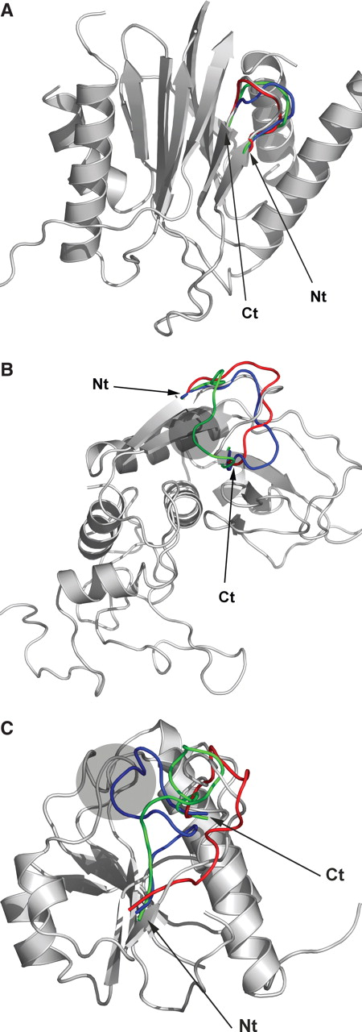
Figure 8 Cartoon representations for three examples of predicted loops. N- and C-termini of loops are marked. The ...
Notes:
Figure 8 Cartoon representations for three examples of predicted loops. N- and C-termini of loops are marked. The experimental structure is in gray while in red, blue and yellow are the candidate loops. Red colored candidate loops are with the highest composite Z -score. Gray shaded spheres indicate regions with repulsive contacts (clashes) between the candidate loop and the protein framework. ( A ) Prediction of a loop of length 4, PDB 1g29, chain 1, residues 37–40. ( B ) Prediction of a loop of length 8, PDB 1srp, residues 107–114. ( C ) Prediction of a loop of length 12, PDB 1j85, chain A residues 121–132. All figures were generated using Pymol ( http:pymol.sourceforge.net ).
Unless provided in the caption above, the following copyright applies to the content of this slide: © The Author 2006. Published by Oxford University Press. All rights reserved The online version of this article has been published under an open access model. Users are entitled to use, reproduce, disseminate, or display the open access version of this article for non-commercial purposes provided that: the original authorship is properly and fully attributed; the Journal and Oxford University Press are attributed as the original place of publication with the correct citation details given; if an article is subsequently reproduced or disseminated not in its entirety but only in part or as a derivative work this must be clearly indicated. For commercial re-use, please contact journals.permissions@oxfordjournals.org

