Slide 1
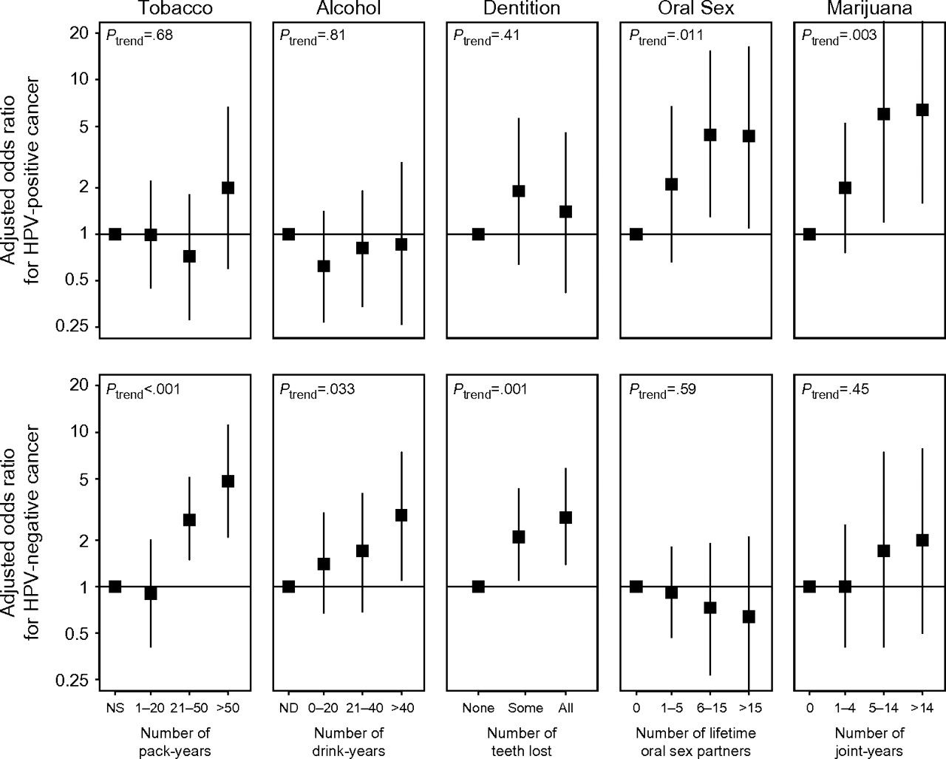
Figure 1 Dose–response relationships for tobacco, alcohol, tooth loss, oral sex partners, and marijuana use and odds ...
Notes:
Figure 1 Dose–response relationships for tobacco, alcohol, tooth loss, oral sex partners, and marijuana use and odds of human papillomavirus type 16 (HPV-16)–positive (top) and HPV-16–negative (bottom) head and neck squamous cell carcinomas (HNSCCs). Black squares represent adjusted odds ratios (ORs) of HNSCC for case subjects vs control subjects; vertical lines represent 95% confidence intervals; horizontal lines represent null associations (ORs = 1). Odds ratios and 95% confidence intervals were derived from conditional logistic regression analysis for case–control comparisons, adjusted for all variables in the figure plus frequency of tooth brushing and race.
Unless provided in the caption above, the following copyright applies to the content of this slide: © The Author 2008. Published by Oxford University Press.

Slide 2
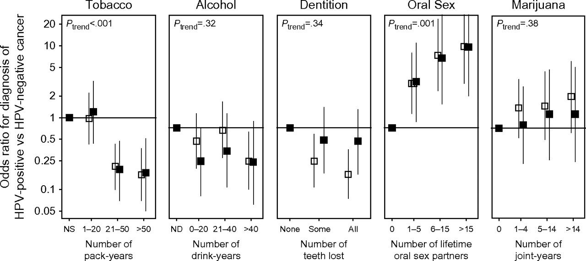
Figure 2 Dose–response relationships for tobacco, alcohol, tooth loss, oral sex partners, and marijuana use and the ...
Notes:
Figure 2 Dose–response relationships for tobacco, alcohol, tooth loss, oral sex partners, and marijuana use and the odds of being diagnosed with human papillomavirus type 16 (HPV-16)–positive vs HPV-16–negative head and neck squamous cell carcinoma. White squares represent univariate odds ratios (ORs), and black squares represent adjusted odds ratios. Vertical lines represent 95% confidence intervals, and horizontal lines represent null associations (ORs = 1). Odds ratios and 95% confidence intervals were derived from unconditional logistic regression analysis for case–case comparisons that adjusted for all variables in the figure plus age, sex, frequency of tooth brushing, and race.
Unless provided in the caption above, the following copyright applies to the content of this slide: © The Author 2008. Published by Oxford University Press.

