Slide 1
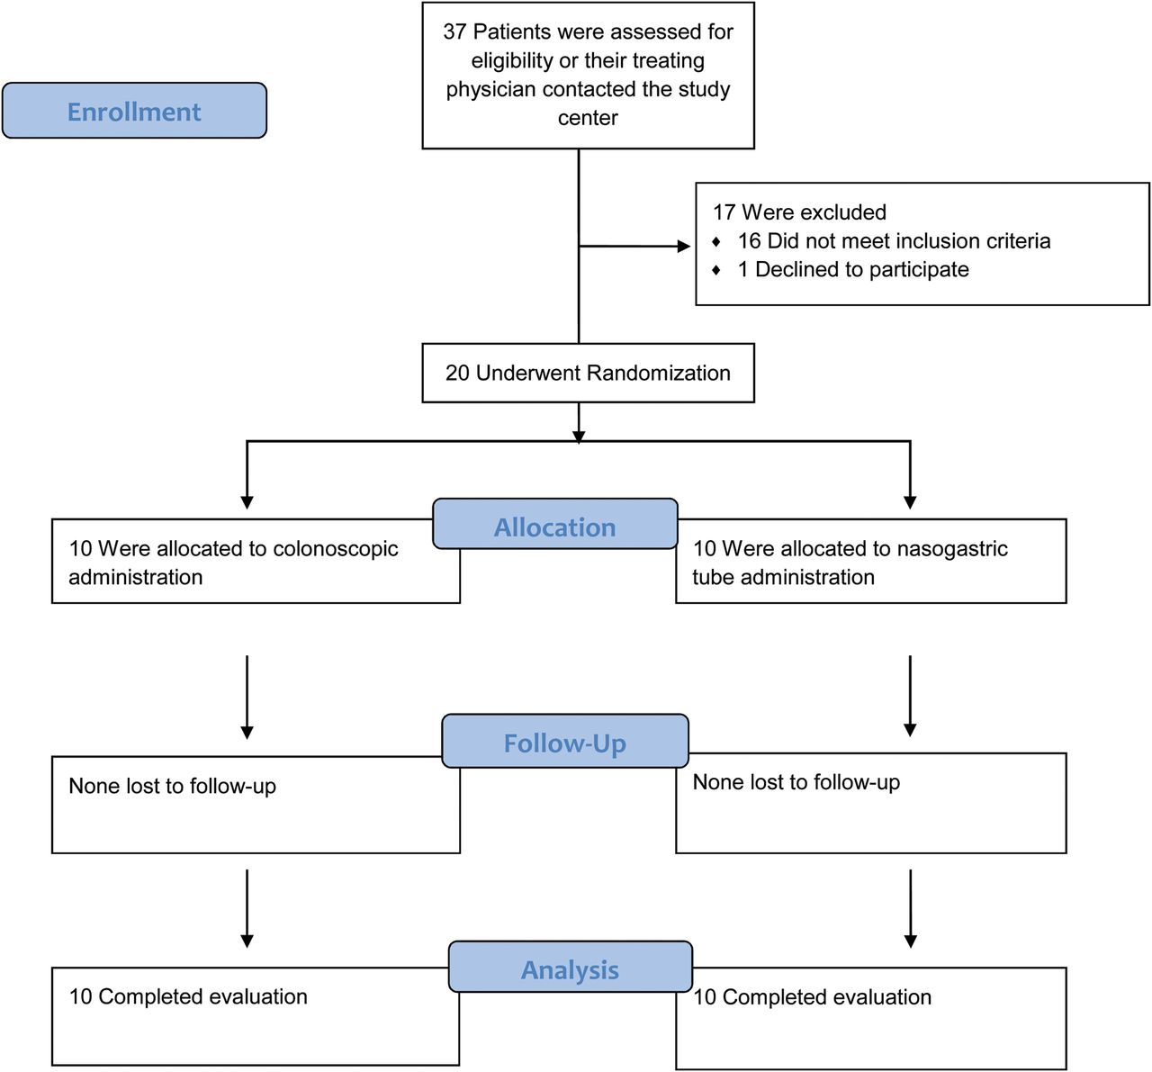
Table 1. Select Baseline Characteristics of Study Population Stratified by Treatment Group Abbreviations: CDI, ...
Notes:
Table 1. Select Baseline Characteristics of Study Population Stratified by Treatment Group Abbreviations: CDI, Clostridium difficile infection; FMT, fecal microbiota transplant. a Mean ± standard deviation. b No. (%). c Median (range). Figure 1.Enrollment and follow-up.
Unless provided in the caption above, the following copyright applies to the content of this slide: © The Author 2014. Published by Oxford University Press on behalf of the Infectious Diseases Society of America. All rights reserved. For Permissions, please e-mail: journals.permissions@oup.com.

Slide 2
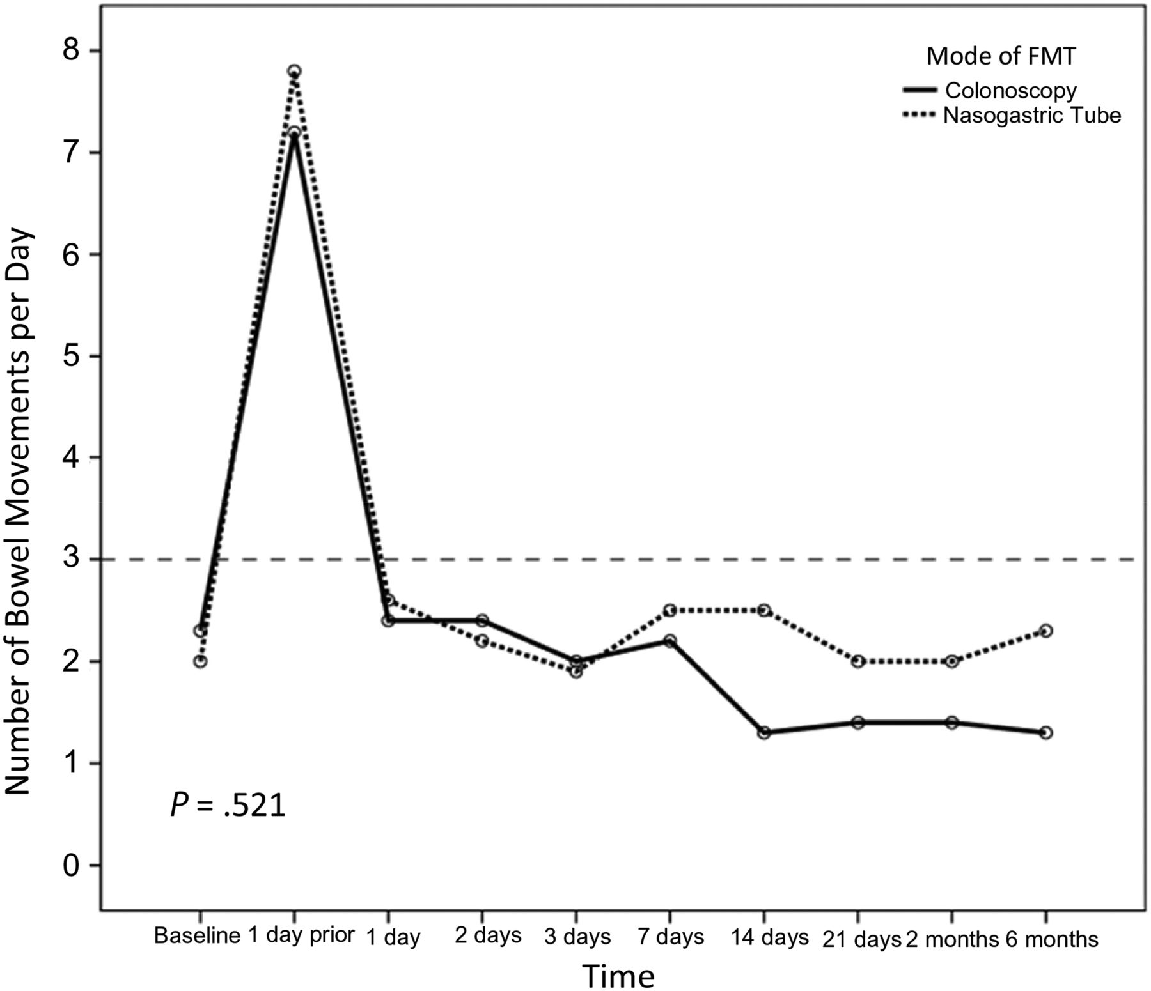
Figure 2. Mean number of daily bowel movements (BMs) in both study arms. Baseline represents reported BMs prior to ...
Notes:
Figure 2. Mean number of daily bowel movements (BMs) in both study arms. Baseline represents reported BMs prior to contracting Clostridium difficile as reported by the patients. Six-month follow-up data are missing from 3 patients in the nasogastric tube group and 2 patients in the colonoscopy group. Abbreviation: FMT, fecal microbiota transplant.
Unless provided in the caption above, the following copyright applies to the content of this slide: © The Author 2014. Published by Oxford University Press on behalf of the Infectious Diseases Society of America. All rights reserved. For Permissions, please e-mail: journals.permissions@oup.com.

Slide 3
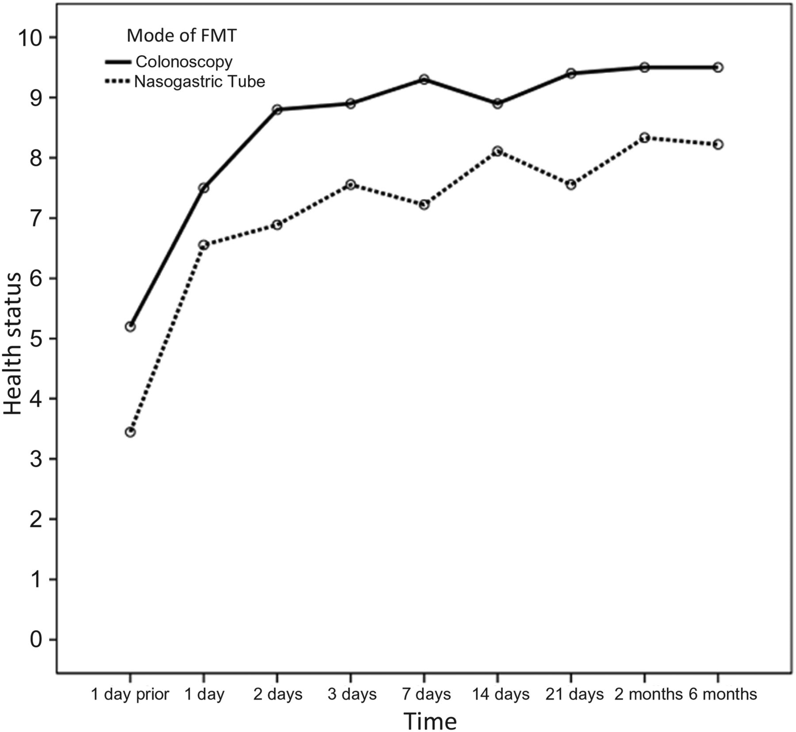
Figure 3. Mean scores of subjective well-being over time as reported using a standardized questionnaire with a scale of ...
Notes:
Figure 3. Mean scores of subjective well-being over time as reported using a standardized questionnaire with a scale of 1–10, 1 being the lowest. The colonoscopy group had consistently higher scores, accounted for by a mean higher reported score at day –1. When analyzing the absolute increment in health scores, the groups did not differ (P = .51). Abbreviation: FMT, fecal microbiota transplant.
Unless provided in the caption above, the following copyright applies to the content of this slide: © The Author 2014. Published by Oxford University Press on behalf of the Infectious Diseases Society of America. All rights reserved. For Permissions, please e-mail: journals.permissions@oup.com.

Slide 4
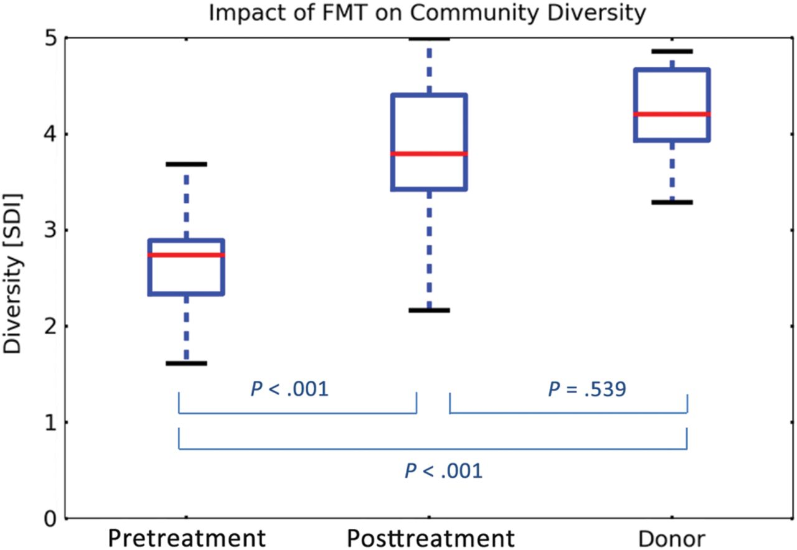
Figure 4. Microbiota diversity in fecal samples obtained from fecal microbiota transplant recipients before and after ...
Notes:
Figure 4. Microbiota diversity in fecal samples obtained from fecal microbiota transplant recipients before and after the procedure, as compared with the donors, expressed by the Shannon diversity index. The box-and-whisker plots indicate interquartile ranges (boxes), medians (red horizontal lines), and range (whiskers). Abbreviations: FMT, fecal microbiota transplant; SDI, Shannon diversity index.
Unless provided in the caption above, the following copyright applies to the content of this slide: © The Author 2014. Published by Oxford University Press on behalf of the Infectious Diseases Society of America. All rights reserved. For Permissions, please e-mail: journals.permissions@oup.com.

Slide 5
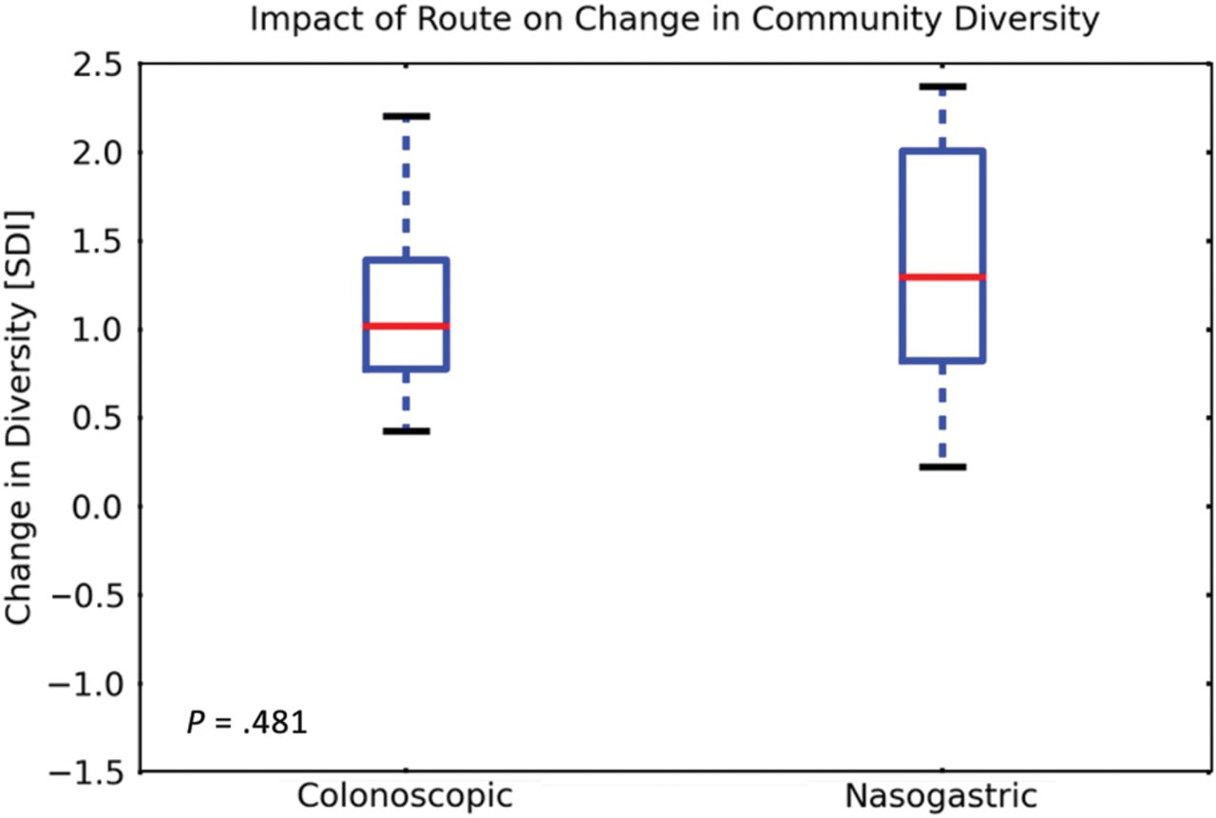
Figure 5. Microbiota diversity in fecal samples obtained from fecal microbiota transplant recipients before and after ...
Notes:
Figure 5. Microbiota diversity in fecal samples obtained from fecal microbiota transplant recipients before and after the procedure, stratified by treatment route and expressed by the Shannon diversity index. The box-and-whisker plots indicate interquartile ranges (boxes), medians (red horizontal lines), and range (whiskers). Abbreviation: SDI, Shannon diversity index.
Unless provided in the caption above, the following copyright applies to the content of this slide: © The Author 2014. Published by Oxford University Press on behalf of the Infectious Diseases Society of America. All rights reserved. For Permissions, please e-mail: journals.permissions@oup.com.

