Slide 1
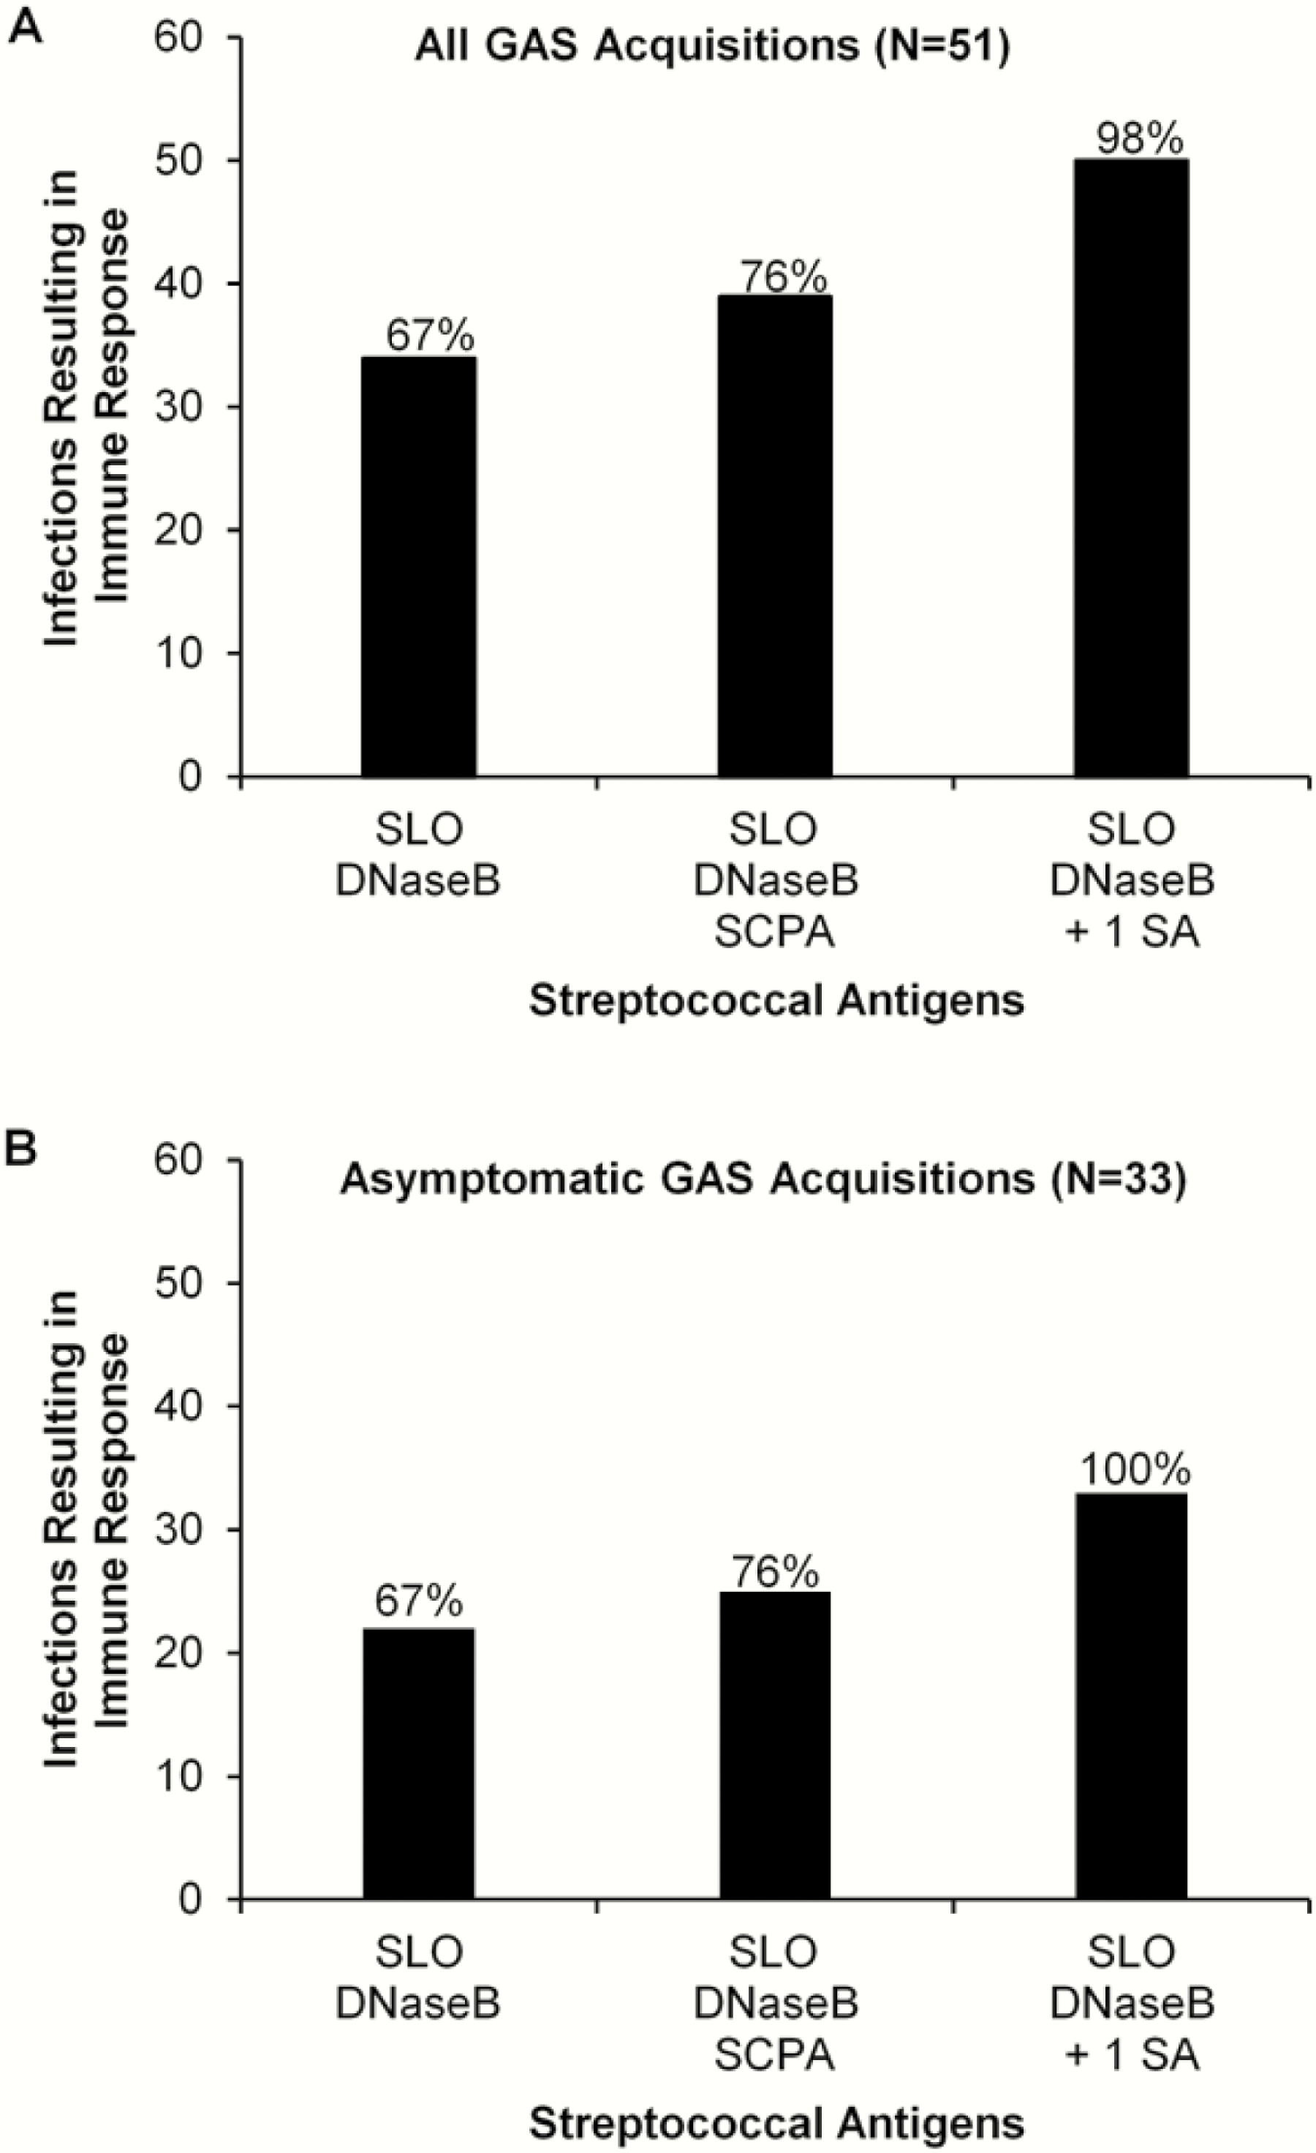
Figure 3. Immune responses to shared antigens after new pharyngeal acquisitions of group A streptococcus (GAS). ...
Notes:
Figure 3. Immune responses to shared antigens after new pharyngeal acquisitions of group A streptococcus (GAS). Antibody responses to combinations of streptolysin O (SLO), deoxyribonuclease B (DNaseB), C5a peptidase (SCPA), or any 1 additional shared antigen were tabulated after all new GAS acquisitions (A) and asymptomatic acquisitions (B). Abbreviation: SA, streptococcal antigen.
Unless provided in the caption above, the following copyright applies to the content of this slide: © The Author 2017. Published by Oxford University Press on behalf of The Journal of the Pediatric Infectious Diseases Society. All rights reserved. For permissions, please e-mail: journals.permissions@oup.com.This is an Open Access article distributed under the terms of the Creative Commons Attribution Non-Commercial License (http://creativecommons.org/licenses/by-nc/4.0/), which permits non-commercial reuse, distribution, and reproduction in any medium, provided the original work is properly cited. For commercial re-use, please contact journals.permissions@oup.com

Slide 2
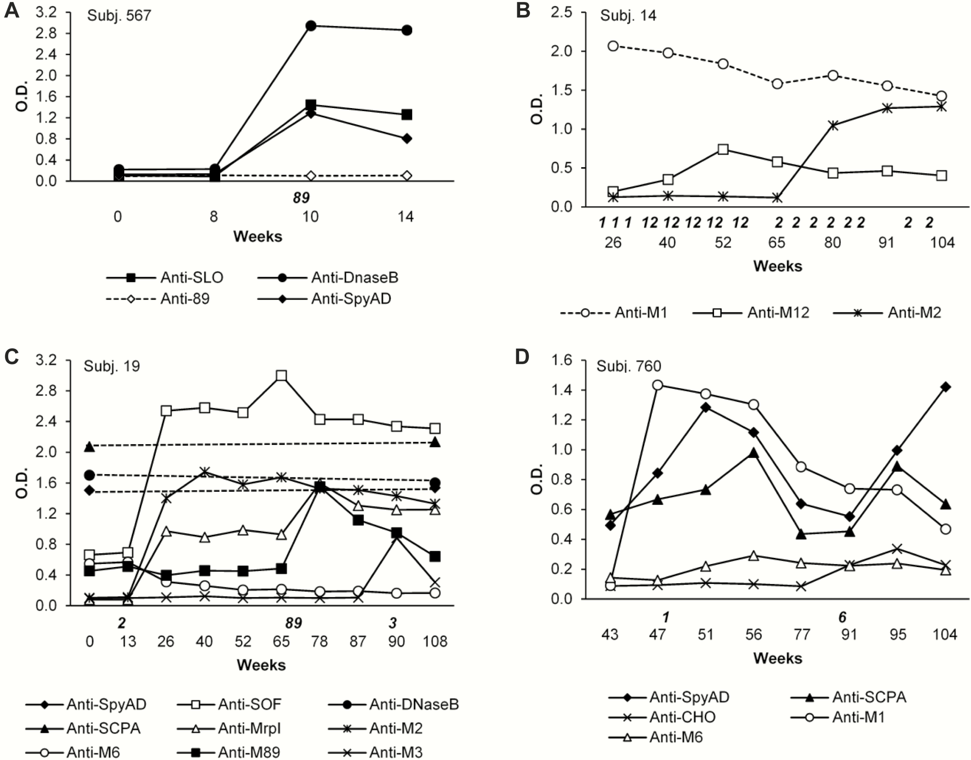
Figure 2. Examples of antigen-specific immune responses in 4 subjects after a new acquisition of group A streptococcus ...
Notes:
Figure 2. Examples of antigen-specific immune responses in 4 subjects after a new acquisition of group A streptococcus (GAS). The subject number is indicated for each set of data. Study weeks are represented on the horizontal axis. The numbers directly under the horizontal axis indicate theemm types of GAS recovered from throat cultures during the study. Dashed lines represent antigen-specific antibody levels that did not increase during the observation period indicated. (A) Subject 567 mounted brisk antibody responses to streptolysin O (SLO), deoxyribonuclease B (DNaseB), and SpyAD but no response to the M89 peptide after a culture positive for M89 GAS. (B) Subject 14 provides an example of sequential acquisitions of 3 different M serotypes of GAS over the course of the study. Throat cultures were positive on several occasions for M1 GAS, and the serum contained high levels of M1 peptide antibodies. By week 40, M1 was replaced by M12 GAS, and there was an immune response to the M12 peptide. At week 65, a throat culture was positive for M2 GAS, and there was an antibody response to the M2 peptide. (C) Subject 19 acquired 3 different M types (M2, M89, and M3) over the 2-year observation period. After each episode, there was an immune response to the homologous M peptide. The acquisition of M2 also triggered an antibody response against M-related peptide I (MrpI), and the acquisitions of serum opacity factor (SOF)-positive M2 and M89 were associated with increases in SOF antibodies. This subject also had persistently elevated levels of antibodies to DNaseB, C5a peptidase (SCPA), and SpyAD that did not change markedly from week 0 to 108. (D) An additional example of multiple GAS acquisitions was subject 760, who acquired 2 differentemm types. A culture positive for M1 was associated with increases in antibodies against M1, SCPA, and SpyAD. Approximately 1 year later, a throat culture was positive for M6, which was associated with an increase in M6 peptide antibodies and more pronounced increases in antibody levels against SpyAD and SCPA. Abbreviations: CHO, group A streptococcus carbohydrate; O.D., optical density.
Unless provided in the caption above, the following copyright applies to the content of this slide: © The Author 2017. Published by Oxford University Press on behalf of The Journal of the Pediatric Infectious Diseases Society. All rights reserved. For permissions, please e-mail: journals.permissions@oup.com.This is an Open Access article distributed under the terms of the Creative Commons Attribution Non-Commercial License (http://creativecommons.org/licenses/by-nc/4.0/), which permits non-commercial reuse, distribution, and reproduction in any medium, provided the original work is properly cited. For commercial re-use, please contact journals.permissions@oup.com

Slide 3
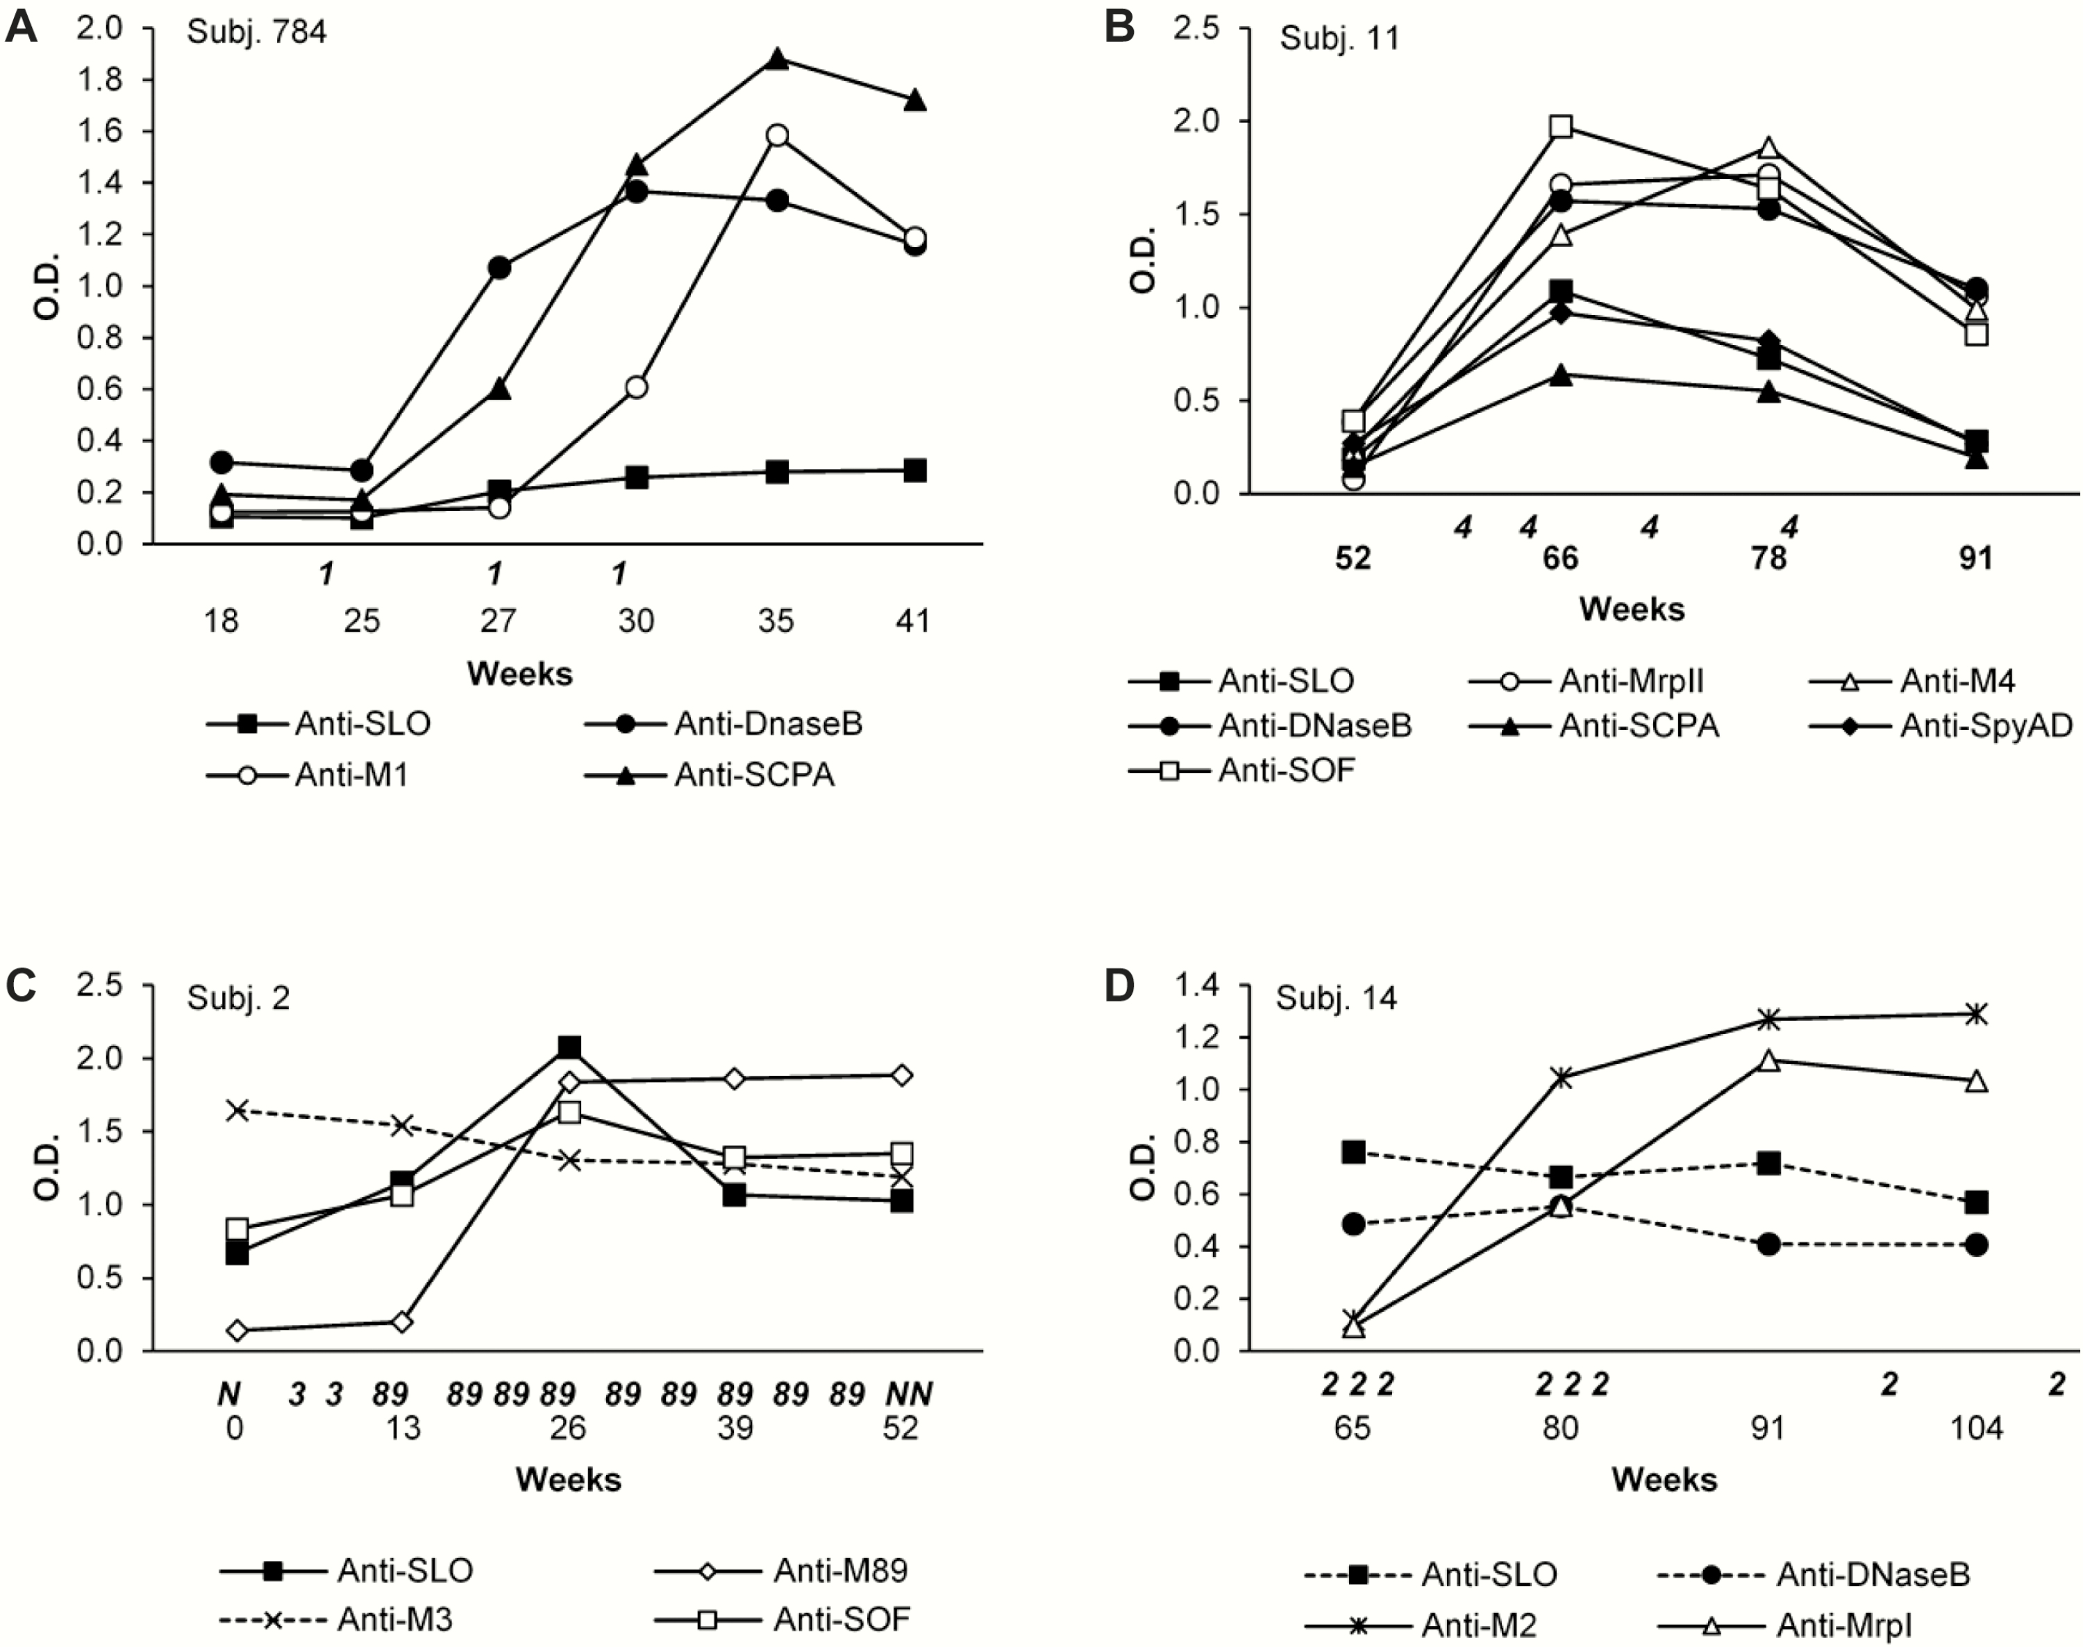
Figure 1. Examples of M peptide antibody responses and variable responses to shared group A streptococcus (GAS) ...
Notes:
Figure 1. Examples of M peptide antibody responses and variable responses to shared group A streptococcus (GAS) antigens. The subject number is indicated for each set of data. Study weeks are represented on the horizontal axis. The numbers directly under the horizontal axis indicate theemm types of GAS recovered from throat cultures during the study, and N indicates a negative culture result. Dashed lines represent antigen-specific antibody levels that did not change during the observation period indicated. (A) Immune responses to the M1 peptide, deoxyribonuclease B (DNaseB), and C5a peptidase (SCPA) that were also sustained after the acquisition of M1 GAS were found in the serum from subject 784. The antibody response to streptolysin O (SLO) was much lower in magnitude but was sustained. (B) Subject 11 acquired a serum opacity factor (SOF)-positive M4 and mounted a brisk immune response to the M4 peptide, M-related peptide II (MrpII), SLO, DNaseB, SOF, SCPA, and SpyAD. (C) Subject 2 entered the study with a throat culture positive for M3 and elevated levels of antibodies against the M3 peptide. In week 13, the throat culture was positive for M89 GAS, and the subject responded with increases in antibody levels against the M89 peptide, SLO, and SOF. (D) No change in antibody levels against SLO or DNaseB in response to M2 GAS were found in the serum from subject 14, but immune responses to the M2 peptide and MrpI were mounted. Abbreviation: O.D., optical density.
Unless provided in the caption above, the following copyright applies to the content of this slide: © The Author 2017. Published by Oxford University Press on behalf of The Journal of the Pediatric Infectious Diseases Society. All rights reserved. For permissions, please e-mail: journals.permissions@oup.com.This is an Open Access article distributed under the terms of the Creative Commons Attribution Non-Commercial License (http://creativecommons.org/licenses/by-nc/4.0/), which permits non-commercial reuse, distribution, and reproduction in any medium, provided the original work is properly cited. For commercial re-use, please contact journals.permissions@oup.com

Slide 4
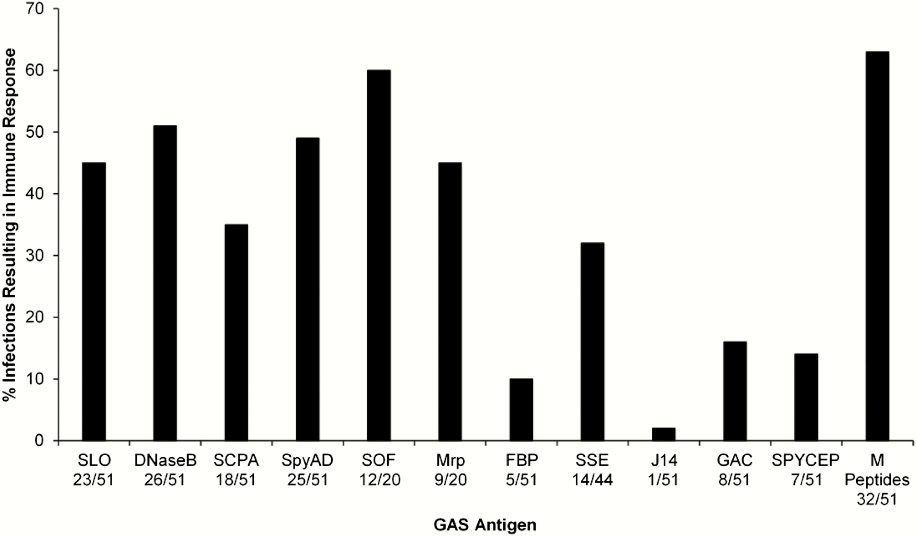
Figure 4. Antigen-specific immune responses in subjects with a new pharyngeal group A streptococcus (GAS) acquisition. ...
Notes:
Figure 4. Antigen-specific immune responses in subjects with a new pharyngeal group A streptococcus (GAS) acquisition. Shown are the percentages of acquisitions that resulted in a specific antibody response, calculated using the number of GAS isolates predicted as the denominator to express each antigen (seeTable 1). Abbreviations: DNaseB, deoxyribonuclease B; FBP, fibronectin-binding protein; GAC, group A carbohydrate; J14, C-repeat M peptide; Mrp, M-related peptide; SCPA, C5a peptidase; SLO, streptolysin O; SOF, serum opacity factor; SpyCEP, serine protease; SSE, serine esterase.
Unless provided in the caption above, the following copyright applies to the content of this slide: © The Author 2017. Published by Oxford University Press on behalf of The Journal of the Pediatric Infectious Diseases Society. All rights reserved. For permissions, please e-mail: journals.permissions@oup.com.This is an Open Access article distributed under the terms of the Creative Commons Attribution Non-Commercial License (http://creativecommons.org/licenses/by-nc/4.0/), which permits non-commercial reuse, distribution, and reproduction in any medium, provided the original work is properly cited. For commercial re-use, please contact journals.permissions@oup.com

