Slide 1
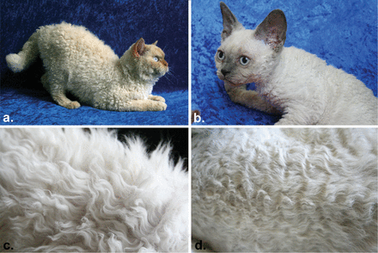
Figure 1. Phenotypes of the Selkirk Rex. (a) Adult heterozygous Selkirk Rex male, short-haired variety. The head ...
Notes:
Figure 1. Phenotypes of the Selkirk Rex. (a) Adult heterozygous Selkirk Rex male, short-haired variety. The head morphology and ear type of the heterozygous cat are more desired. (b) Adult homozygous Selkirk Rex. The head morphology and bigger ears of a homozygous curled cat are not desired by the breed standard. (c) Desired curly coat of a heterozygous curled cat. (d) Not desired curly coat of a homozygous cat is more similar to Cornish Rex marcel wave.
Unless provided in the caption above, the following copyright applies to the content of this slide: © The American Genetic Association. 2012. All rights reserved. For permissions, please email: journals.permissions@oup.com.

Slide 2
Figure 2. Pedigree of Selkirk Rex cats segregating for curled hair type. Cats with filled symbols are heterozygous ...
Notes:
Figure 2. Pedigree of Selkirk Rex cats segregating for curled hair type. Cats with filled symbols are heterozygous curled; cats with stippled symbols are homozygous curled. Cats in parentheses did not have their DNA sampled and have unconfirmed parentage, however completed the represented litters.
Unless provided in the caption above, the following copyright applies to the content of this slide: © The American Genetic Association. 2012. All rights reserved. For permissions, please email: journals.permissions@oup.com.

Slide 3
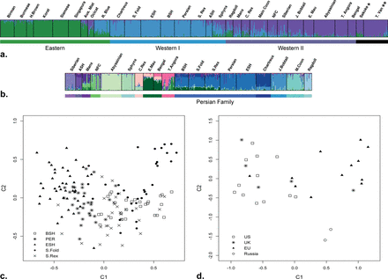
Figure 3. Population genetics assessment of the Selkirk Rex breed. (a) Bayesian clustering of 30 recognized cat breeds ...
Notes:
Figure 3. Population genetics assessment of the Selkirk Rex breed. (a) Bayesian clustering of 30 recognized cat breeds at K = 3. The Selkirk Rex clusters within the Western I group. Sokoke and Turkish Van, denoted by * and ** respectively, are breeds that group within Western II at K = 3 but form their distinct groups at higher K values. (b) Bayesian clustering of 19 Western breeds at K = 15. Selkirk Rex clusters with breeds that belong to the Persian family. (c) Principal component analysis of the Persian family breeds. (d) Principal component analysis of the Selkirk Rex breed, which shows the geographic distribution of the breed (BSH: British Shorthair, PER: Persian, ESH: Exotic Short Hair, S. Fold: Scottish Fold, S. Rex: Selkirk Rex).
Unless provided in the caption above, the following copyright applies to the content of this slide: © The American Genetic Association. 2012. All rights reserved. For permissions, please email: journals.permissions@oup.com.

