Slide 1
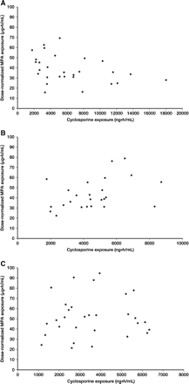
Fig. 1 Scatter plots showing the correlation between CsA exposure and MPA exposure at (A) Day 7, (B) Month 1 and (C) ...
Notes:
Fig. 1 Scatter plots showing the correlation between CsA exposure and MPA exposure at (A) Day 7, (B) Month 1 and (C) Month 3 of the study.
Unless provided in the caption above, the following copyright applies to the content of this slide: © Oxford University Press 2009

