Slide 1
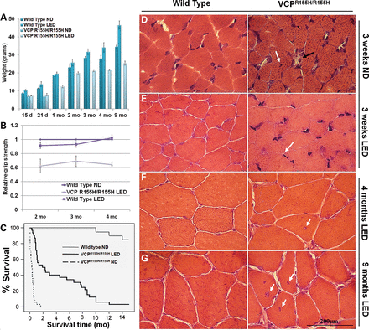
Figure 1. Measurements, survival curves and histological analyses of WT and VCP^{R155H/R155H} mice on normal ...
Notes:
Figure 1. Measurements, survival curves and histological analyses of WT and VCPR155H/R155H mice on normal and LEDs. (A) Weight measurements, (B) grip strength analysis and (C) Kaplan–Meier survival curve of WT and VCPR155H/R155H mice (P≤ 0.001). H&E staining of quadriceps muscle from WT and VCPR155H/R155H animals at (D and E) 3 weeks of age depicting centrally located nuclei and necrosis (black arrows) on a ND and significant improvement in muscle architecture (arrows) on LED and (F and G) 4 months and 9 months of age showing centrally localized nuclei and increased endomysial space (black arrow), respectively, on normal versus LEDs (magnification: 630×). The number of mice analyzed per experiment is 5–6.
Unless provided in the caption above, the following copyright applies to the content of this slide: © The Author 2013. Published by Oxford University Press. All rights reserved. For Permissions, please email: journals.permissions@oup.com

Slide 2
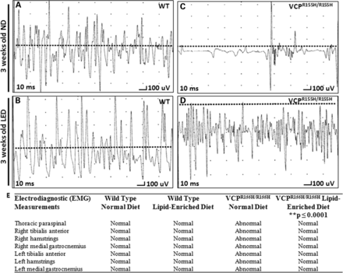
Figure 2. EMG analysis of quadriceps in VCP^{R155H/R155H} and WT animals on normal and LEDs. EMG data of (A) WT ...
Notes:
Figure 2. EMG analysis of quadriceps in VCPR155H/R155H and WT animals on normal and LEDs. EMG data of (A) WT animals and (C) VCPR155H/R155H animals on a ND at 3 weeks of age, and (B) WT animals and (D) VCPR155H/R155H animals on a LED at 3 weeks of age. Each graph shows a representative from three animals analyzed. (E) EMG muscle measurements (bilateral tibialis anterior, bilateral hamstrings, bilateral medial gastrocnemius and unilateral thoracic paraspinal muscles) of 3-week-old WT and VCPR155H/R155H animals on ND versus LEDs. **denotes a statistical significance of P≤ 0.0001.
Unless provided in the caption above, the following copyright applies to the content of this slide: © The Author 2013. Published by Oxford University Press. All rights reserved. For Permissions, please email: journals.permissions@oup.com

Slide 3
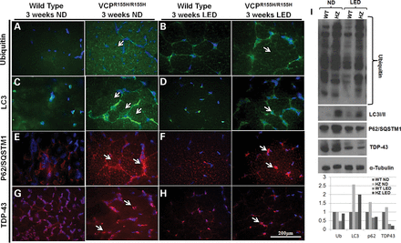
Figure 3. Autophagy is stimulated in the quadriceps of WT and VCP^{R155H/R155H} mice on a LED. Quadriceps ...
Notes:
Figure 3. Autophagy is stimulated in the quadriceps of WT and VCPR155H/R155H mice on a LED. Quadriceps muscles from 3-week-old WT and VCPR155H/R155H mice on a (A, C, E and G) ND and (B, D, F and H) LED were stained with anti-ubiquitin, LC3, p62 and TDP-43-specific antibodies, respectively (shown by arrows). Nuclei were stained with DAPI (magnification: 630×). (I) Western blot expression analysis of autophagy proteins including ubiquitin, LC3-I/II, p62 and TDP-43. Alpha-tubulin was used as a positive control. Densitometric analysis of western blot bands as shown in a bar graph. The number of mice analyzed per experiment is 5–6.
Unless provided in the caption above, the following copyright applies to the content of this slide: © The Author 2013. Published by Oxford University Press. All rights reserved. For Permissions, please email: journals.permissions@oup.com

Slide 4
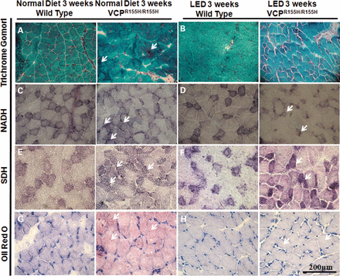
Figure 4. Mitochondrial enzyme analysis of the WT and VCP^{R155H/R155H} mouse quadriceps muscles on normal and ...
Notes:
Figure 4. Mitochondrial enzyme analysis of the WT and VCPR155H/R155H mouse quadriceps muscles on normal and LEDs. Quadriceps muscles from WT and VCPR155H/R155H mice at 3 weeks of age on (A) normal and (‘ragged red’ fibers and fiber degeneration shown by arrows) and (B) LEDs were stained with Gomori Trichrome. Quadriceps muscles from WT and VCPR155H/R155H mice at 3 weeks of age on a (C) normal and (D) LEDs stained with NADH antibody. Quadriceps muscles from WT and VCPR155H/R155H mice at 3 weeks of age on a (E) normal and (F) LEDs stained with SDH antibody. Quadriceps muscles from WT and VCPR155H/R155H mice at 3 weeks of age on a (G) normal and (H) LEDs stained with Oil Red O (Magnification: 400×). The number of mice analyzed per experiment is 5–6.
Unless provided in the caption above, the following copyright applies to the content of this slide: © The Author 2013. Published by Oxford University Press. All rights reserved. For Permissions, please email: journals.permissions@oup.com

Slide 5
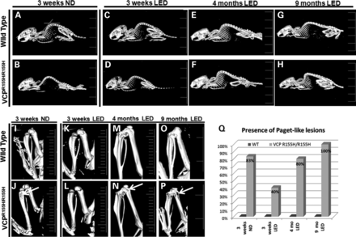
Figure 5. MicroCT analysis of hind limb bones in WT and VCP^{R155H/R155H} animals on normal and LEDs. (A–H) ...
Notes:
Figure 5. MicroCT analysis of hind limb bones in WT and VCPR155H/R155H animals on normal and LEDs. (A–H) MicroCT images showed thoracic and cervical kyphosis of the VCPR155H/R155H mice at 3 weeks, 4 months and 9 months of age. (I–P) Close inspection of the long hind limb bones revealed lucencies of the proximal tibiae (shown by arrows) in the 3-week-old VCPR155H/R155H mice on an ND and in the 4-month and 9-month-old VCPR155H/R155H mice on the LED. (Q) Quantification of Paget-like lesions from ND and LED WT and VCPR155H/R155H animals at 3 weeks, 4 months and 9 months of age. The number of mice analyzed per experiment is 5–6.
Unless provided in the caption above, the following copyright applies to the content of this slide: © The Author 2013. Published by Oxford University Press. All rights reserved. For Permissions, please email: journals.permissions@oup.com

Slide 6
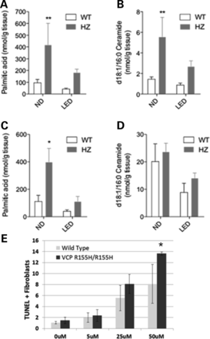
Figure 6. Lipid analyses of quadriceps muscles and livers from WT and VCP^{R155H/R155H} animals on normal and ...
Notes:
Figure 6. Lipid analyses of quadriceps muscles and livers from WT and VCPR155H/R155H animals on normal and LEDs. (A and B) Levels of non-esterified palmitic acids (A, n = 4–6) and d18:1/16:0 ceramides (B, n = 7–9) in the quadriceps of WT and VCPR155H/R155H mice on the normal versus LEDs were determined by using liquid chromatography–mass spectrometry (LC–MS). (C and D) Levels of non-esterified palmitic acids (C) or d18:1/16:0 ceramide (D) in the liver of WT and VCPR155H/R155H mice on the normal versus LEDs were determined using LC–MS (n = 4–6). (E) Percentage of TUNEL+ fibroblasts from WT and VCPR155H/R155H animals treated for 24 h with increasing ceramide concentrations. Experiments were done in triplicate.
Unless provided in the caption above, the following copyright applies to the content of this slide: © The Author 2013. Published by Oxford University Press. All rights reserved. For Permissions, please email: journals.permissions@oup.com

