Slide 1
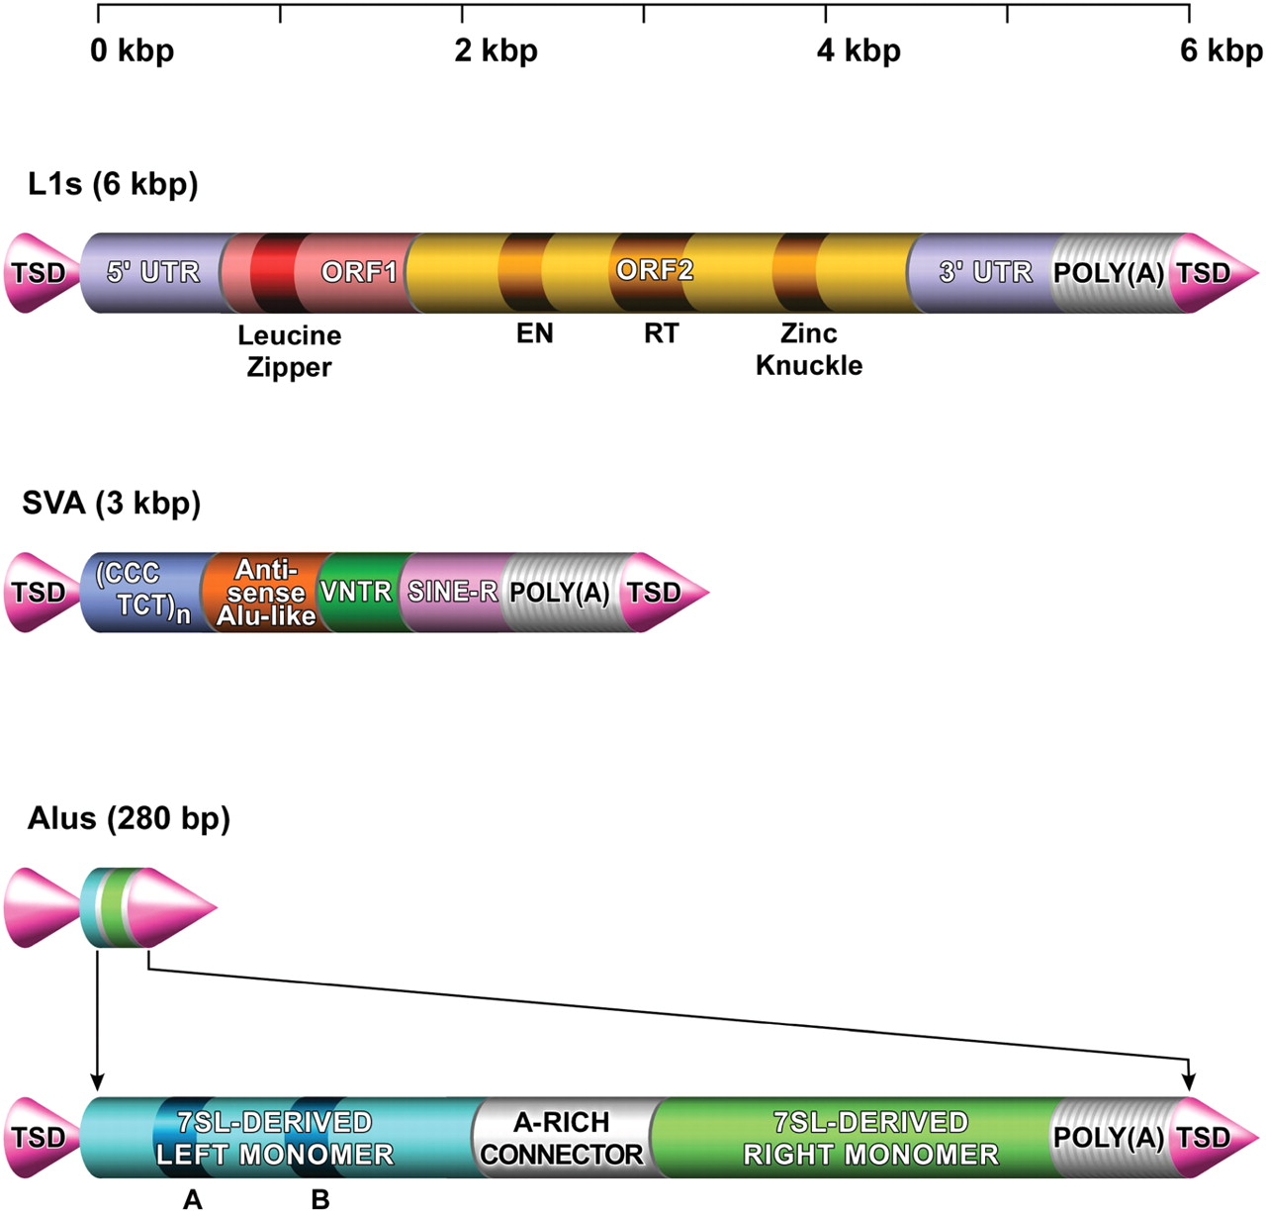
Figure 1. Active transposable elements in the human genome. Although full-length active L1 elements can transcribe all ...
Notes:
Figure 1. Active transposable elements in the human genome. Although full-length active L1 elements can transcribe all the necessary open-reading frames (ORF1 and ORF2) for autonomous mobilization, Alu s and SVAs only can transpose using the L1 machinery in trans . TSD, target site duplication; UTR, untranslated region; EN, endonuclease domain; RT, reverse transcriptase domain; VNTR, variable number of tandem repeats.
Unless provided in the caption above, the following copyright applies to the content of this slide: © The Author 2007. Published by Oxford University Press. All rights reserved. For Permissions, please email: journals.permissions@oxfordjournals.org

Slide 2
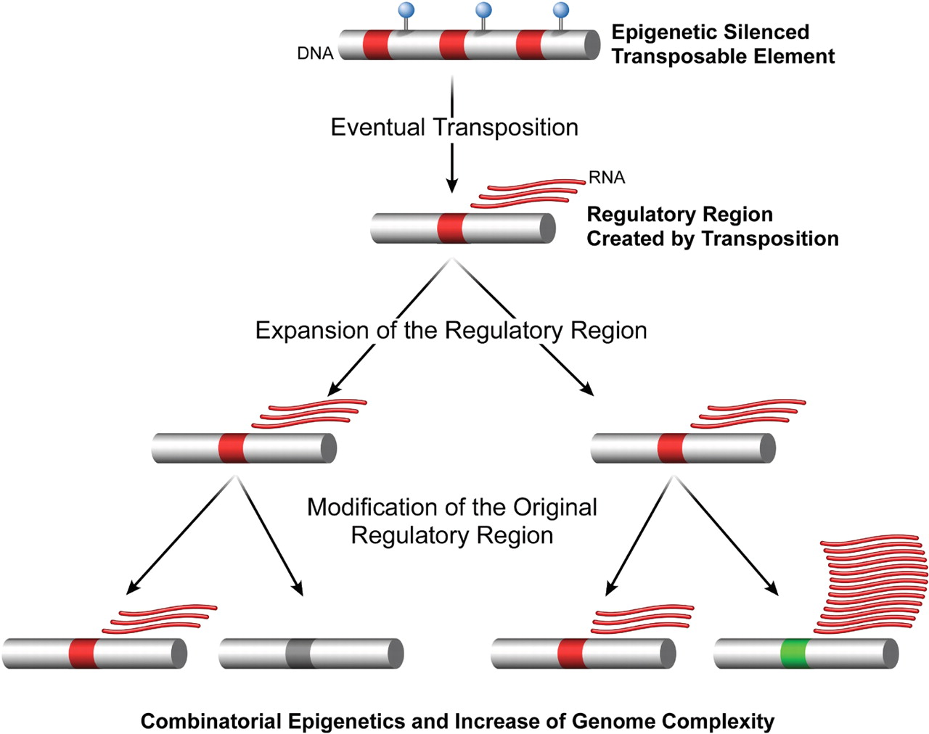
Figure 2. Generation of regulatory sequences by transposition. Epigenetically silenced transposable elements can ...
Notes:
Figure 2. Generation of regulatory sequences by transposition. Epigenetically silenced transposable elements can escape the genome defense and generate a new regulatory region in a different region of the genome. Such insertion can work as an enhancer and drive the expression of genes nearby. After expansion, the transposable regulatory region can mutate or even fall under the control of epigenetic mechanisms. Under these circumstances, genes that were previously regulated by the ancient insertion will now be under the control of the new insertional version, causing gene silencing or upregulation and thus increasing genome complexity. Such processes can take several generations to develop, but the detection of somatic de novo insertions may help to elucidate the genetic molecular mechanisms that shape new regulatory regions during evolution.
Unless provided in the caption above, the following copyright applies to the content of this slide: © The Author 2007. Published by Oxford University Press. All rights reserved. For Permissions, please email: journals.permissions@oxfordjournals.org

Slide 3
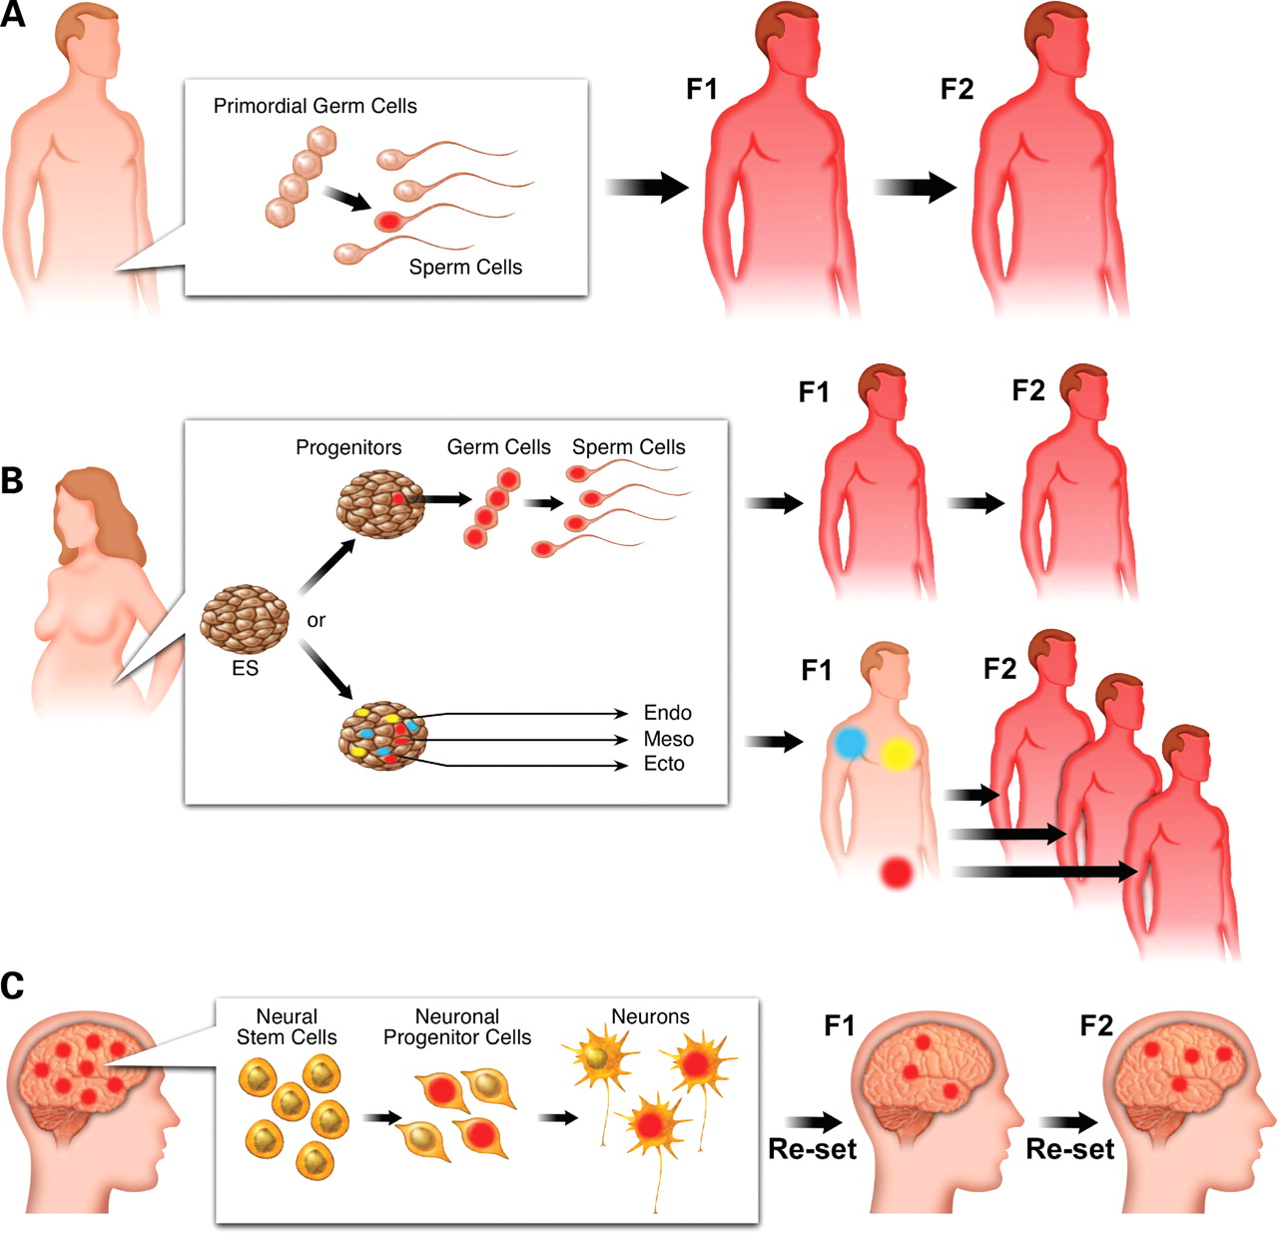
Figure 3. Evolutionary consequences of retrotransposition in different cell types. ( A ) Retrotransposition in ...
Notes:
Figure 3. Evolutionary consequences of retrotransposition in different cell types. ( A ) Retrotransposition in primordial germ cells will give rise to germ cells carrying a new insertion (in red). If the germ cells carrying the new insertion are used to produce an egg, the resultant individual will pass the new insertion on throughout the generations. ( B ) New insertions that occurred in early development will only be carried through a new generation if the insertion is in germ progenitor cells (red). Alternatively, new insertions may not be present in germ cells, but in specific cells derived from ES cells (blue, yellow and red). In this case, the resultant individual will be a mosaic for new transposable insertions and only insertions in the germ cells (red) will be carried to the next generation. ( C ) Somatic new insertions will never be passed on to the next generation. As an example, insertions that occurred in neuronal progenitor cells during the development of an individual represent a genetic mosaic signature of the brain. The F1 progeny and subsequently derived generations will not have the same signature because the brain development will be re-set in each generation.
Unless provided in the caption above, the following copyright applies to the content of this slide: © The Author 2007. Published by Oxford University Press. All rights reserved. For Permissions, please email: journals.permissions@oxfordjournals.org

