Slide 1
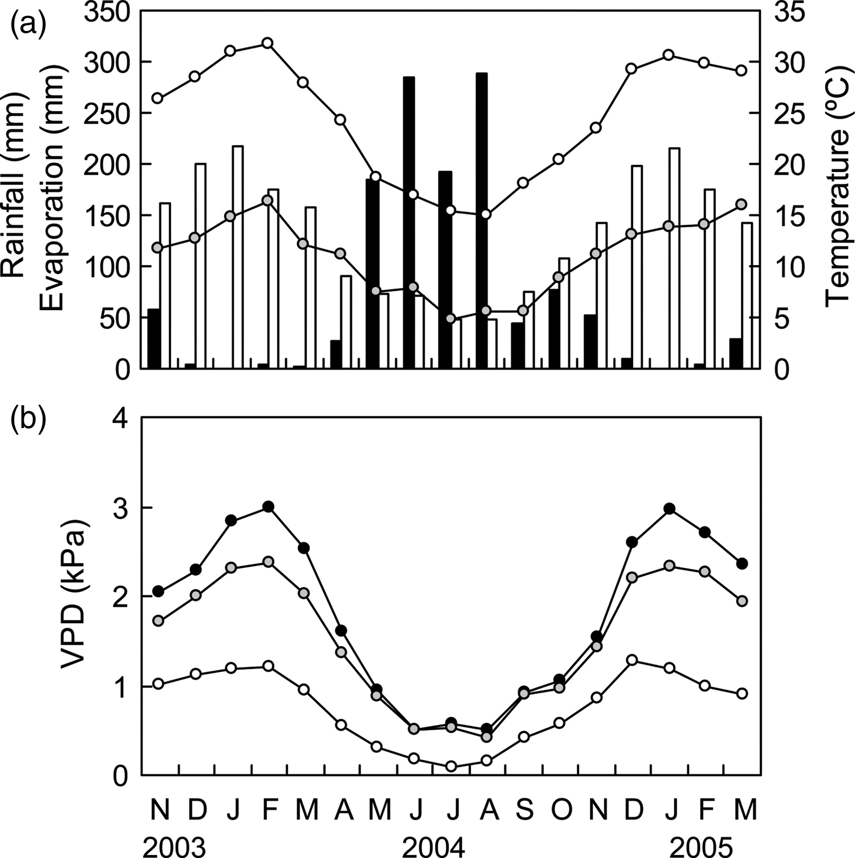
Figure 1. (a) Mean monthly maximum (white circles) and minimum (grey circles) temperatures, total monthly rainfall ...
Notes:
Figure 1. (a) Mean monthly maximum (white circles) and minimum (grey circles) temperatures, total monthly rainfall (black bars) and total monthly pan evaporation (white bars). (b) Mean monthly VPD at 09:00 h (white circles), 12:00 h (grey circles) and 15:00 h (black circles) over the study period between November 2003 and March 2005. All weather data were recorded by the Bureau of Meteorology at the Dwellingup weather station (32.71°S, 116.06°E), Western Australia.
Unless provided in the caption above, the following copyright applies to the content of this slide: © The Author 2011. Published by Oxford University Press. All rights reserved. For Permissions, please email: journals.permissions@oup.com

Slide 2
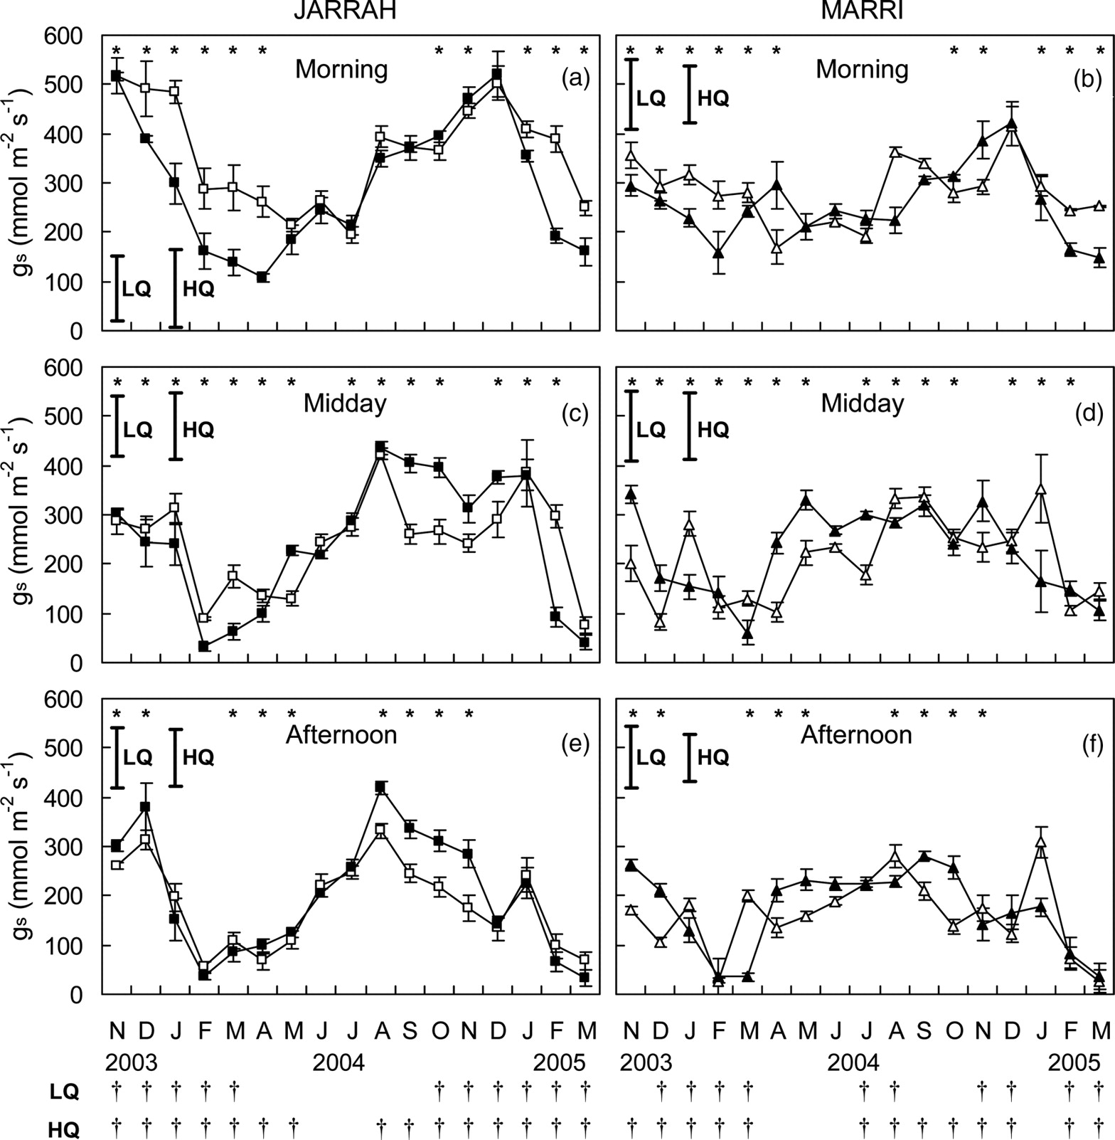
Figure 2. Morning (a and b), midday (c and d) and afternoon (e and f) stomatal conductance (g_{s}) of E. ...
Notes:
Figure 2. Morning (a and b), midday (c and d) and afternoon (e and f) stomatal conductance (gs) of E. marginata (jarrah) and C. calophylla (marri) at low-quality (black) and high-quality (white) restored mine sites. Bars on mean values represent mean standard error (n = 3–9). Bold bars represent least significant difference (P < 0.05) between months within site and species for the low-quality (LQ) and high-quality (HQ) sites. Significant differences (P < 0.05) for the interaction site × species within any given month are represented by an asterisk. Significant differences (P < 0.05) between time of day within site and species are represented by † below the x-axis of the figure.
Unless provided in the caption above, the following copyright applies to the content of this slide: © The Author 2011. Published by Oxford University Press. All rights reserved. For Permissions, please email: journals.permissions@oup.com

Slide 3
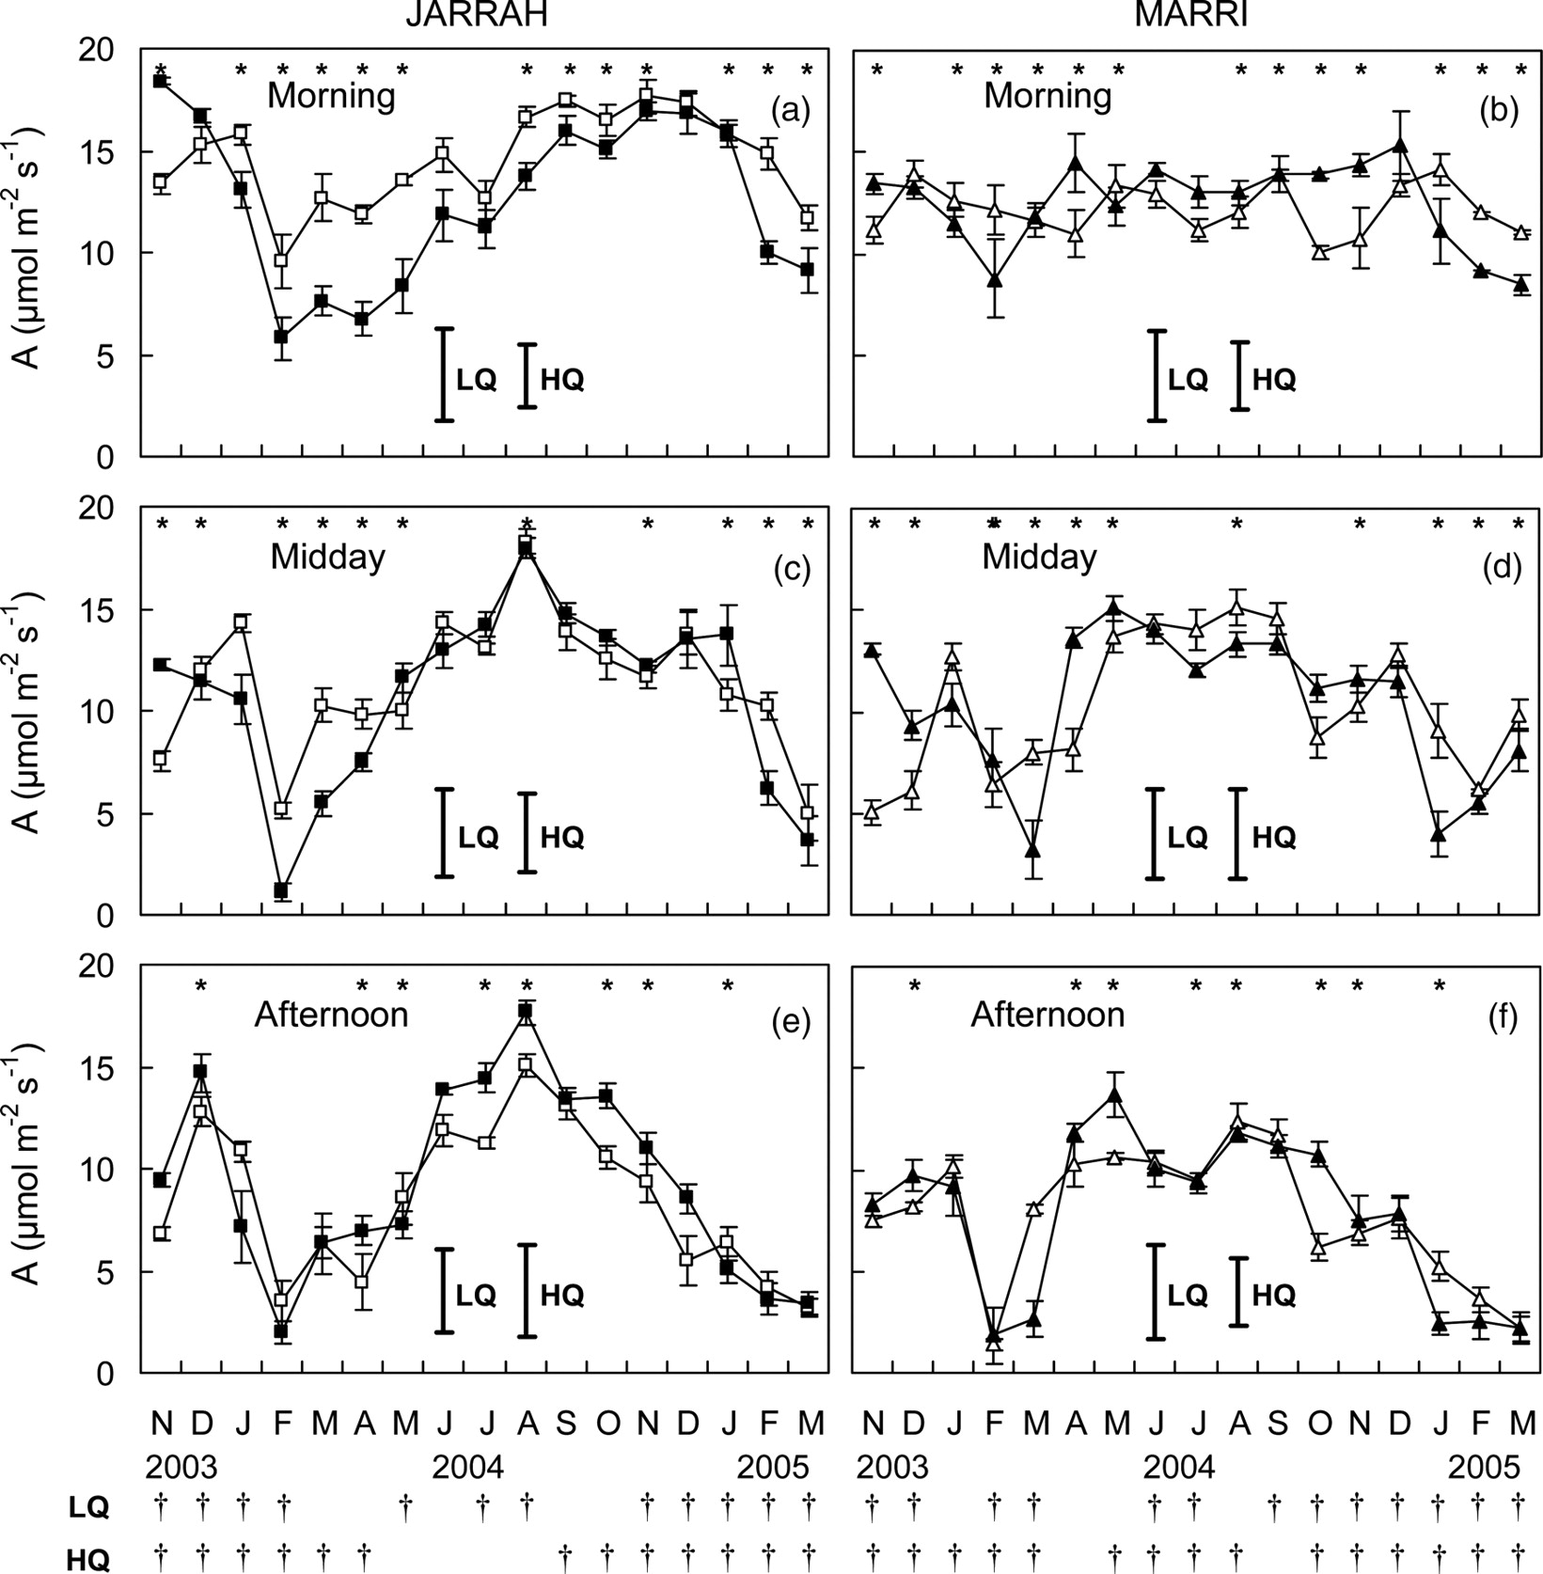
Figure 3. Morning (a and b), midday (c and d) and afternoon (e and f) photosynthesis (A) of E. marginata (jarrah) and ...
Notes:
Figure 3. Morning (a and b), midday (c and d) and afternoon (e and f) photosynthesis (A) of E. marginata (jarrah) and C. calophylla (marri) at low-quality (black) and high-quality (white) restored bauxite mine sites. Bars on mean values represent mean standard error (n = 3–9). Bold bars represent least significant difference (P < 0.05) between months within site and species for the low-quality (LQ) and high-quality (HQ) sites. Significant differences (P < 0.05) for the interaction site × species within any given month are represented by an asterisk. Significant differences (P < 0.05) between time of day within site and species are represented by † below the x-axis of the figure.
Unless provided in the caption above, the following copyright applies to the content of this slide: © The Author 2011. Published by Oxford University Press. All rights reserved. For Permissions, please email: journals.permissions@oup.com

Slide 4
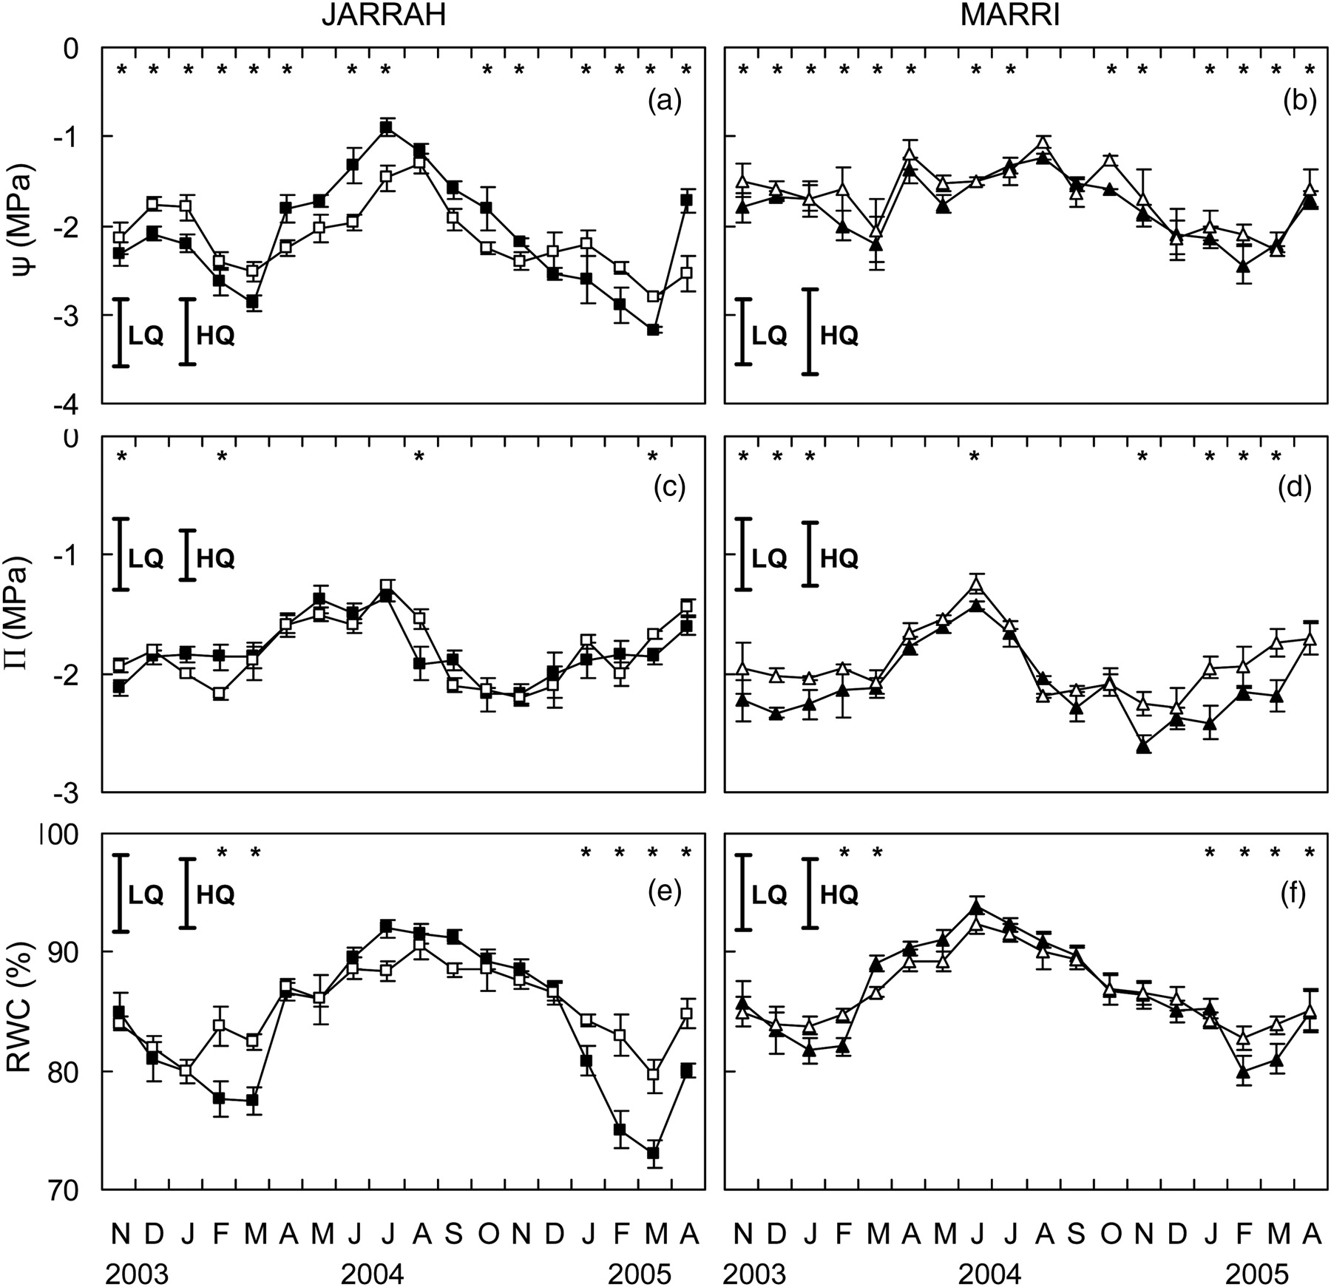
Figure 4. Midday leaf water potential (ψ) (a and b), daily average osmotic potential (ψ) corrected for RWC (c and d) ...
Notes:
Figure 4. Midday leaf water potential (ψ) (a and b), daily average osmotic potential (ψ) corrected for RWC (c and d) and daily average RWC ­(e and f) of E. marginata (jarrah) and C. calophylla (marri) at low-quality (black) and high-quality (white) restored bauxite mine sites. Bars on mean values represent mean standard error (n = 3–18). Bold bars represent least significant difference (P < 0.05) between months within site and species for the low-quality (LQ) and high-quality (HQ) sites. Significant differences (P < 0.05) for the interaction site × species within any given month are represented by an asterisk.
Unless provided in the caption above, the following copyright applies to the content of this slide: © The Author 2011. Published by Oxford University Press. All rights reserved. For Permissions, please email: journals.permissions@oup.com

Slide 5
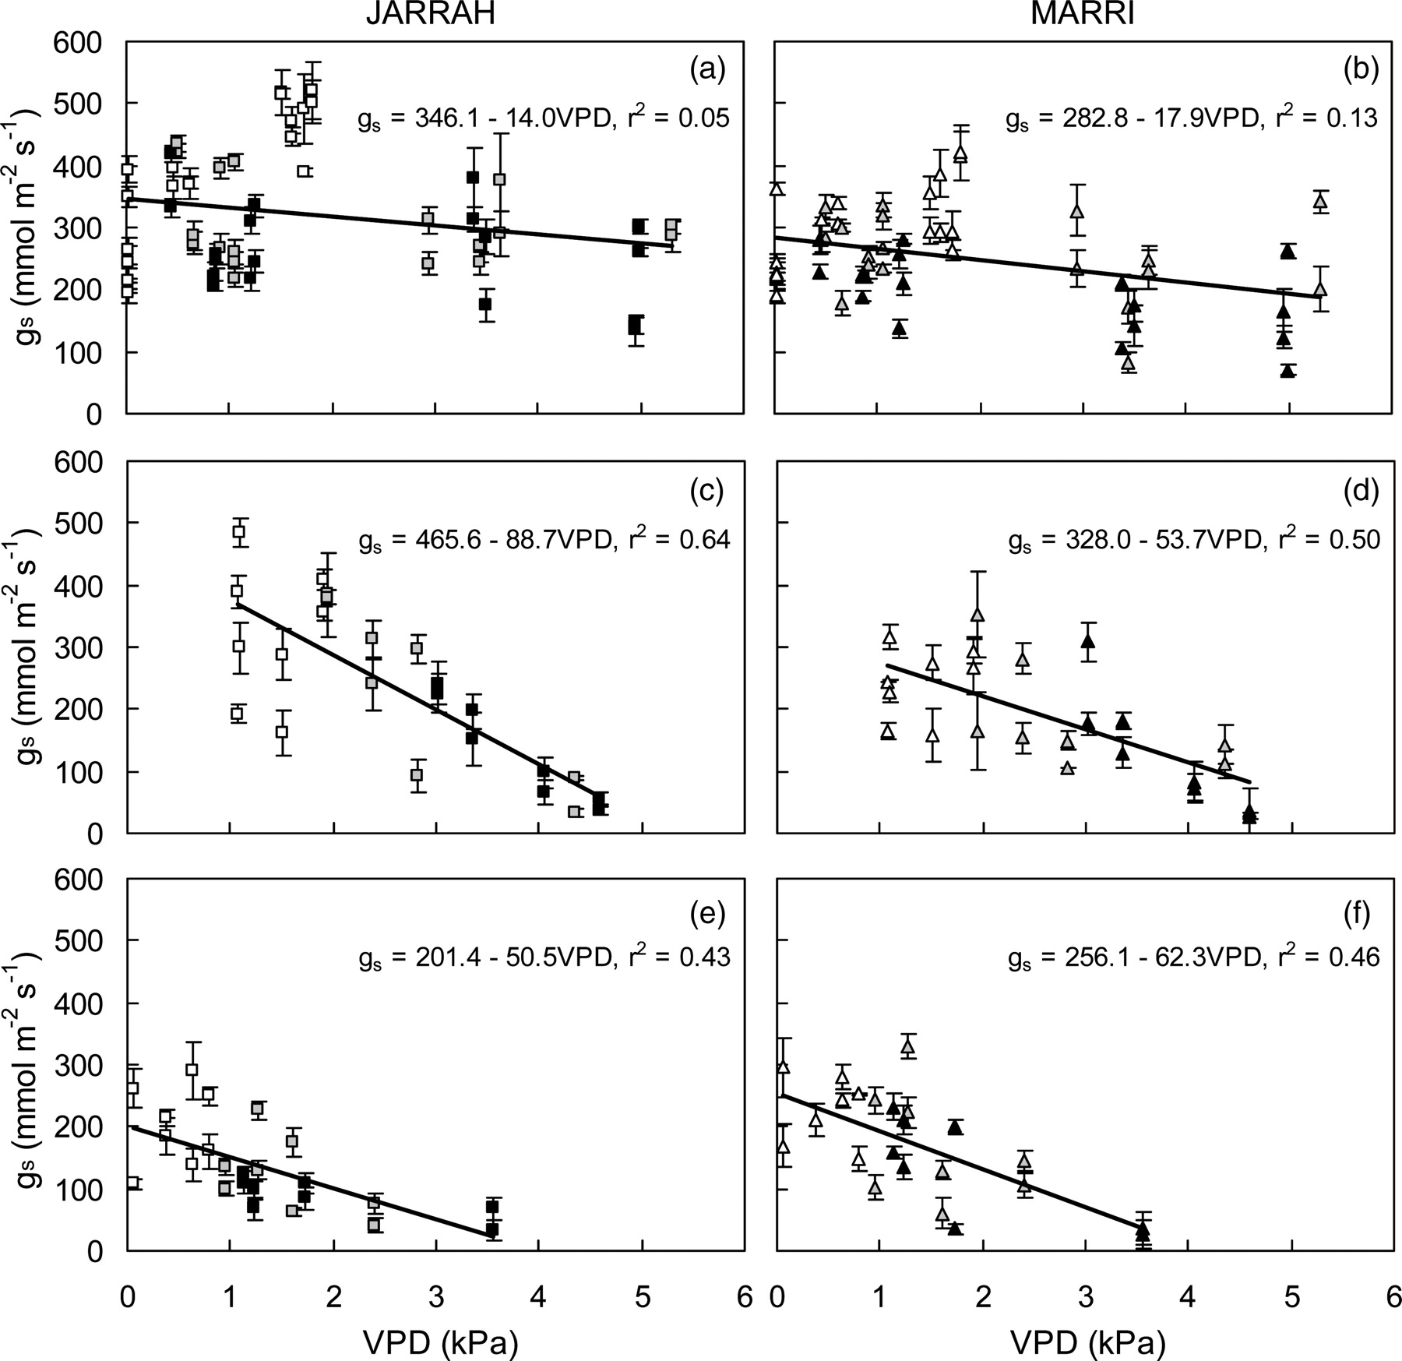
Figure 5. Morning (white), midday (grey) and afternoon (black) stomatal conductance (g_{s}) in relation to VPD ...
Notes:
Figure 5. Morning (white), midday (grey) and afternoon (black) stomatal conductance (gs) in relation to VPD during ‘winter/spring’ (June − December; a and b), ‘mid-summer’ (January − February; c and d) and ‘late summer/autumn’ (March − May; e and f) for E. marginata (jarrah) and C. calophylla (marri) at low-quality and high-quality restored bauxite mine sites. Bars represent mean standard error (n = 3–9).
Unless provided in the caption above, the following copyright applies to the content of this slide: © The Author 2011. Published by Oxford University Press. All rights reserved. For Permissions, please email: journals.permissions@oup.com

Slide 6
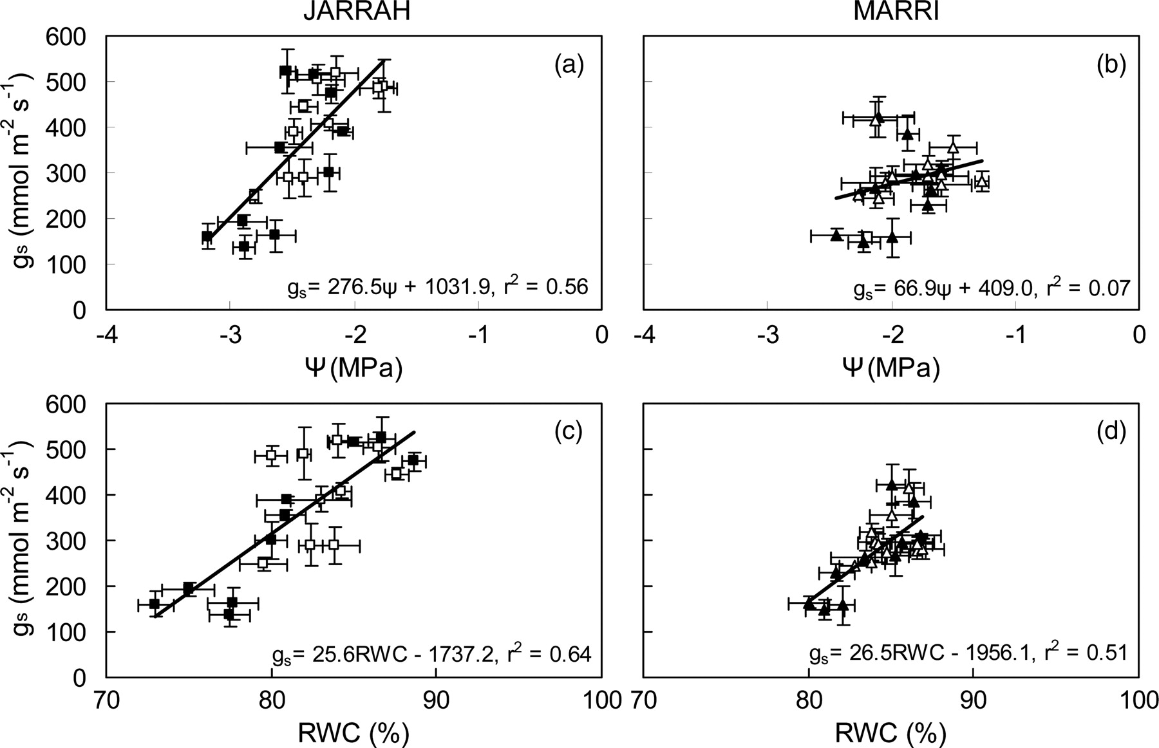
Figure 6. Relationship between morning stomatal conductance (g_{s}) and midday water potential (ψ; a and b), ...
Notes:
Figure 6. Relationship between morning stomatal conductance (gs) and midday water potential (ψ; a and b), and average daily RWC (c and d) for E. marginata (jarrah) and C. calophylla (marri) from both low-quality (black) and high-quality (white) restored bauxite mine sites. Each point represents data captured for each month between November 2003 and March 2005. Data for April–September, 2004, are omitted to avoid the complication of low gs as a result of low morning vapour pressure deficits (VPD < 1 kPa) and/or temperature (<15 °C). Bars represent mean standard error (n = 3–18).
Unless provided in the caption above, the following copyright applies to the content of this slide: © The Author 2011. Published by Oxford University Press. All rights reserved. For Permissions, please email: journals.permissions@oup.com

