Slide 1
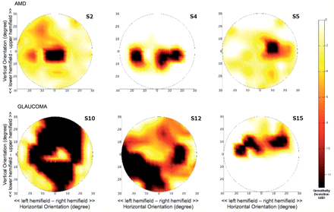
Figure 1 Individual binocular sensitivity deviation maps. Upper row shows maps for three representative subjects from ...
Notes:
Figure 1 Individual binocular sensitivity deviation maps. Upper row shows maps for three representative subjects from the AMD group, the lower row shows maps for three subjects with glaucoma. Subject numbers correspond to those in Table 1.
Unless provided in the caption above, the following copyright applies to the content of this slide: © 2009 The Author(s)This is an Open Access article distributed under the terms of the Creative Commons Attribution Non-Commercial License (http://creativecommons.org/licenses/by-nc/2.0/uk/) which permits unrestricted non-commercial use, distribution, and reproduction in any medium, provided the original work is properly cited.

Slide 2
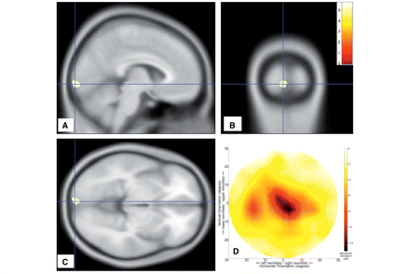
Figure 2 Analysis of subjects with AMD. (A–C) Sections of the brain showing regions of grey matter density reduction. ...
Notes:
Figure 2 Analysis of subjects with AMD. (A–C) Sections of the brain showing regions of grey matter density reduction. Colours indicate statistical significance (t-values), with red indicating more significant changes, and yellow/green indicating less significant changes (all changes are at least P < 0.001, uncorrected). (D) Mean visual field sensitivity deviation (in dB). The largest change in sensitivity is located centrally in the visual field. dB = decibel.
Unless provided in the caption above, the following copyright applies to the content of this slide: © 2009 The Author(s)This is an Open Access article distributed under the terms of the Creative Commons Attribution Non-Commercial License (http://creativecommons.org/licenses/by-nc/2.0/uk/) which permits unrestricted non-commercial use, distribution, and reproduction in any medium, provided the original work is properly cited.

Slide 3
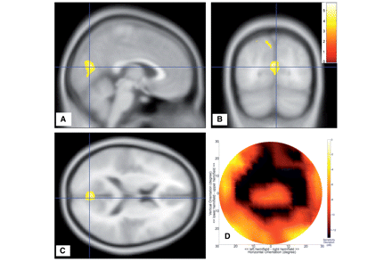
Figure 3 Analysis of subjects with glaucoma. (A–C) Sections of the brain showing the regions of grey matter density ...
Notes:
Figure 3 Analysis of subjects with glaucoma. (A–C) Sections of the brain showing the regions of grey matter density reduction. Colours indicate statistical significance (t-values), with red indicating more significant changes, and yellow/green indicating less significant changes (all changes are at least P < 0.001, uncorrected). (D) Mean visual field sensitivity deviation (in dB). The largest changes in sensitivity are located peripherally in the visual field, leaving the macular region relatively unaffected. dB = decibel.
Unless provided in the caption above, the following copyright applies to the content of this slide: © 2009 The Author(s)This is an Open Access article distributed under the terms of the Creative Commons Attribution Non-Commercial License (http://creativecommons.org/licenses/by-nc/2.0/uk/) which permits unrestricted non-commercial use, distribution, and reproduction in any medium, provided the original work is properly cited.

Slide 4
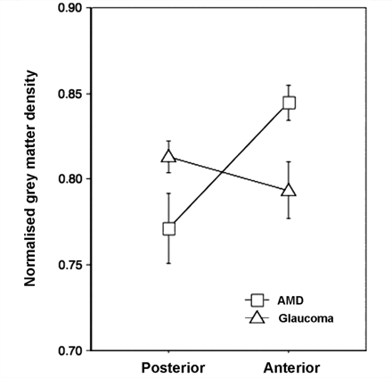
Figure 4 Results from a VOI-based analysis. Relative change in grey matter density for the AMD and glaucoma groups ...
Notes:
Figure 4 Results from a VOI-based analysis. Relative change in grey matter density for the AMD and glaucoma groups compared to the control group in anatomically defined volumes of interest in posterior (approximate foveal projection zone) and anterior (approximate peripheral visual field projection zone) visual cortex. Relative changes were calculated by dividing for each participant group the averaged grey matter density in each VOI by that of the control group.
Unless provided in the caption above, the following copyright applies to the content of this slide: © 2009 The Author(s)This is an Open Access article distributed under the terms of the Creative Commons Attribution Non-Commercial License (http://creativecommons.org/licenses/by-nc/2.0/uk/) which permits unrestricted non-commercial use, distribution, and reproduction in any medium, provided the original work is properly cited.

Slide 5
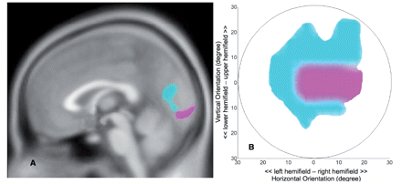
Figure 5 Summary of visual field sensitivity and grey matter reduction in AMD and glaucoma. (A) Cortical grey matter ...
Notes:
Figure 5 Summary of visual field sensitivity and grey matter reduction in AMD and glaucoma. (A) Cortical grey matter density reduction in glaucoma is found in the anterior half of the medial occipital cortex (cyan). Cortical grey matter density reduction in AMD (magenta) is found in the posterior part of the occipital cortex. (B) Thresholded mean visual field sensitivity deviation maps indicating central defects in AMD (magenta) and more peripheral defects in glaucoma (cyan). For this thresholded map, for the glaucoma group, sensitivity deviations below −12 dB are shown in cyan. For the AMD group, sensitivity deviations below −8 dB are shown in magenta.
Unless provided in the caption above, the following copyright applies to the content of this slide: © 2009 The Author(s)This is an Open Access article distributed under the terms of the Creative Commons Attribution Non-Commercial License (http://creativecommons.org/licenses/by-nc/2.0/uk/) which permits unrestricted non-commercial use, distribution, and reproduction in any medium, provided the original work is properly cited.

