Slide 1
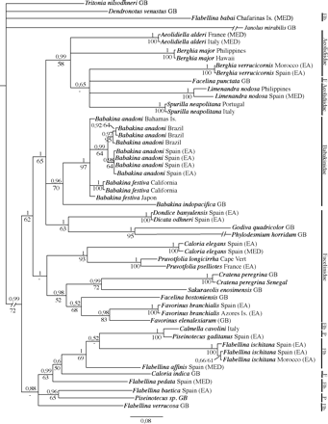
Figure 1. Phylogenetic hypothesis based on full dataset (H3 + COI + 16S; with missing values for some taxa, see ...
Notes:
Figure 1. Phylogenetic hypothesis based on full dataset (H3 + COI + 16S; with missing values for some taxa, see Table 1), produced by BI. Numbers above branches are posterior probabilities from BI; numbers below branches are bootstrap values for ML analysis. Abbreviations: EA, Eastern Atlantic Ocean; F, Facelinidae; Flb, Flabellinidae; GB, GenBank; MED, Mediterranean Sea; P, Piseinotecidae.
Unless provided in the caption above, the following copyright applies to the content of this slide: © The Author 2011. Published by Oxford University Press on behalf of The Malacological Society of London, all rights reserved

Slide 2
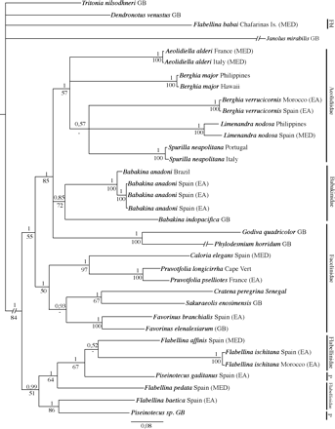
Figure 2. Phylogenetic hypothesis based on reduced dataset of taxa for which all genes were sequenced (H3 + COI + 16S), ...
Notes:
Figure 2. Phylogenetic hypothesis based on reduced dataset of taxa for which all genes were sequenced (H3 + COI + 16S), produced by BI. Numbers above branches are posterior probabilities from BI; numbers below branches are bootstrap values for ML analysis. Abbreviations: EA, Eastern Atlantic Ocean; Flb, Flabellinidae; GB, GenBank; MED, Mediterranean Sea; P, Piseinotecidae.
Unless provided in the caption above, the following copyright applies to the content of this slide: © The Author 2011. Published by Oxford University Press on behalf of The Malacological Society of London, all rights reserved

