Slide 1
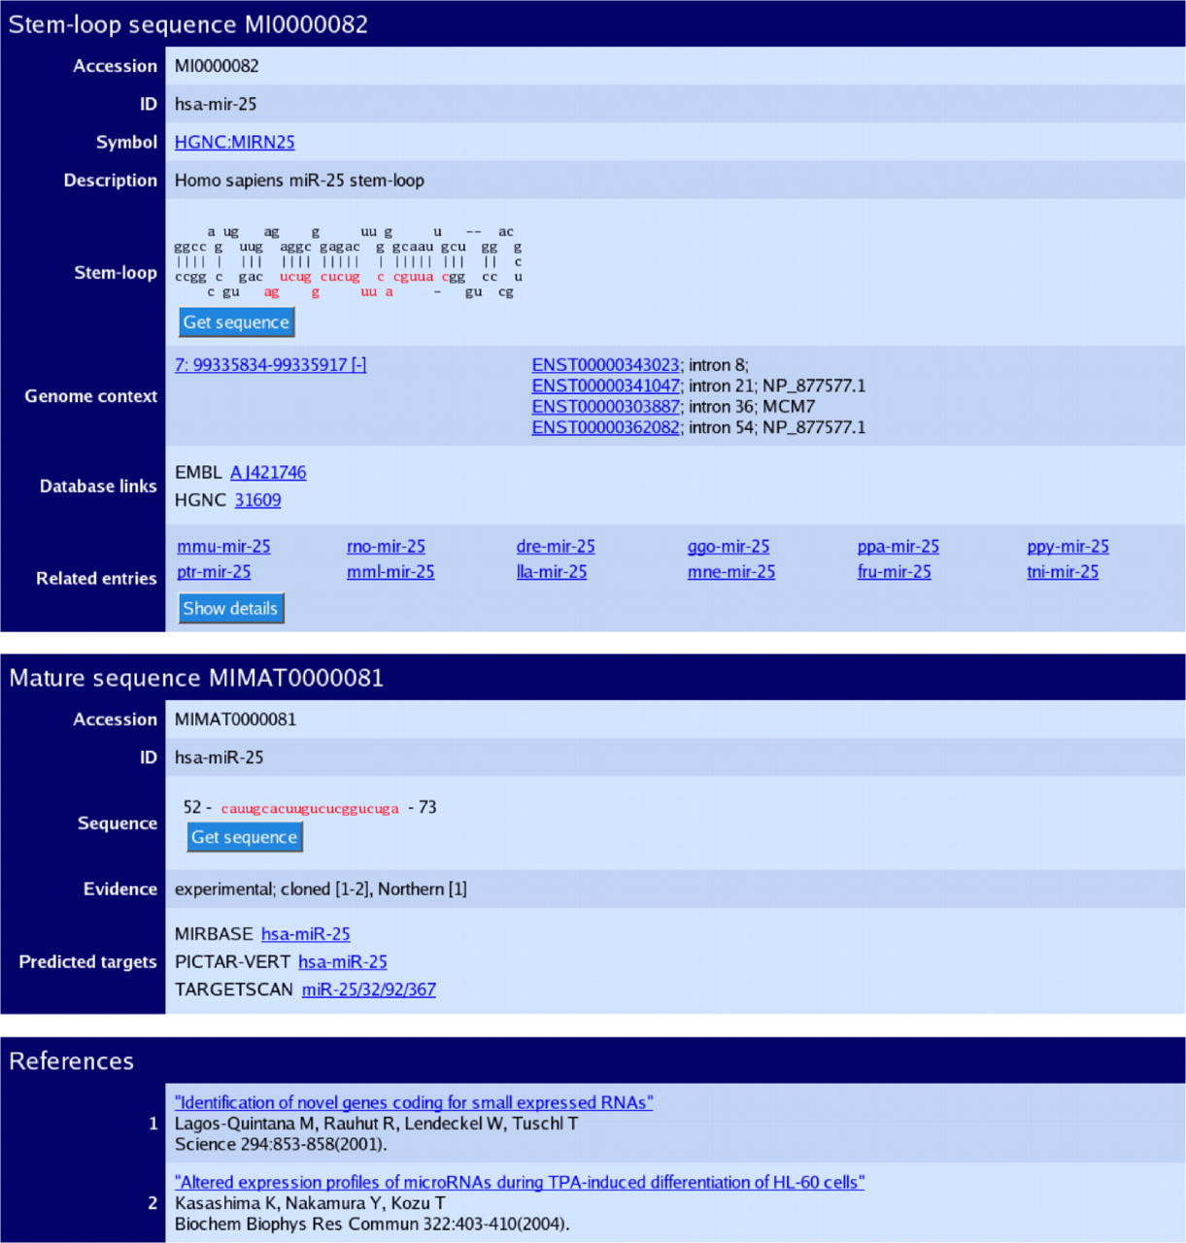
Figure 1 The sequence database entry for hsa-mir-25. The three sections of the page describe the predicted stem–loop ...
Notes:
Figure 1 The sequence database entry for hsa-mir-25. The three sections of the page describe the predicted stem–loop hairpin, mature sequences and primary references. The genomic coordinates and contextual information link to the Ensembl database. Each mature miRNA contains an evidence field, and links are provided to predicted target pages.
Unless provided in the caption above, the following copyright applies to the content of this slide: © The Author 2006. Published by Oxford University Press. All rights reserved The online version of this article has been published under an open access model. Users are entitled to use, reproduce, disseminate, or display the open access version of this article for non-commercial purposes provided that: the original authorship is properly and fully attributed; the Journal and Oxford University Press are attributed as the original place of publication with the correct citation details given; if an article is subsequently reproduced or disseminated not in its entirety but only in part or as a derivative work this must be clearly indicated. For commercial re-use, please contact journals.permissions@oxfordjournals.org

Slide 2
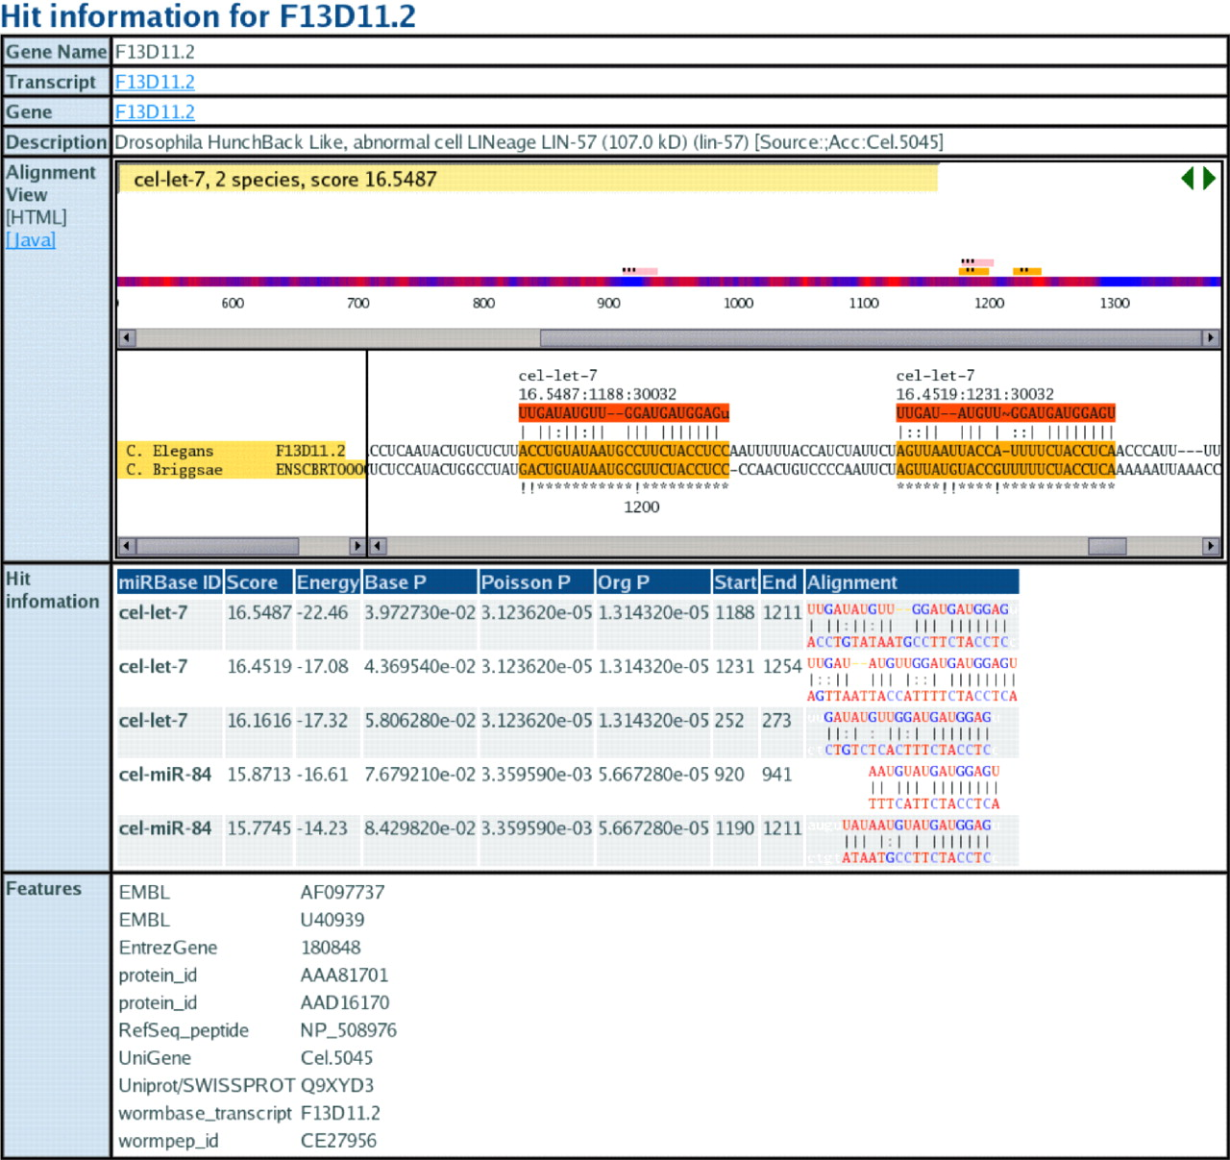
Figure 2 miRBase Target view page for transcript F13D11.2. The alignment view shows the alignment of miRNA binding ...
Notes:
Figure 2 miRBase Target view page for transcript F13D11.2. The alignment view shows the alignment of miRNA binding sites in orthologous 3′-UTRs. Bits scores, P-values, folding energies and alignments are shown for each miRNA match.
Unless provided in the caption above, the following copyright applies to the content of this slide: © The Author 2006. Published by Oxford University Press. All rights reserved The online version of this article has been published under an open access model. Users are entitled to use, reproduce, disseminate, or display the open access version of this article for non-commercial purposes provided that: the original authorship is properly and fully attributed; the Journal and Oxford University Press are attributed as the original place of publication with the correct citation details given; if an article is subsequently reproduced or disseminated not in its entirety but only in part or as a derivative work this must be clearly indicated. For commercial re-use, please contact journals.permissions@oxfordjournals.org

