Slide 1
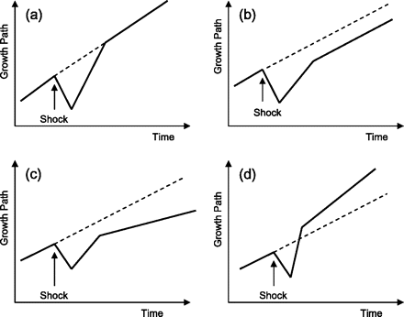
Figure 1. Stylised Responses of a Regional Economy to a Major Shock. Notes: (a) Return of region to its pre-existing ...
Notes:
Figure 1. Stylised Responses of a Regional Economy to a Major Shock. Notes: (a) Return of region to its pre-existing steady growth path following the shock; (b) and (c) region fails to resume former steady growth path after the shock, but settles on inferior path (d) region recovers from shock and assumes an improved growth path.
Unless provided in the caption above, the following copyright applies to the content of this slide: © The Author 2010. Published by Oxford University Press on behalf of the Cambridge Political Economy Society. All rights reserved. For permissions, please email: journals.permissions@oxfordjournals.org

Slide 2
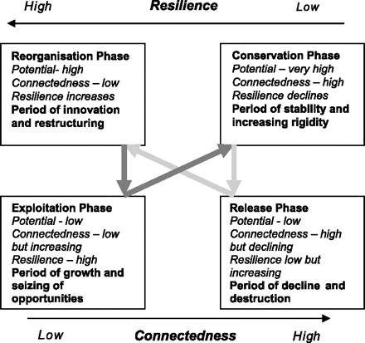
Figure 2. A four-phase adaptive cycle model of regional economic resilience. Source: Adapted from Holling and Gunderson ...
Notes:
Figure 2. A four-phase adaptive cycle model of regional economic resilience. Source: Adapted from Holling and Gunderson (2002) and Pendall et al. (2008).
Unless provided in the caption above, the following copyright applies to the content of this slide: © The Author 2010. Published by Oxford University Press on behalf of the Cambridge Political Economy Society. All rights reserved. For permissions, please email: journals.permissions@oxfordjournals.org

Slide 3
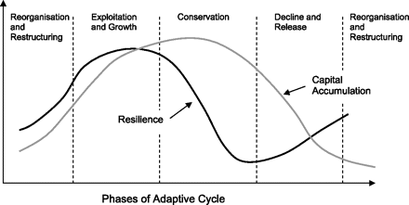
Figure 3. Resilience as a process: variations in resilience across the adaptive cycle.
Notes:
Figure 3. Resilience as a process: variations in resilience across the adaptive cycle.
Unless provided in the caption above, the following copyright applies to the content of this slide: © The Author 2010. Published by Oxford University Press on behalf of the Cambridge Political Economy Society. All rights reserved. For permissions, please email: journals.permissions@oxfordjournals.org

Slide 4
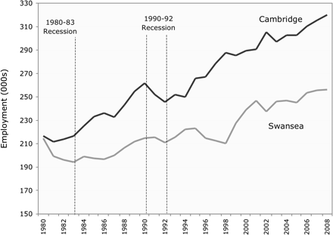
Figure 4. Employment growth paths in the two city regions, 1980–2008. Source: Cambridge Econometrics.
Notes:
Figure 4. Employment growth paths in the two city regions, 1980–2008. Source: Cambridge Econometrics.
Unless provided in the caption above, the following copyright applies to the content of this slide: © The Author 2010. Published by Oxford University Press on behalf of the Cambridge Political Economy Society. All rights reserved. For permissions, please email: journals.permissions@oxfordjournals.org

Slide 5
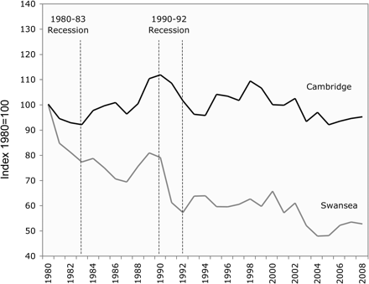
Figure 5. Manufacturing employment growth paths in the two city regions, 1980–2008. Source: Cambridge Econometrics.
Notes:
Figure 5. Manufacturing employment growth paths in the two city regions, 1980–2008. Source: Cambridge Econometrics.
Unless provided in the caption above, the following copyright applies to the content of this slide: © The Author 2010. Published by Oxford University Press on behalf of the Cambridge Political Economy Society. All rights reserved. For permissions, please email: journals.permissions@oxfordjournals.org

Slide 6
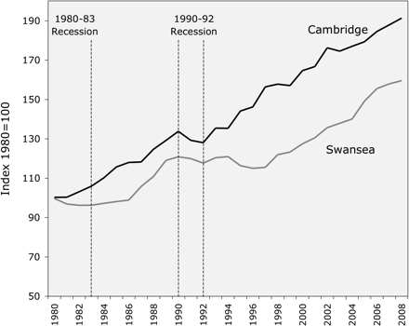
Figure 6. Service sector employment growth paths in the two city regions, 1980–2008. Source: Cambridge Econometrics.
Notes:
Figure 6. Service sector employment growth paths in the two city regions, 1980–2008. Source: Cambridge Econometrics.
Unless provided in the caption above, the following copyright applies to the content of this slide: © The Author 2010. Published by Oxford University Press on behalf of the Cambridge Political Economy Society. All rights reserved. For permissions, please email: journals.permissions@oxfordjournals.org

Slide 7
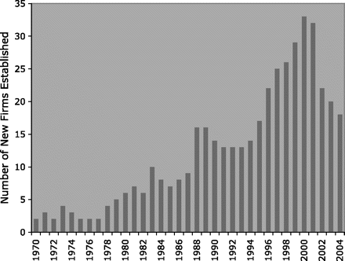
Figure 7. Number of new firms established in the Cambridge high-tech cluster, 1970–2004. Source: Library House.
Notes:
Figure 7. Number of new firms established in the Cambridge high-tech cluster, 1970–2004. Source: Library House.
Unless provided in the caption above, the following copyright applies to the content of this slide: © The Author 2010. Published by Oxford University Press on behalf of the Cambridge Political Economy Society. All rights reserved. For permissions, please email: journals.permissions@oxfordjournals.org

