Slide 1
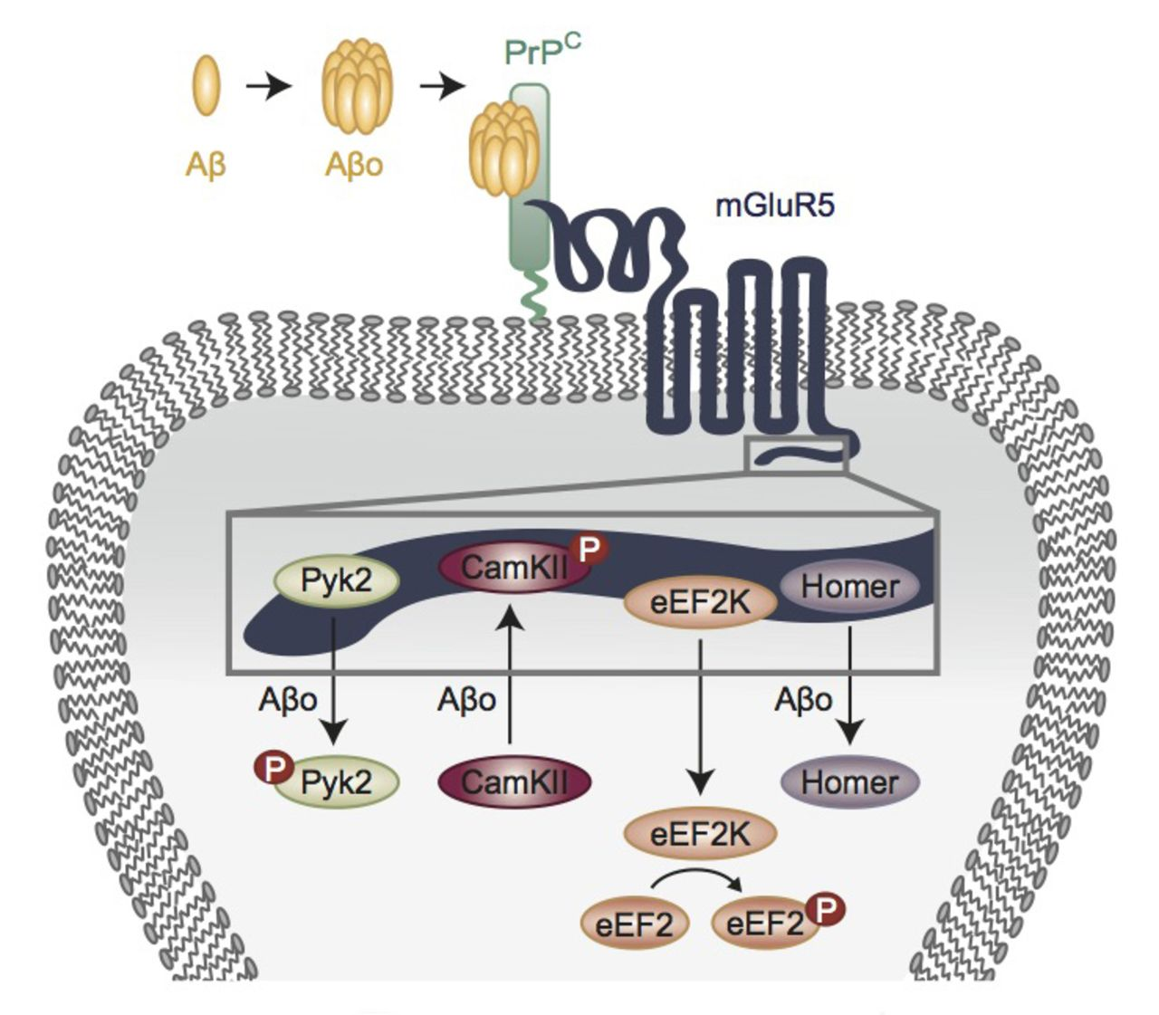
Cellular prion protein (PrP^{C}) and mGluR5 have both been implicated in Alzheimer’s disease-related ...
Notes:
Cellular prion protein (PrPC) and mGluR5 have both been implicated in Alzheimer’s disease-related phenotypes in mice. Using genetic and biochemical methods, Haas et al. show that direct coupling between PrPC and mGluR5 contributes to Alzheimer’s disease pathology. Partial blockade of this complex has the potential to modify the disease course.
Unless provided in the caption above, the following copyright applies to the content of this slide: © The Author (2015). Published by Oxford University Press on behalf of the Guarantors of Brain. All rights reserved. For Permissions, please email: journals.permissions@oup.com

Slide 2
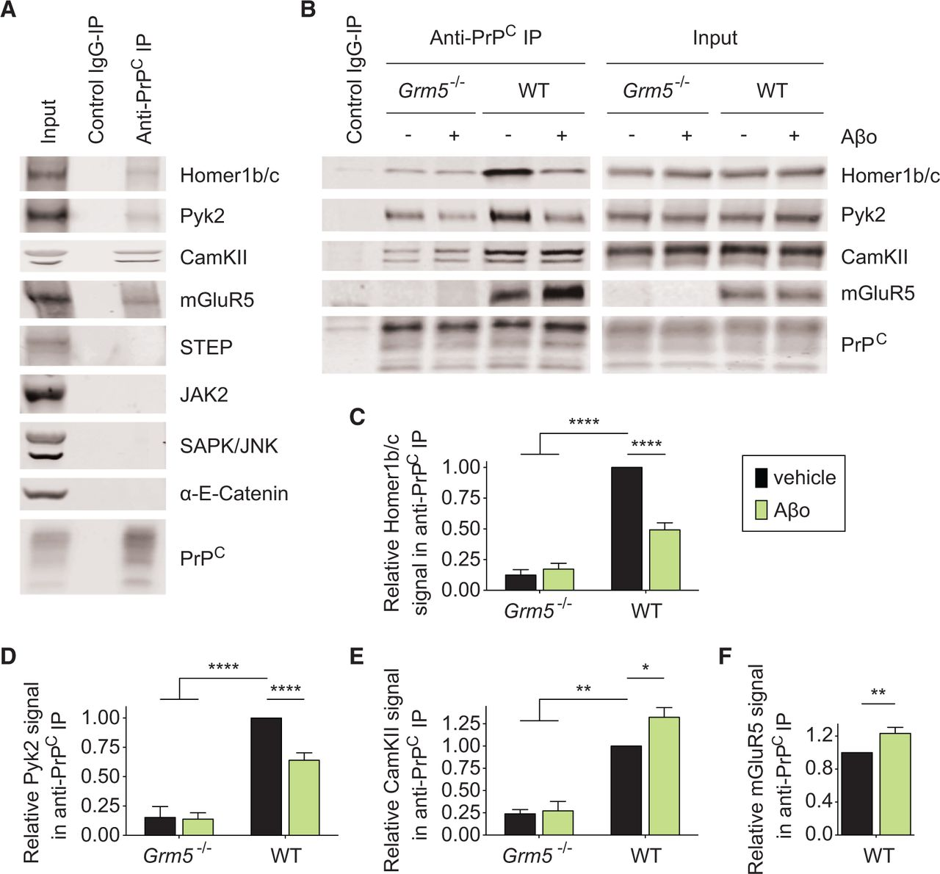
Figure 1 mGluR5 couples PrP^{C} to intracellular protein mediators in acute mouse brain slices. (A) ...
Notes:
Figure 1 mGluR5 couples PrPC to intracellular protein mediators in acute mouse brain slices. (A) Representative immunoblots showing co-immunoprecipitation (co-IP) between PrPC and Homer1b/c, Pyk2, CamKII and mGluR5 in acute mouse brain slice crude synaptoneurosome preparations. In contrast, STEP, JAK2, SAPK/JUNK and α-E-catenin are not precipitated. (B) Co-immunoprecipitation between PrPC and Homer1b/c, Pyk2 and CamKII is largely reduced by genetic deletion of Grm5 and altered by acute amyloid-β oligomer treatment. Genotype and treatment of acute brain slices is indicated above each lane. (C–F) Densitometric analysis of the immunoblots from B, analysed by one-way ANOVA with post hoc Tukey’s multiple comparisons test (C–E) and by Mann-Whitney test (F). Data are mean ± SEM, n = 14 wild-type mice and n = 3 Grm5−/− mice. (C) Co-immunoprecipitation between PrPC and Homer1b/c is significantly reduced in Grm5−/− acute brain slice crude synaptoneurosome preparations and in wild-type acute brain slice crude synaptoneurosome preparations after amyloid-β oligomer treatment (****P < 0.0001). (D) Co-immunoprecipitation between PrPC and Pyk2 is significantly reduced in acute Grm5−/− brain slice crude synaptoneurosome preparations and in acute wild-type brain slice crude synaptoneurosome preparations after amyloid-β oligomer treatment (****P <0.0001). (E) Co-immunoprecipitation between PrPC and CamKII is significantly reduced in Grm5−/− acute brain slice crude synaptoneurosome preparations (**P < 0.01), but enhanced in wild-type acute brain slice crude synaptoneurosome preparations after amyloid-β oligomer treatment (*P < 0.05). F. Treatment of acute brain slices with 1 µM amyloid-β oligomers for 30 min significantly enhanced the mGluR5 signal in anti-PrPC immunoprecipitates (*P < 0.05). Aβo = amyloid-β oligomer; WT = wild-type.
Unless provided in the caption above, the following copyright applies to the content of this slide: © The Author (2015). Published by Oxford University Press on behalf of the Guarantors of Brain. All rights reserved. For Permissions, please email: journals.permissions@oup.com

Slide 3
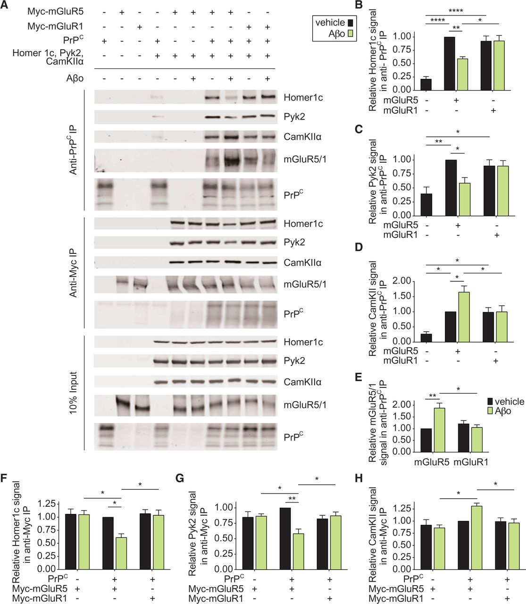
Figure 2 mGluR5 couples PrP^{C} to intracellular protein mediators in HEK-293T cells. (A) Representative ...
Notes:
Figure 2 mGluR5 couples PrPC to intracellular protein mediators in HEK-293T cells. (A) Representative immunoblots of co-immunoprecipitation between PrPC and Myc-mGluR5, Homer1c, Pyk2, and CamKIIα or between Myc-mGluR and PrPC, Homer1c, Pyk2, and CamKIIα in HEK-293T cells. Transfection of plasmids and treatment with 1 µM amyloid-β oligomers for 30 min is indicated above each lane. The input panel displays proteins in 10% input of the anti-Myc immunoprecipitation experiment. The 10% input of the anti-PrPC experiment depicted comparable protein expression and is not replicated here. (B–H) Densitometric analysis of the immunoblots from A, analysed by one-way ANOVA with post hoc Tukey’s multiple comparisons test. Data are mean ± SEM, n = 5 for anti-PrPC immunoprecipitation and n = 4 for anti-Myc immunoprecipitation. (B–D) Co-immunoprecipitation between PrPC and Homer1c (B), Pyk2 (C) and CamKIIα (D) is significantly enhanced by co-expression of either Myc-mGluR5 or Myc-mGluR1. Amyloid-β oligomer treatment significantly modulates co-immunoprecipitation in Myc-mGluR5- but not Myc-mGluR1-coexpressing cells (****P < 0.0001; **P < 0.01; *P < 0.05). (E) Amyloid-β oligomer treatment of HEK-293T cells overexpressing PrPC and Myc-mGluR5 but not PrPC and Myc-mGluR1 significantly enhances the Myc-mGluR5 signal in anti-PrPC immunoprecipitates (**P < 0.01; *P < 0.05). (F–H) Co-immunoprecipitation between Myc-mGluR and Homer1c (F), Pyk2 (G) and CamKIIα (H). Amyloid-β oligomer-treatment of HEK-293T cells co-expressing PrPC and Myc-mGluR5 but not Myc-mGluR1 significantly alters co-immunoprecipitation signals (**P < 0.01; *P < 0.05). Aβo = amyloid-β oligomer; WT = wild-type.
Unless provided in the caption above, the following copyright applies to the content of this slide: © The Author (2015). Published by Oxford University Press on behalf of the Guarantors of Brain. All rights reserved. For Permissions, please email: journals.permissions@oup.com

Slide 4
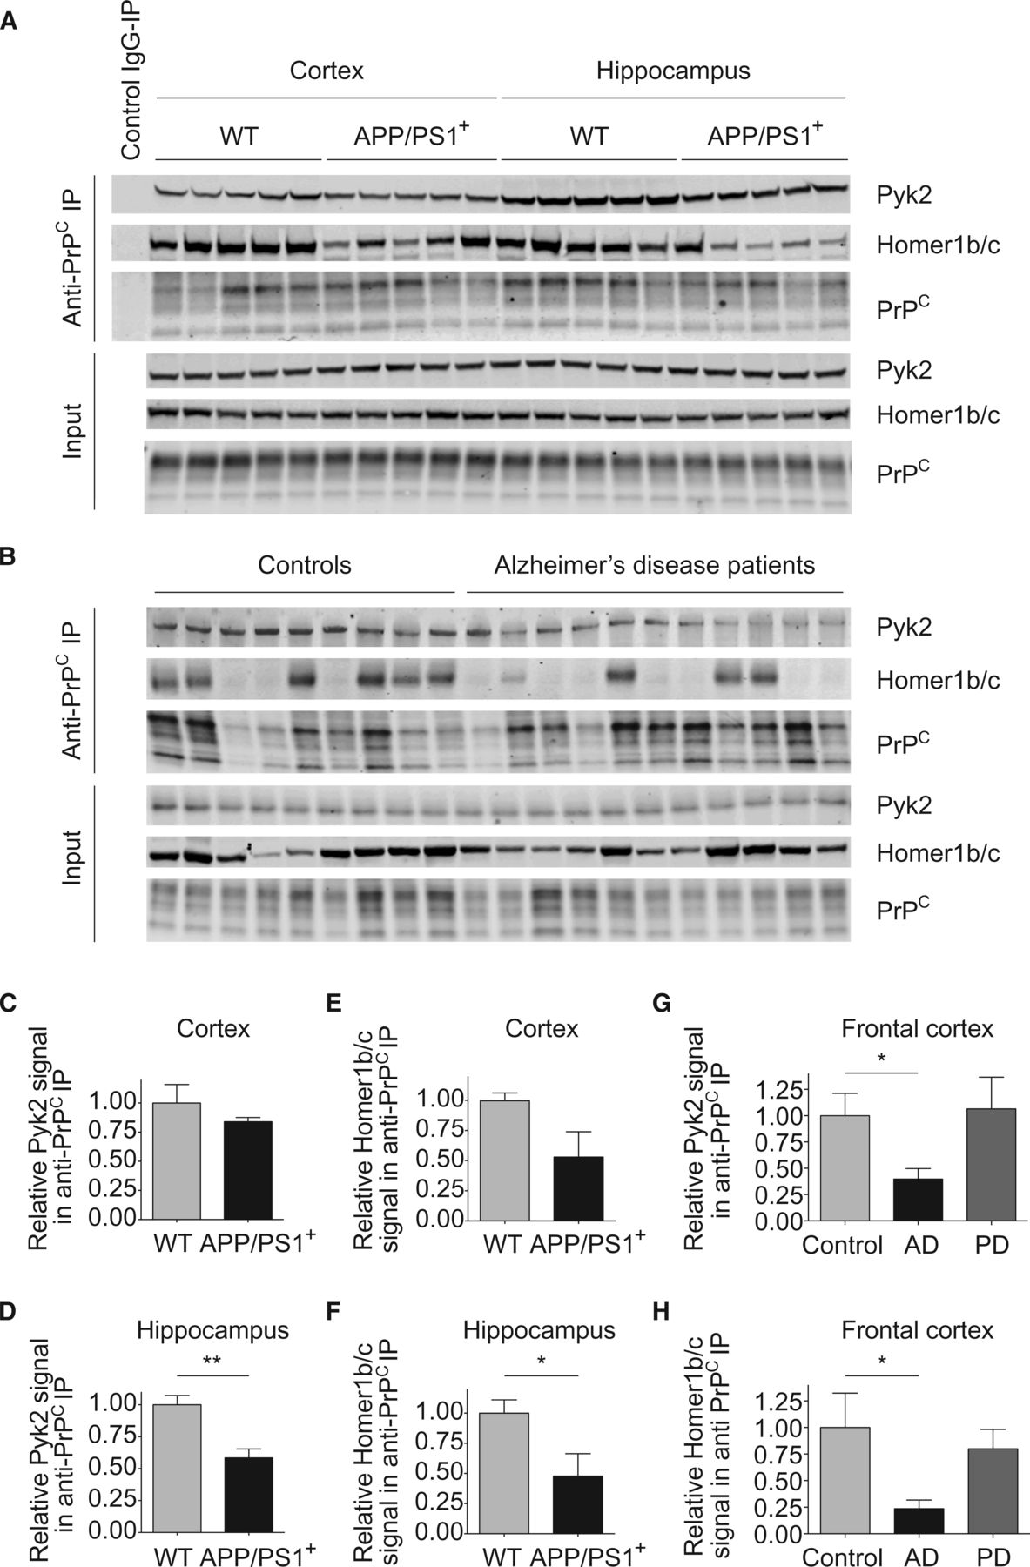
Figure 3 The coupling between PrP^{C} and intracellular protein mediators is pathologically altered in ...
Notes:
Figure 3 The coupling between PrPC and intracellular protein mediators is pathologically altered in Alzheimer’s model mice and in human Alzheimer’s disease patients. (A) Representative immunoblots of brain region-specific lysates of age-matched 14–19-month-old wild-type and APP/PS1+ brain. (B) Representative immunoblots of human frontal cortex of 50–90-year-old controls (n = 9) and 52–89-year-old Alzheimer’s disease patients (n = 11). (C–F) Densitometric analysis of the immunoblots from A. Data are mean ± SEM, n = 5 mice. (C) Co-immunoprecipitation between PrPC and Pyk2 in cortical lysates. (D) The Pyk2 signal in anti-PrPC immunoprecipitates is significantly reduced in APP/PS1+ hippocampus compared to wild-type (**P < 0.01) by Mann-Whitney test. (E) Co-immunoprecipitation between PrPC and Homer1b/c in cortical lysates. (F) The Homer1b/c signal in anti-PrPC immunoprecipitates is significantly reduced in APP/PS1+ hippocampus compared to wild-type (*P < 0.05) by unpaired t-test with Welch’s correction. (G–H) Densitometric analysis of the immunoblots from B, analysed by Mann-Whitney test. Data are mean ± SEM. The Pyk2 (G) and Homer1b/c (H) signal in anti-PrPC immunoprecipitates is significantly reduced in Alzheimer’s disease (AD) frontal cortex compared to controls (*P < 0.05). Pyk2 and Homer1b/c levels in anti-PrPC immunoprecipitates of 59–86-year-old Parkinson’s disease (PD) patients (n = 3) are not significantly different to controls.
Unless provided in the caption above, the following copyright applies to the content of this slide: © The Author (2015). Published by Oxford University Press on behalf of the Guarantors of Brain. All rights reserved. For Permissions, please email: journals.permissions@oup.com

Slide 5
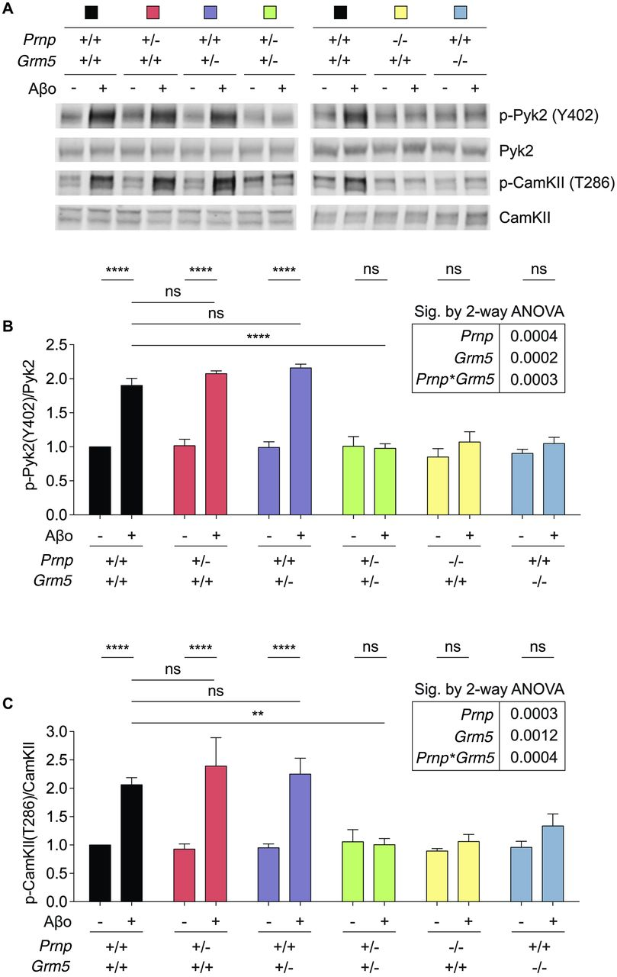
Figure 4 Genetic coupling between Prnp and Grm5 mediates alterations in protein activation states in acute brain ...
Notes:
Figure 4 Genetic coupling between Prnp and Grm5 mediates alterations in protein activation states in acute brain slices. (A) Representative immunoblots showing enhanced Pyk2(Y402) and CamKII(T286) phosphorylation after amyloid-β oligomer treatment in acute wild-type and single heterozygote brain slices, but not in double heterozygote or single knockout brain slices. Genotype and treatment with 1 µM amyloid-β oligomers for 30 min is indicated above each lane. (B and C) Densitometric analysis of the immunoblots from A, analysed by one-way and two-way ANOVA with Tukey’s multiple comparisons test. Data are mean ± SEM, n = 13 wild-type mice and n = 3 for every other genotype. Amyloid-β oligomer treatment increases phosphorylation of Pyk2 at Y402 (B) and CamKII at T286 (C) in wild-type and single heterozygote brain slices (****P 0.05). Amyloid-β oligomer-induced enhanced phosphorylation is not significantly different between wild-type and single heterozygote brain slices (P > 0.05). Removal of one allele of both Grm5 and Prnp significantly reduces amyloid-β oligomer-induced enhanced Pyk2(Y402)-phosphorylation (****P < 0.0001) and CamKII(T286)-phosphorylation (**P < 0.01). A two-way ANOVA with post hoc Tukey’s multiple comparisons test for Prnp and Grm5 showed a significant interaction between Prnp and Grm5 in triggering amyloid-β oligomer-induced enhanced phosphorylation of Pyk2 (P = 0.0003) and CamKII (P = 0.0004). Aβo = amyloid-β oligomer; ns = not significant.
Unless provided in the caption above, the following copyright applies to the content of this slide: © The Author (2015). Published by Oxford University Press on behalf of the Guarantors of Brain. All rights reserved. For Permissions, please email: journals.permissions@oup.com

Slide 6
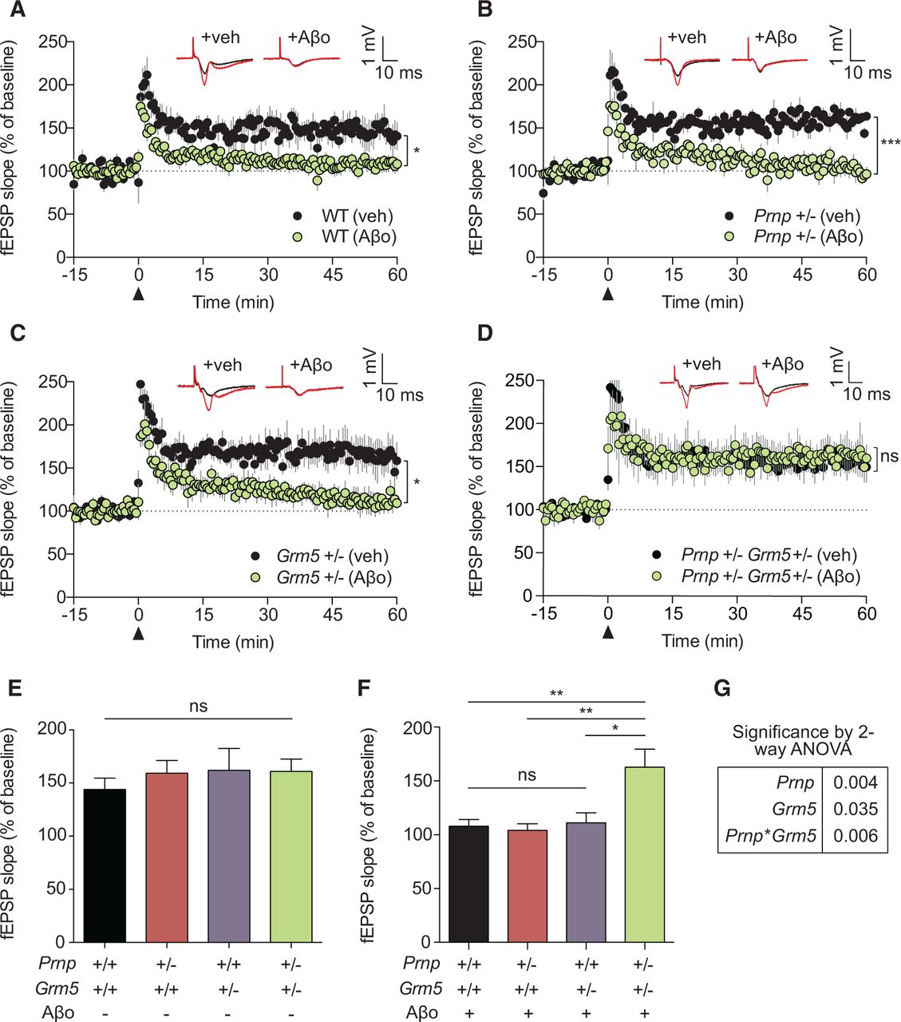
Figure 5 Genetic coupling between Prnp and Grm5 mediates acute amyloid-β oligomer-induced impairment of synaptic ...
Notes:
Figure 5 Genetic coupling between Prnp and Grm5 mediates acute amyloid-β oligomer-induced impairment of synaptic plasticity. Field potentials were recorded from the CA1 region of adult wild-type (A), Prnp+/− (B), Grm5+/− (C), and Prnp+/−Grm5+/− (D) brain slices. The slope of the field EPSP (fEPSP)is plotted as a function of time. Representative traces immediately before theta burst stimulation (denoted by arrowhead at 0 min; black) and 60 min post- theta burst stimulation (red) are superimposed (average six sweeps) in each respective graph. Data are graphed as mean ± SEM of averaged slices per animal. Slices were treated with either vehicle (wild-type: five mice, six slices; Prnp+/−: four mice, seven slices; Grm5+/−: six mice, seven slices; Prnp+/−Grm5+/−: six mice, 11 slices) or 1 µM amyloid-β oligomers (wild-type: seven mice, 12 slices; Prnp+/−: six mice, eight slices; Grm5+/−: five mice, six slices; Prnp+/−Grm5+/−: five mice, five slices) 30 min prior to theta burst stimulation. Field EPSPs in 50–60 min post-theta burst stimulation are significantly decreased in amyloid-β oligomer-treated slices compared to vehicle treated for wild-type, Prnp+/− and Grm5+/− (*P < 0.05; ***P < 0.001), but not Prnp+/−Grm5+/− slices by two-tailed t-test. (E and F) Field EPSPs are graphed as mean ± SEM of all slices per genotype (E). Field EPSPs in the 50–60-min post-theta burst stimulation are not different between vehicle-treated slices. (F) Field EPSPs in amyloid-β oligomer-treated Prnp+/−Grm5+/− slices are significantly enhanced when analysed by one-way ANOVA with post hoc Tukey’s multiple comparisons test (**P < 0.01; *P < 0.05). (G) A two-way ANOVA with post hoc Tukey’s multiple comparisons test for Prnp and Grm5 showed a significant interaction between Prnp and Grm5 in triggering amyloid-β oligomer-induced inhibition of LTP. Aβo = amyloid-β oligomer; WT = wild-type.
Unless provided in the caption above, the following copyright applies to the content of this slide: © The Author (2015). Published by Oxford University Press on behalf of the Guarantors of Brain. All rights reserved. For Permissions, please email: journals.permissions@oup.com

Slide 7
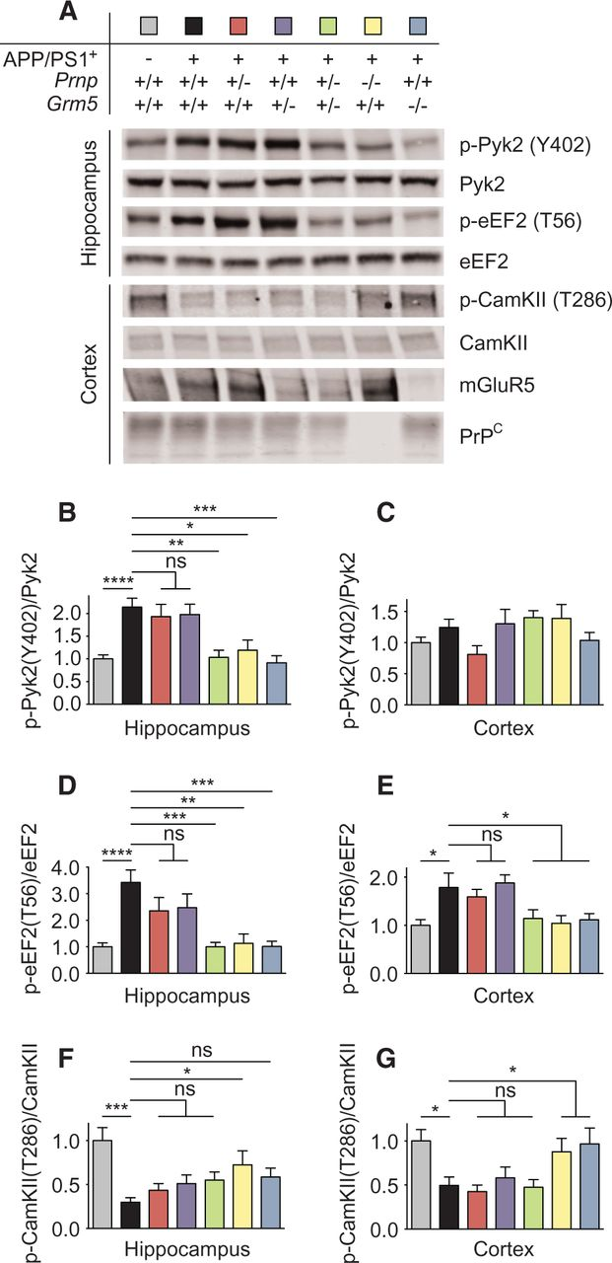
Figure 6 Genetic coupling between Prnp and Grm5 mediates chronic alterations in protein activation states in ...
Notes:
Figure 6 Genetic coupling between Prnp and Grm5 mediates chronic alterations in protein activation states in Alzheimer’s model mice in vivo. (A) Representative immunoblots of brain region-specific lysates revealed altered Pyk2(Y402), eEF2(T56) and CamKII(T286) phosphorylation in APP/PS1+ brain compared to wild-type brain, which is recovered in APP/PS1+Prnp+/−Grm5+/−, APP/PS1+Prnp−/− and APP/PS1+Grm5−/− brain at an average age of 644 ± 32 days. Samples derive from one experiment and all gels/blots were processed in parallel. A sample processing control was included on all gels. (B–G) Densitometric analysis of the immunoblots from A, analysed by one-way ANOVA with post hoc Tukey’s multiple comparisons test, unless otherwise stated. Mean ± SEM, n = 12 mice (wild-type and APP/PS1+), n = 6 mice (every other genotype). (B) Phospho-Pyk2(Y402) levels are enhanced in APP/PS1+hippocampus (****P < 0.0001), which is not different to APP/PS1+ single het erozygous hippocampus. Enhanced phospho-Pyk2(Y402) levels are reduced in APP/PS1+Prnp+/− Grm5+/−, APP/PS1+Prnp−/− and APP/PS1+Grm5−/− hippocampus (***P < 0.001; **P < 0.01; *P < 0.05). (C) Cortical phospho-Pyk2(Y402) levels. (D and E) eEF2(T56) phosphorylation is increased in APP/PS1+ hippocampus (D; ****P < 0.0001) and cortex (E; *P < 0.05), which is not different to APP/PS1+ single het erozygous brain areas. Enhanced phospho-eEF2(T56) levels are significantly reduced in APP/PS1+Prnp+/− Grm5+/−, APP/PS1+Prnp−/− and APP/PS1+Grm5−/− brain areas (***P < 0.001; **P < 0.01; *P < 0.05). (F and G) CamKII phosphorylation at T286 is significantly reduced in APP/PS1+ hippocampus (***P < 0.001) and cortex (*P < 0.05), which is not different to APP/PS1+ single het erozygous brain areas. Reduced phosphorylation is enhanced by genetic deletion of Prnp in hippocampus and cortex or by genetic deletion of Grm5 in cortex by one-way ANOVA with Fisher’s LSD post hoc pairwise comparisons (*P < 0.05). ns = not significant.
Unless provided in the caption above, the following copyright applies to the content of this slide: © The Author (2015). Published by Oxford University Press on behalf of the Guarantors of Brain. All rights reserved. For Permissions, please email: journals.permissions@oup.com

Slide 8
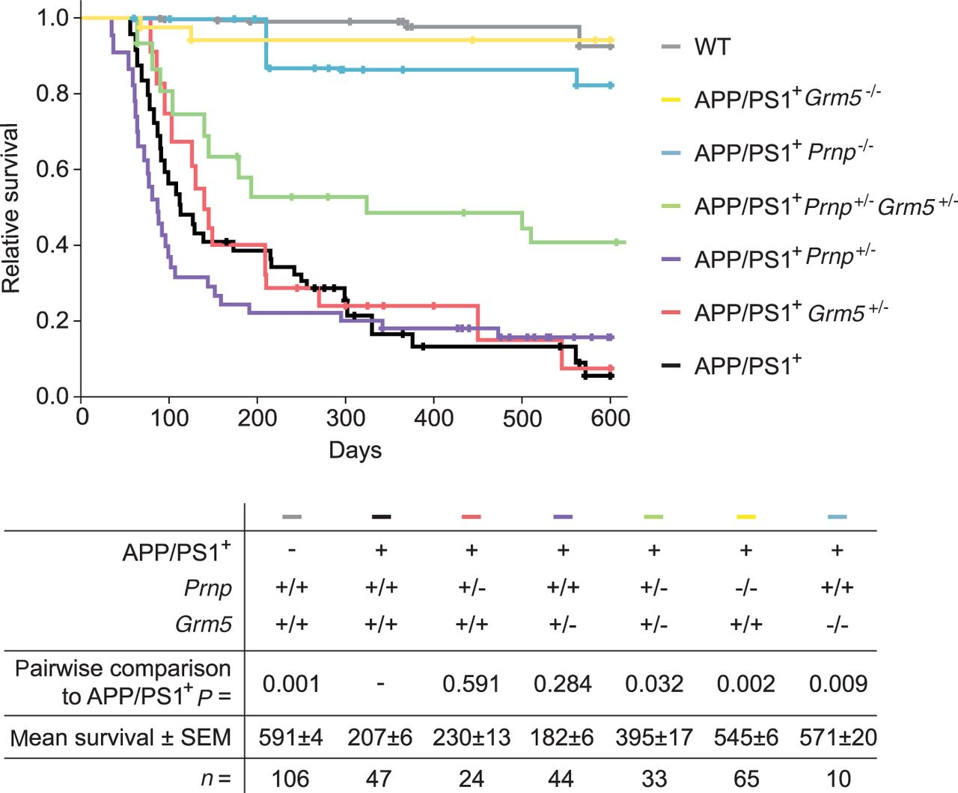
Figure 7 Genetic coupling between Prnp and Grm5 mediates reduced survival of Alzheimer’s model mice. Survival of ...
Notes:
Figure 7 Genetic coupling between Prnp and Grm5 mediates reduced survival of Alzheimer’s model mice. Survival of wild-type, APP/PS1+, APP/PS1+Prnp+/−, APP/PS1+Grm5+/−, APP/PS1+Prnp+/−Grm5+/−, APP/PS1+Prnp−/− and APP/PS1+Grm5−/− over 600 days. Survival of APP/PS1+ transgenic mice is significantly shorter than of wild-type mice (P = 0.001), which is recovered in APP/PS1+Prnp+/−Grm5+/− (P = 0.032), APP/PS1+Prnp−/− (P = 0.002), and APP/PS1+Grm5−/− mice (P = 0.009) by Wilcoxon statistics with cases weighted by numbers in each group. n = 106 wild-type mice, n = 47 APP/PS1+mice, n = 24 APP/PS1+Prnp+/− mice, n = 44 APP/PS1+Grm5+/− mice, n = 33 APP/PS1+Prnp+/−Grm5+/− mice, n = 65 APP/PS1+Prnp−/− mice, n = 10 APP/PS1+Grm5−/− mice.
Unless provided in the caption above, the following copyright applies to the content of this slide: © The Author (2015). Published by Oxford University Press on behalf of the Guarantors of Brain. All rights reserved. For Permissions, please email: journals.permissions@oup.com

Slide 9
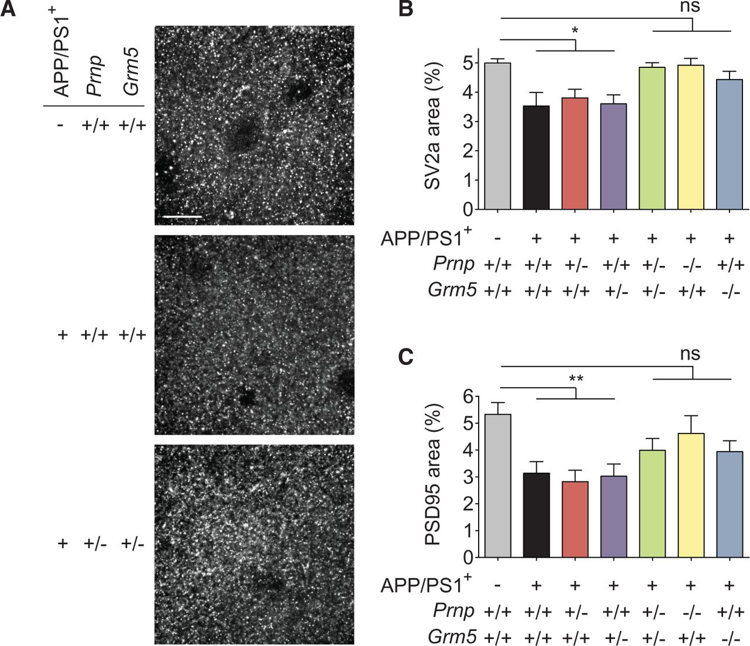
Figure 8 Genetic coupling between Prnp and Grm5 mediates loss of synaptic markers in Alzheimer’s model mice in vivo. ...
Notes:
Figure 8 Genetic coupling between Prnp and Grm5 mediates loss of synaptic markers in Alzheimer’s model mice in vivo. (A) Representative confocal images of the dentate gyrus of indicated groups stained with SV2a at an average age of 666 ± 35 days. Scale bar = 12 µm. (B and C) Fractional area of immunoreactive puncta for SV2a (B) and PSD95 (C) in the dentate gyrus of the indicated groups. A one-way ANOVA with Fisher’s LSD post hoc pairwise comparisons shows that the APP/PS1+ and APP/PS1+ single heterozygote groups differ from the wild-type group (*P < 0.05; **P 0.05). Data are mean ± SEM, n = 4 mice per group, with nine images from three slices analysed per mouse. ns = not significant.
Unless provided in the caption above, the following copyright applies to the content of this slide: © The Author (2015). Published by Oxford University Press on behalf of the Guarantors of Brain. All rights reserved. For Permissions, please email: journals.permissions@oup.com

