Slide 1
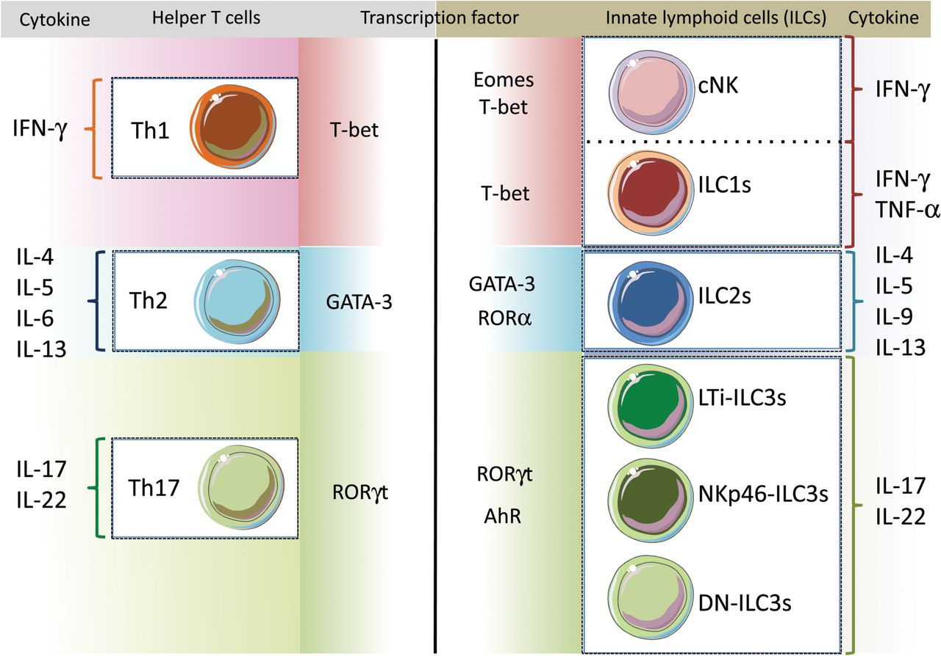
Fig. 1. Comparison of helper T cells and their counterpart ILCs with regard to transcriptional regulation. T-bet is ...
Notes:
Fig. 1. Comparison of helper T cells and their counterpart ILCs with regard to transcriptional regulation. T-bet is required for T h1 and ILC1 development, and both produce IFN-γ. In contrast, IFN-γ-producing cNK cells are regulated by Eomes with T-bet and are differentiated from pre-NK cells. ILC2s mainly produce IL-5 and IL-13 after being stimulated by IL-33, although ILC2s also capable of producing IL-4 and IL-9. There are no reports of IL-6 secretion from ILC2s. Similarly, T h2 cells are well known to produce IL-4, IL-5, IL-6 and IL-13 under activation. IL-17 and IL-22 are regulated by RORγt for cell differentiation in T h17 and ILC3s. T-bet and AhR are also required for NKp46-expressing ILC3s.
Unless provided in the caption above, the following copyright applies to the content of this slide: © The Author(s) 2015. Published by Oxford University Press on behalf of The Japanese Society for Immunology. All rights reserved. For permissions, please e-mail: journals.permissions@oup.comThis article is published and distributed under the terms of the Oxford University Press, Standard Journals Publication Model (https://academic.oup.com/journals/pages/open_access/funder_policies/chorus/standard_publication_model)

