Slide 1
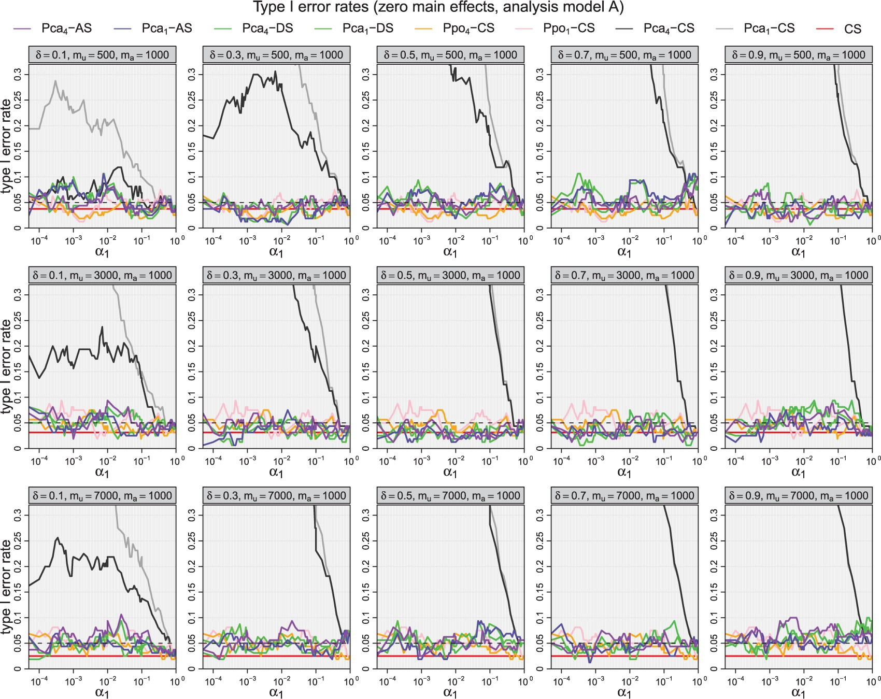
Fig. 1. Type I error rates for various two-stage methods with $z(x,y)=xy$ as functions of $\alpha_1$ with five ...
Notes:
Fig. 1. Type I error rates for various two-stage methods with $z(x,y)=xy$ as functions of $\alpha_1$ with five different values of $\delta$ ranging between 0.1 and 0.9 (left to right) and $m=500$, $m=3000$, $m=7000$ (top to bottom), $m_a=1000$ and $\beta_1=\beta_2=0$). In each plot the $y$-axes have the same range from 0 to 0.3.
Unless provided in the caption above, the following copyright applies to the content of this slide: © The Author 2017. Published by Oxford University Press. All rights reserved. For permissions, please e-mail: journals.permissions@oup.com.

Slide 2
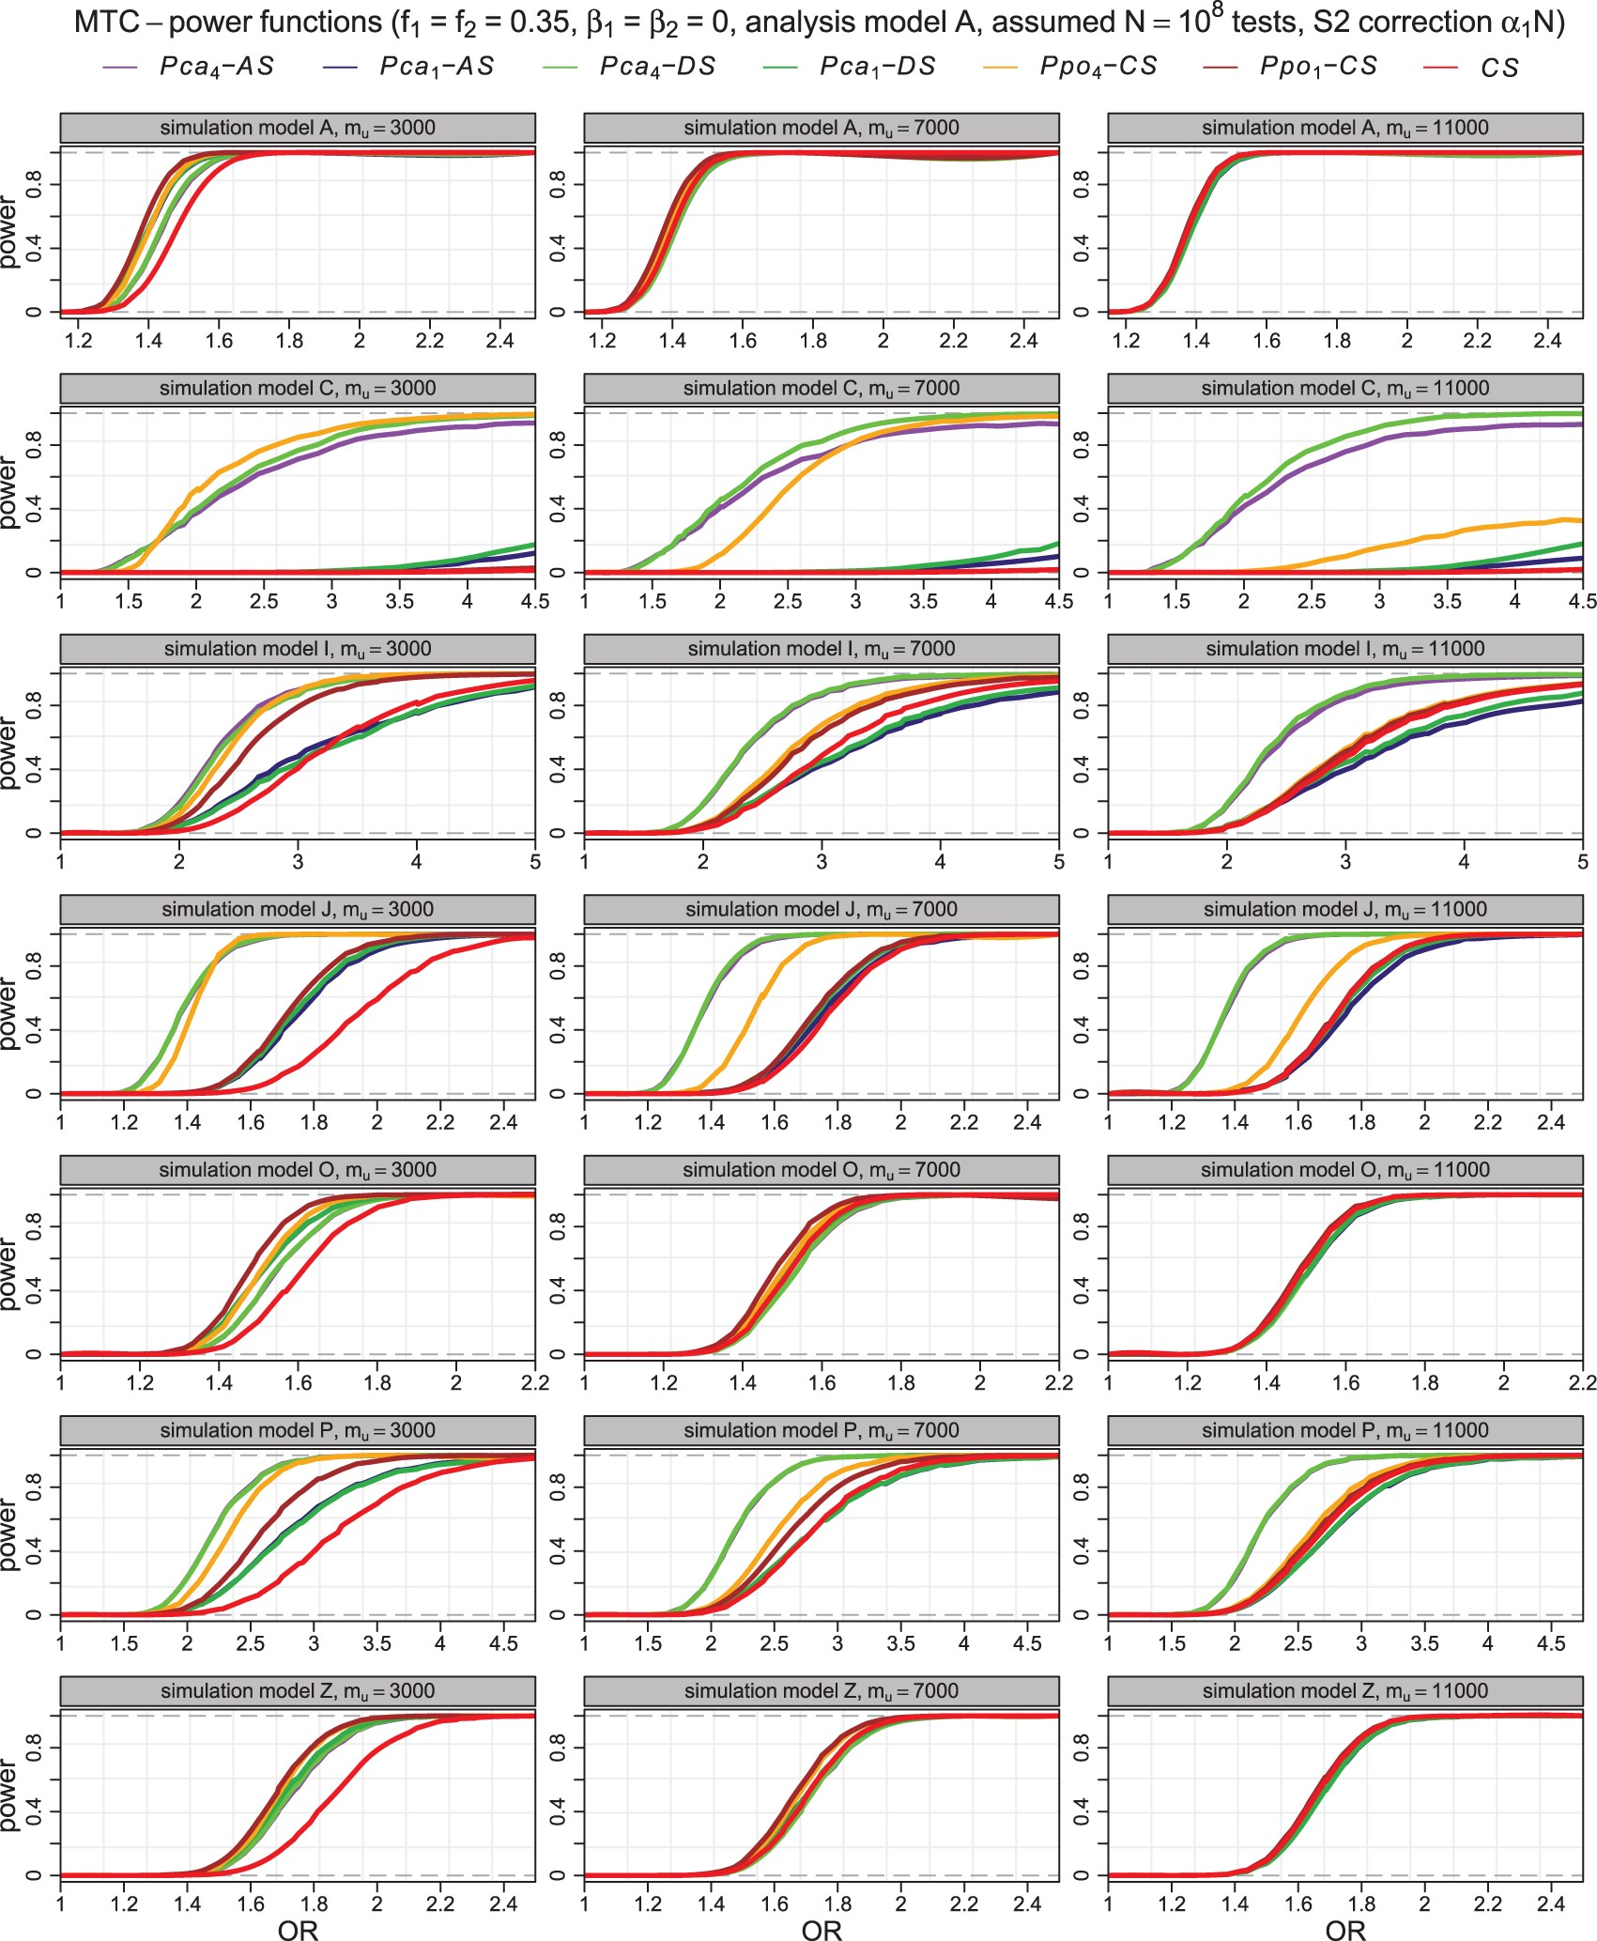
Fig. 2. Empirical MTC-powers at optimal input parameters $\alpha_1$ and $\delta$ for the nine testing methods as ...
Notes:
Fig. 2. Empirical MTC-powers at optimal input parameters $\alpha_1$ and $\delta$ for the nine testing methods as functions of interaction odds ratio $\text{OR}_3=\log\beta_3$ for simulation models A,C,I,J,O,P,Z with analysis model A, $m_a=2000$ with MAF close to $0.35$ for both loci in each test, phenotype population prevalence of 5% and $\beta_1=\beta_2=0$.
Unless provided in the caption above, the following copyright applies to the content of this slide: © The Author 2017. Published by Oxford University Press. All rights reserved. For permissions, please e-mail: journals.permissions@oup.com.

Slide 3
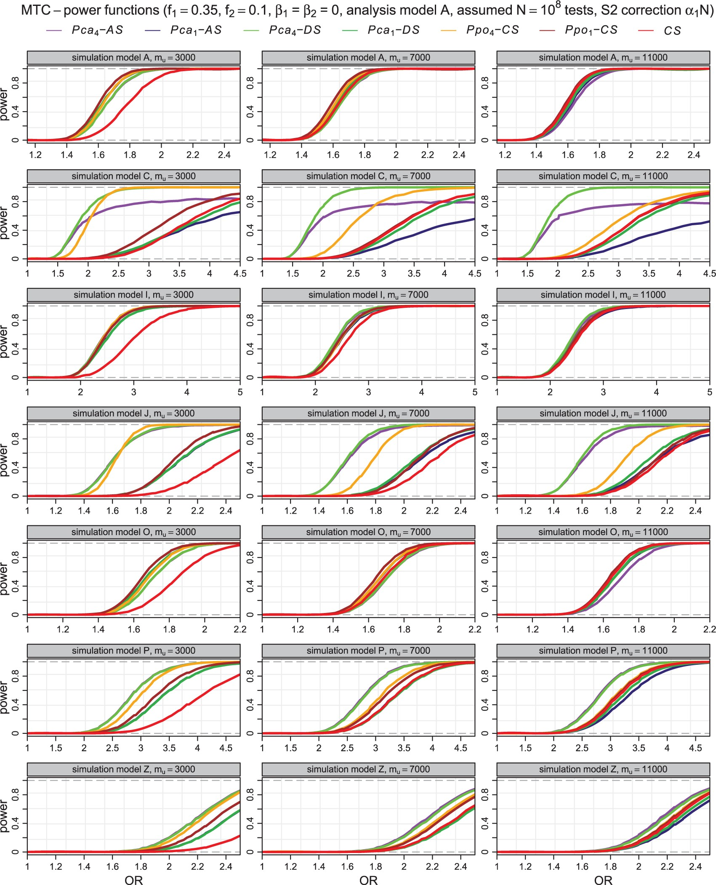
Fig. 3. Empirical MTC-powers at optimal input parameters $\alpha_1$ and $\delta$ for the nine testing methods as ...
Notes:
Fig. 3. Empirical MTC-powers at optimal input parameters $\alpha_1$ and $\delta$ for the nine testing methods as functions of interaction odds ratio $\text{OR}_3=\log\beta_3$ for simulation models A,C,I,J,O,P,Z with analysis model A, $m_a=2000$ with MAF close to $0.35$ and $0.1$ for the two loci within each test, phenotype prevalence of 5% and $\beta_1=\beta_2=0$.
Unless provided in the caption above, the following copyright applies to the content of this slide: © The Author 2017. Published by Oxford University Press. All rights reserved. For permissions, please e-mail: journals.permissions@oup.com.

Slide 4
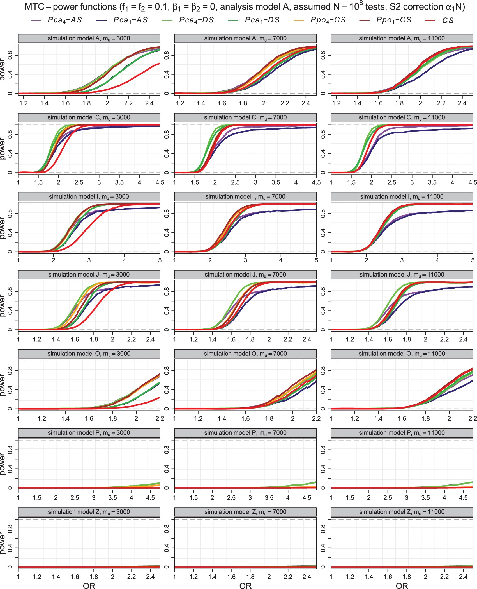
Fig. 4. Empirical MTC-powers at optimal input parameters $\alpha_1$ and $\delta$ for the nine testing methods as ...
Notes:
Fig. 4. Empirical MTC-powers at optimal input parameters $\alpha_1$ and $\delta$ for the nine testing methods as functions of interaction odds ratio $\text{OR}_3=\log\beta_3$ for simulation models A,C,I,J,O,P,Z with analysis model A, $m_a=2000$ with MAF close to $0.1$ for both loci within each test, phenotype prevalence of 5% and $\beta_1=\beta_2=0$.
Unless provided in the caption above, the following copyright applies to the content of this slide: © The Author 2017. Published by Oxford University Press. All rights reserved. For permissions, please e-mail: journals.permissions@oup.com.

